Slide 1

SCIENTIFIC RESEARCH METHODOLOGIES AND TECHNIQUES
Unit 1: INTRODUCTION
Luis M. Camarinha-Matos cam@uninova.pt
PhD PROGRAM IN ELECTRICAL AND COMPUTER ENGINEERING
© L. M. Camarinha-Matos, 2009-2012
1
1. PRELIMINARIES
2

Slide 2
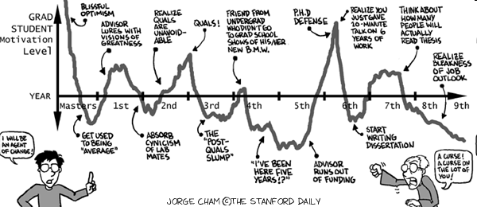




Are you ready?
© L. M. Camarinha-Matos, 2009-2012
Some key questions
How to do scientific research?
How to publish results?
Is it important?
How to plan my thesis?
How are research results assessed?
How to plan and manage a research project?
4

Slide 3
PhD Thesis
“The thesis must be a substantial original contribution to the knowledge or understanding of any field of study and demonstrate the capacity of the candidate to conceive, design and carry to completion independent research.
The Doctoral candidate should uncover new knowledge either by the discovery of new facts, the formulation of theories or the innovative re-interpretation of known data and established ideas.
In particular, the thesis should demonstrate that the candidate has:
surveyed literature relevant to the thesis;
skills in the gathering and analysis of information and report presentation;
demonstrated a critical, perceptive and constructive analysis of the subject;
carried out original and significant research in the field.”
Keywords (thesis and publications):
  originality/novelty
  contribution
  significance
  technical soundness
  critical assessment of existing work
[Hong 2006]
© L. M. Camarinha-Matos, 2009-2012
PhD Objectives in detail
The PhD degree is awarded to those candidates that show:
The capacity for a systematic understanding of his / her specialization area.
Skills and clear mastery of the engineering research methods.
c. Autonomous capacity for conceiving, designing, adapting, and realizing significant research, as autonomous researcher or member of a team, respecting the usual academic levels of quality, rigor and integrity.
Aptitude for contributing to widen the knowledge frontiers through the development of a significant amount of original research duly accredited by publication in selected international Conferences and or Scientific Journals with peer reviewing.
Capacity to analyze with a critical spirit, to evaluate, and to synthesize new and complex ideas in a context of fast technological and socio-organizational change.
Capacity to communicate with his / her peers and the academic community as well as the society in general, both at national and international levels, regarding his / her specialization area.
Capacity to promote, both in the academic and professional contexts, the technological, socio-economic and cultural progress under the framework of a
knowledge- and collaboration-based society.
[Portuguese Law]
6

Slide 4



PhD Jobs
Research
Post-doc
Senior member of advanced team
Team leader
Group leader
Institute leader
Academy
Professor & Researcher Assistant professor Associate professor Full professor
Group leader
Conference chair
Scientific society member / leader
R&D reviewer / evaluator
Consultant
Invited speaker
Industry
Senior R&D member
Innovation project leader
R&D group leader
R&D director
Entrepreneur
High-Tech company
founder
Consultant
© L. M. Camarinha-Matos, 2009-2012
7
Course contents
Unit 1: INTRODUCTION
Objectives for a PhD, base concepts, types of research, relationship with supervisor Unit 2: SCIENTIFIC METHOD
Overview of research methods, steps of the scientific method, engineering research Unit 3: LITERATURE REVISION
Information sources, information search, special sources, synthesis and critics Unit 4: PUBLICATION OF RESULTS
Writing scientific papers, publication channels, evaluation procedures, citations Unit 5: THESIS ORGANIZATION AND VALIDATION
Structure, research question, thesis contribution, validation of results Unit 6: RESEARCH IN COLLABORATION
Types of projects and partnerships, requirements, collaboration spirit and constraints Unit 7: PROJECT PROPOSAL PREPARATION
General structure of a proposal, typical example Unit 8: RESEARCH PROJECT MANAGEMENT
Management structure, management principles, tools, risks, reporting Unit 9: ASSESSMENT OF RESEARCH RESULTS
Phases of research and outcomes, research performance indicators Unit 10: RESEARCH ETHICS
Ethical issues and behavior, responsible conduct, scientific practices and violation Unit 11: INTELLECTUAL PROPERTY RIGHTS
Concepts, types, protection mechanisms, rights identification, rights transfer Unit 12: ROADMAPPING AND FUTURE PLANNING (1)
Future planning objectives and approaches, concept of roadmapping Unit 13: ROADMAPPING AND FUTURE PLANNING (2)
Roadmapping methodology
Unit 14: PROJECT PROPOSAL PREPARATION - EXAMPLES
Examples in different programs – EC-ICT, ESA, IMS & ISSS Unit 15: PANEL – PROPOSALS NEGOTIATION EXERCISE
8

Slide 5
2. BASE CONCEPTS
© L. M. Camarinha-Matos, 2009-2012
9
Science
SCIENCE:
The systematic observation of natural events and conditions in order to discover facts about them and to formulate laws and principles based on these facts.
The organized body of knowledge that is derived from such observations and that can be verified or tested by further investigation.
Any specific branch of this general body of knowledge, such as biology, physics, geology, or astronomy.
Academic Press Dictionary of Science & Technology
Science is an intellectual activity carried on by humans that is designed to discover information about the natural world in which humans live and to discover the ways in which this information can be organized into meaningful patterns.
A primary aim of science is to collect facts (data). An ultimate purpose of science is to discern the order that exists between and amongst the various facts.
Sheldon Gottlieb - http://www.theharbinger.org/articles/rel_sci/gottlieb.html
http://www.gly.uga.edu/railsback/1122science3.html

Slide 6
Technology
TECHNOLOGY:
Technology is the process by which humans modify nature to meet their needs and wants.
"...the know-how and creative processes that may assist people to utilise tools, resources and systems to solve problems and to enhance control over the natural and made environment in an endeavour to improve the human condition." (UNESCO, 1985).
Often Science and Technology appear together
€ S&T
referring to advanced technology based on new scientific principles
© L. M. Camarinha-Matos, 2009-2012
11
Engineering
ENGINEERING:
“The creative application of scientific principles
to design or develop structures, machines, apparatus, or manufacturing processes, or works utilizing them singly or in combination;
or to construct or operate the same with full cognizance of their design; or to forecast their behavior under specific operating conditions;
all as respects an intended function, economics of operation and safety to life and property.”
American Engineers' Council for Professional Development
Science aims to understand the "why" and "how" of nature. Engineering seeks to shape the natural world to meet human needs and wants.
Scientists study the world as it is; engineers create the world that has never been.
Theodore von Kármán
12

Slide 7
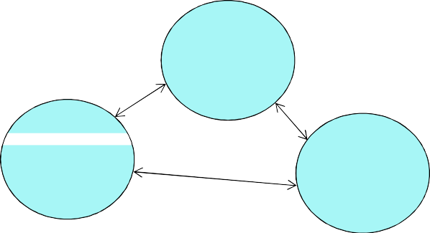
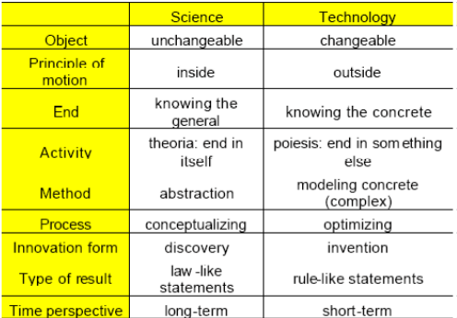
Innovation
The introduction of something new, a new way of doing something, the successful exploitation of new ideas.
Invention - an idea made manifest
... the first occurrence of an idea for a new product or process
Innovation - ideas applied successfully
... the first attempt to carry it out into practice
Incremental innovation - where something is adapted or modified.
Radical innovation - which involves completely new ideas.
DISCUSSION:
Which relationship?
Do all scientists invent something?
Science
Engineering
Innovation
© L. M. Camarinha-Matos, 2009-2012
13
Science vs. technology ? One view
[Dodig-Crnkovic, 2002]
14

Slide 8

Science – some characteristics
Science is empirical. Science relies on experience more than authority, common sense, or logic.
Science is objective. Objectivity means that same conclusion should be arrived if same observation is made.
Science is self-correcting. Because science is empirical, new evidences may contradict the old ones.
Science is progressive. Because science is empirical and self-correcting, it is also progressive.
Science is tentative. Science never claims to have the whole truth. New information may make current knowledge obsolete.
Science is parsimonious. Use the simplest explanation to account for a phenomenon.
Science is concerned with theory. Develop theory of how something works.
© L. M. Camarinha-Matos, 2009-2012
15
Evolution of science
“Science progresses best when observations force us to alter our preconceptions.”
Vera Rubin
“Science progresses when separated things are brought together”
[Berman 2002]
16

Slide 9

Evolution of science ...
Traditional view - linear and cumulative (follows a direct path from past to present, adding at each point to the achievements of earlier generations)
Kuhn’s view:
Scientific development is not smooth and linear; instead it is episodic—that is, different kinds of science occur at different times.
The most significant episodes in the development of a science are normal science and revolutionary science. It is also cyclical with these episodes repeating themselves.
Nor is it cumulative, since revolutionary science typically discards some of the achievements of earlier scientists.
Science does not itself aim at some grand goal such as the Truth; rather individual scientists seek to solve the puzzles they happen to be faced with.
There is no logic of science or fixed scientific method. Instead scientists make discoveries thanks to their training with exemplary solutions to past puzzles
© L. M. Camarinha-Matos, 2009-2012
17
Scientific theory, scientific law
Theory
the explanation or a model for a phenomenon
a conceptual framework that explains existing observations and predicts new ones
a logical, time tested explanation for events that occur in nature.
Theories not only describe why or how the phenomenon occurred but also guide
the way for further research.
A real Scientific Theory tells you what observations are necessary to falsify it.
Theories can really never be completely proven, only disproven. When new evidence comes along, we must modify our theory or at times even get rid of it and start over again.
18

Slide 10
Hypothesis
Hypothesis:
This is an educated guess based upon observation. It is a rational explanation of a single event or phenomenon based upon what is observed, but which has not been proved.
A hypothesis is basically a(n educated) guess.
It is a possible answer to the problem or question.
A hypothesis is testable and falsifiable
A hypothesis is an explanation for a phenomenon which can be tested in some way which ideally either proves or disproves the hypothesis. For the duration of testing, the hypothesis is taken to be true, and the goal of the researcher is to rigorously test the terms of the hypothesis.
When a hypothesis passes the test it is adopted as a theory (or thesis) as it correctly explains a range of phenomena but it can, at any time, be falsified by new experimental evidence.
© L. M. Camarinha-Matos, 2009-2012
19
Thesis
Thesis:
A thesis statement declares what you believe and what you intend to prove.
"a position or proposition that a person (as a candidate for scholastic honors) advances and offers to maintain by argument.“
[Webster's 7th New Collegiate Dictionary].
A defense presents evidence for a thesis.
20

Slide 11
Paradigm
Paradigm:
"a philosophical and theoretical framework of a scientific school or discipline within which theories, laws, and generalizations and the experiments performed in support of them are formulated; broadly : a philosophical or theoretical framework of any kind.
Merriam-Webster Online dictionary
A paradigm is a “excellent example”, a model to which others aspire.
Usually scientists seek to match their work to the paradigm in a way that depends on their seeing similarities between their work and the paradigm
“Followers”
Paradigm Shift is when a significant change happens
or scientific revolution
… when scientists encounter anomalies which cannot be explained by the universally accepted paradigm within which scientific progress has thereto been made.
© L. M. Camarinha-Matos, 2009-2012
21
Discipline
A particular branch of scientific knowledge.
A discipline has six basic characteristics:
Focus of study
Paradigm
Reference disciplines
Principles and practices
Research agenda
Education
Professionalism
Liles et al. (1995),
Discussion: Is Robotics a discipline?
And Collaborative Networks? And Cloud Computing?
22

Slide 12

The emergence of a new discipline
When enough significant anomalies have accrued against a current paradigm, the scientific discipline is thrown into a state of crisis, according to Kuhn.
During this crisis, new ideas, perhaps ones previously discarded, are tried.
Eventually a new paradigm is formed, which gains its own new followers, and an intellectual "battle" takes place between the followers of the new paradigm and the hold-outs of the old paradigm.
The new paradigm may lead to a new discipline.
www.computer.org/portal/site/computer/menuitem.5d61c1d591162e4b0ef1bd10 8bcd45f3/index.jsp?&pName=computer_level1_article&TheCat=1015&path=co mputer/homepage/1205&file=profession.xml&xsl=article.xsl&;jsessionid=JvyLpg TKQzWNJqGWnpKNh6QL9JBVk1dhVQyt8pWsXTjTGjjd9CSG!-1582182879
© L. M. Camarinha-Matos, 2009-2012
23
Research
Research is the systematic process of collecting and analyzing information to increase our understanding of a phenomenon under study.
The systematic investigation into and study of materials, sources, etc, in order to establish facts and reach new conclusions.
An endeavour to discover new or collate old facts etc by the scientific study of a subject or by a course of critical investigation.
[Oxford Concise Dictionary]
Research encompasses activities that increase the sum of human knowledge.
[OECD Definition]
The word research is composed of two syllables, re and search.
The dictionary defines the former as a prefix meaning again, anew or over again and the latter as a verb meaning to examine closely and carefylly, to test and try, or to proble.
Together they form a noun describing a careful, systematic, patient study and investigation in some field of knowledge, undertaken to establish facts or principles.
[Grinnel, 1993]
24

Slide 13
Research ...
The systematic process of collecting and analyzing information (data) in order to discover new knowledge or expand and verify the existing one (e.g. theory - law)
The research process must :
Be undertaken within a framework of a set of philosophies.
Use procedures, methods and techniques that have been tested for their validity and reliability.
Be designed to be unbiased and objective.
Subjectivity: an integral part of your way of thinking that is conditioned by your educational background, discipline, philosophy, experience and skills.
Bias: a deliberate attempt to either conceal or highlight something.
[Kumar 2005]
© L. M. Camarinha-Matos, 2009-2012
25
Research and Development – R&D
Research and experimental development (R&D) comprises creative work undertaken on a systematic basis in order to increase the stock of knowledge, including knowledge of man, culture and society, and the use of this stock of knowledge to devise new applications.
[OECD Definition]
In the world of business, research and development is the phase in a product's life that might be considered the product's 'conception‘:
research phase: basic science must exist to support the product's viability, and if the science is lacking, it must be discovered.
development phase: if the science exists, then turning it into a useful product.
26

Slide 14
Research characteristics
To qualify as research the process must have the following characteristics:
Controlled – in exploring causality in relation to two variables, the study must be set in a way to minimise the effects of other factors affecting the relationship.
Rigorous – be scrupulous in ensuring that the procedures followed to find answers to questions are relevant, appropriate and justified.
Systematic – the procedures adopted to undertake an investigation follow a certain logical sequence ... Different steps cannot be taken in a hazardous way.
Valid and verifiable – whatever is concluded on the basis of the findings must be correct and can be verified by the researcher and others.
Empirical – any conclusions drawn are based upon hard evidence gathered from information collected from real-life experiences or observations.
Critical – critical scrutiny of the procedures used and the methods employed.
[Kumar 2005]
© L. M. Camarinha-Matos, 2009-2012
27
Principles
Deduction vs. Induction
DEDUCTION
Begins with a general principle and reasons to particulars (individual examples)
•Type of reasoning most commonly associated with geometric proofs
General Principle or Law
INDUCTION
•Begins with observation of individual examples and reasons to form general principles about their relationships
•Type of reasoning most commonly associated with experimentation
 Advantage: If all the terms are perfectly defined it produces absolute certainty
 Disadvantage: Difficult
to find circumstances in which all terms and principles can be defined perfectly
 Advantage: Relatively easy to do – just observe the world
 Disadvantage: Can never be absolutely certain one has observed ALL particulars
[Hadbavny , 2008]
Individual Examples
28

Slide 15
Concept, Indicator, Variable
Concepts are mental images or perceptions
-> their meanings vary from individual to individual.
Variables or indicators are measurable (with varying degrees of accuracy).
Measurability is the main difference between a concept and a variable.
In order to assess research results it is important for the concepts to be converted into variables or indicators as they can be subjected to measurement.
Operationalisation of a concept => how it will be measured.
[Kumar 2005]
© L. M. Camarinha-Matos, 2009-2012
29
3. SCIENTIFIC RESEARCH
30

Slide 16
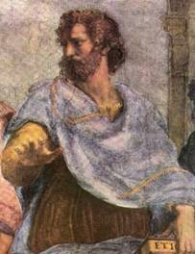
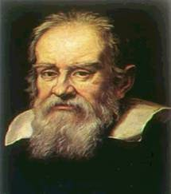
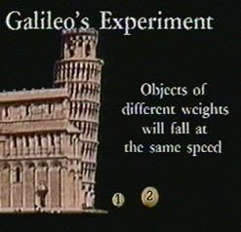
Brief history landmarks
Aristotle
Aristotle, more than any other thinker, determined the orientation and the content of Western intellectual history.
He was the author of a philosophical and scientific system that through the centuries became the support and vehicle for both medieval Christian and Islamic scholastic thought: until the end of the 17th century, Western culture was Aristotelian.
Aristotle and his contemporaries believed that all problems could be solved by thinking about them.
(384 BC - 322 BC)
Sometimes this worked, other times it did not.
For example, Aristotle thought that heavy objects would fall faster than lighter ones.
What did Aristotle not do? He never tested his ideas!
The world would have to wait almost 2000 years for that to happen.
© L. M. Camarinha-Matos, 2009-2012
31
Brief history landmarks ...
Galileo Galilei
Often considered the first true scientist.
Why?
Because he actually did the experiment !
Aristotle thought that heavy objects fall faster than lighter ones.
So Galileo asked, “How much faster?”
He sent students up to the top of a building and had them drop a heavy ball and a lighter one off at the same time. He had other students waiting below to measure the difference in time between the two hitting the ground.
(1564-1642 AD)
Much to everyone’s surprise both balls hit the ground at about the same time!
This shows that it is much preferred to test your ideas rather than merely think about them.
.... Simulation is not enough either !

Slide 17
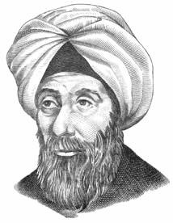


Brief history landmarks ...
Ibn al-Haytham
(Alhacen or Alhazen)
Perhaps not so known in the West ....
He is considered the pioneer of the modern scientific method and the originator of the experimental nature of physics and science
... long before Galileo
He made significant improvements in optics, physical science, and the scientific method which influenced the development of science for over five hundred years after his death.
(965 - 1039 AD)
Ibn al-Haytham's work on optics is credited with contributing a new emphasis on experiment.
Example:
Ibn al-Haytham proved that light travels in straight lines using the scientific method.
© L. M. Camarinha-Matos, 2009-2012
Types of research – Viewpoint of application
Pure, basic, or fundamental research
Driven by the scientist’s curiosity or interest in a scientific question.
Involves development and testing theories and hypothesis that are intellectually challenging to the researcher but may or may not have practical application at the present time or in the future.
...Frequently involve very abstract and specialized concepts
Applied research
Designed to solve practical problems of the real world, rather than to acquire knowledge for knowledge’s sake.
Often involves the use of some technology in the development of new processes or systems.
Frequently linked to R&D
What distinguishes applied research from engineering?
34

Slide 18





Types of research – Viewpoint of application ...
Another classification:
Pure basic research is experimental and theoretical work undertaken to acquire new knowledge without looking for long-term benefits other than the advancement of knowledge.
Strategic basic research is experimental and theoretical work undertaken to acquire new knowledge directed into specified broad areas in the expectation of useful discoveries. It provides the broad base of knowledge necessary for the solution of recognised practical problems.
Applied research is original work undertaken primarily to acquire new knowledge with a specific application in view. It is undertaken either to determine possible uses for the findings of basic research or to determine new ways of achieving some specific and predetermined objectives.
Experimental development is systematic work, using existing knowledge gained from research or practical experience, that is directed to producing new materials, products or devices, to installing new processes, systems and services, or to improving substantially those already produced or installed.
http://www.jcu.edu.au/office/research_office/researchdef.html
© L. M. Camarinha-Matos, 2009-2012
35
Types of research – Viewpoint of objectives
Descriptive research
Attempts to describe systematically a situation, problem, phenomenon, serivce, etc. E.g. Structure of a system, organization, etc.
Correlational research To discover or establish the existence of a relationship / association
/ interdependence between two or more aspects of a situation.
E.g. What is the relationship / impact / effect of <this> in <that>.
Explanatory research Attempts to clarify or explain why and how there is a relationship
between two aspects of a situation or phenomenon.
Exploratory research When the objective is to explore an area where little is known or to
investigate the possibility of launching a particular research study.
[Kumar, 2005]
Another perspective:
Descriptive (of the significant aspects of the research domain)
Explicative (of the behavior of a phenomenon)
Predictive (of the future)
Prescriptive (involving, in addition to prediction, prescription and application
of norms and processes)
36

Slide 19
Types of research – Viewpoint of inquiry mode
(Strategies of inquiry)
Quantitative strategies (or structure approach) ... to determine the extent of a
problem, issue, or phenomenon
Survey research
... Studies samples
Experimental research ... To determine impacts or influences
Qualitative strategies (or unstructure approach)
... to explore the nature of a problem, issue, or phenomenon
Ethnography
Grounded theory Case studies
... Studies an intact “cultural group” in a natural setting over a prolonged period of time
... Derives a general, abstract theory of a process, action, or interaction grounded in the views of participants
... Exploring in depth an event, activity, process or entity
Phenomenological research ... Trying to understand the meaning of a phenomenon as
perceived by the actors that “lived it”
Narrative research ... Based on the analysis of stories / narratives
[Creswell, 2009]
© L. M. Camarinha-Matos, 2009-2012
37
Types of research – Viewpoint of inquiry mode ...
Mixed strategies
Sequential mixed methods
Elaborate on / or expand the findings of one method with another method
Concurrent mixed methods
Merges quantitative and qualitative data in order to reach a comprehensive analysis of the research problem
Transformative mixed methods
Uses a theoretical lens to determine topics of interest and the methods to apply
[Creswell, 2009]
Often researchers engaged in one type despise those involved in another type ... !!!
38

Slide 20
Some “philosophies”
Assumptions of Post - Positivism
Absolute truth can never be found.
Research is a process of making claims and then testing, refining or abandoning some of them for other claims more strongly warranted.
Data, evidence and rational considerations shape knowledge.
Research seeks to develop relevant, true statements that can serve to explain the situation that is of concern or that describes the causal relationship of interest.
Researchers must examine their methods and conclusions and control or limit bias.
Assumptions of Interpretivism
Meanings are constructed by humans as they engage with the world they are interpreting. Humans make sense of the world based on their historical and social perspective. They seek to understand the context and then make an interpretation of what they find which is shaped by their own experiences and backgrounds.
The basic generation of meaning is always social.
© L. M. Camarinha-Matos, 2009-2012
39
Some “philosophies” ...
Assumptions of Participatory
Participatory research is recursive and dialectical and is focused on bring about change in practices.
Begins with a stance about the problems in society.
It is emancipatory.
It is inquiry completed with others rather than on or to others.
The research process is cyclical.
Assumptions of Pragmatism
Is not committed to any one system of philosophy or reality.
Individual researchers have freedom of choice to select procedures that best meet their needs.
Pragmatists do not see the world as an absolute unity.
Truth is what works at the time.
We need to stop asking questions about reality and the laws of nature and start solving problems.
40

Slide 21
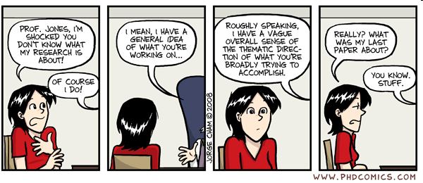
4. PRACTICAL ISSUES
© L. M. Camarinha-Matos, 2009-2012
41
You and your supervisor ?
42

Slide 22


Relationship with supervisor
Scientific & methodological guidance
Suggestions and assessment
Reassurance, support
Polishing technical writting
Resources, hosting project
Contacts, social networking
Facilitator to access scientific channels
Experience
Mentor, friend, confidante, adviser and also a voice of reason
• ...
WIN-WIN
SUPERVISOR
Hard work, enthusiasm
Labor resource (for projects, etc.)
Generation of experimental results
Contribution to publications
Contribution to project proposals (at a later stage)
• ...
PhD STUDENT
© L. M. Camarinha-Matos, 2009-2012
43
Choosing a supervisor
Before jumping into the unknown, remember that your supervisor will be your guide
... One of the most critical decisions ...
Is an expert in the area you selected ?
Is internationally recognized in the area ?
Is well connected in the international scientific arena ?
Is willing and able to promote your work at conferences and the like?
Is active (research, publications) ?
Has previous supervision experience ?
Is interested in the topic you selected ?
Can provide research facilities ?
Is willing to fight the system for you ?
Will you be integrated in a group ?
Do you want co-supervision?
Personal chemistry ?
44

Slide 23
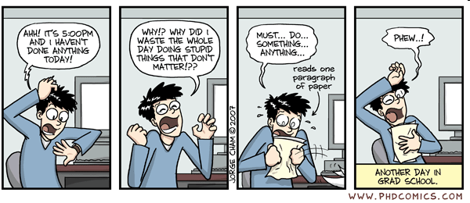







How does a researcher work?
Above all …
you need strong psychological resistance !
© L. M. Camarinha-Matos, 2009-2012
45
Emotional factors
Research is hard.
All research involves risk.... If your project can't fail, it is development, not research. Along your career, you'll accumulate a lot of failures.
... Even the (apparently) successful researchers accumulate (many) failures.
Research always takes much, much longer than it initially seems. Crucial to success is making your research part of your everyday life.
... think about your research in background mode all the time.
You'll find that your rate of progress seems to vary a lot ... Sometimes no progress at all. At other times you get stuck and feel like you can't do anything for a long time.
Setting your sights too high leads to paralysis. Work on a sub-problem to get back into the flow.
It's hard to get started working in the morning, easy to keep going once you've started €Leave something easy or fun unfinished in the evening that you can start with in the morning.
Fear of failure can make work hard and discourage.
Based on MIT: www.cs.indiana.edu/mit.research.how.to/section3.13.html
You are aiming a PhD, not a Nobel prize (at this time) !
46

Slide 24






How should you work?
SOME HINTS FOR A PhD CANDIDATE:
Work regularly ... It helps keeping things in mind. Allocate large blocks of time for research
... Task switching takes time
... Do something significant in each session
Maintain a research notebook / journal of day-to-day thoughts. Read it periodically.
Keep an updated task list ... and focus on accomplishing something each session.
Periodically write a few pages (summaries, accomplishments, problems, speculations) on a subset of your work.
A good practice: send a 1-page summary, weekly, to your supervisor
What you have achieved during the week (not the activities but rather the achievements)
What you plan to do during next week.
© L. M. Camarinha-Matos, 2009-2012
47
Relationship with the rest of the program
Free Option Advanced Topics ...
Background
Scientific Research Methodologies and Techniques
General knowledge of the area and its challgences
Thesis Preparation
Methods
Research Planning
SoA & Plan
Paper on Thesis Plan
Doctoral conference
Dissemination experience
IPR & ethics
Dissemination plans
Entrepreneurship Methods
Dissemination & exploitation plans
48

Slide 25
Creswell, J. W. (2009). Research Design: Qualitative, Quantitative, and Mixed Method Approaches. SAGE.
Dodig-Crnkovic, G. (2002). COMPUTER SCIENCE IN A THEORY OF SCIENCE DISCOURSE. Master
Thesis in Computer Science. http://citeseerx.ist.psu.edu/viewdoc/download;jsessionid=664AECAC339E0C2AD06D8BAF52BCDD0E? doi=10.1.1.12.5766&rep=rep1&type=pdf
Hong, L. Y. (2006). RESEARCH METHODS IN ENGINEERING AND SCIENCE.
http://www.wabri.org.au/postgrads/documents/RM%20sci_eng_notes/Eng_Leung.pdf
Kumar, R. (2005). Research methodology – A step-by-step guide for beginners. SAGE.
Liles, D.; Johnson, M.; Meade, L.; Underdown, D. (1995). Enterprise Engineering: A discipline?, Society for Enterprise Engineering (SEE) Conference, Orlando, FL, http://www.webs.twsu.edu/enteng/ENTENG1.html
© L. M. Camarinha-Matos, 2009-2012
49

