Slide 1
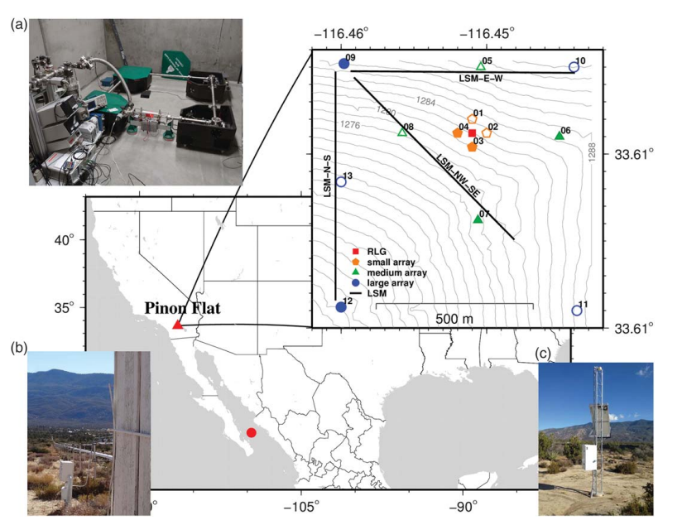
Azimuthal Anisotropy Beneath Southern California:
PFO- 6C-preliminary test
Le Tang
LMU, 23/09/2022
(Donner at al.,2017, SRL)

Slide 2
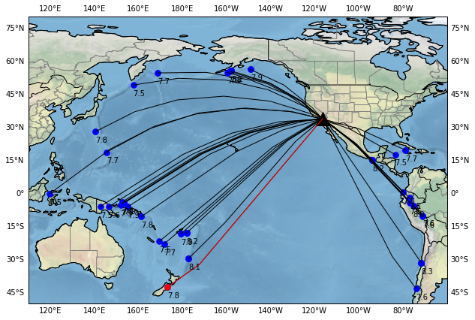
quake75.xml-11

Slide 3
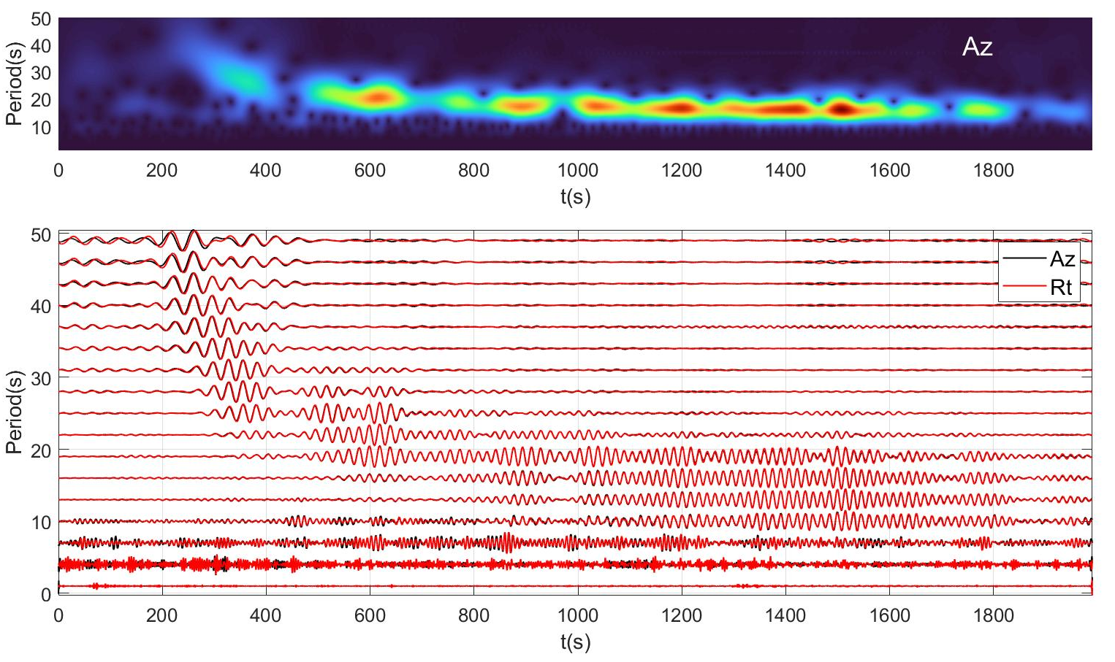
(ADR: Array-derived rotation)
(Donner at al.,2017, SRL)
Period=12-40s
qR waves

Slide 4
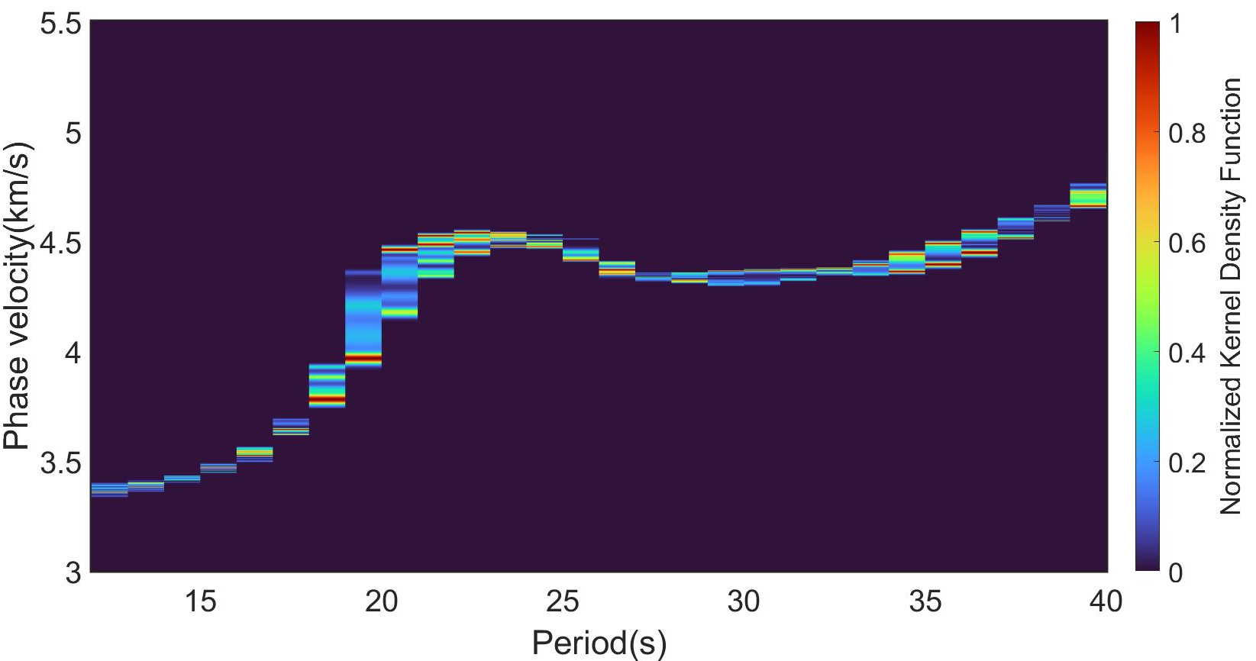
qR waves
A high-velocity anomaly in the period of 20s to 27s?

Slide 5
quake75.xml-15

Slide 6
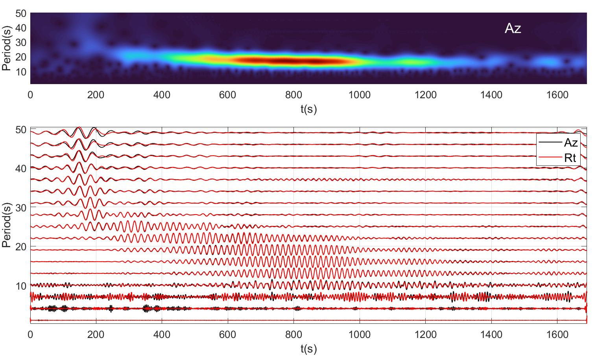
qR waves

Slide 7
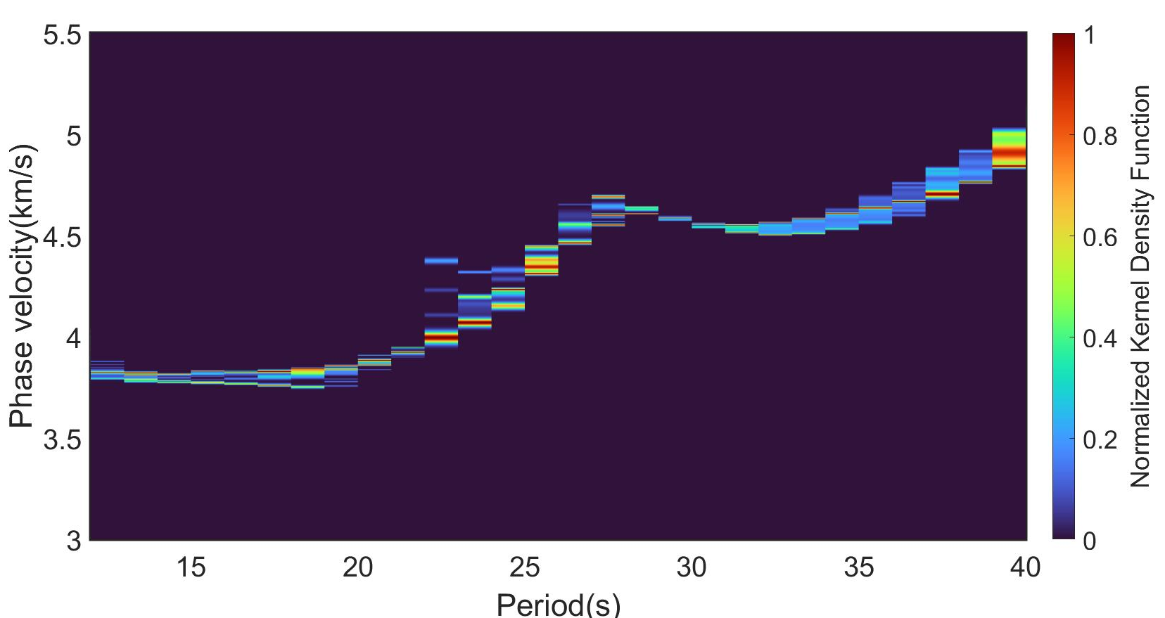
qR waves

Slide 8
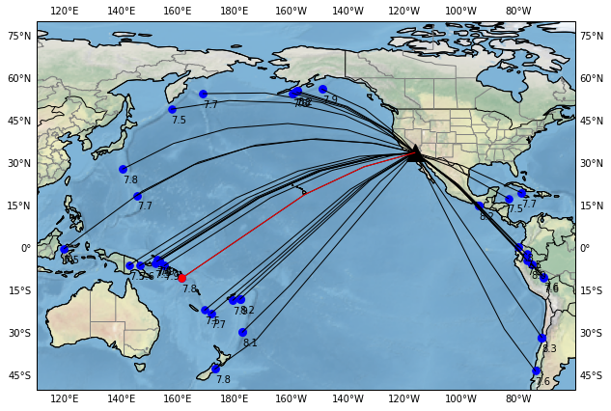
quake75.xml-10

Slide 9
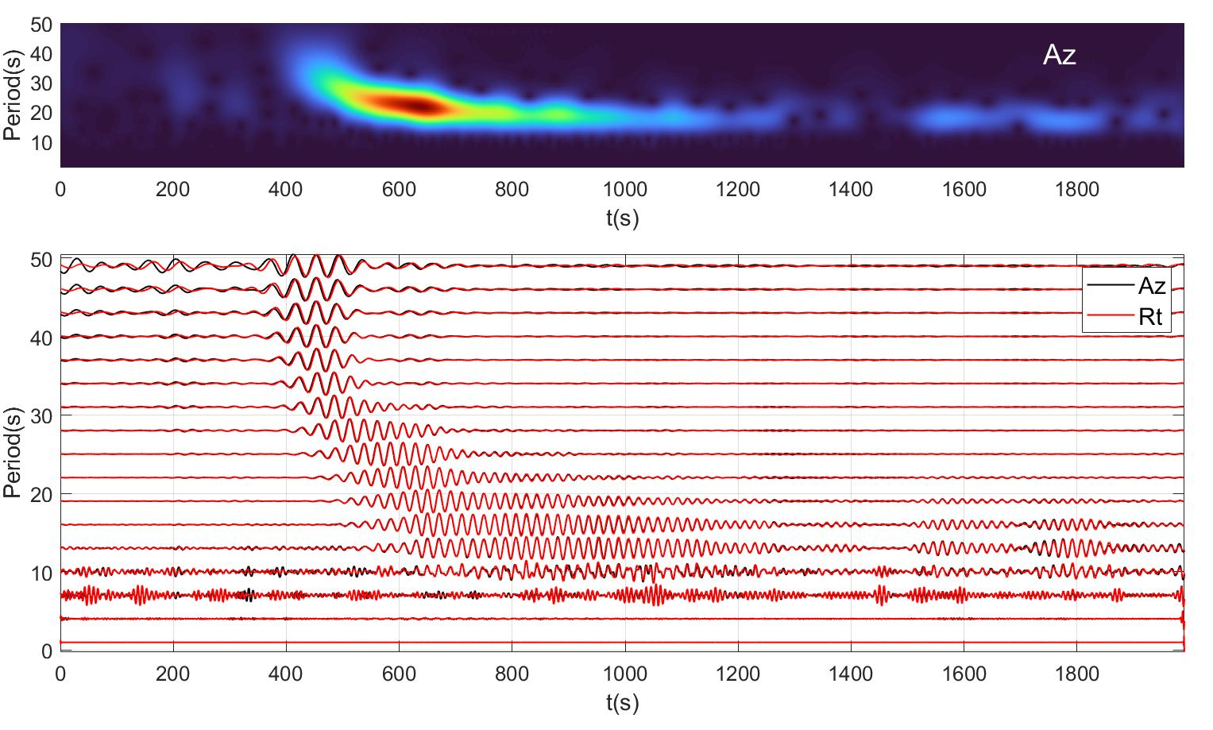
qR waves

Slide 10
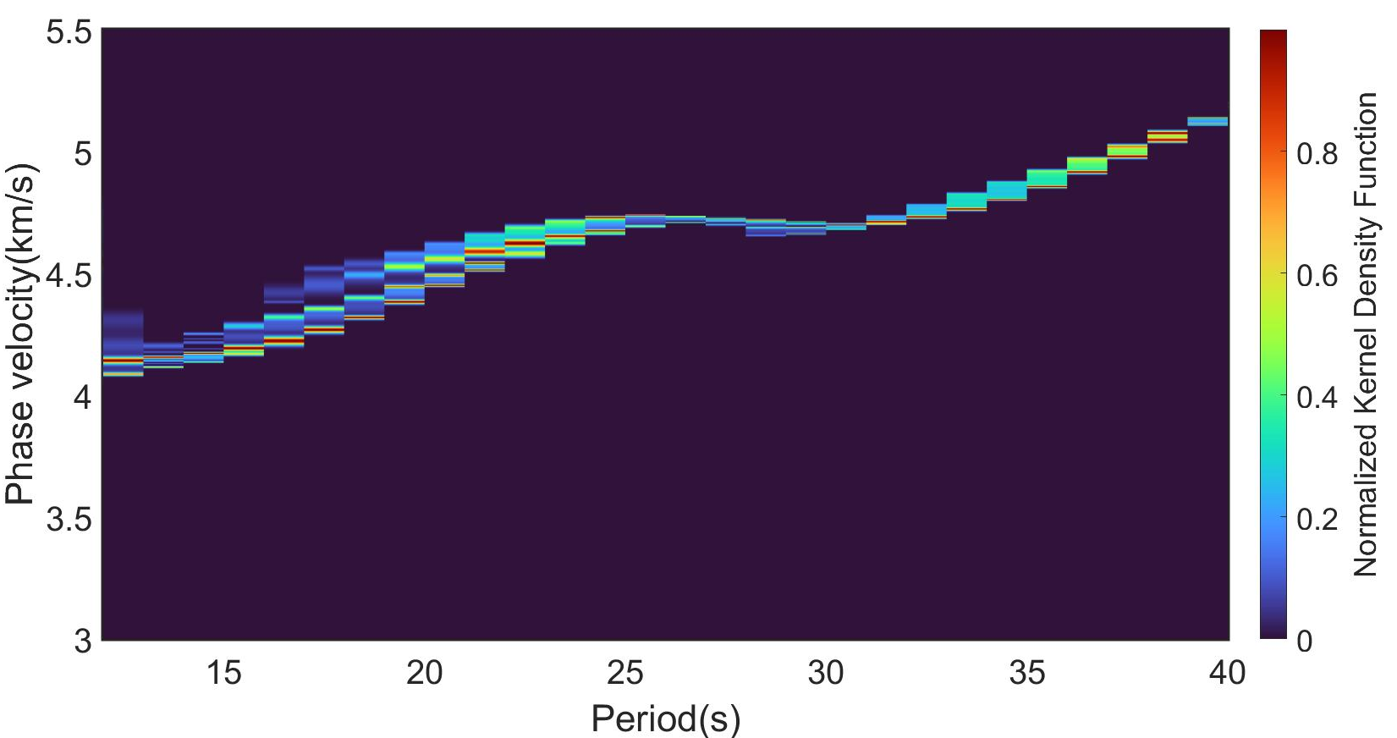
qR waves

Slide 11
quake75.xml-7

Slide 12
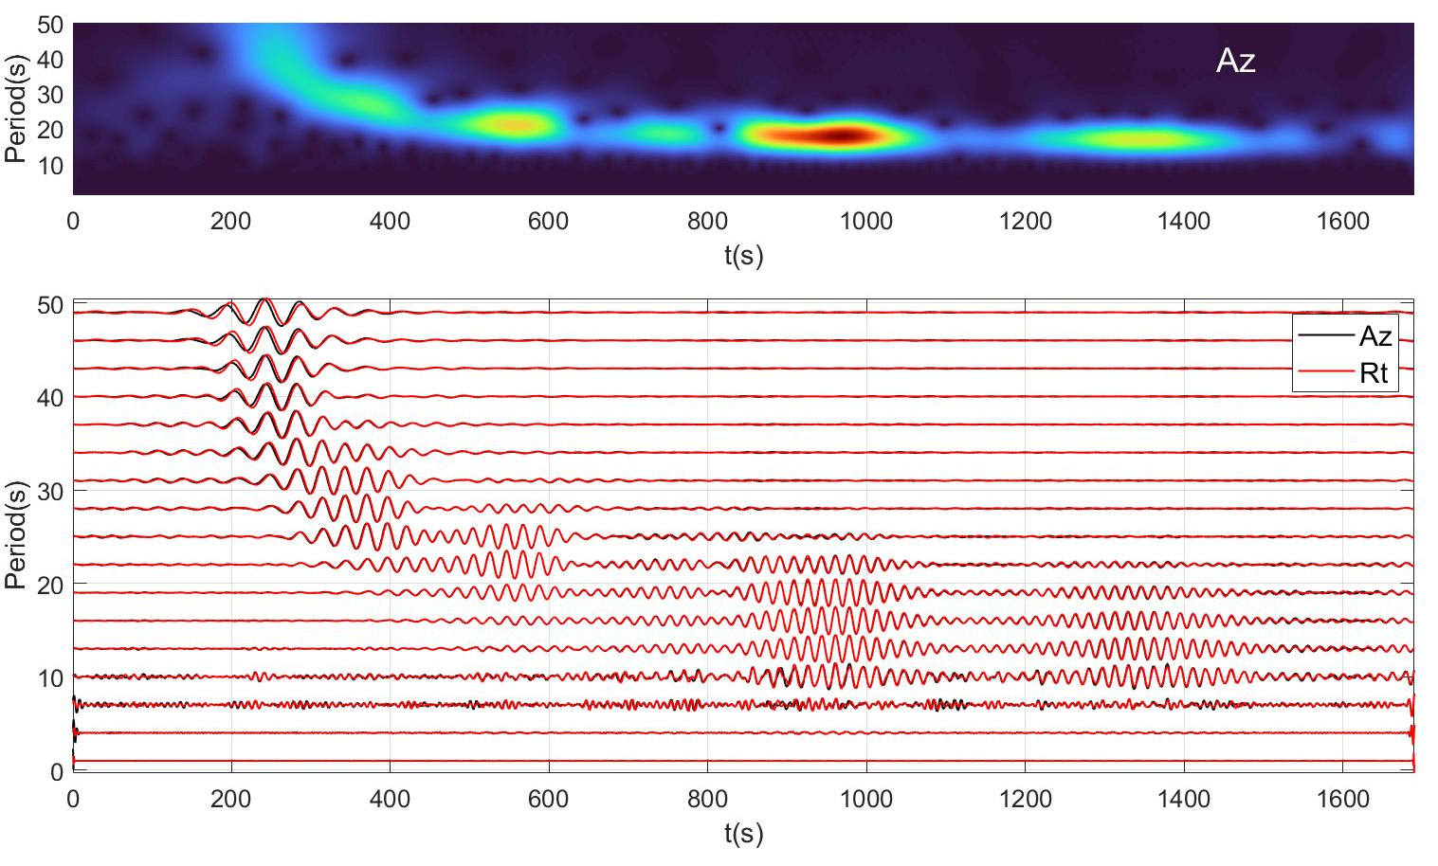
qR waves

Slide 13
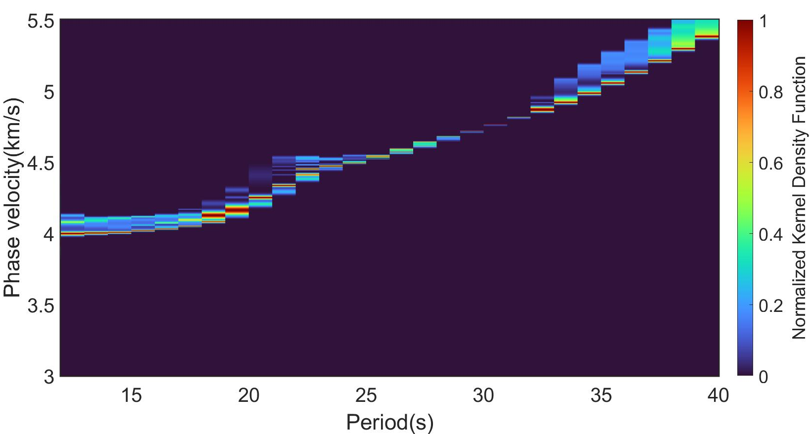
qR waves

Slide 14
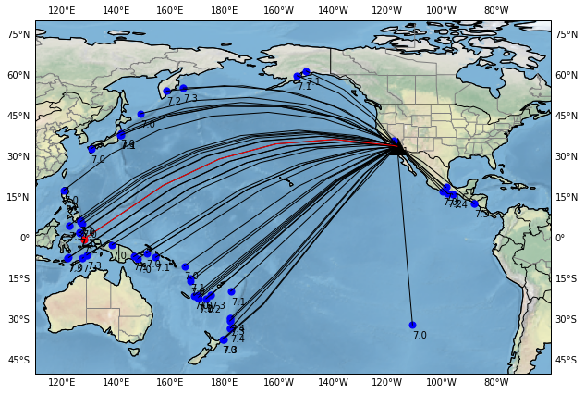
quake7_74.xml-19

Slide 15
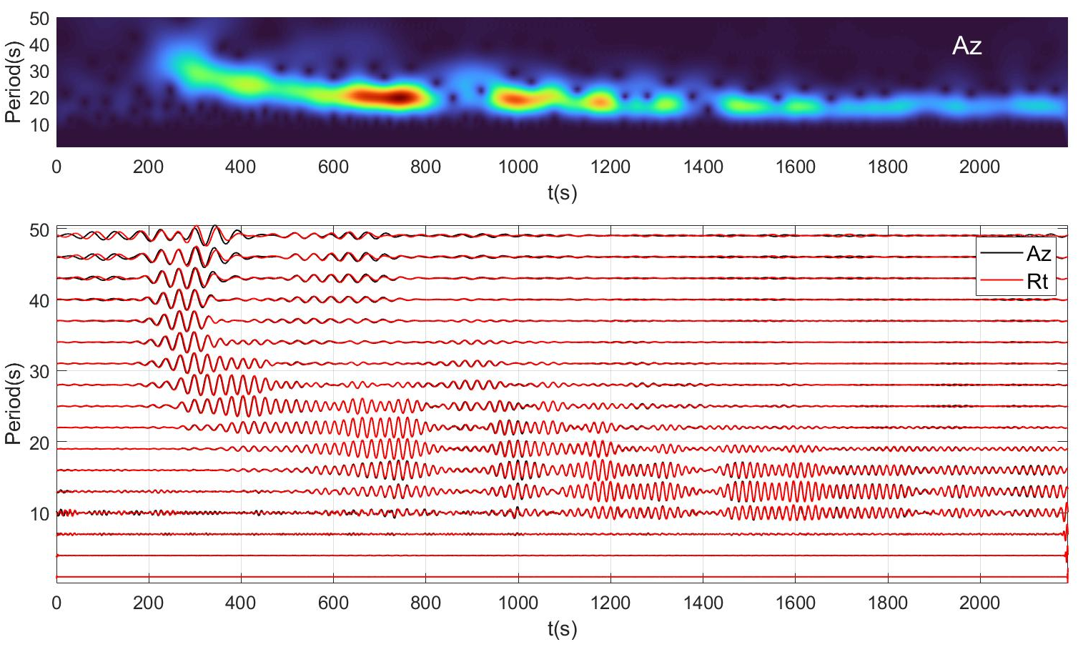
qR waves

Slide 16
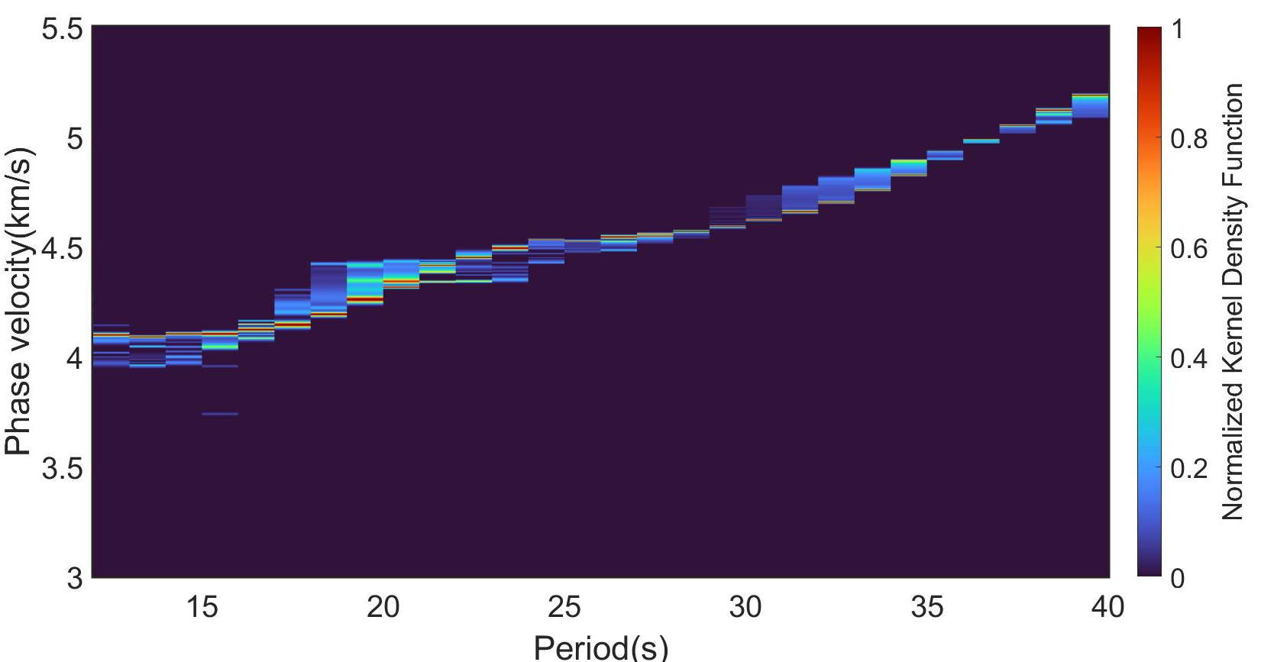
qR waves

Slide 17
quake7_74.xml-36

Slide 18
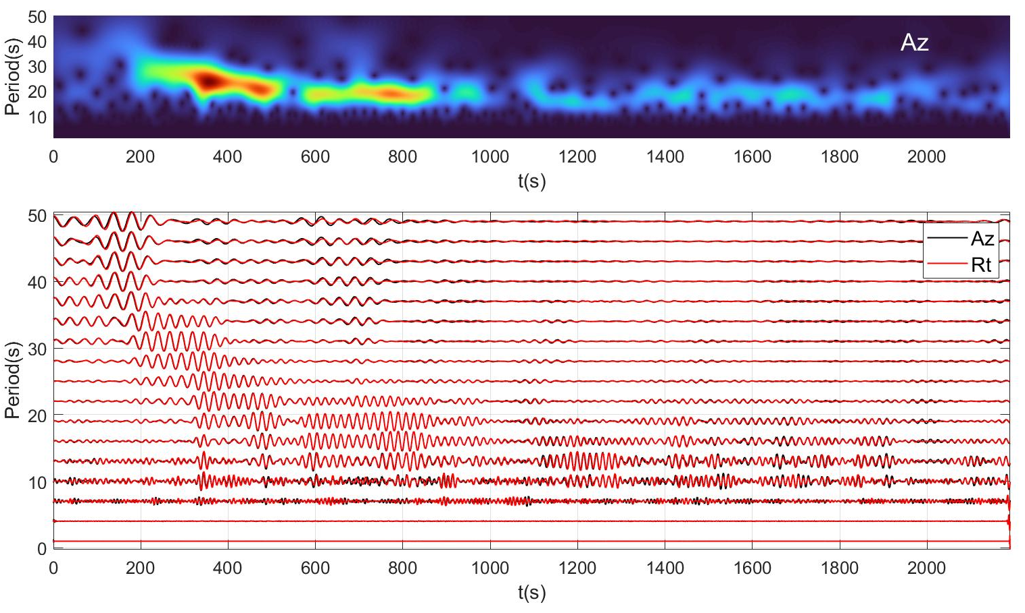
qR waves

Slide 19
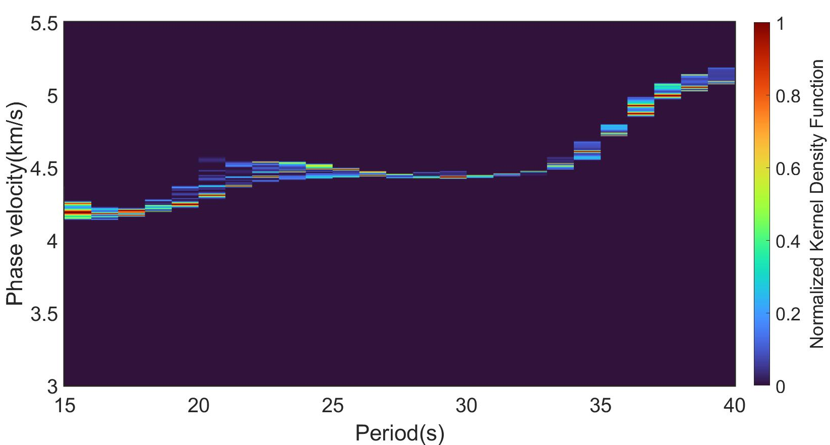
qR waves

Slide 20
quake75.xml-18

Slide 21
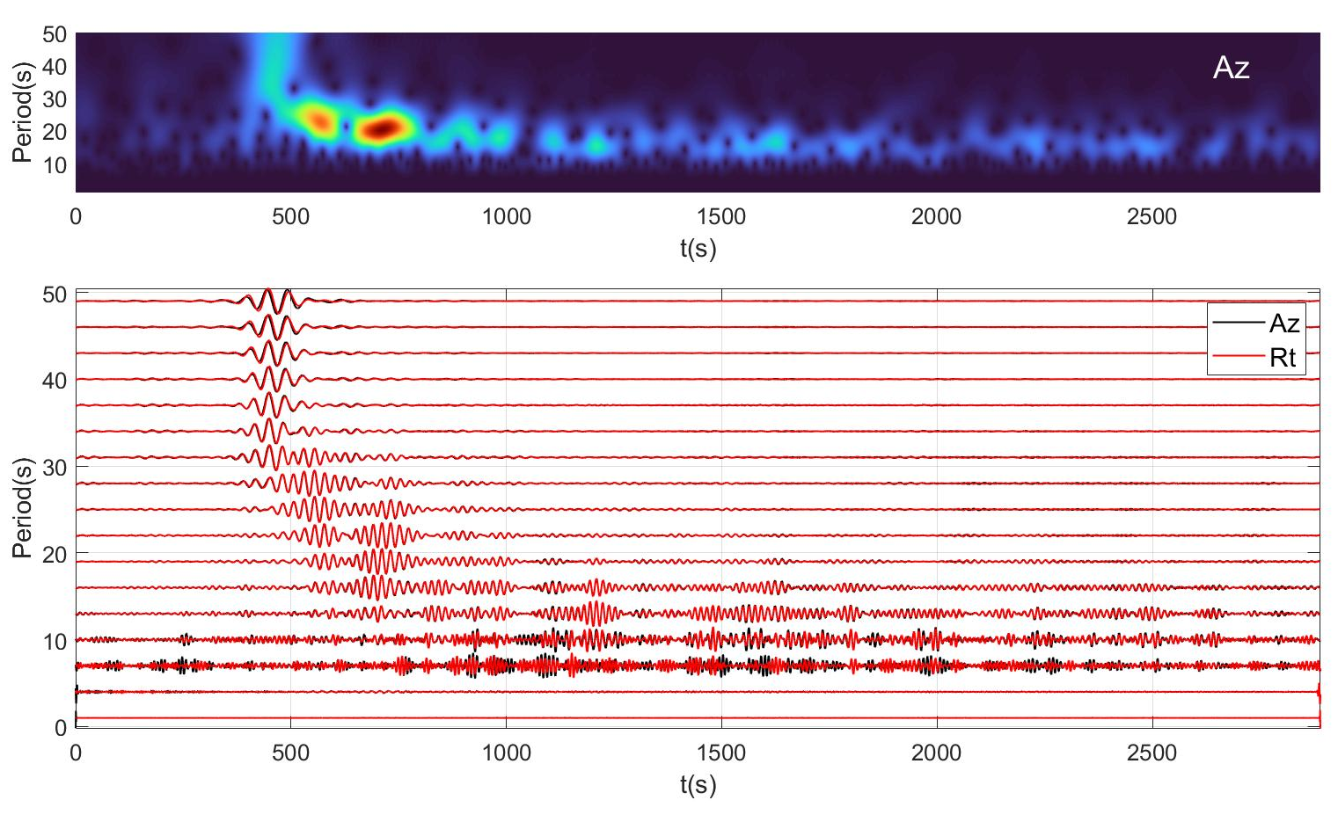
qR waves

Slide 22
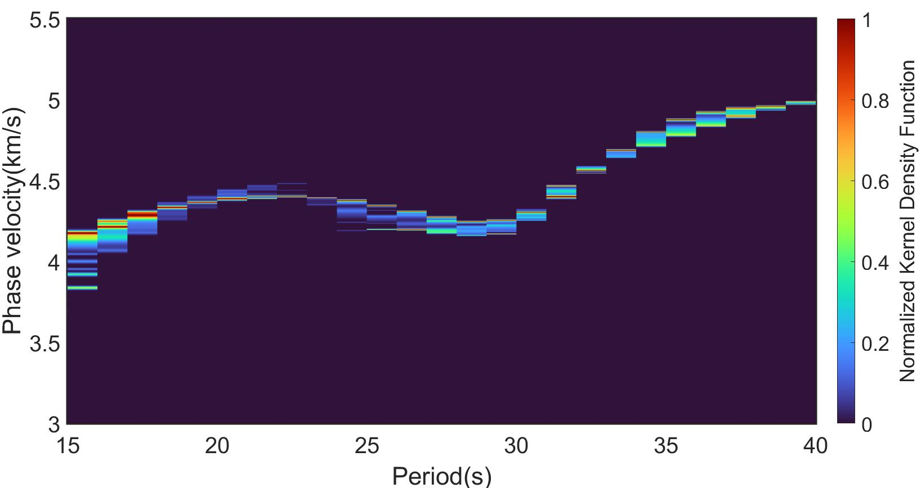
qR waves

Slide 23
quake7_74.xml-26

Slide 24
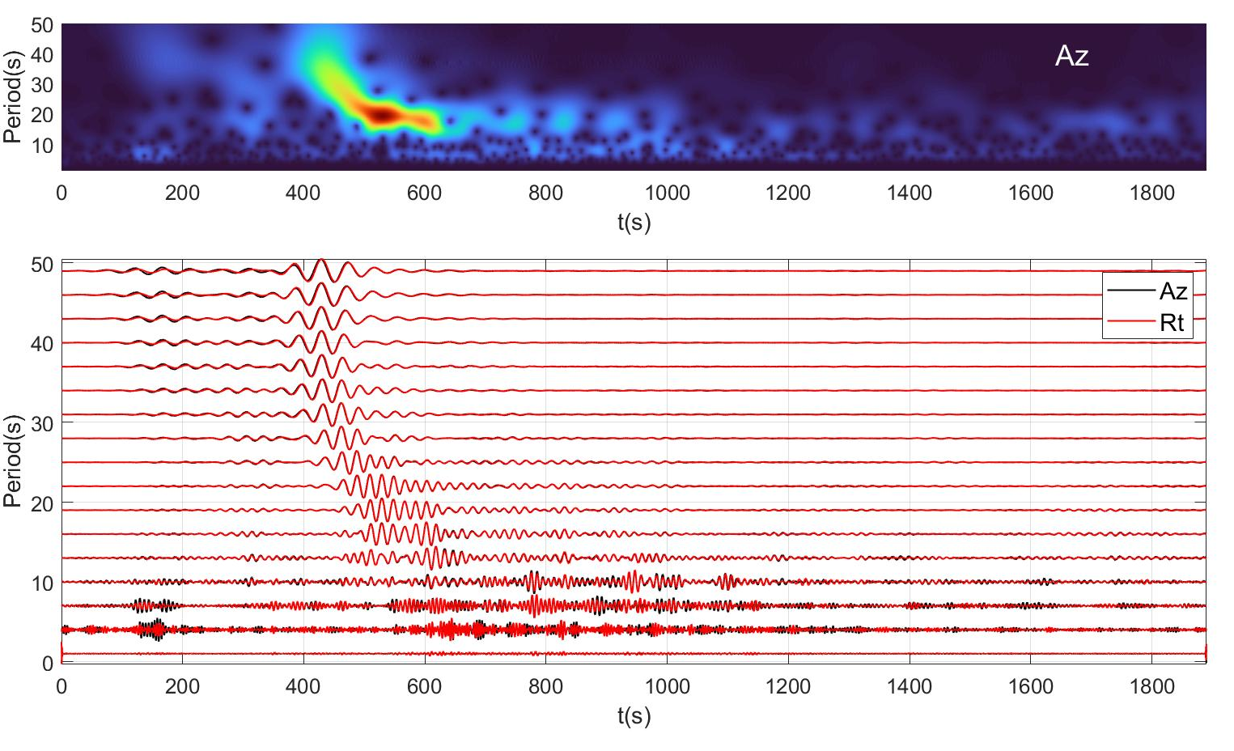
qR waves

Slide 25
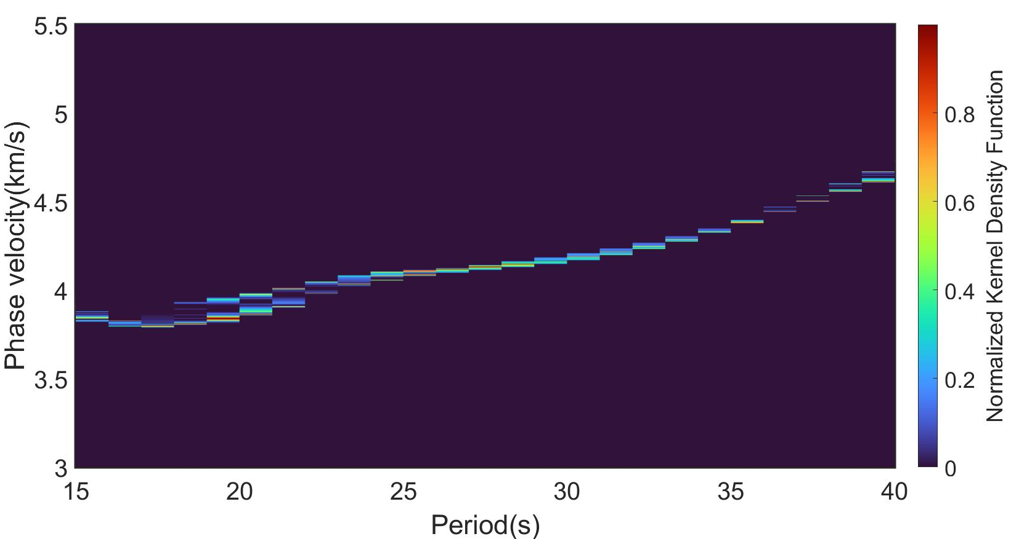
qR waves

Slide 26
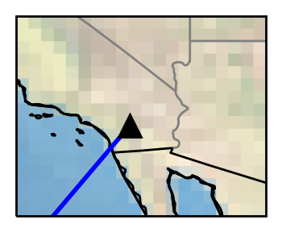
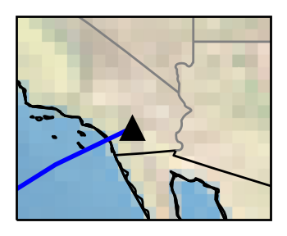
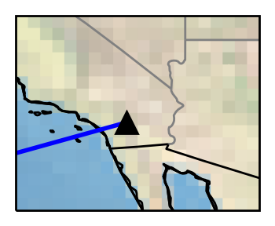
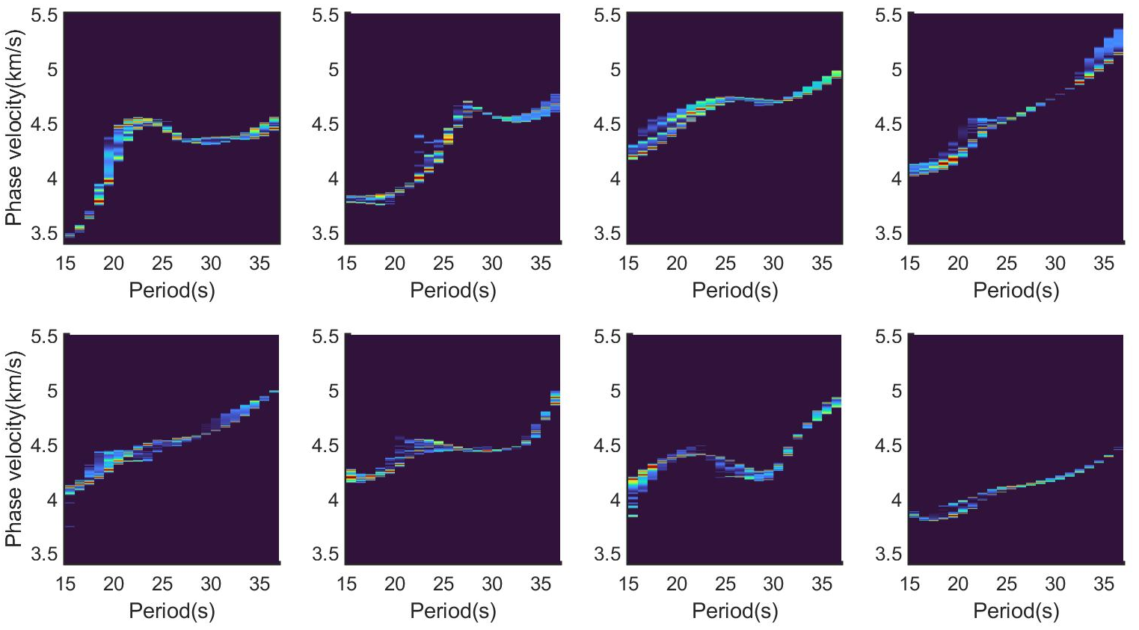
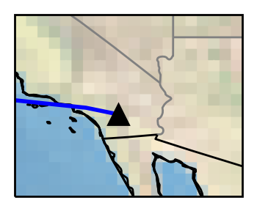
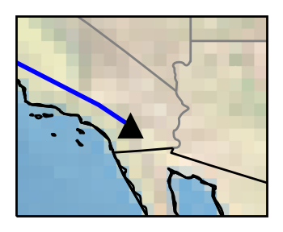
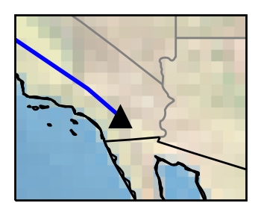
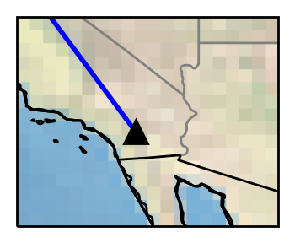

Slide 27
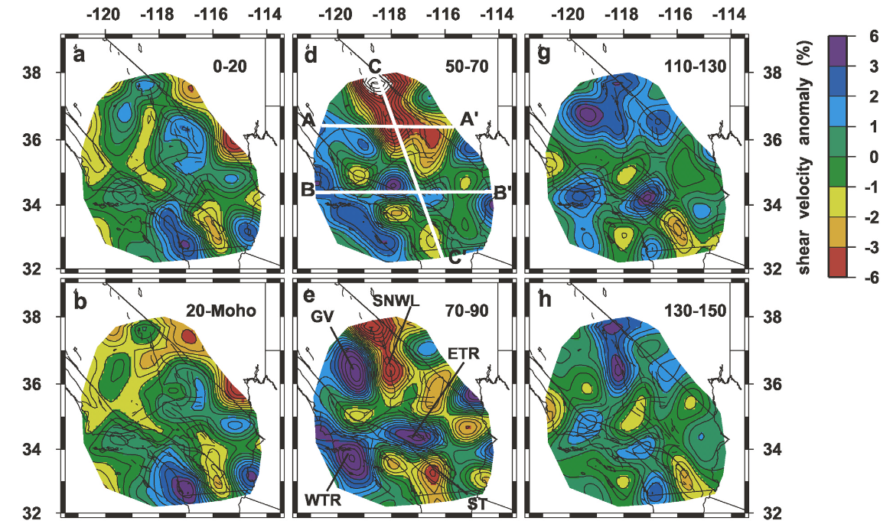
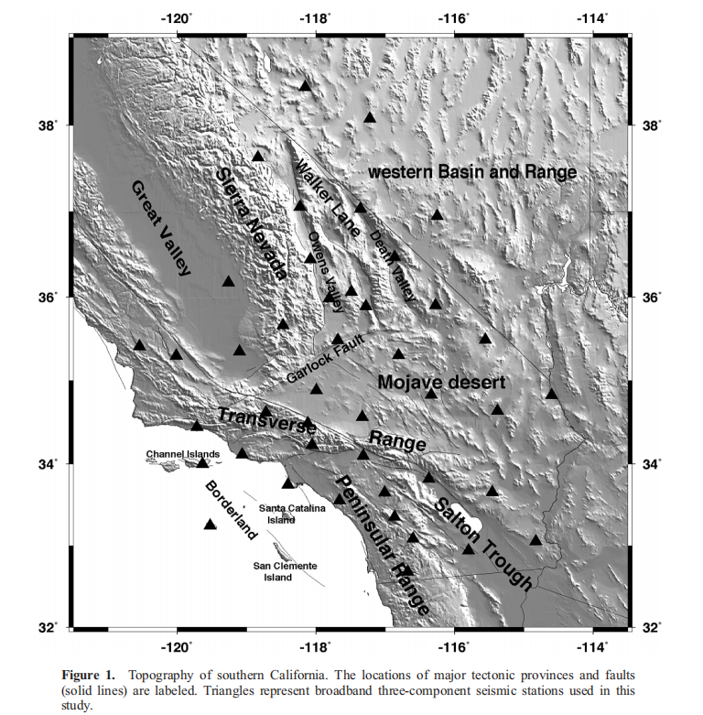
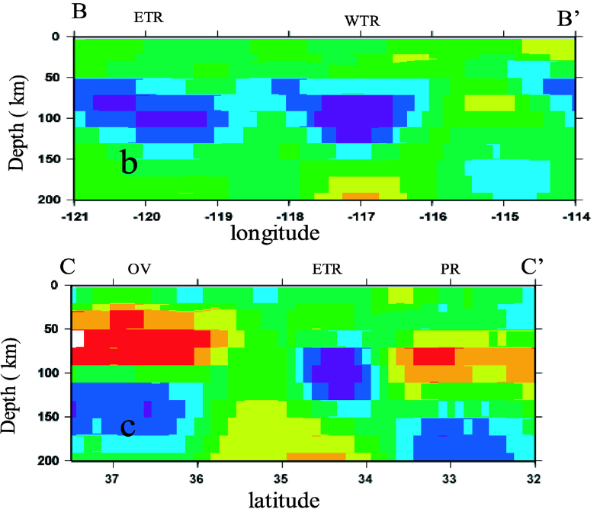
(Yang and W. Forsyth, JGR, solid earth,2006)

Slide 28
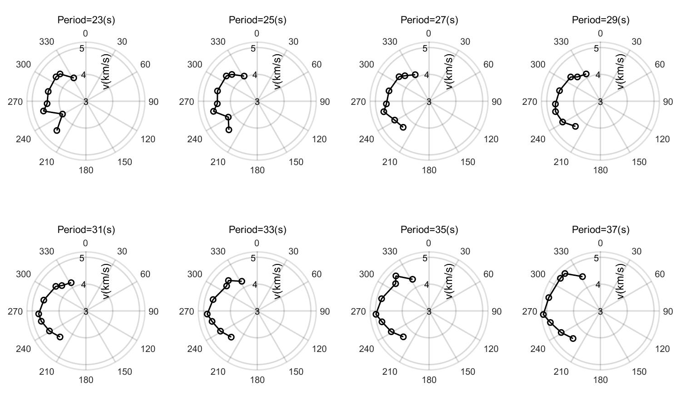

Slide 29
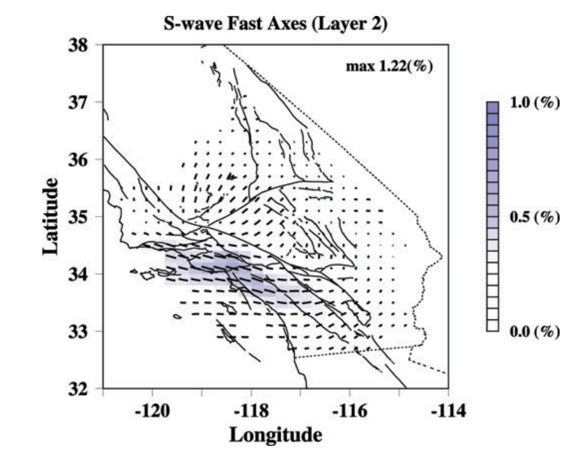
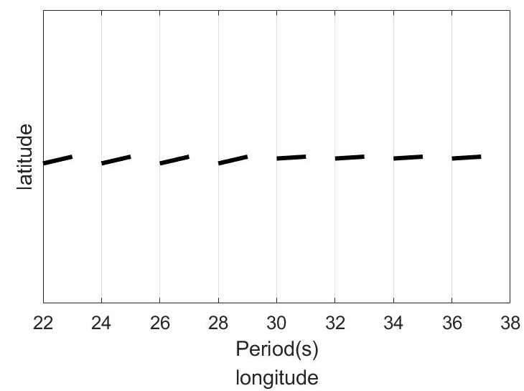
33-100km
Rayleigh wave Fast-direction
(our preliminary tests)
(Alvizuri and Tanimoto, GJI, 2011)

Slide 30
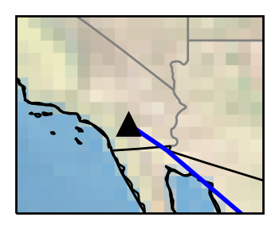
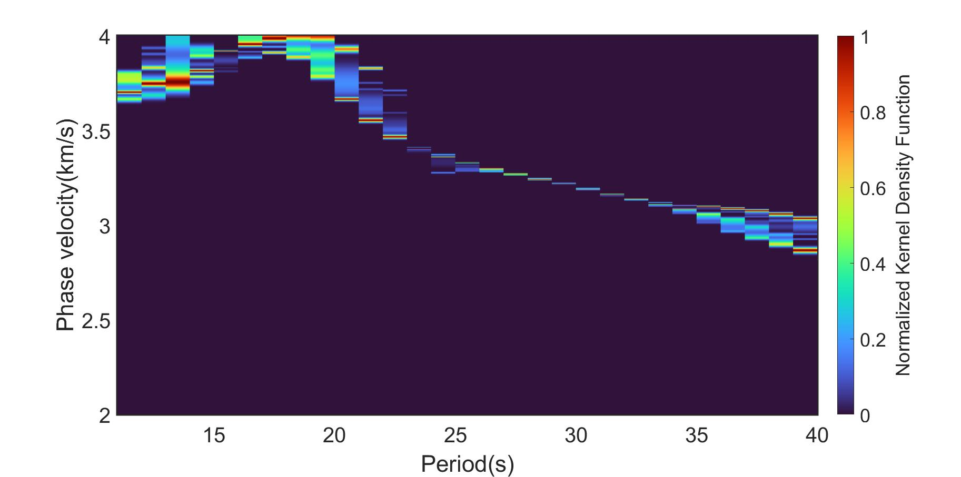
quake7_74.xml-31

Slide 31
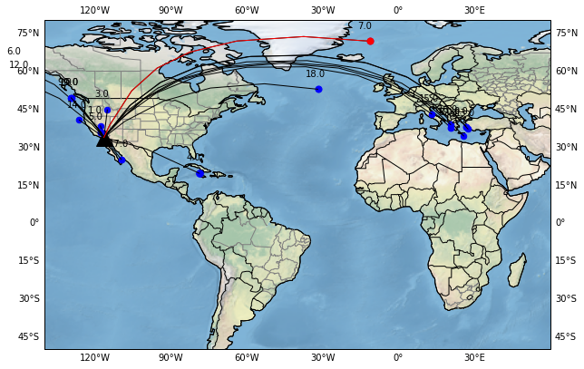
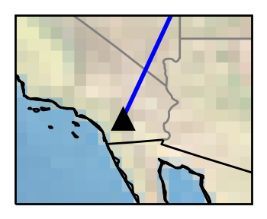
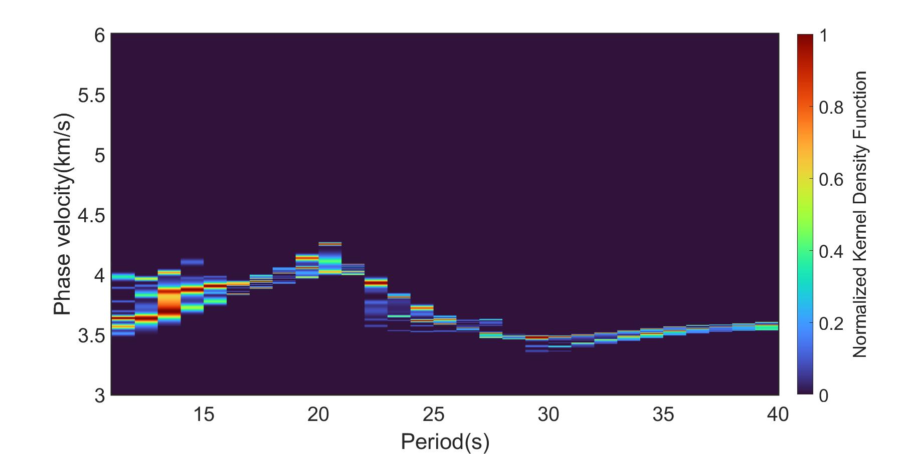
Quake_right.xml-7

Slide 32
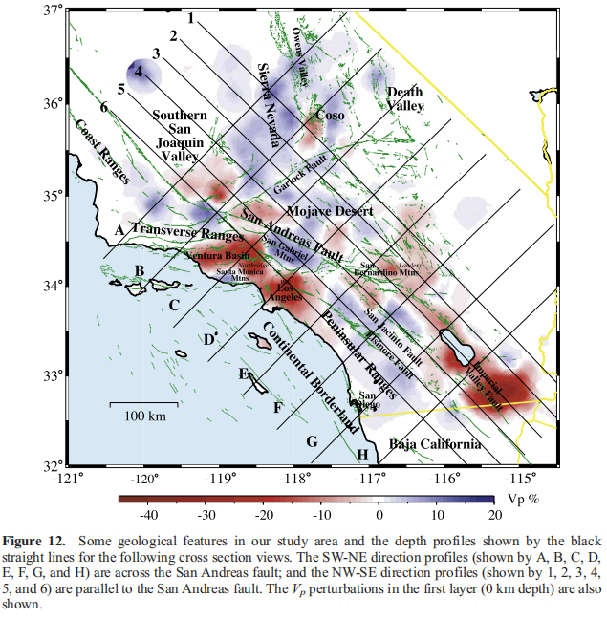
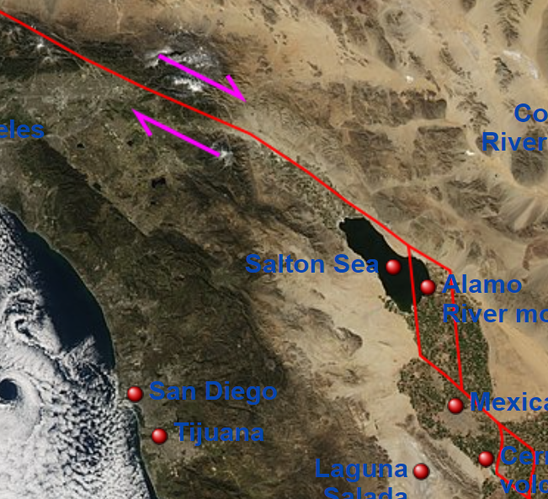
(JGR, solid earth,2007，
P and S arrival times from local earthquakes and explosions)
100km
PFO
https://en.wikipedia.org/wiki/San_Andreas_Fault

Slide 33
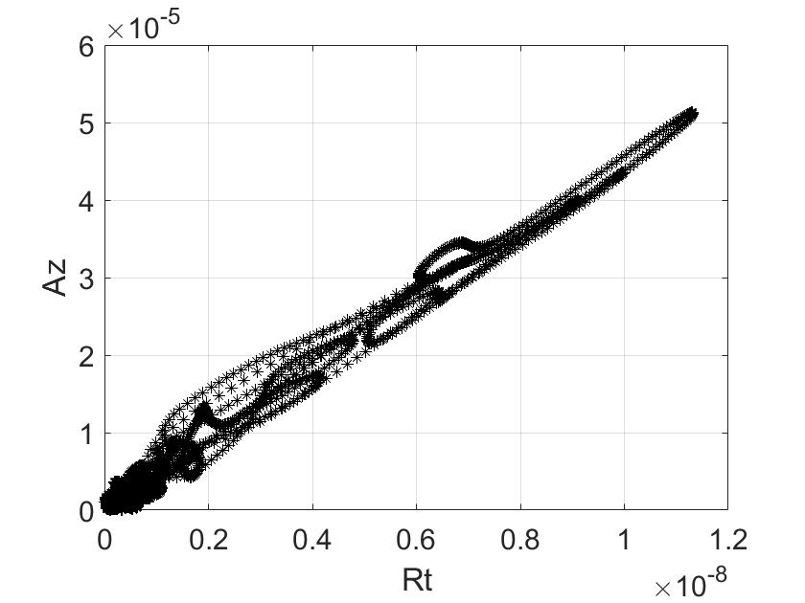
Extract dispersion curves algorithm
45%
70%
90%
(Tang et al., 2022, in preparation)
(10%-90%)

