Slide 1
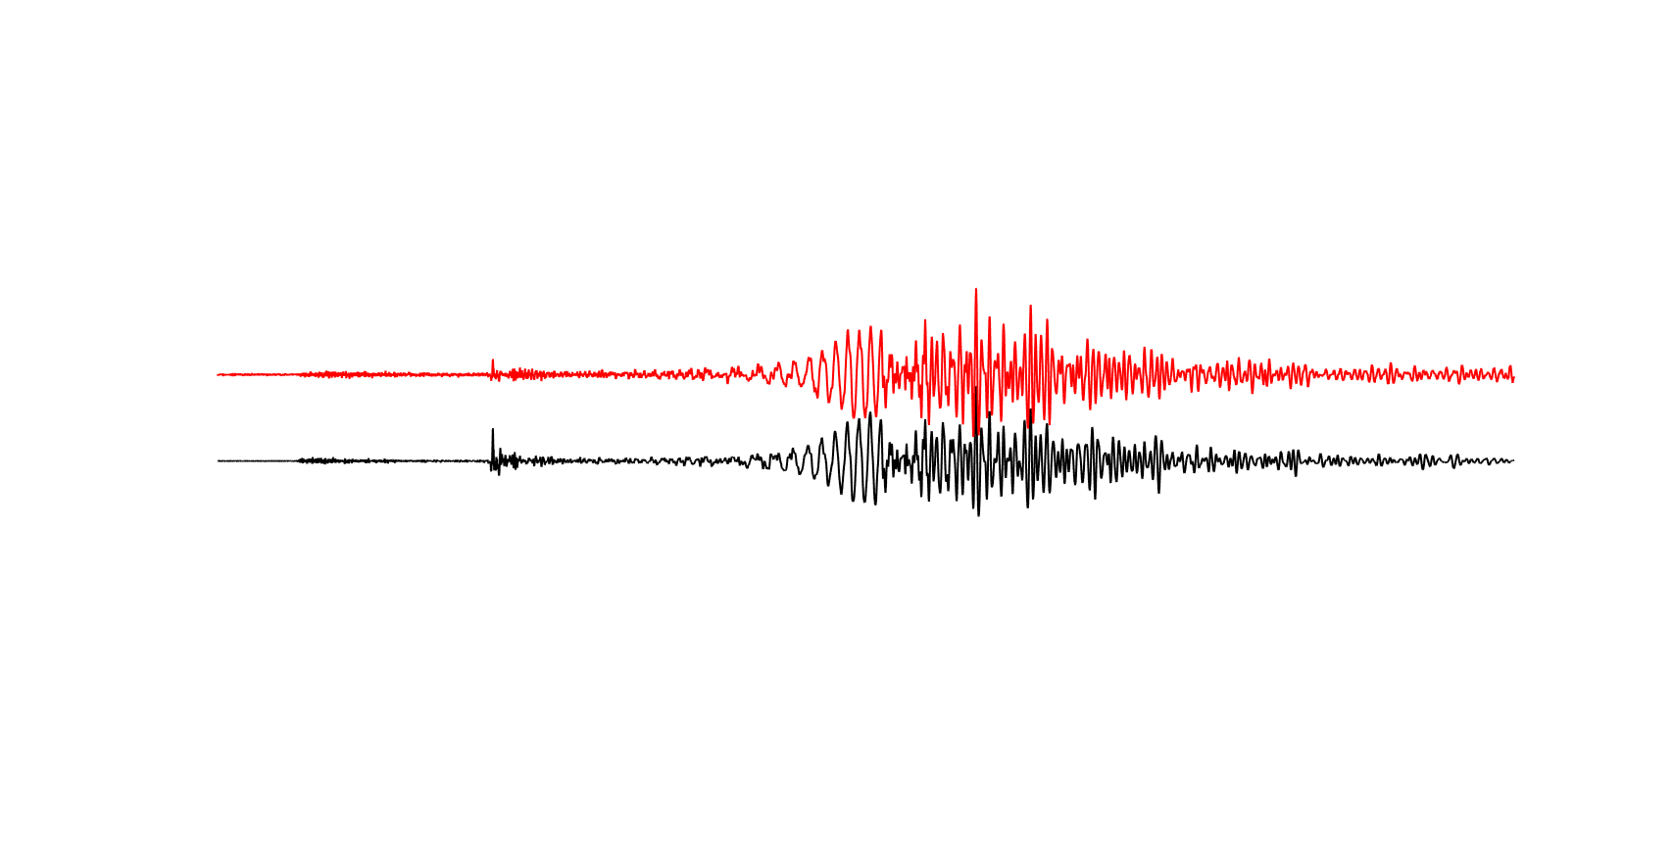

The ROMY project:
ROtational ground Motions: a new observable for seismologY
Werner Bauer, Felix Bernauer¹, Moritz Bernauer¹, Bryant Chow¹, Stefanie Donner¹, Sven Egdorf, Celine Hadziioannou¹, Heiner Igel¹, Chin-Jen Lin¹, Andreas Fichtner², Andre Gebauer^{2,1}, Frederic Guattari⁷, Fabian Lindner¹, Maria-Fernanda Nader-Nieto¹, Michael Reinwald¹, Johannes Salvermoser¹, Karl Ulrich Schreiber², Andrea Simonelli^{6,1}, Toshiro Tanimoto⁵, Frank Vernon⁴, Joachim Wassermann¹, and others
¹ LMU Munich, Germany
² TU Munich, Germany
³ ETH Zurich, Switzerland
ROMY funded
⁴ UCSD, La Jolla, CA
⁵ UC Santa Barbara, CA
⁶University of Pisa, Italy
⁷iXBlue, St. Germain-en-Laye

Slide 2

ROMY - facts
Funded by the European Research Council
Duration (5+1) years, 2014-2020
2.5 million Euro (plus support for ring laser construction by LMU)
12 postdoctocal years
Approx. 1 million for instruments, hardware
Ring laser
Portable sensors
Seismic arrry
Field studies

Slide 3
Current ROMY activities
[Instrumentation]
ring lasers – the ROMY ring (talk Schreiber)
array rotations vs. direct rotations (ROMY)
fibre-optic gyros (talk, poster Bernauer, Guattari)
ocean bottom seismometry (paper Lindner)
[Observations]
ring laser event data base (poster Salvermoser, Chow)
understanding ocean-generated seismic noise (talk Tanimoto, poster Hadziioannou)
array-derived rotation and strain (talk Lin)
[Theory]
earthquake source inversion (poster Donner)
wavefield separation (poster Nakata)
tomography with rotations
[Outlook]

Slide 4
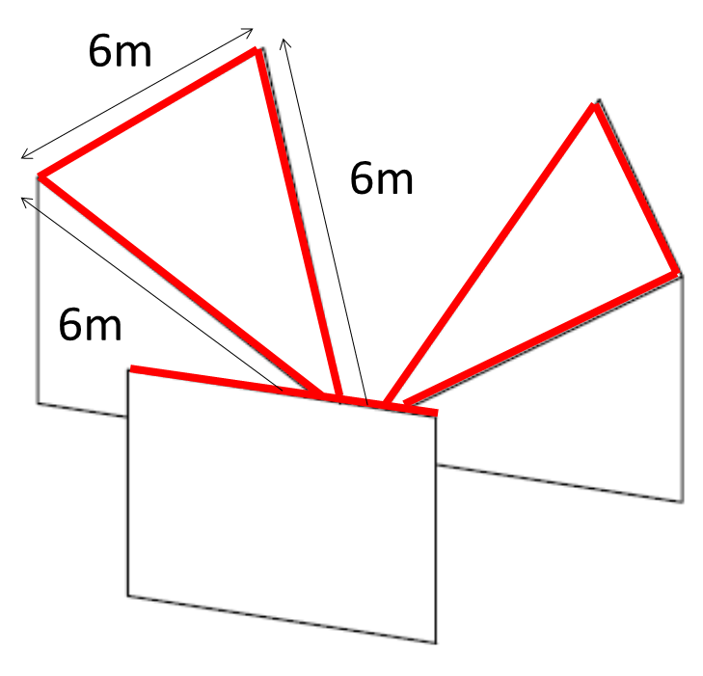
Multi-component ring laser for geodesy and seismology
High resolution >=3-component observations of rotational motions for Earth‘s free oscillations, ocean generated seismic signals, Earth rotation, space geodesy

Slide 5
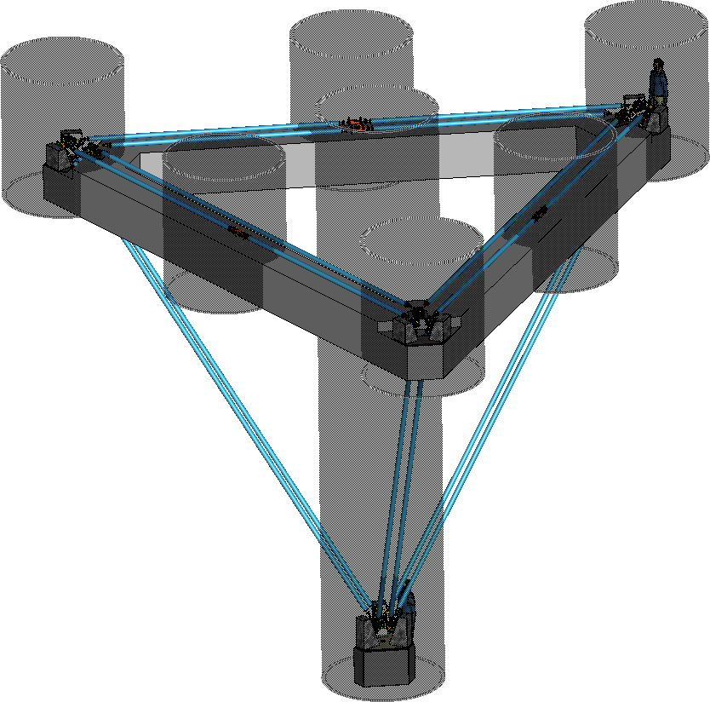
The ROMY ring – the first 4C ring laser
15m

Slide 6
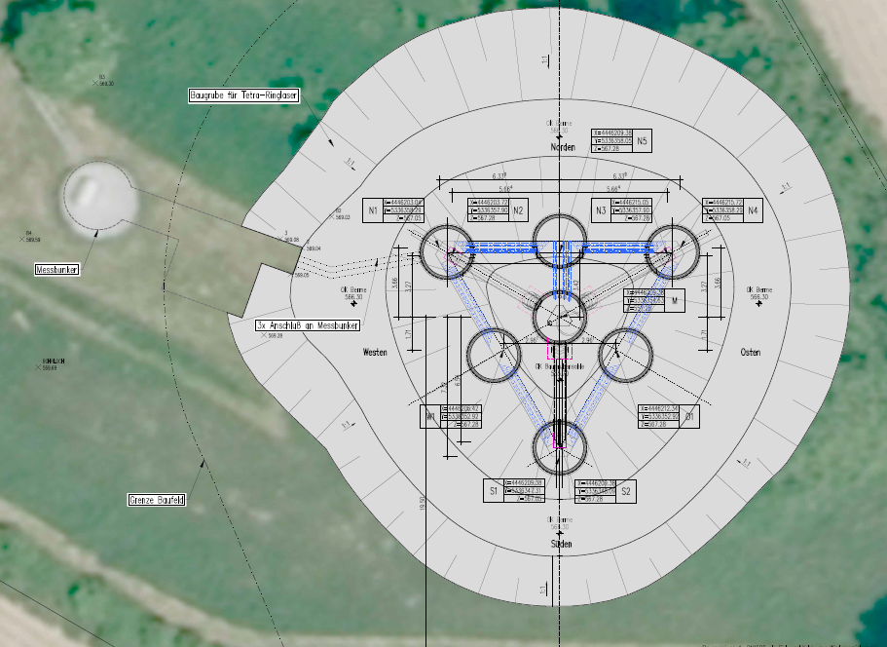
ROMY ring - Construction

Slide 7
Construction - side view

Slide 8
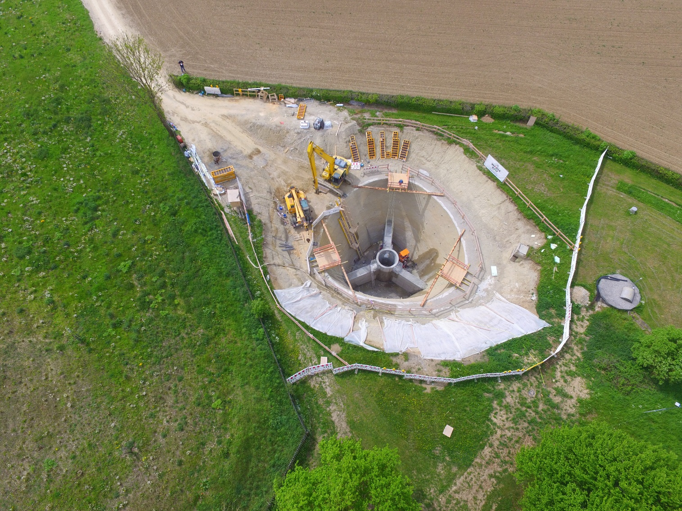

Slide 9
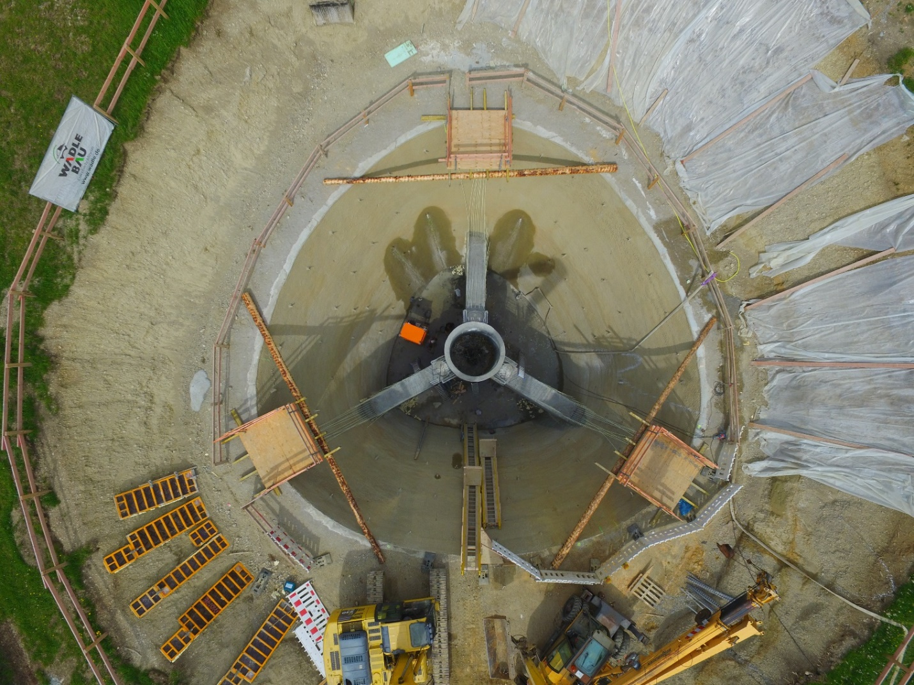
Expected sensitivity
Sagnac frequencies:
RL-horitzontal: 593Hz RL-S1 (az 60° clockwise, dip 70.5°): 448Hz RL-S2 (az 180° clockwise, dip 70.5°): 302Hz RL-S3 (az 300° clockwise, dip 70.5°): 448Hz
Sensitivity:
0.02-0.05 prad/s

Slide 10
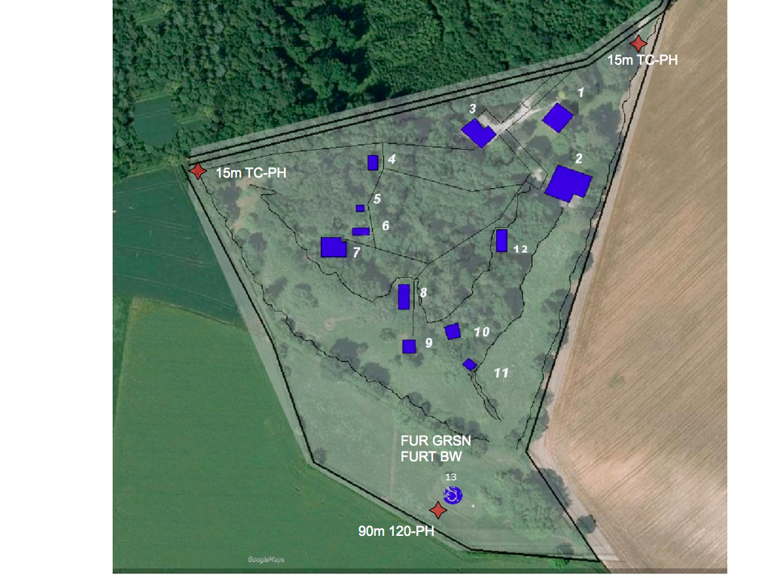
3D – 3C Array Observations

Slide 11
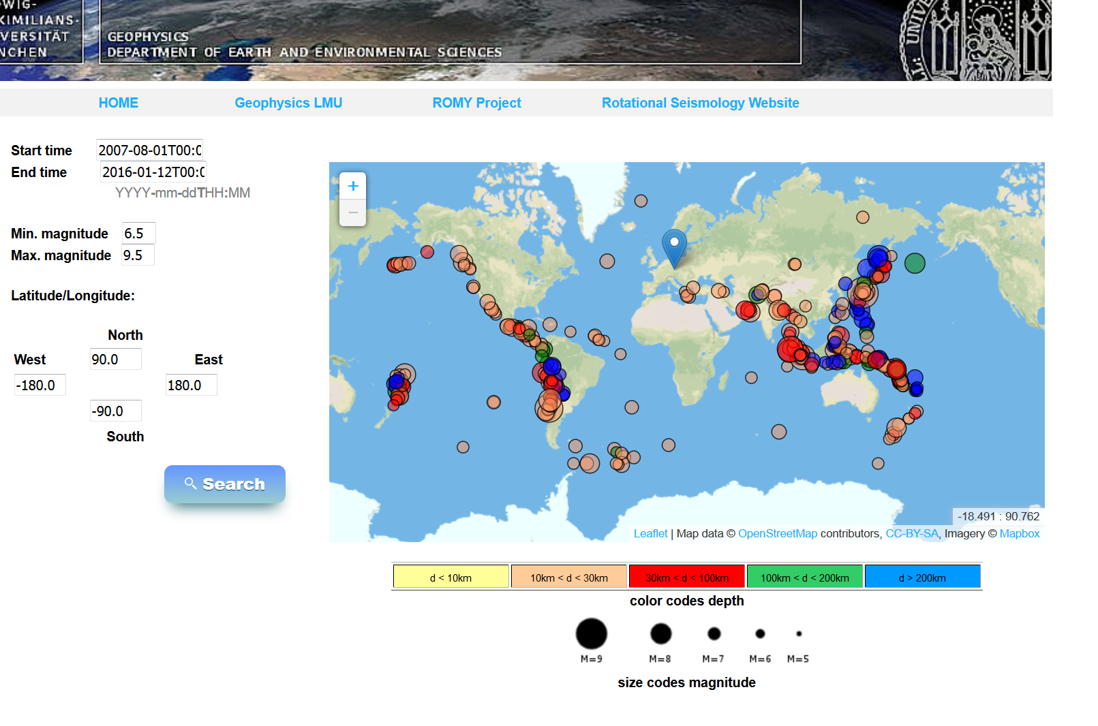
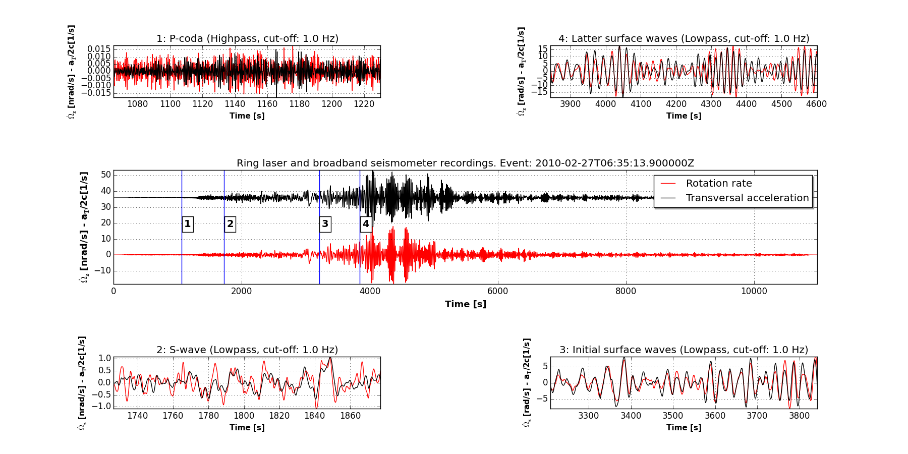
Event Data Base (G-Ring + ROMY)

Slide 12
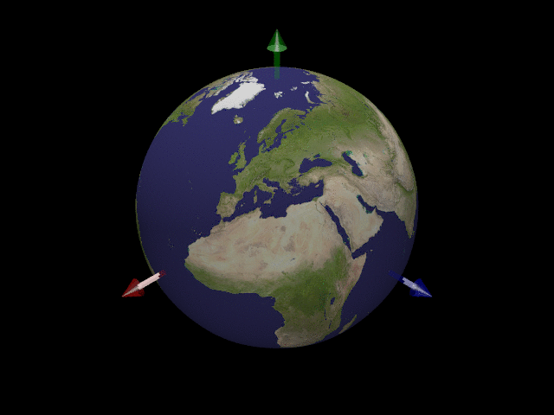
Observations – Earth‘s free oscillations
M9.1. Tohoku-Oki earthquake March 11, 2011
Nader-Nieto et al., 2015

Slide 13
Rotations and ocean bottom observations - the experiment
Experiment site
OBS System
Fiber-optic gyro

Slide 14
Rotations and ocean bottom observations - data

Slide 15
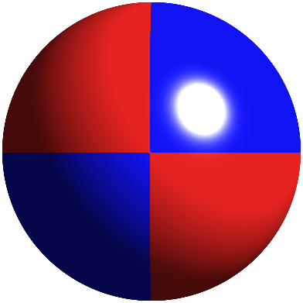
Theory – Earthquake Model Parameters
Finite Source
Point Source
Rupture velocity
Rise time
Static slip
Source location
Moment tensor components

Slide 16
Theory – Point source inversion
Counts
Information gain
N/2 6C stations
N 3C stations
Counts
Information gain
Donner et al., GJI, submitted

Slide 17
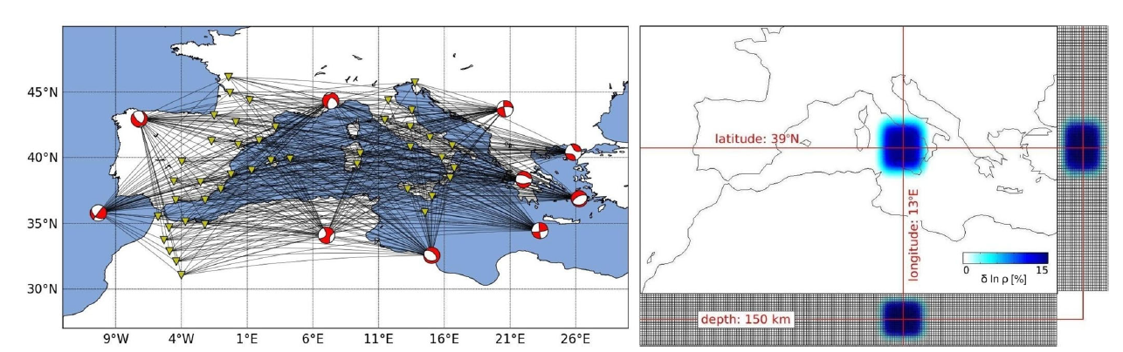
Tomographic inverse problem

Slide 18
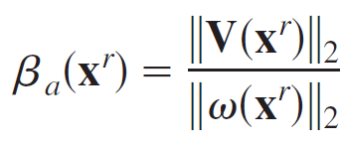
Let s define a new observable…
… and call it apparent shear velocity (the same principle works with translations and strain) …

Slide 19
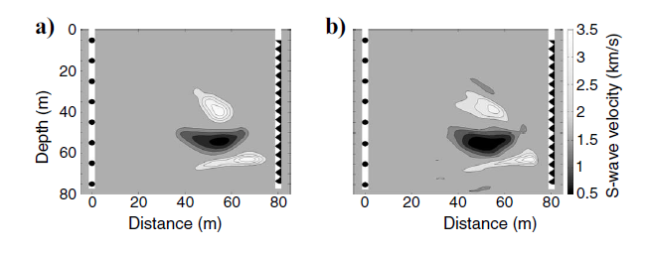
… and calculate sensitivity kernels …
Tomography without travel times!
(Bernauer et al., 2009, 2012,205)
Local sensitivity to structure
below receiver

Slide 20
ROMY Outlook
ROMY construction finished August 2016
ROMY 4 ring laser components operational … sometime after
Realtime data aquisition and display (translations, direct rotations, array-derived rotation, strain)
Cross-correlation of rotational motions (G-Ring - ROMY)
Analysis of free oscillations, ocean-generated noise, earthquakes etc etc
Prototype Blueseis September 2016
Labtests, field tests (volcano, near field, active seismology, etc)
OBS prototype with 6C -> ocean noise model
Blueseis pool of sensors -> extensive field studies
Papers, more info on www.romy-erc-eu

