Slide 1
10 components of waveform at Pinon Flat Observatory (PFO), California
LMU (Ludwig-Maximilians-University Munich, Germany)
Chin-Jen Lin, Joachim Wassermann, André Gebauer,
Stefanie Donner, Celine Hadziioannou, Heiner Igel
TUM (Technical University Munich, Germany)
Ulrich Schreiber
SCRIPPS (Institution of Oceanography, La Jolla, CA)
Frank Vernon, Duncan Carr Agnew

Slide 2
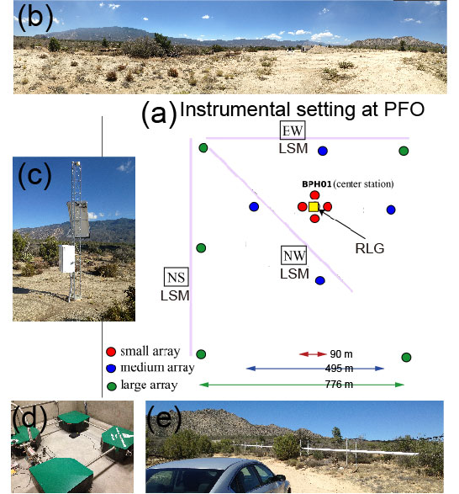
Instruments at PFO
Thirteen broadband seismic stations (c)
+
Vertical ring-laser rotation sensor (d)
+
Three surface laser strainmeters (e)
Array-derivation vs. direct observation
(Teleseismic) Joint analysis of translation and rotation/strain
(Microseismic) Joint analysis vs. F-K methods
Back-azimuth

Slide 3
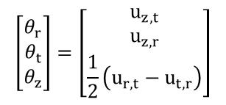


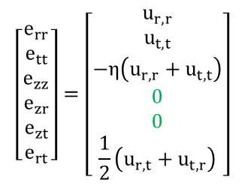
Array spatial calculation
Suffer to the condition of zero traction at the free-surface …
$$u_{z,t}=−u_{t,z}$$
$$u_{z,r}=−u_{r,z}$$
Rotation vector (3 components)
$$\left[\begin{matrix}θ_{r} \\ θ_{t} \\ θ_{z}\end{matrix}\right]=\left[\begin{matrix}u_{z,t} \\ u_{z,r} \\ \frac{1}{2}\left(u_{r,t}−u_{t,r}\right)\end{matrix}\right]$$
Strain Tensor (4 components)
$$\left[\begin{matrix}e_{rr} \\ e_{tt} \\ e_{zz} \\ e_{zr} \\ e_{zt} \\ e_{rt}\end{matrix}\right]=\left[\begin{matrix}u_{r,r} \\ u_{t,t} \\ −η\left(u_{r,r}+u_{t,t}\right) \\ 0 \\ 0 \\ \frac{1}{2}\left(u_{r,t}+u_{t,r}\right)\end{matrix}\right]$$
assuming plane wave propagation
courtesy of Heiner Igel
All observable components on the ground are 10
[Spudich et al., 1995]

Slide 4
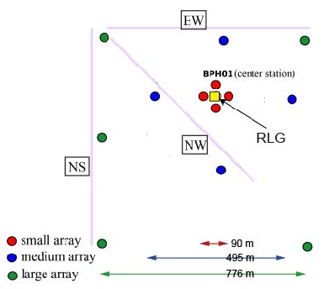
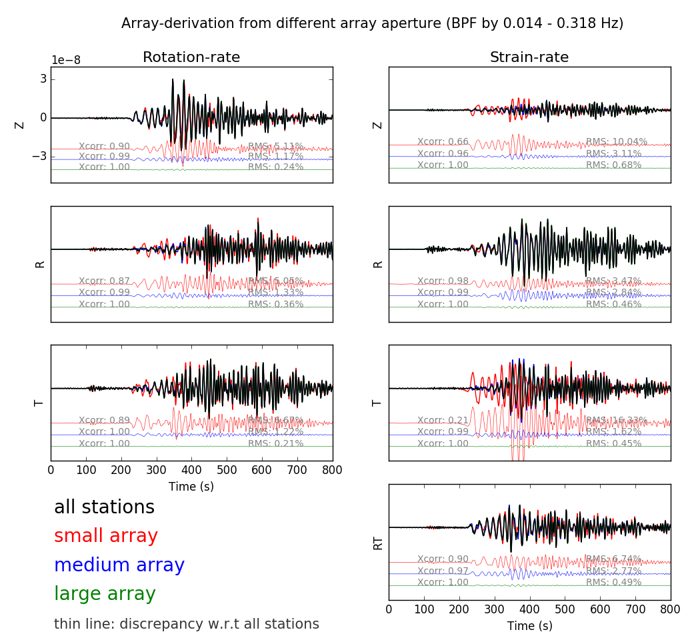
Array-derived rotation/strain
results
discrepancies
Smaller array are prone to error. why?

Slide 5
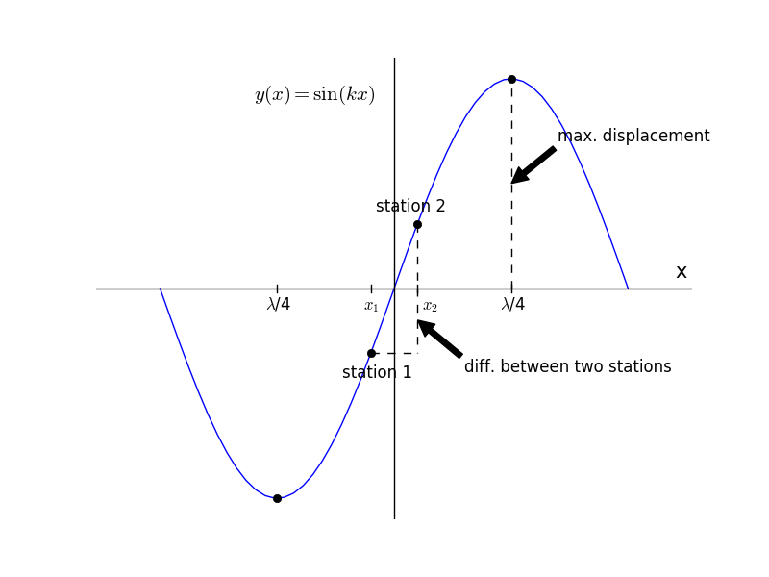



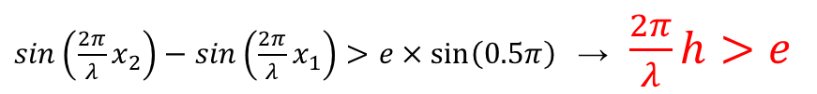

Limitation of array-derivation
…as small as possible…
… cannot be too close…
keep uniform strain
prevent unreliable result due to measurement uncertainty
P. Spudich (1995)
aperture
$$h<\frac{1}{4}λ$$
aperture
$$h>\frac{λ}{2π}e$$
wavelength
$$λ$$
wavelength
$$λ$$
measurement uncertainty
$\sin\left(\frac{2π}{λ}x_{2}\right)−\sin\left(\frac{2π}{λ}x_{1}\right)>e×\sin\left(0.5π\right)$ →$\frac{2π}{λ}h$ $>e$

Slide 6
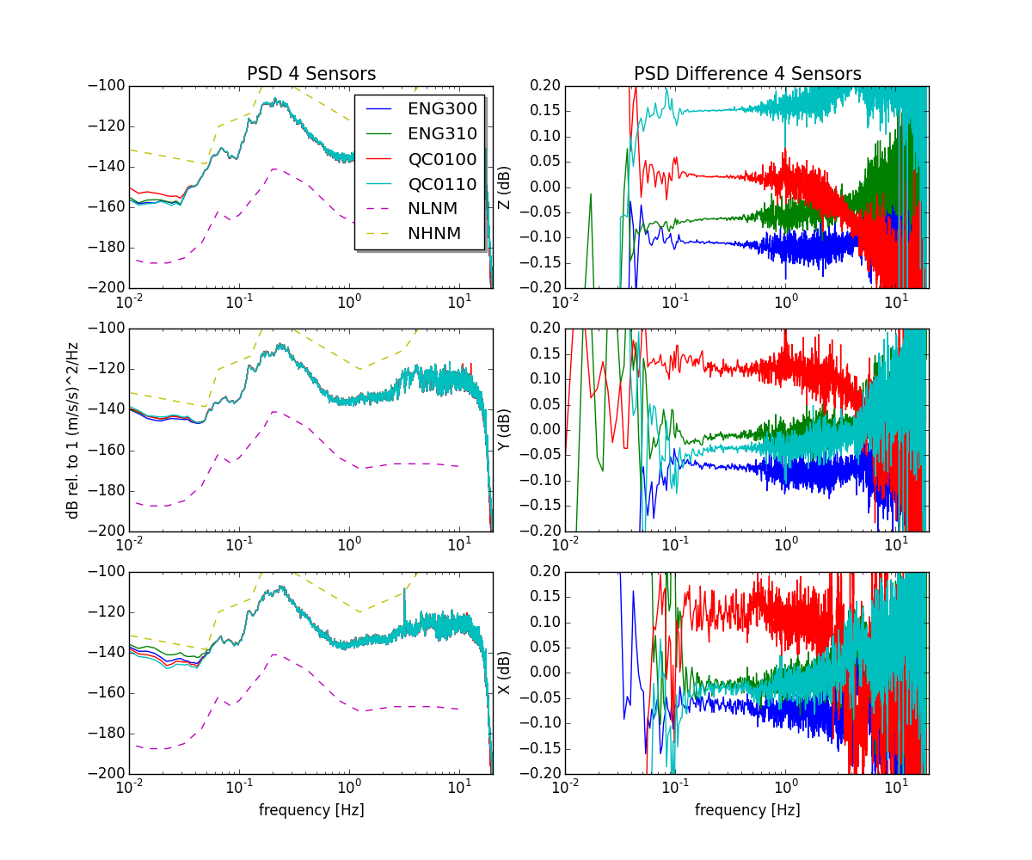
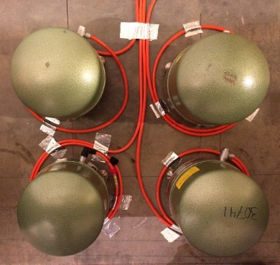
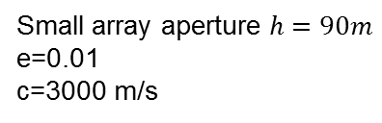
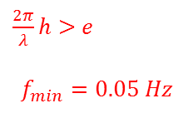
Measurement uncertainty
4 co-located STS-2 seismometers
Z
+1 % uncertainty
Y
Small array aperture $h=90m$
e=0.01
c=3000 m/s
X
$\frac{2π}{λ}h$ $>e$
$$f_{min}=0.05 Hz$$

Slide 7
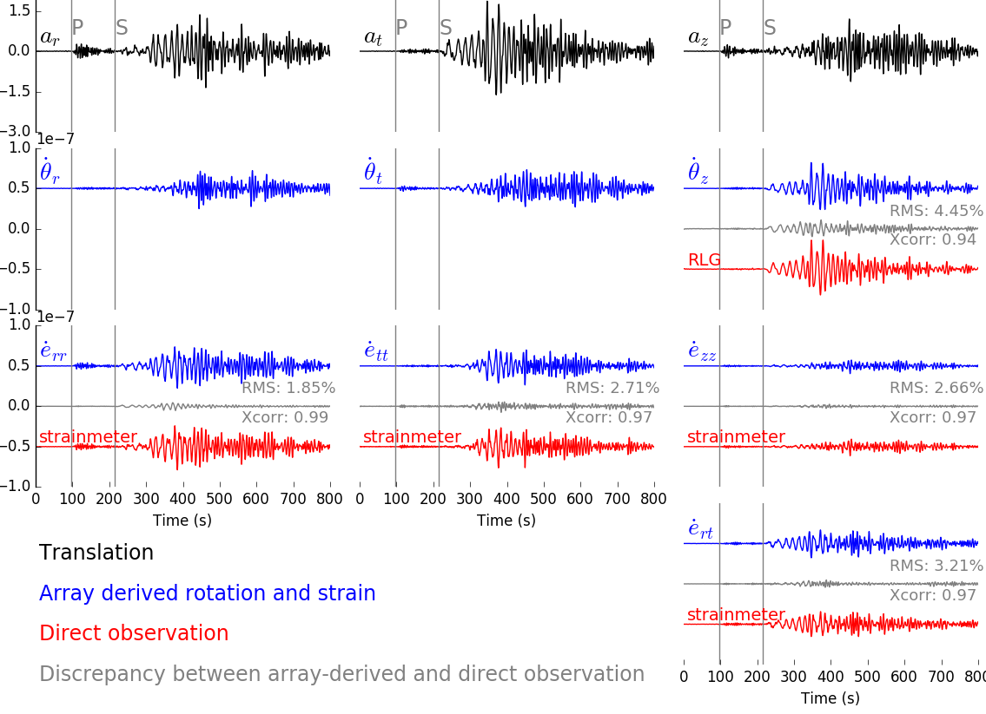
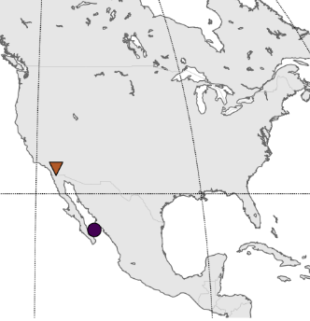
10 components of waveform (f = 0.014 – 0.318 Hz)
radial
transverse
vertical
acceleration
rotation
Strain are matched better than vertical rotation. why ?
strain
PFO
Eq.

Slide 8
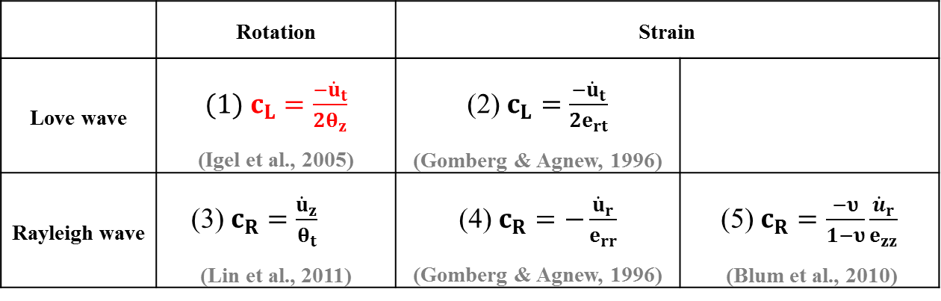

Assuming plane wave propagation …
Vertical rotation
$$\frac{a_{T}\left(ω\right)}{2{\dot{θ}}_{Z}\left(ω\right)}=c\left(ω\right)$$
Transverse acceleration
Heiner Igel, Ulrich Schreiber, et.al. (2005)
 | Rotation | Strain
Love wave | $(1) c_{L}=\frac{−{\dot{u}}_{t}}{{2θ}_{z}}$ (Igel et al., 2005) | (2) $c_{L}=\frac{−{\dot{u}}_{t}}{{2e}_{rt}}$ (Gomberg & Agnew, 1996)
Rayleigh wave | (3) $c_{R}=\frac{{\dot{u}}_{z}}{θ_{t}}$ (Lin et al., 2011) | (4) $c_{R}=−\frac{{\dot{u}}_{r}}{e_{rr}}$ (Gomberg & Agnew, 1996) | (5) $c_{R}=\frac{−υ}{1−υ}\frac{{\dot{u}}_{r}}{e_{zz}}$ (Blum et al., 2010)

Slide 9
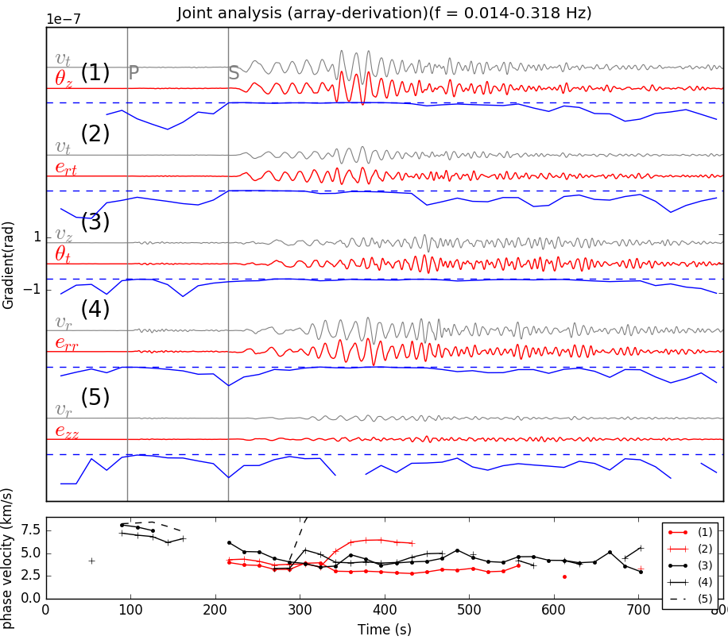
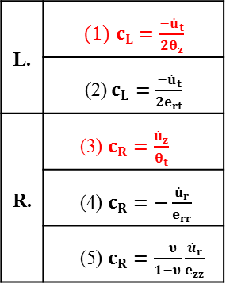
Teleseismic event
Xcorr.
Vertical rotation
horizontal rotation
Assuming plane wave propagation …
L. | $(1) c_{L}=\frac{−{\dot{u}}_{t}}{{2θ}_{z}}$
 | (2) $c_{L}=\frac{−{\dot{u}}_{t}}{{2e}_{rt}}$
R. | (3) $c_{R}=\frac{{\dot{u}}_{z}}{θ_{t}}$
 | (4) $c_{R}=−\frac{{\dot{u}}_{r}}{e_{rr}}$
 | (5) $c_{R}=\frac{−υ}{1−υ}\frac{{\dot{u}}_{r}}{e_{zz}}$
Phase velocity

Slide 10
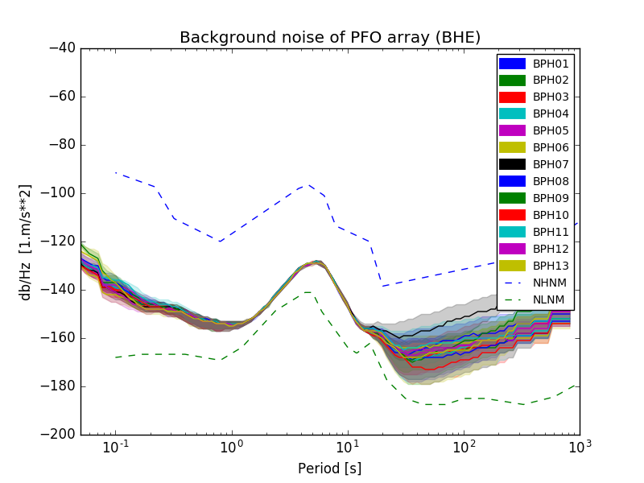
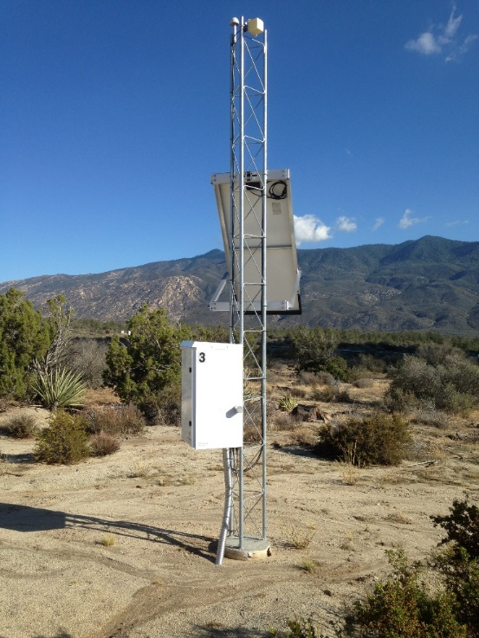
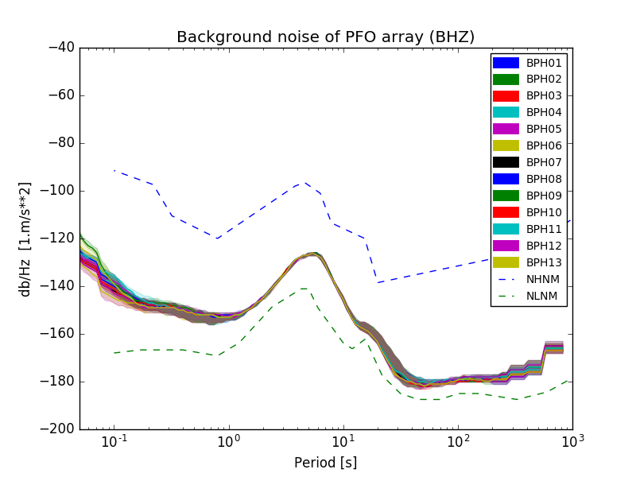
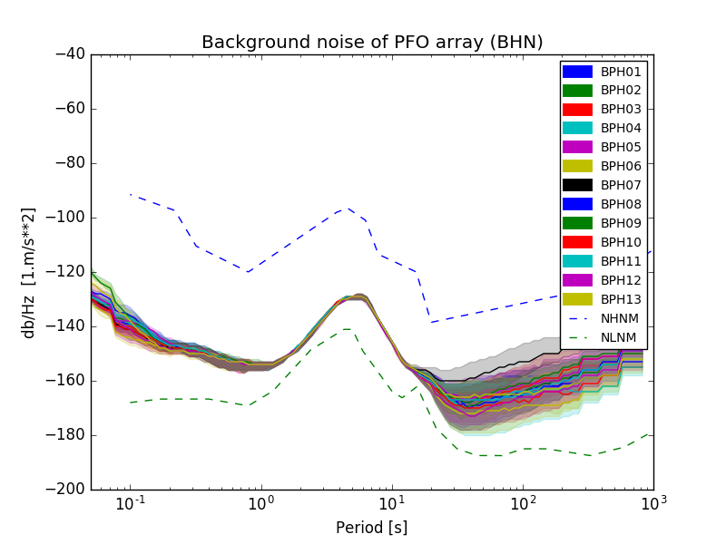
Background noise
PFO
E
seismograms
seismic station at PFO
Z
N
Seismometers are installed at depth of 2-3 m

Slide 11
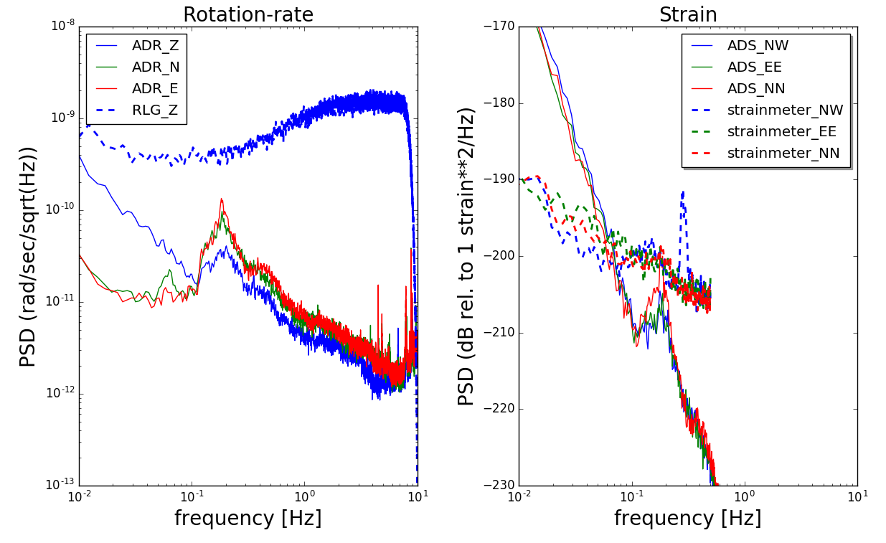
Background noise
PFO
rotation
strain
GEOSensor
(1.6*1.6 m²)
LSM
(732 m)
Array-derived strain
Array-derived rotation

Slide 12
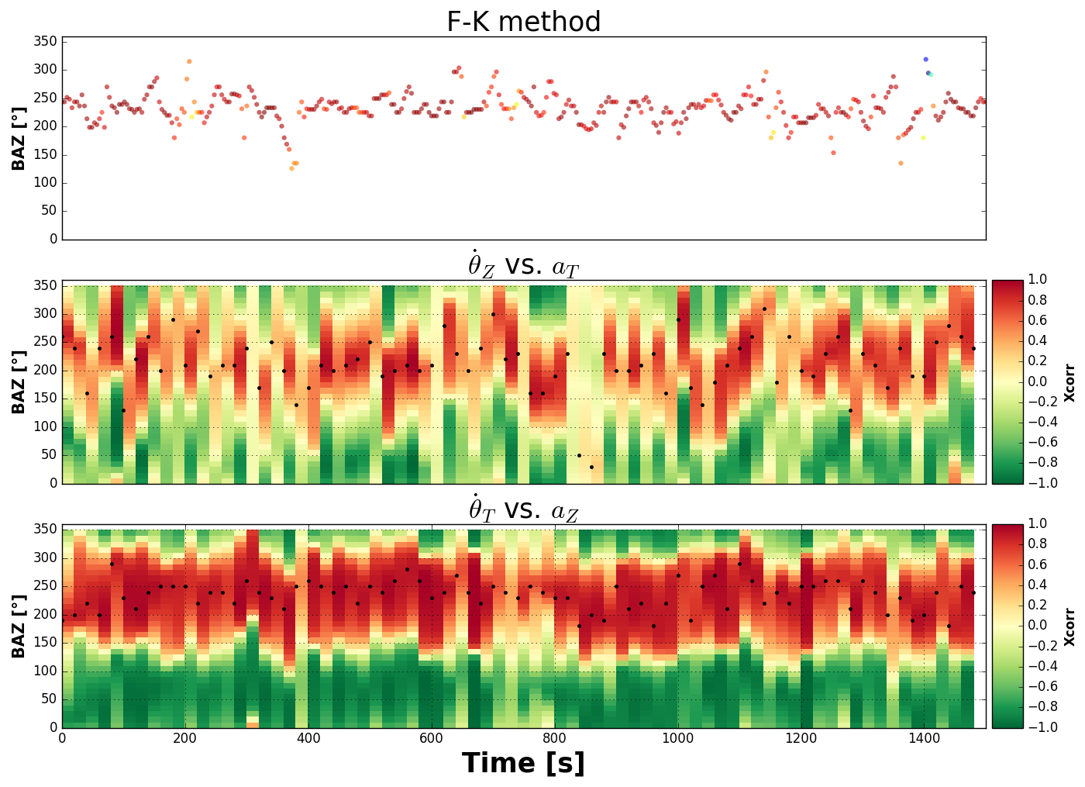
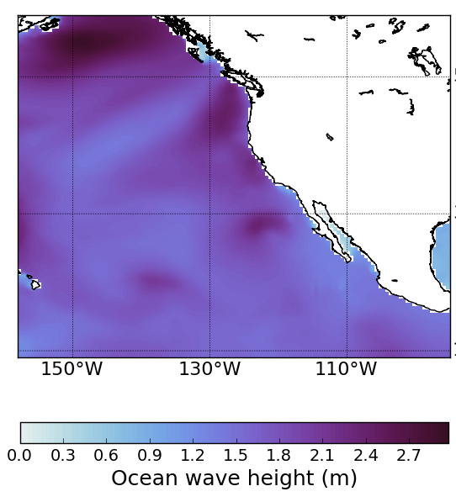


Microseismic signal (f=0.1~0.3 Hz)
~ R. wave (F-K)
240º
PFO
~ L. wave (${\dot{θ}}_{z}$)
240º
~ R. wave (${\dot{θ}}_{h}$)
240º
Courtesy of C. Juretzek
orientation

Slide 13
Conclusions
Array-derived rotation vs. point measurement
The result is slightly different due to effect of measurement scale
Assuming plane wave propagation
Translations can be scaled to the rotation/strain
Derived apparent velocities, from rotation and strain, are consistent.
Microseismic signal
Back-azimuth of the source determined by three methods are consistent.

Slide 14

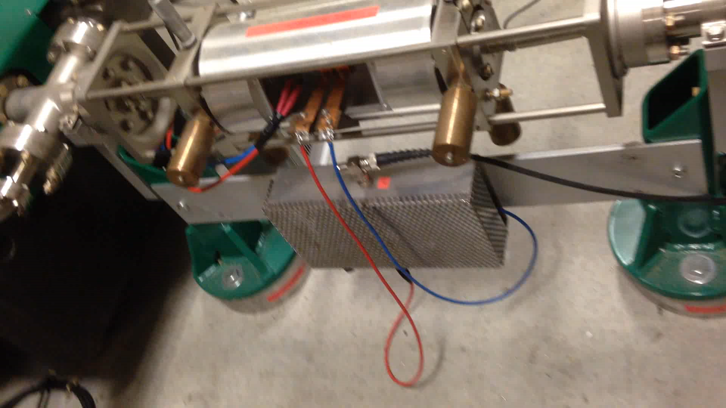
Acknowledgement
Ulrich Schreiber
André Gebauer
Joachim Wassermann

