Slide 1
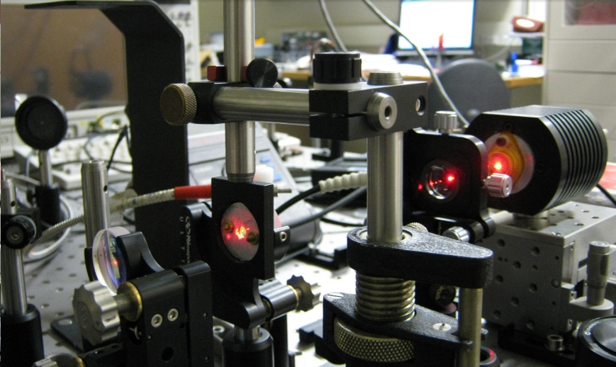
Rotation Sensing with Lasers
Jon-Paul Wells, Ulrich Schreiber (and many others)
Department of Physics & Astronomy

Slide 2
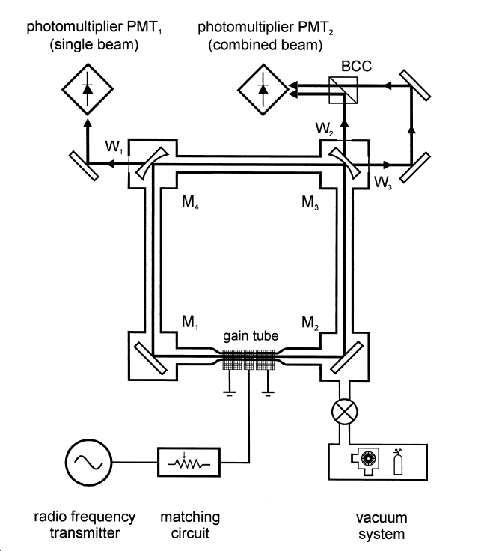
Bi-Directional Ring Lasers
Sensitivity to (for example) Earth
rotation, described by the
instantaneous angular velocity
vector Ω, is given by the Sagnac
frequency, which can be observed
as the frequency difference
between two counter rotating
laser beams:
with
A area enclosed by the laser beam
n normal vector of A
P perimeter
λ optical wavelength

Slide 3
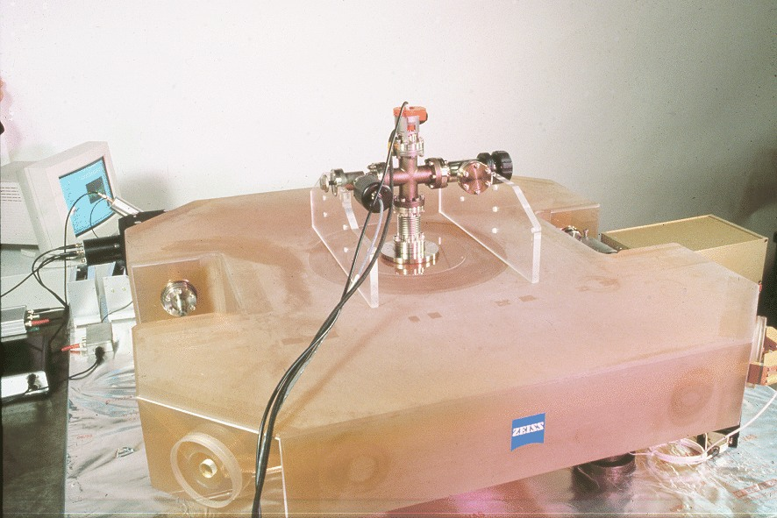
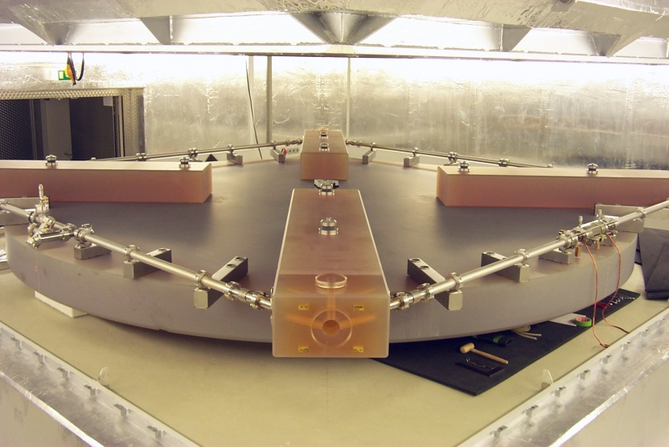
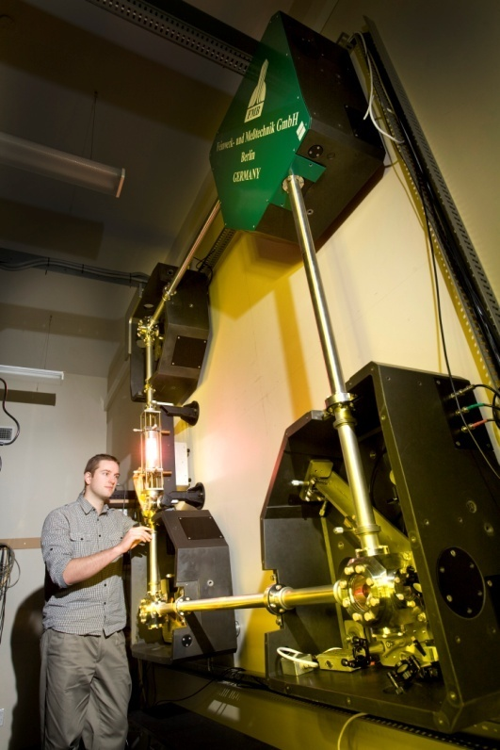
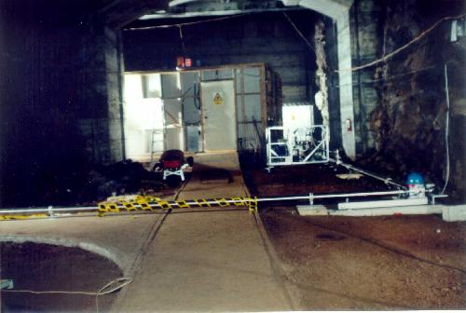
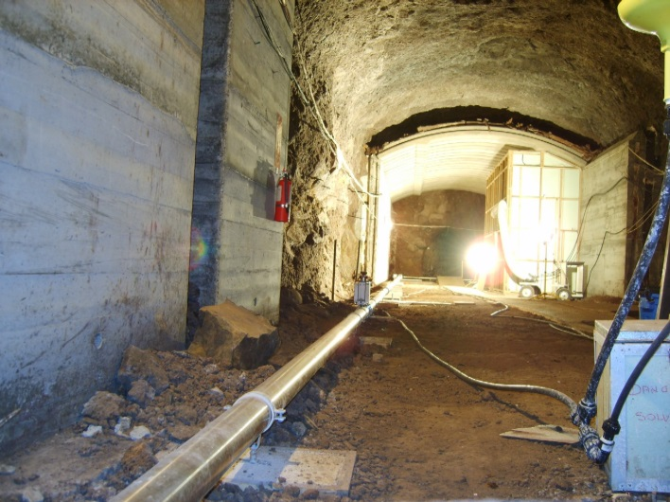
Bi-Directional Ring Lasers
G
C-II
GEO Sensor
UG-1
UG-2
Six orders of magnitude increase in sensitivity in 25 years

Slide 4
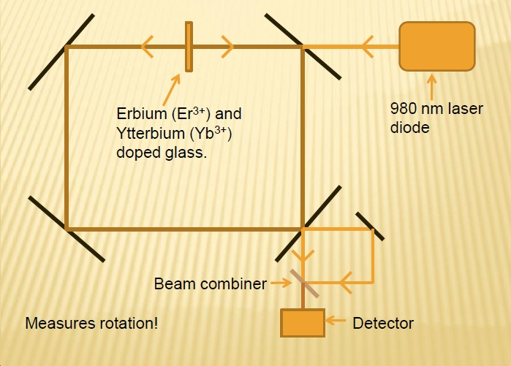
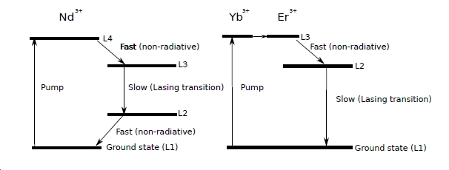
Different Concept: All Solid State Sensors
Replace the gain medium for a high gain, condensed phase alternative.
We have used phosphate glass doped with (optically active) lanthanide ions.

Slide 5
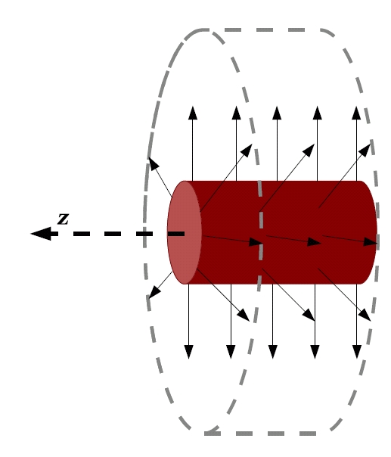
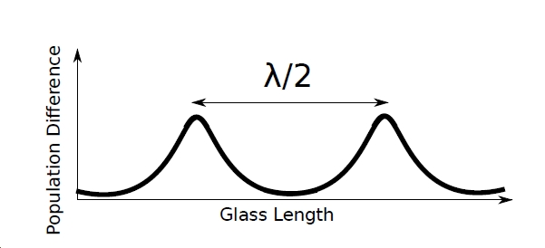
Different Concept: The Hitch…
In a static, solid state material the counter propagating travelling waves induce a gain grating.
From this both beams can strongly interact, leading to intensity oscillation or even uni-directional lasing

Slide 6
Contrast with Helium-Neon
He
Ne
Collision
2¹S
3s
3p
Collision
632.8 nm
621.0 nm
2³S
2s
Energy
594.1 nm
543.3 nm
2p
Pumping by electron collision
Non-radiative
transition
1s
Discharge tube
collision
Base State

Slide 7
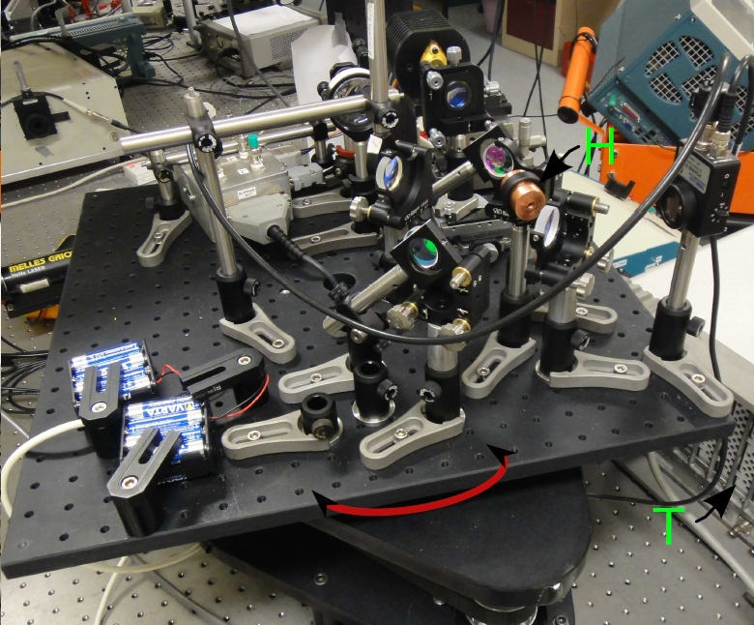
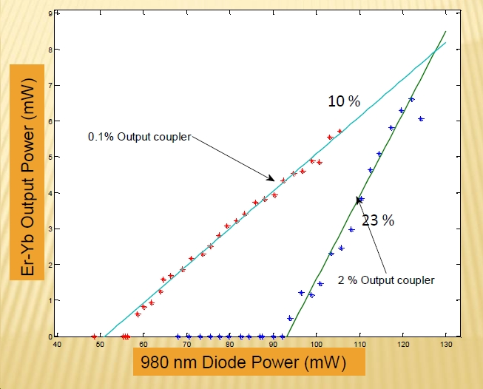
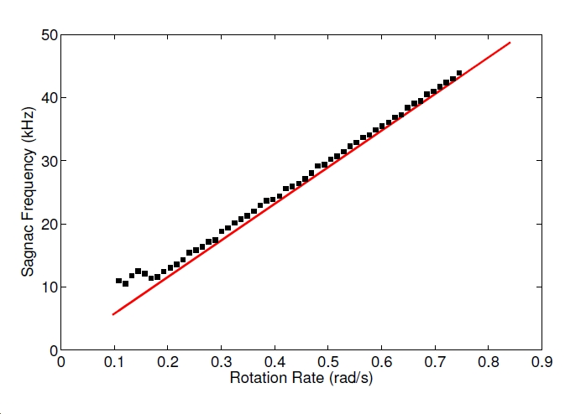
Free Space Ring.
Phosphate glass: Er/Yb
Laser wavelength 1.53 micron
Lasing threshold 50 mW.

Slide 8
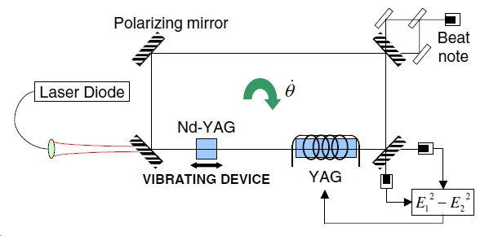
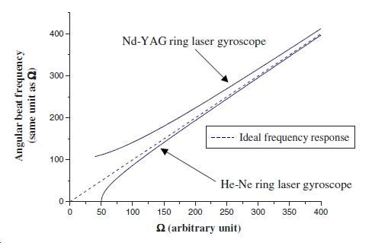
Earlier Work used YAG:Nd

Slide 9
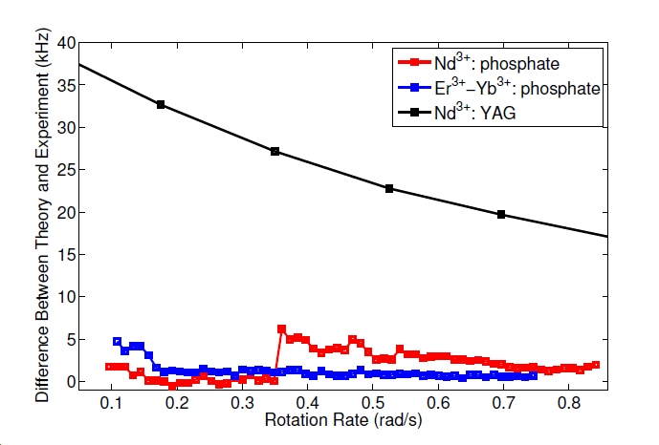
Comparison: YAG vs Phosphate Glass

Slide 10
Return to the Helium-Neon system
He
Ne
Collision
2¹S
3s
3p
Collision
632.8 nm
621.0 nm
2³S
2s
Energy
594.1 nm
543.3 nm
2p
Pumping by electron collision
Non-radiative
transition
1s
Discharge tube
collision
Base State

Slide 11
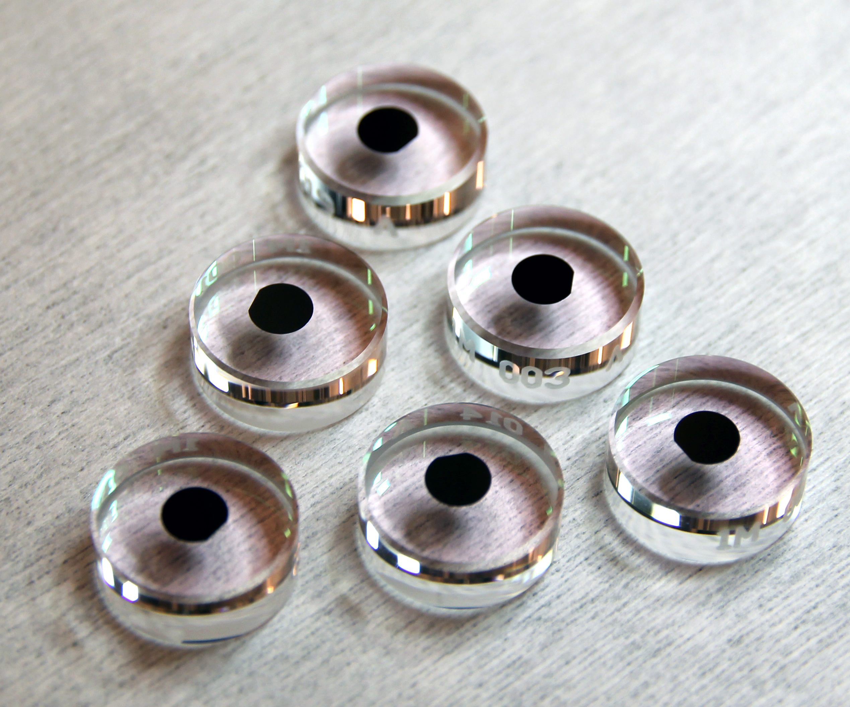
Infrared Operation of a He-Ne Gyroscope
Crystalline coating mirrors (AlGaAs)
Gain medium is a 50:50 mix of ²⁰Ne and ²²Ne
⁴He added to quench the 2s4→2p7 transition
cavity Q of 3.2×10¹⁰

Slide 12
Infrared Operation of a He-Ne Gyroscope

Slide 13
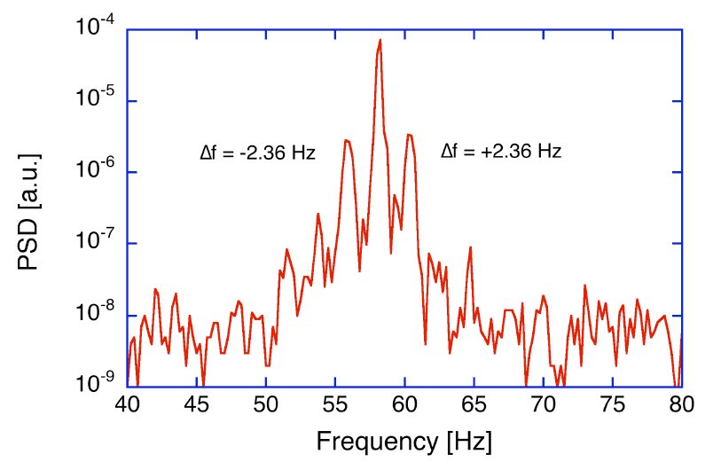
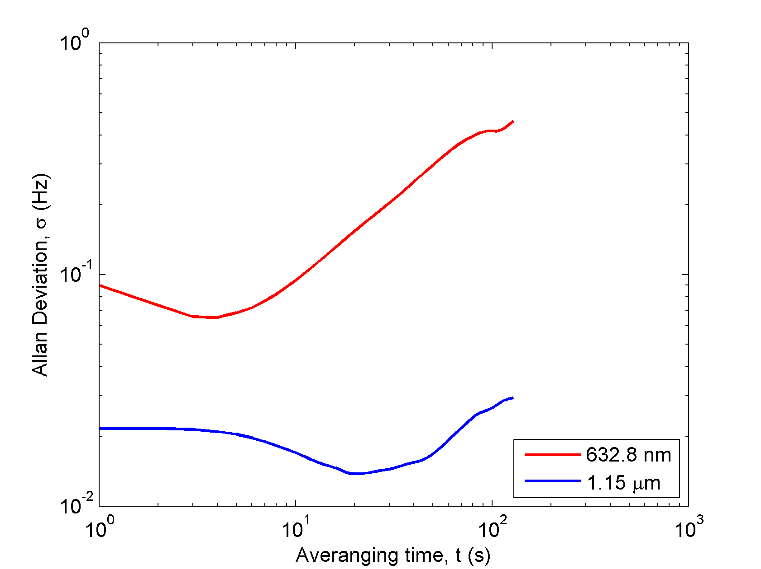
Infrared Operation of a He-Ne Gyroscope
First 1.15 micron gyroscope to unlock on the bias provided by Earth rotation alone.
In a comprised environment, it seems to out perform operation at 633 nm.

Slide 14
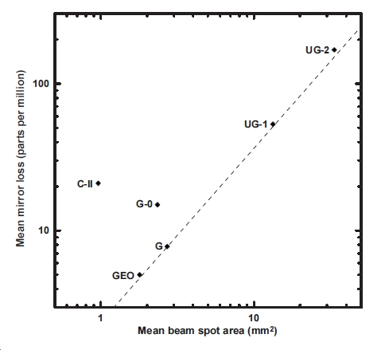
Why Not Go Further? Go Green… its trendy
Why use the 632.8 nm transition at all?
Operation at 543.3 nm gives an automatic 17% increase in scale factor, 10% reduction in optical footprint.
The cavity Q increases by 17% as
$$Q=2πf_{0}τ$$
543.5 nm Green 3s₂->2p₁₀ 0.52
632.8 nm Red 3s₂->2p₄ 10.0
3,391.3 nm Mid-IR 3s₂->3p₄ 440.0

Slide 15
Conclusions
Portable Sensors: Solid state gyros can run on less than a watt, but need development. However there is a road map.
Big Rings: Ring laser gyroscopes have improved in overall usable sensitivity by around six orders of magnitude in 25 years.
So what is left in the toolbox?
I suggest we are close to the limits of what operation at 632.8 nm can do for us…

Slide 16
Thanks to the ‘many others’
Dr Robert Hurst
Dr Nishanthan Rabeendran
Ms Caroline Anyi
Mr Robert Thirkettle
Dr Andre Gebauer
Mr Marinus Meyerbacher

