Slide 1


Microseismic event localization using both wavefields and their spatial gradients
Zhenhua Li* and Mirko van der Baan
University of Alberta

Slide 2
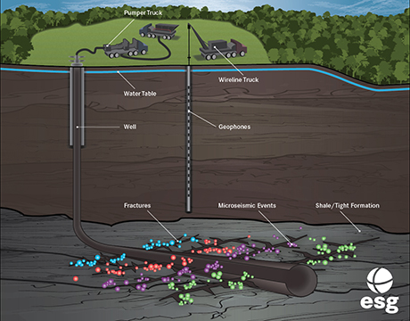
Microseismic monitoring
Microseismicity :
1. Human-activity related
(mining, oil/gas production)
2. Very small magnitude
(smaller than 0)
3. Indication of fracture development
(accurate determination of
microseismic event locations)
Color coding: hydraulic fracture stages

Slide 3
Microseismic event localization
Ray-based method :
P- and S-wave first arrival picking
Polarization analysis for all the pickings
(incident direction)
3. Travel time inversion based methods
Advantages:
Fast algorithms
Less computation requirement
Drawbacks:
Picking errors from miss-picking and inaccurate picking
Manual picking can be very time-consuming (especially for surface array)
High frequency approximation is seriously affected by medium velocity errors
P
S
Example of surface array microseismic record

Slide 4
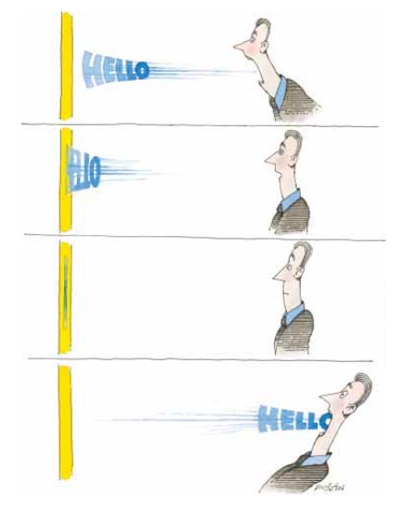
Microseismic event localization
What will happen if you shout to the wall
Fink, 1999

Slide 5
Microseismic event localization
Forward
Time-reversal
seismic source
Estimated source
Reverse-time-extrapolation (RTE) based method :
Injecting full 3C elastic recordings into the estimated medium
Focusing criterion (where and when)
Advantages:
No picking needed
Stacking increases image signal-to-noise ratio
Simple algorithm
Limitations:
Relatively accurate velocity
Computationally intensive (Parallel computing)
May introduce artifacts for vertical borehole recordings for traditional RTE based method

Slide 6
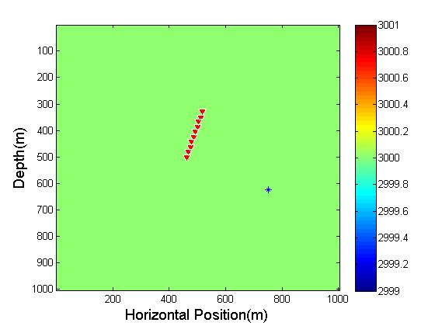
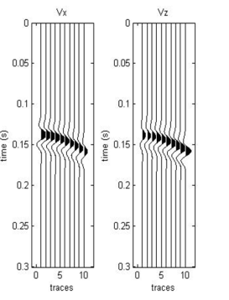
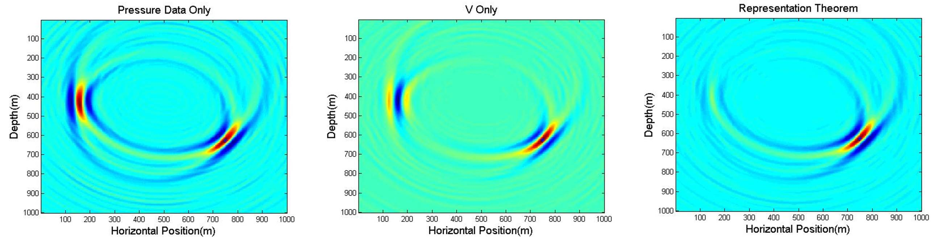
Example - Homogeneous acoustic model with noiseless data
3C receivers
Explosive point source
Ghost focus
We want to
Keep advantages of RET based methods
Remove ghost focus
How?
By combining both wavefields and their spatial gradients

Slide 7
How?
wavefield
Spatial gradient
Acoustic
hydrophone
3-component geophone
The acoustic/elastic representation theorem
Elastic
3-component geophone
3-component rotational sensor

Slide 8








The body force equivalence of seismic source
$$𝔻$$
$$𝔻$$
$$S^{}$$
$$S^{}$$
$$r$$
$$r$$
$$∂𝔻$$
$$∂𝔻$$
Spatial gradient of the wavefield
Wavefield
(Aki and Richards, 2002, chapter 3, eq. 3.3)

Slide 9









2D acoustic reverse time extrapolation
$$𝔻$$
$$𝔻$$
$$S^{A}$$
$$S^{A}$$
$$r$$
$$r$$
$$r^{B}$$
$$r^{B}$$
$$∂𝔻$$
$$∂𝔻$$
Pressure wavefield back-propagation image
3C particle velocity/displacement back-propagation image

Slide 10
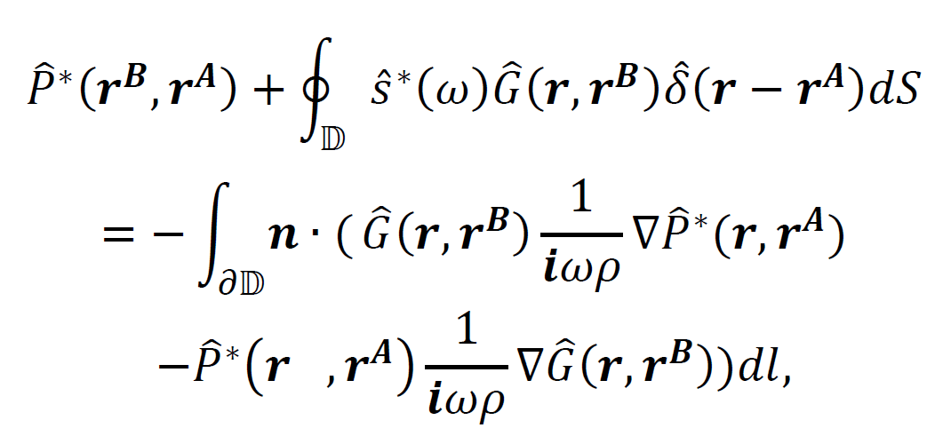
2D acoustic reverse time extrapolation
Back-propagated pressure wavefield
Acoustic Sink
Measured pressure field
Measured particle displacement/velocity

Slide 11








2D elastic reverse time extrapolation
$$𝔻$$
$$𝔻$$
$$r^{A}$$
$$r^{A}$$
$$r$$
$$r$$
$$r^{B}$$
$$r^{B}$$
$$∂𝔻$$
$$∂𝔻$$
3C particle velocity/displacement back-propagation image
3C rotational wavefield back-propagation image

Slide 12
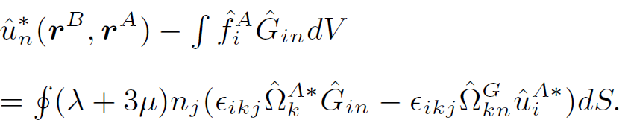
2D elastic reverse time extrapolation
Reconstructed backpropagation translational wavefield
Sink
Measured Rotational motion with translational Green’s function
Measured translational motion with rotational Green’s function
The first time we involve rotational signal in reverse-time extrapolation

Slide 13
Focusing criterion (2D)
The Hough transform （HT）
Shape detection (Circle)
Value Accumulation
Original image
The Hough image

Slide 14



Focusing criterion (2D)
Z
X
Z
Z
X
t
X
$$t_{0}$$
t
$$t_{0 }—dt$$
$$t_{0}+dt$$
Summation image
t

Slide 15
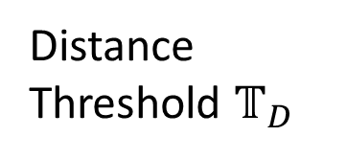
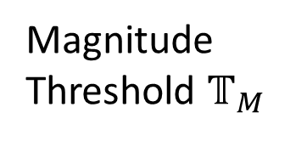
Focusing criterion (2D)
Maxima on each summation image
Spatial Coordinates (X,Z)
Summation Magnitude
Corresponding Time
Minimum distance to receivers
Estimated microseismic event
Distance
Threshold $𝕋_{D}$
Event location
origin Time
Magnitude
Threshold $𝕋_{M}$

Slide 16
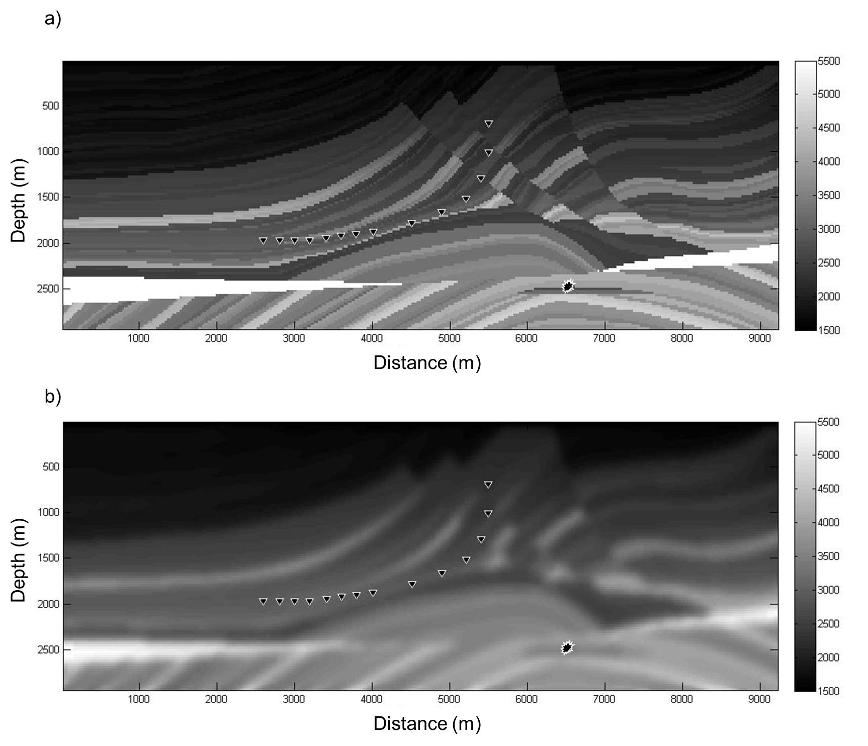
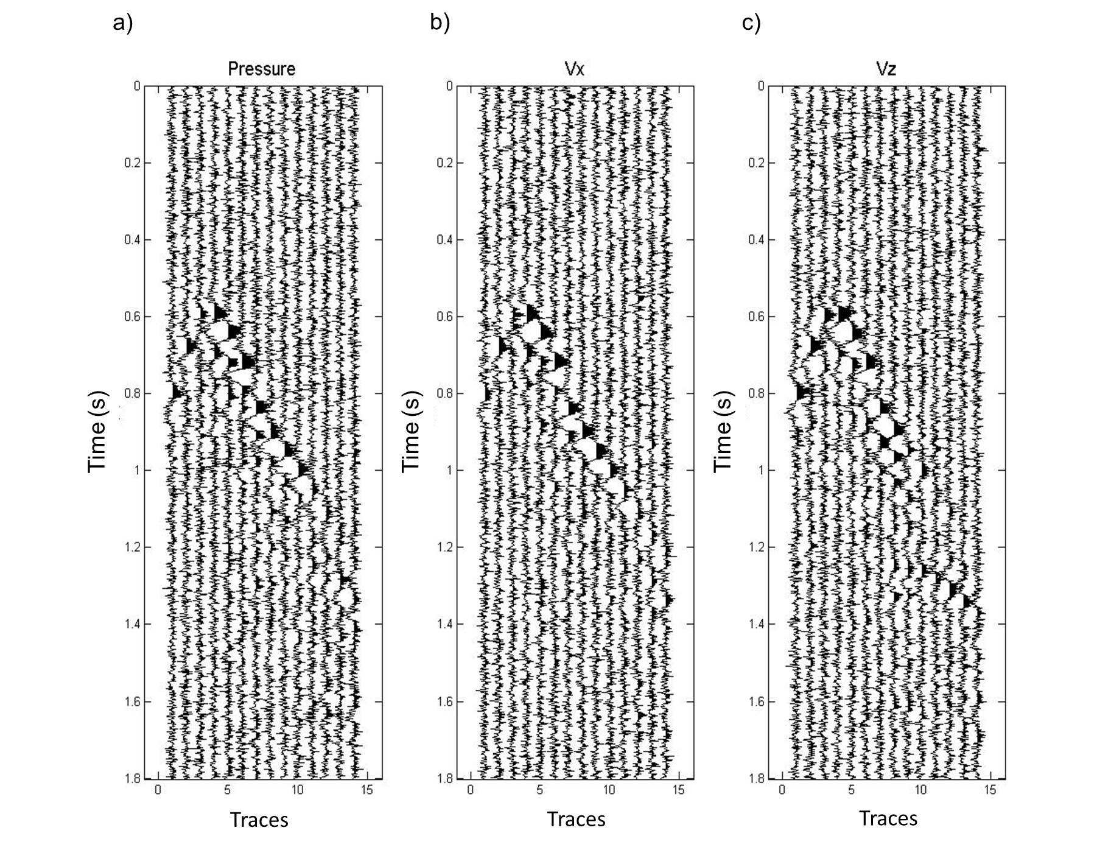
Example - Acoustic
Deviated borehole with an explosive source

Slide 17
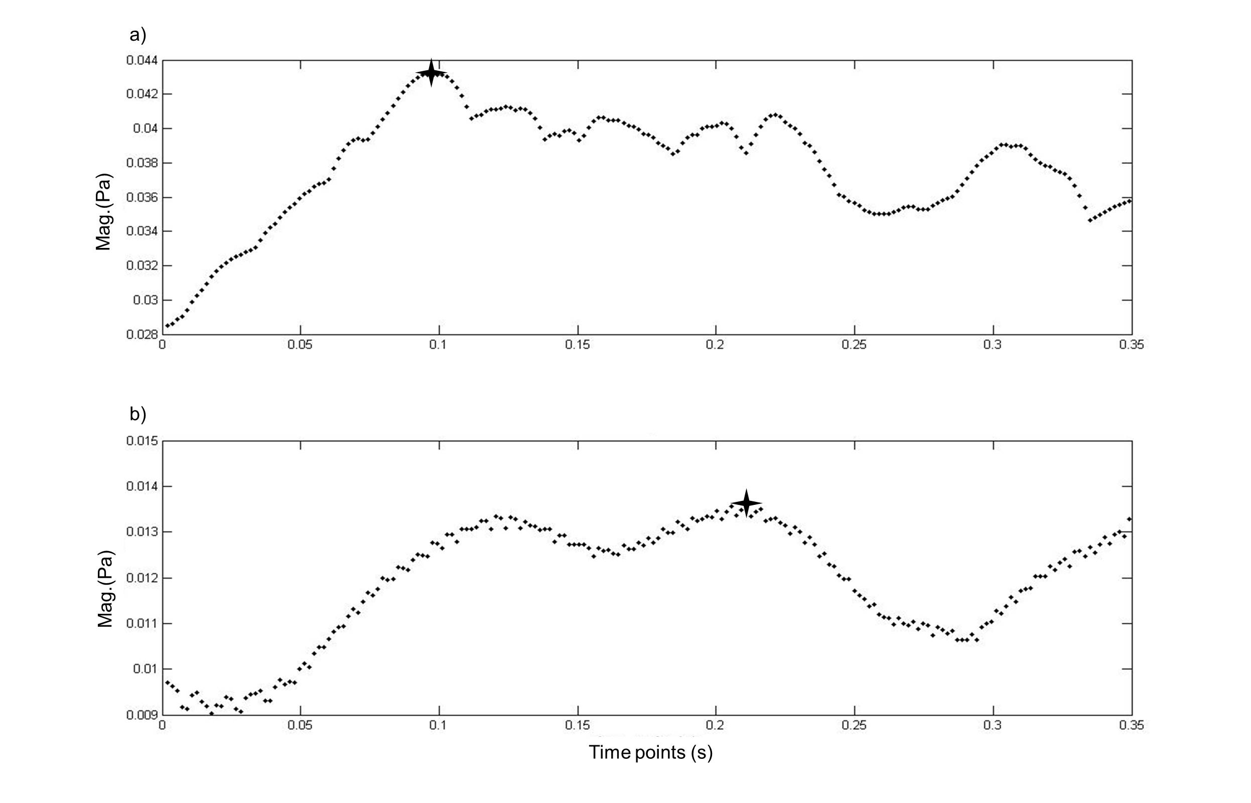
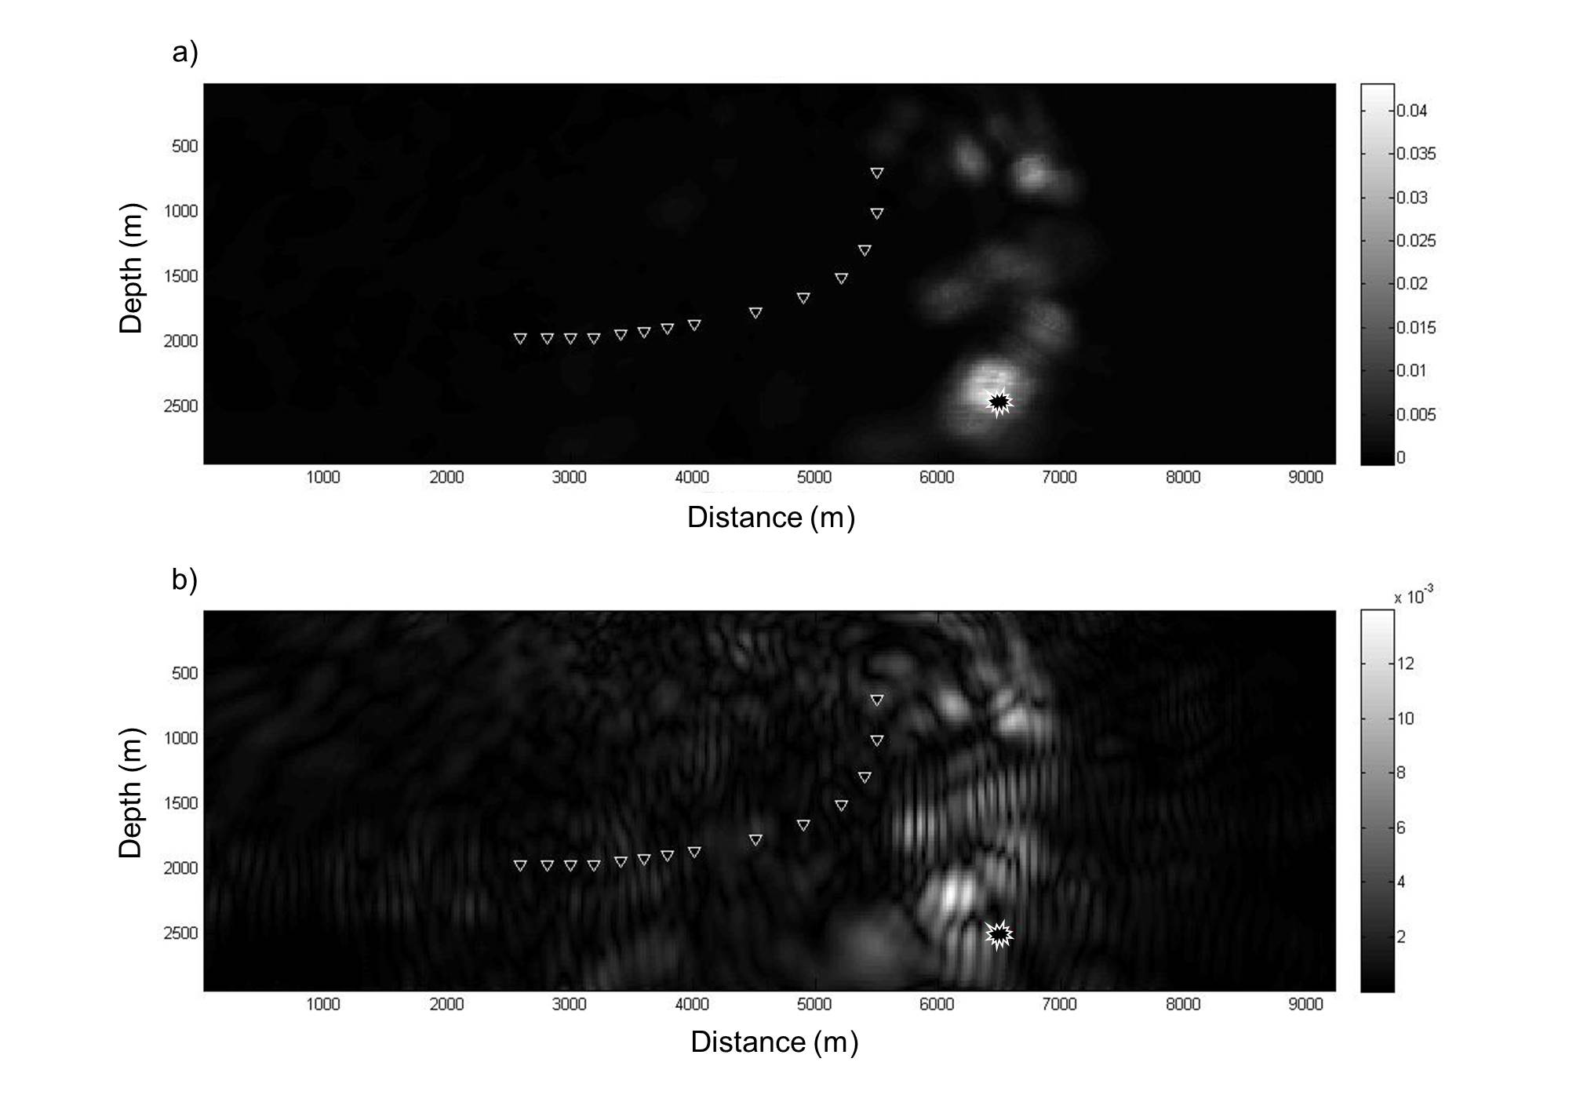
Example - Acoustic
Representation theorem
Tradition

Slide 18
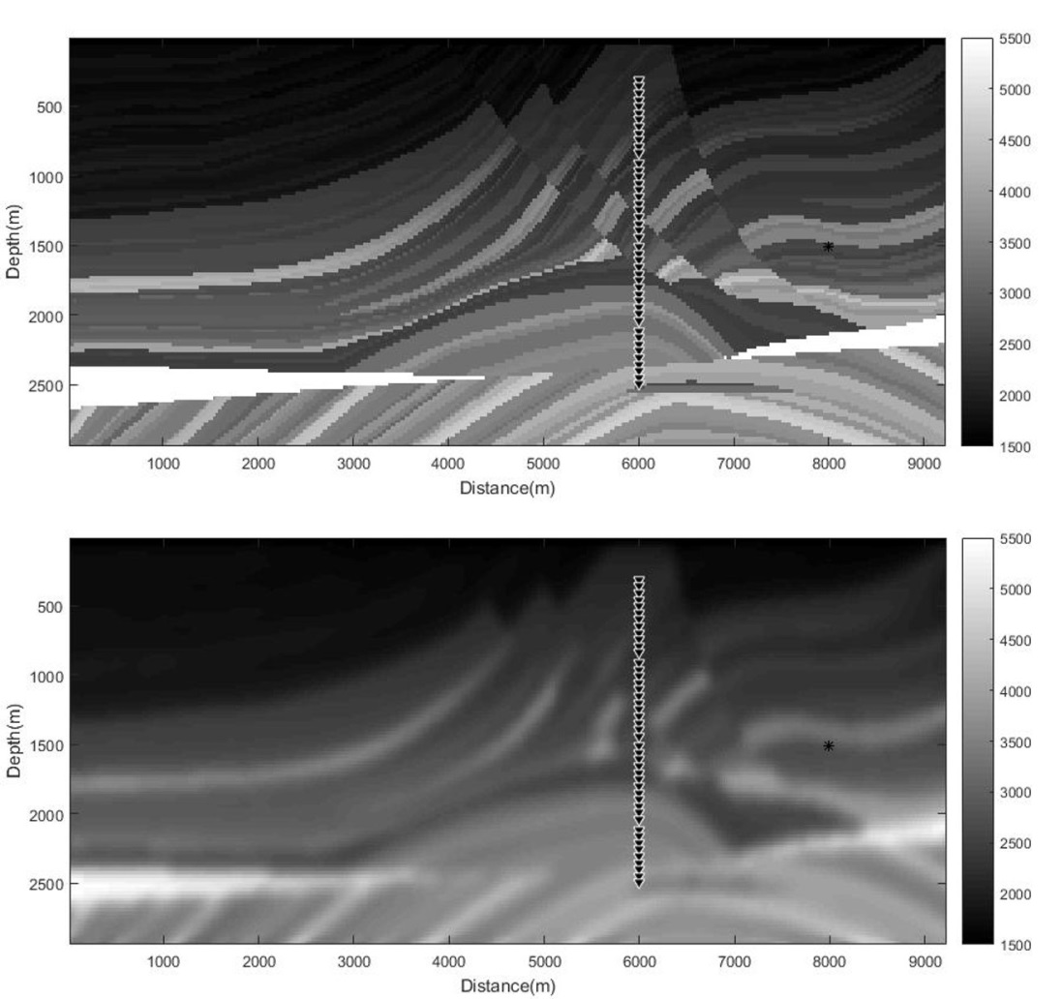
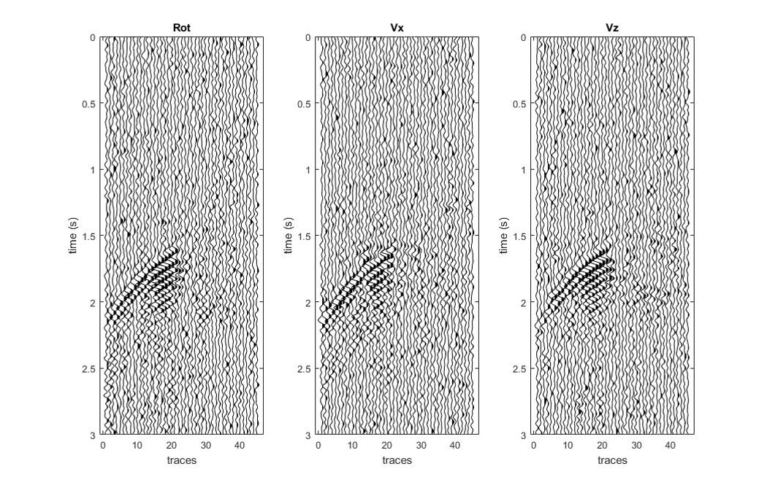
Example - Elastic
Vertical borehole with a double couple source

Slide 19
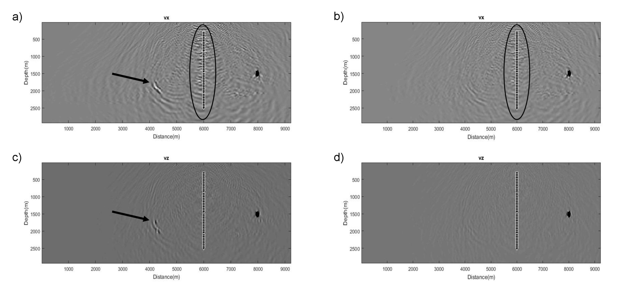
Example - Elastic

Slide 20
Conclusion
Reverse time extrapolation doesn’t require P- and S- wave first arrival picking
The acoustic focusing criterion can conveniently determine microseismic event location and time
Acoustic case: hydrophone + three-component receivers = > better locations
Elastic case: three-component translational + three
component rotational sensors = > better locations
Flexible combination of wavefields to improve source
image
Surface receivers are more suitable for this method

Slide 21
Acknowledgements
We thank the sponsors of the Microseismic Industry Consortium for financial support.
Thank You!

