Slide 1



4th Meeting of IWGoRS
A large-scale passive laser gyroscope based on ultra-stable lasers
K. Liu, J. Zhang, F. L. Zhang, X. H. Shi, X. Y. Zeng, X. L. Lv and Z. H. Lu
Center for Gravitational Experiments,
School of Physics,
Huazhong University of Science & Technology
2016.6.21 @ Meeting of IWGoRS
Notes:
Good afternoon, my name is Liu Kui, my presentation is about A large-scale passive laser gyroscope based on ultra-stable lasers. And I am a Ph. D student from Center for Gravitational Experiments, School of Physics, Huazhong University of Science and Technology.

Slide 2
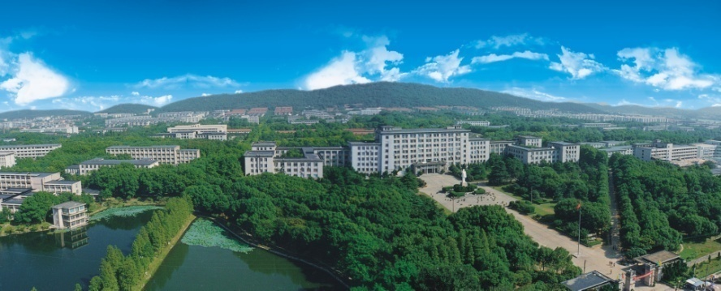
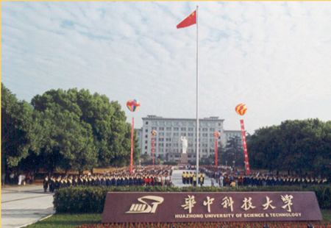

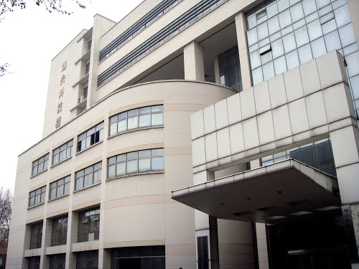

Huazhong University of Science and Technology
2
Notes:
Our university is in Wuhan, Hubei province, as shown with a red dot in the China map, is one of the top 10 universities in China. This is a photo of the main campus of the university. As you can see, about 72% of the campus is filled with green areas. The university sits in front of a small hill. We have about 4000 m2 cave labs under the hill.

Slide 3
Outline
1
Motivation
2
Recent Progress
3
Summary
3
Notes:
Here is the outline of my talk. First I will give you a background introduction about our project. Then, I will talk about our research progress on the laser development and design of the ring laser. Finally, I will conclude with a brief discussion of our future plan.
3

Slide 4
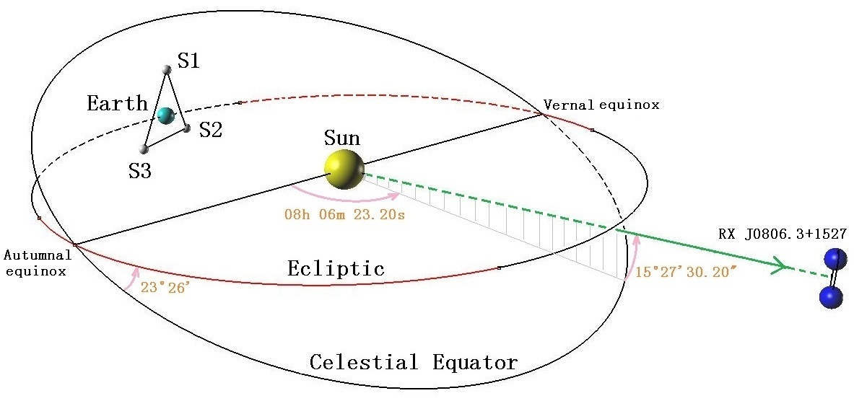


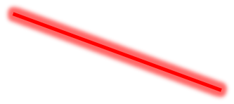


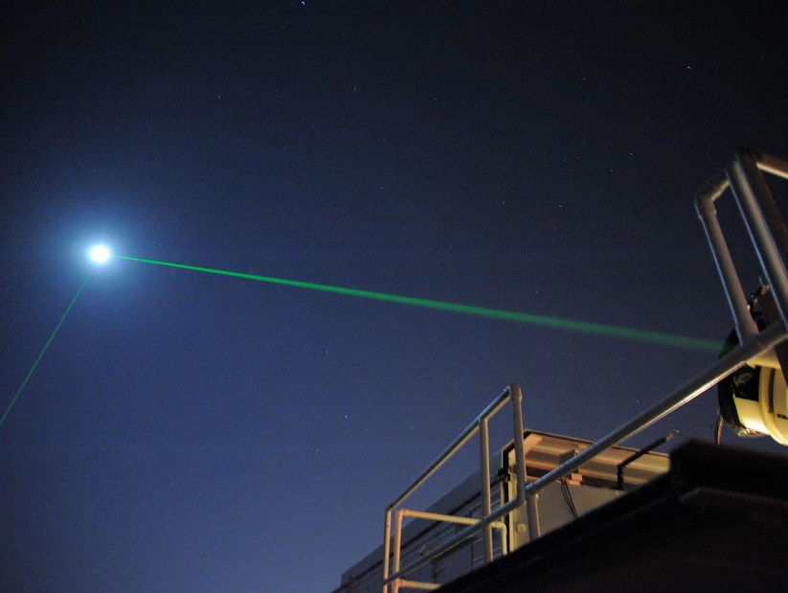
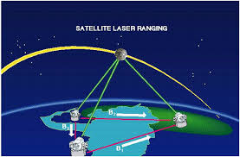
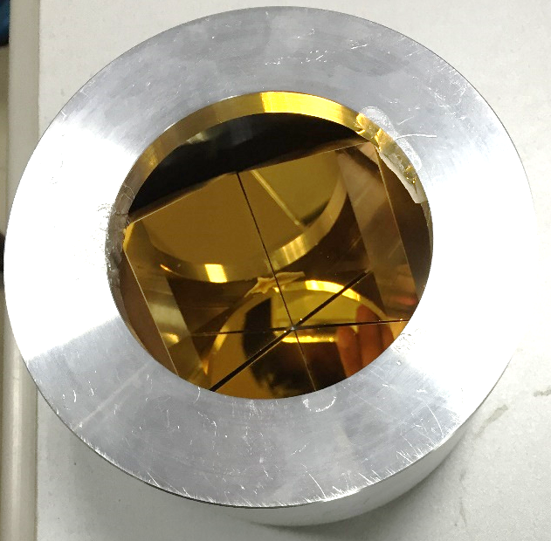
Motivation
TianQin mission (a space-borne gravitational wave detector)
Satellite orbit determination to cm level
Satellite Orbit determination 1cm
Lunar Laser Ranging
Retroreflector
4
Notes:
The main goal to develop a gyroscope is to serve as a ground base facility for a TianQin mission which is a space-borne gravitational wave detector project. And the satellite orbit has to be determined to a cm level. The Lunar Laser Ranging is another space project. A high accuracy gyroscope can give the real time rotation data of the earth, it will play important roles in the Satellite Orbit Determination and the lunar laser ranging.

Slide 5
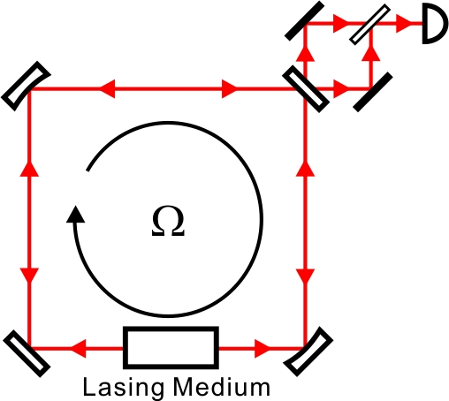
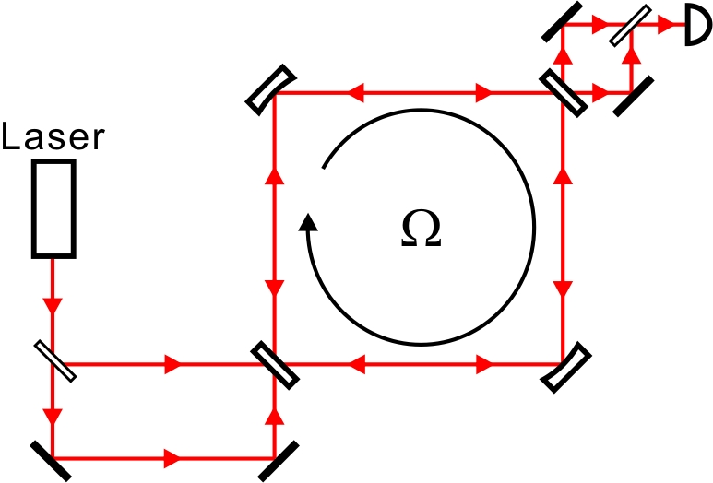
Active/Passive Laser Gyroscope
Active Laser Gyro
Passive Laser Gyro
“Comparison between active- and passive-cavity interferometers.”
A. Abramovici and Z. Vager, Phys. Rev. A 33, 3181 (1986).
“Passive versus active interferometers: Why cavity losses make them equivalent.” J. Gea-Banacloche, Phys. Rev. A 35, 2518 (1987).
5
Notes:
Our aim is to build a passive laser gyroscope while there are so many active gyroscopes in the world. The difference between them is the active gyroscope have lasing medium inside the cavity while the passive one utilize an external laser to inject in. But they have essentially the same ultimate sensitivity, which is limited by the cavity loss.

Slide 6
Active or Passive
Active laser gyro：
Spontaneous emission
Gain medium fluctuation
Backscattering
Geometrical stabilization
Passive laser gyro：
Shot noise limit
No gain medium (high vacuum)
Backscattering
Geometrical stabilization
Injection laser
Feedback locking
An ultrastable laser as injection laser source
A large scale passive laser gyroscope: challenge but deserve to try.
6
Notes:
But they have quite different technical noises. The reasons for us to choose a passive one are the following: The beam power inside the cavity can be increased by several orders of magnitude compared to the active one. No gain medium within the cavity, so there is no gain medium fluctuations; And in our lab we have developed ultra-stable lasers for optical frequency standards, so ultra-stable lasers are easier for us to get. With a high stability laser as the injection laser can reduce backscattering, improve geometrical stability.

Slide 7
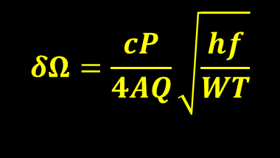
$$δΩ=\frac{cP}{4AQ}\sqrt{\frac{hf}{WT}}$$
Major theoretical parameters
N30.52º E114.41º | 1 m Gyroscope | 10 m Gyroscope (Final Goal)
Square cavity | 1 m×1 m | 10 m×10 m
Perimeter/Area | 4 m/1 m² | 40 m/100 m²
Scale factor stability | 10⁻⁹ | 10⁻¹¹
Reflectivity | 99.999% | 99.999%
Finesse | 157000 | 157000
FSR | 74.9 MHz | 7.49 MHz
Q factor | 5.9×10¹¹ | 5.9×10¹²
Sagnac frequency | 34.7 Hz | 347 Hz
Laser performance | Stability<10⁻¹⁴@1s, Stability<10⁻¹³@1000s
Power | 100 μW
Sensitivity@1000s | 8×10⁻⁹ Ω_{E} | 8×10⁻¹¹ Ω_{E}
Notes:
This is a table shown the theoretical sensitivity estimations of our first-stage goal and final goal. As a first 1m*1m prototype, with a stronger detection power of 100uW, the relative ultimate sensitivity at 1000s is estimated to be 8*10-9. The final goal for us is to be build a much larger passive laser gyroscope with 10m arms. In principle, another two orders of magnitude improvement can be expected.

Slide 8
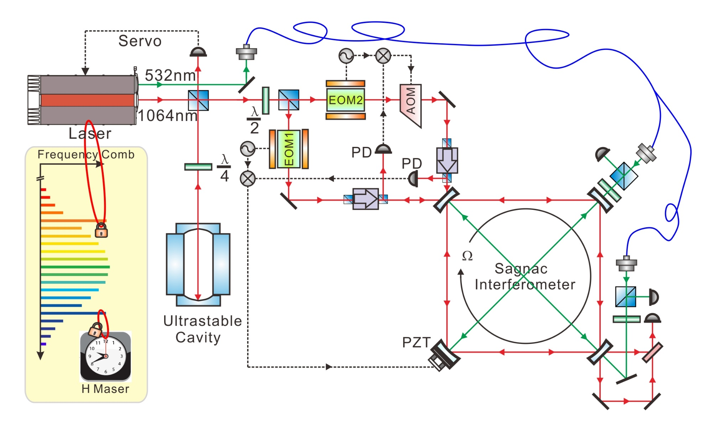
Optical Setup
The ring cavity is locked to one injection beam, and the other beam is locked to the ring cavity, monitoring diagonal lengths.
8
Notes:
This is our optical setup. The blue shadow shows the external laser source. The laser’s short-term stability is stabilized by an ultra-stable FP cavity and the long-term stability is controlled with a Frequency Comb referenced to a Hydrogen Maser. The red shadow shows the main gyro interferometer. The yellow shadow shows the locking system and the detection unit. The ring cavity is locked to one of the injection beams with a PZT, and the other beam is locked to the ring cavity with an AOM as a feedback unit. In the meanwhile, we will monitor the two diagonal lengths with a 532nm laser generated by the same laser source.

Slide 9
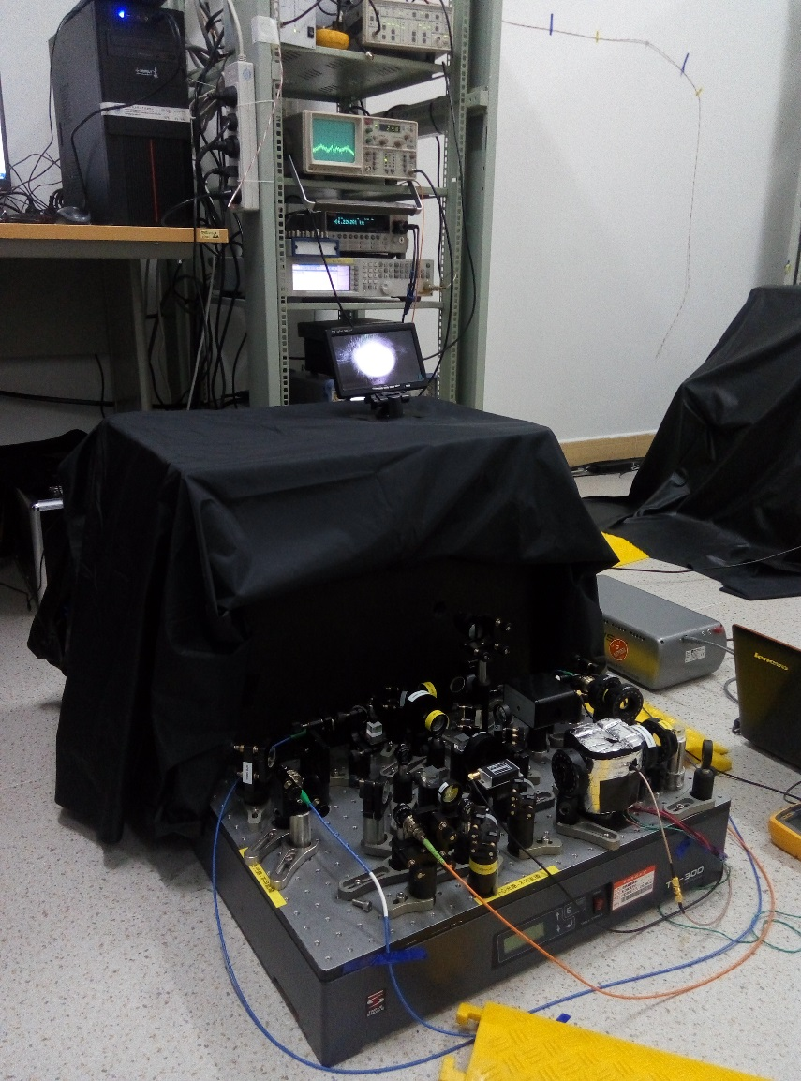
Laser Development: Short-term Stability
A diode laser is locked to a 10 cm-long ULE ultra-stable cavity.
9
Notes:
We use an ultra-stable cavity to obtain a good laser short-term stability. A diode laser is locked to a 10 cm-long ULE(Ultra low expansion glass) cavity. The cavity is put inside a vacuum chamber, and the whole setup is placed on an active vibration isolate table. The figure shows the Allan Deviations calculated by beating two lasers with each other. Each of them has a short-term stability better than 4E-15 between 0.1s to 10s. The cavity temperature is controlled to its zero expansion point 36oC. We use a frequency comb to measure the cavity drift, which is about 10 mHz/s.

Slide 10
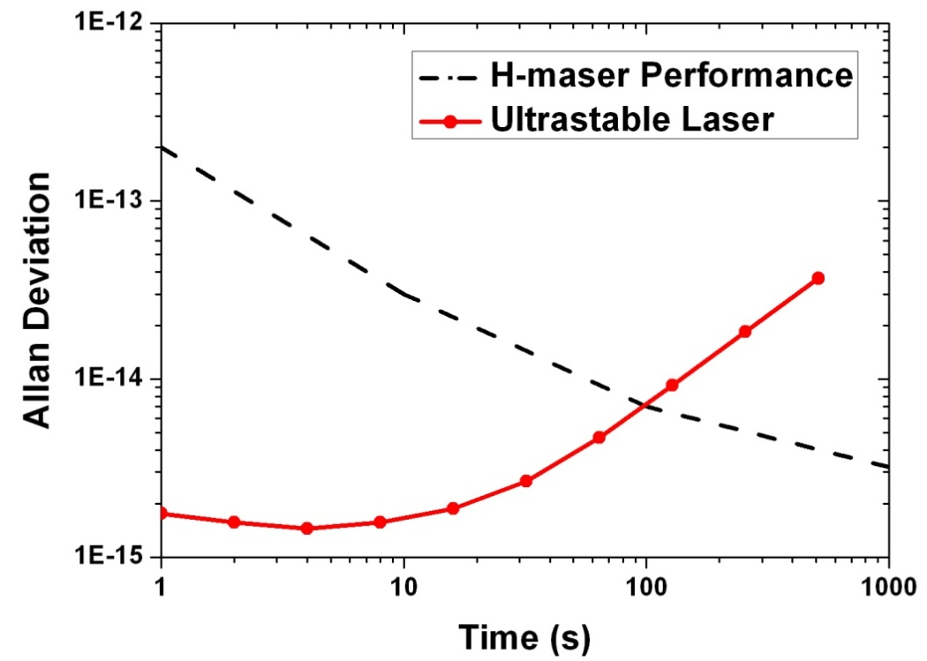
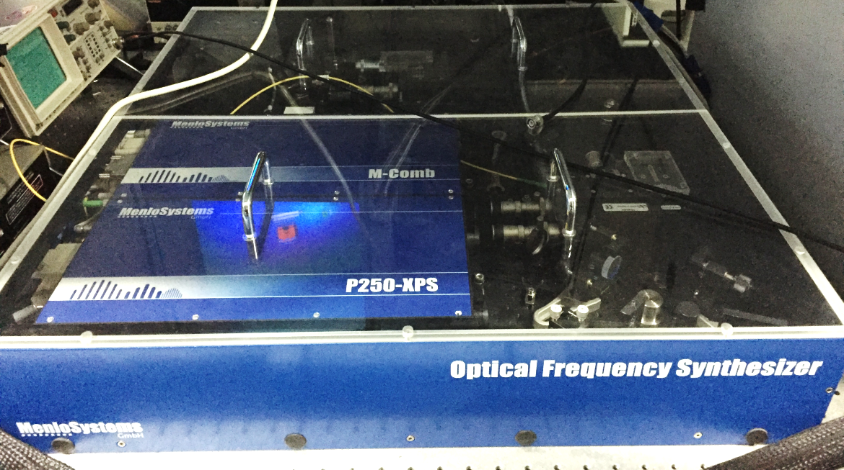
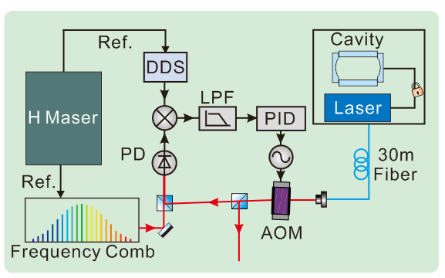
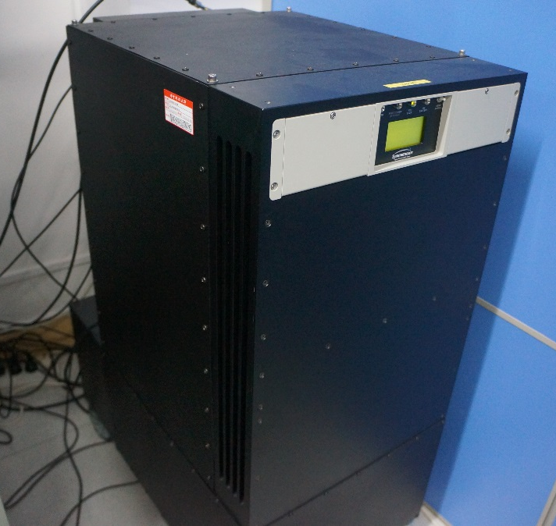
Laser Development: Long-term Stability
10
Notes:
Although the cavity is controlled to its zero expansion point, it still has a long-term drift. So for the long-term stability, we choose a H-Maser as the reference, use a frequency comb to bridge the laser and the maser. This is our optical setup. Once the laser is locked to a FP cavity, and then we transfer the laser to our frequency comb. We then use an AOM as the actuator to phase-lock it to a frequency comb with a proper designed bandwidth. In this way the long-term stability can be controlled by our Hydrogen Maser.

Slide 11
Laser Development: Long-term Stability
Next step:
Digital PID locking for better short-term performance
11
Notes:
This is the experimental result we obtained. After locking to the comb and H-maser, the long-term drift of the laser is reduced to be about 95$μ$Hz/s. From the Allan deviation result, the red curve shows the stabilized laser. We can see that the long-term stability of the laser follows the performance of the H-Maser now, but the short-term stability is ruined by two orders of magnitude. This is because the locking bandwidth we used is not slow enough. So in the next step we will use a more flexible digital locking system to get a better short-term performance.

Slide 12
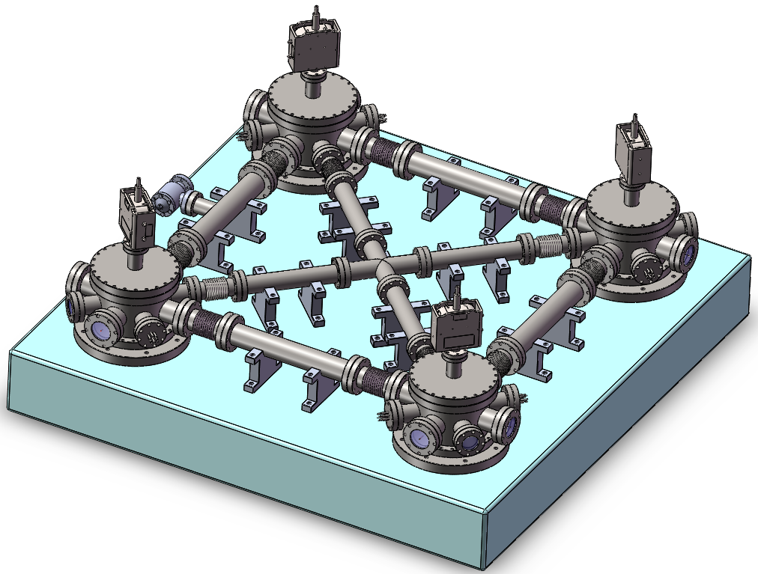
Vacuum System Design
Side length: 1m
Optical plane height: 115mm
Notes:
Our designed vacuum chamber is shown in this slide. We use a square granite base plate. Four stainless steel chambers and some tubes to build a vacuum system. Four high reflection mirrors inside the chambers compose a square cavity.

Slide 13
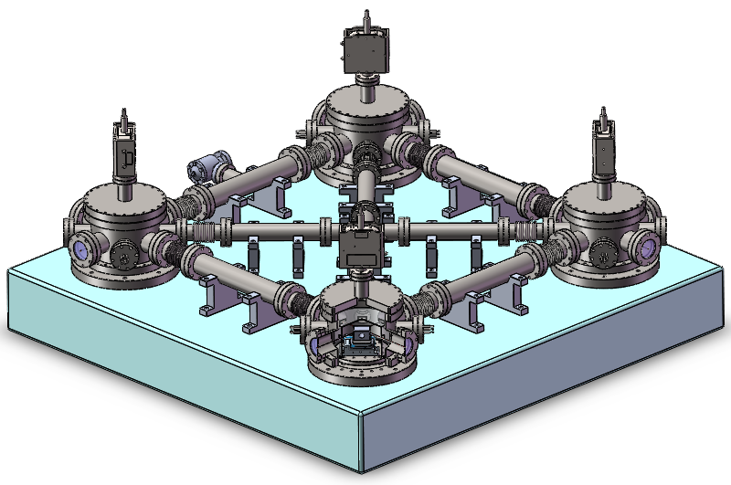
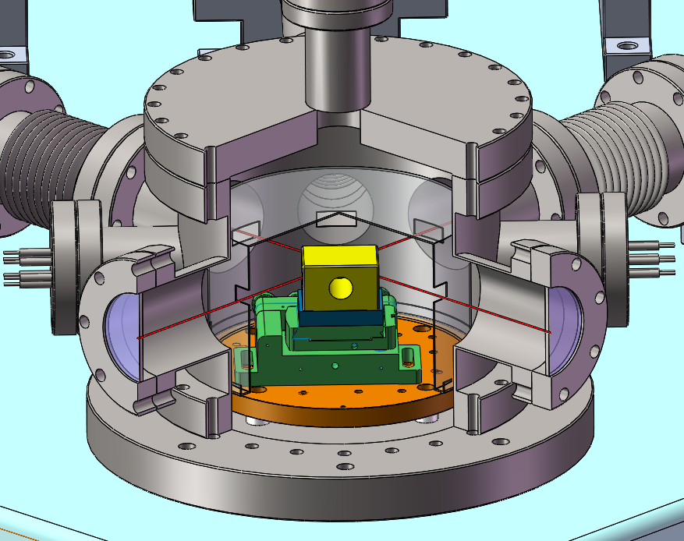
Vacuum System Design
Notes:
Inside the chambers, we use four five-dimensions nano-position stages to adjust the mirror position precisely, the X&Y&Z translation resolutions are about 30nm, travel range is around 3mm. We can also tune the angles by $Θ_{X}$&$Θ_{Y}$. To improve the geometrical stability, the gyroscope will be placed in our cave Lab.

Slide 14
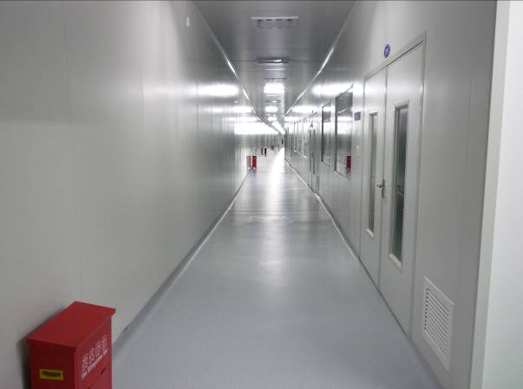
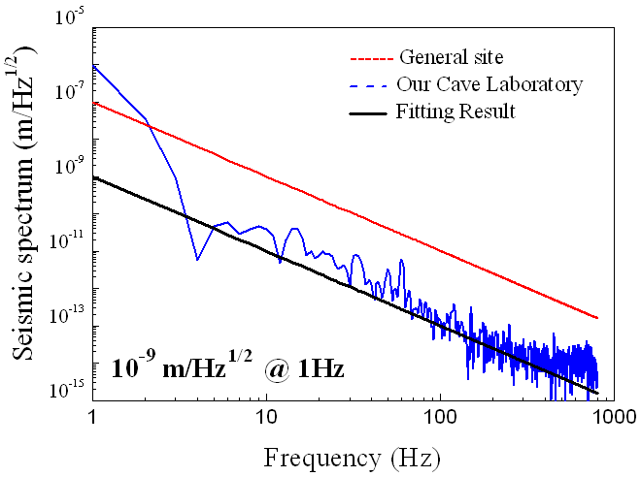
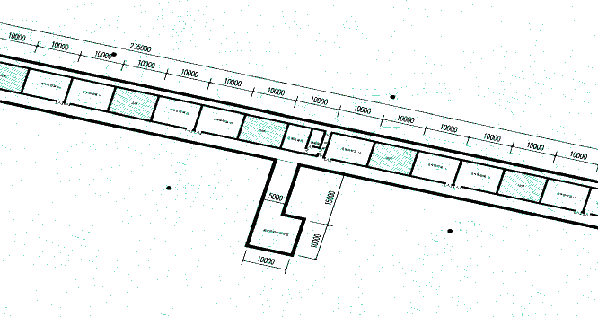
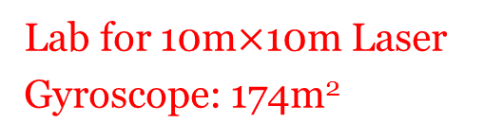
Cave Lab
Lab Space: 7000 m² (cave lab: 4000 m², machine shop: 600 m²)
Temperature variation inside cave laboratory
Annual variation: ~ 1K
Daily variation < 5mK
Seismic noise at cave laboratory
100 times lower than the seismic noise of a typical 1st-floor laboratory
Lab for 10m$×$10m Laser Gyroscope: 174m²
Notes:
The annual temperature variation inside the cave laboratory is about 1K, and the daily variation is less than 5mK for an empty lab. The Seismic noise in cave lab is 100 times lower than the seismic noise of a typical 1st-floor laboratory. For the 10m*10m gyroscope, a new 174 m2 cave lab is planned which is near the current cave site.

Slide 15
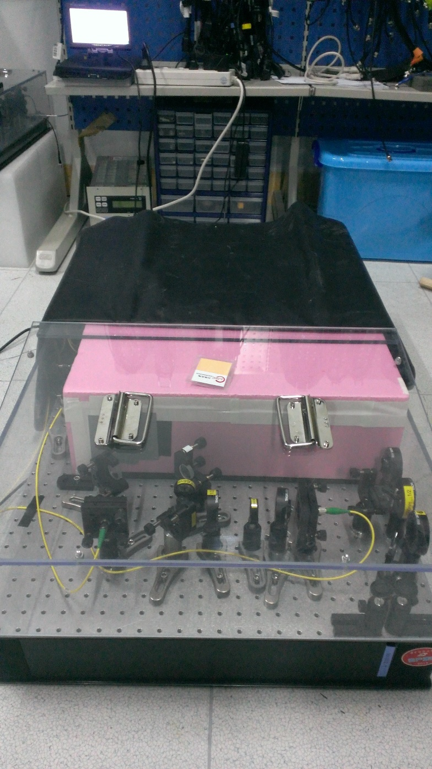
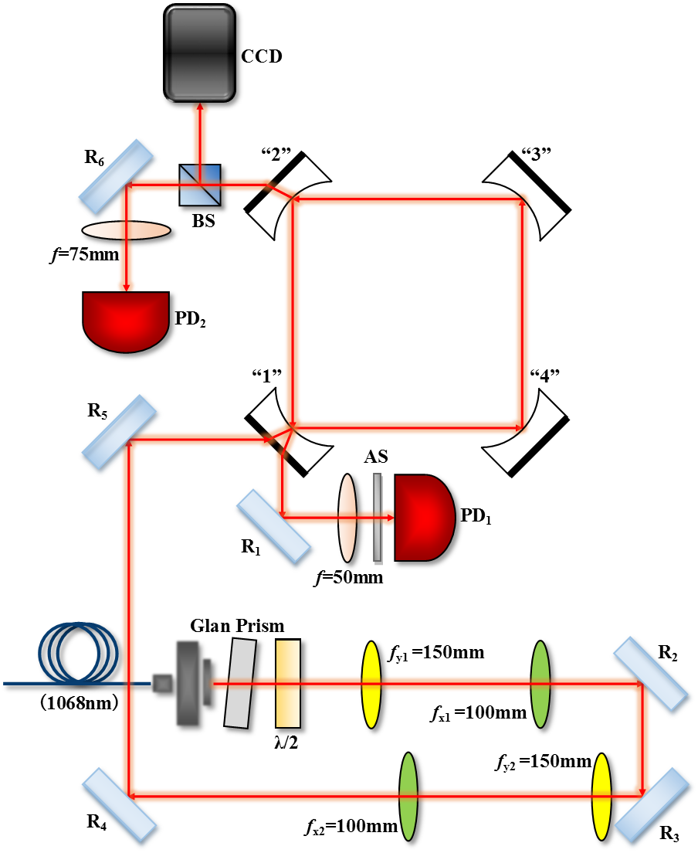
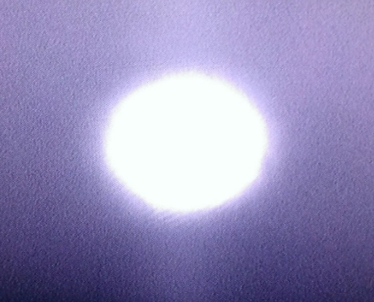
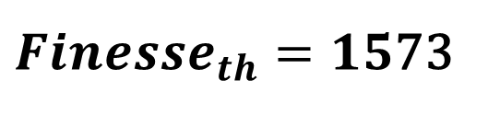


A Free Space 0.3 m × 0.3 m Ring Cavity
$$\text{}=20\%$$
$$Finesse=329$$
$Finesse_{th}=15$73
S-polarization reflectivity：99.9%
Notes:
To test the mode match and injection locking, we constructed a small free space ring cavity. by now, we use 2 pairs of cylindrical lenses to perform the mode matching. This the obtain TEM00 mode, and a 20% coupling efficiency is obtained. But the measured finesse is fairly low compared with the theoretical finesse. so we need to spend more time to diagnose where the problems are.

Slide 16
Summary
A laser source is developed with a short-term stability of 1×10⁻¹³ at 0.1s. The long-term stability is 1×10⁻¹⁵ at 2000s;
We have designed the Sagnac interferometer;
Ring cavity alignment and mode matching is under test.
Future Plans:
For the 1m×1m gyroscope, a 1st step goal is to achieve a relative sensitivity of 3×10⁻⁷ at 1000s in 2017;
a 2nd step goal is a relative sensitivity of 8×10⁻⁹ at 1000s;
Design a 10m ×10m gyroscope.

Slide 17
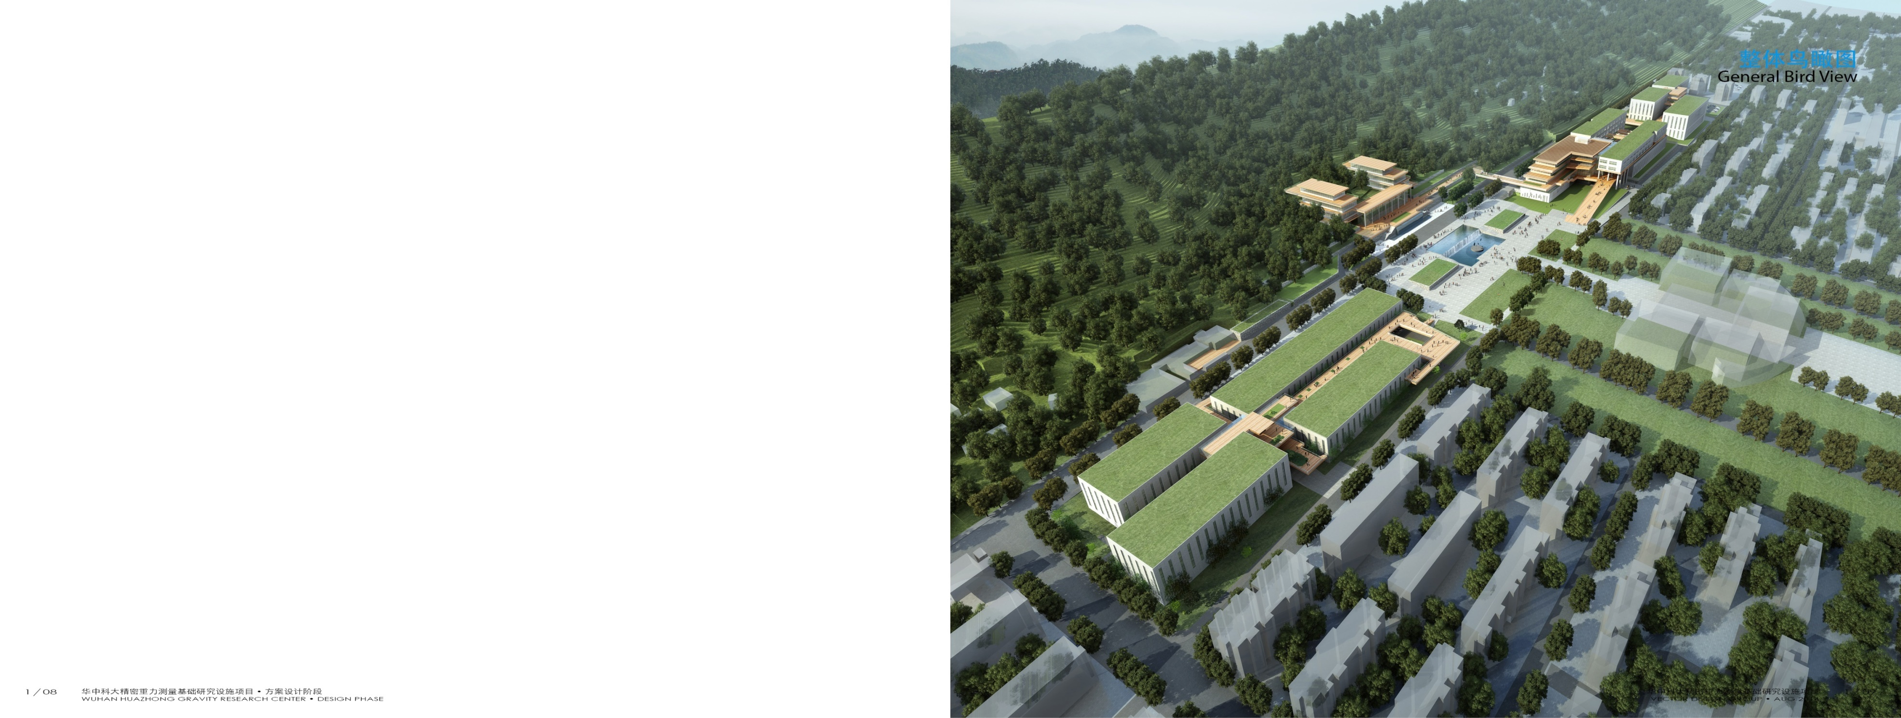
National Facility (2017-2021)
Precision Gravity Measurement Facility (PGMF)
Notes:
The gyroscope project is funded by a National project which is called Precision Gravity Measurement Facility. It starts from 2017 to 2021 with a total budget of 0.9 billion RMB. There are plenty of positions opened for faculty members and Postdocs. Visitors and cooperators are also very welcomed.

Slide 18
Thank you very much for your attention！
18

Slide 19
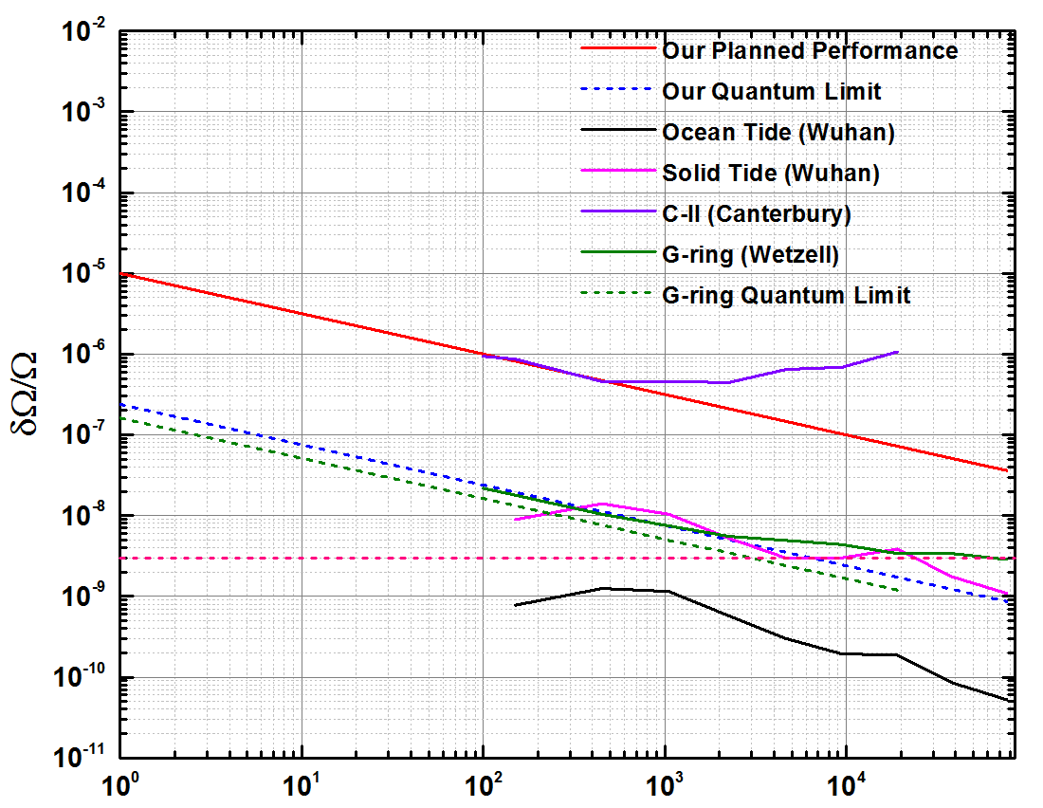
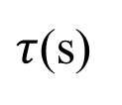
Research Goal for the 1m×1m Gyroscope
1st step target
2nd step target
$τ$(s)
19
Notes:
For the 1m×1m Gyroscope, the 1st step research goal is to achieve a relative sensitivity of 3*10-7 at 1000s, shown the red line. This is also the sensitivity achieved by the C-II at Canterbury. The 2nd step goal is to diagnose the encountered problems and to achieve the designed quantum noise limit.

Slide 20
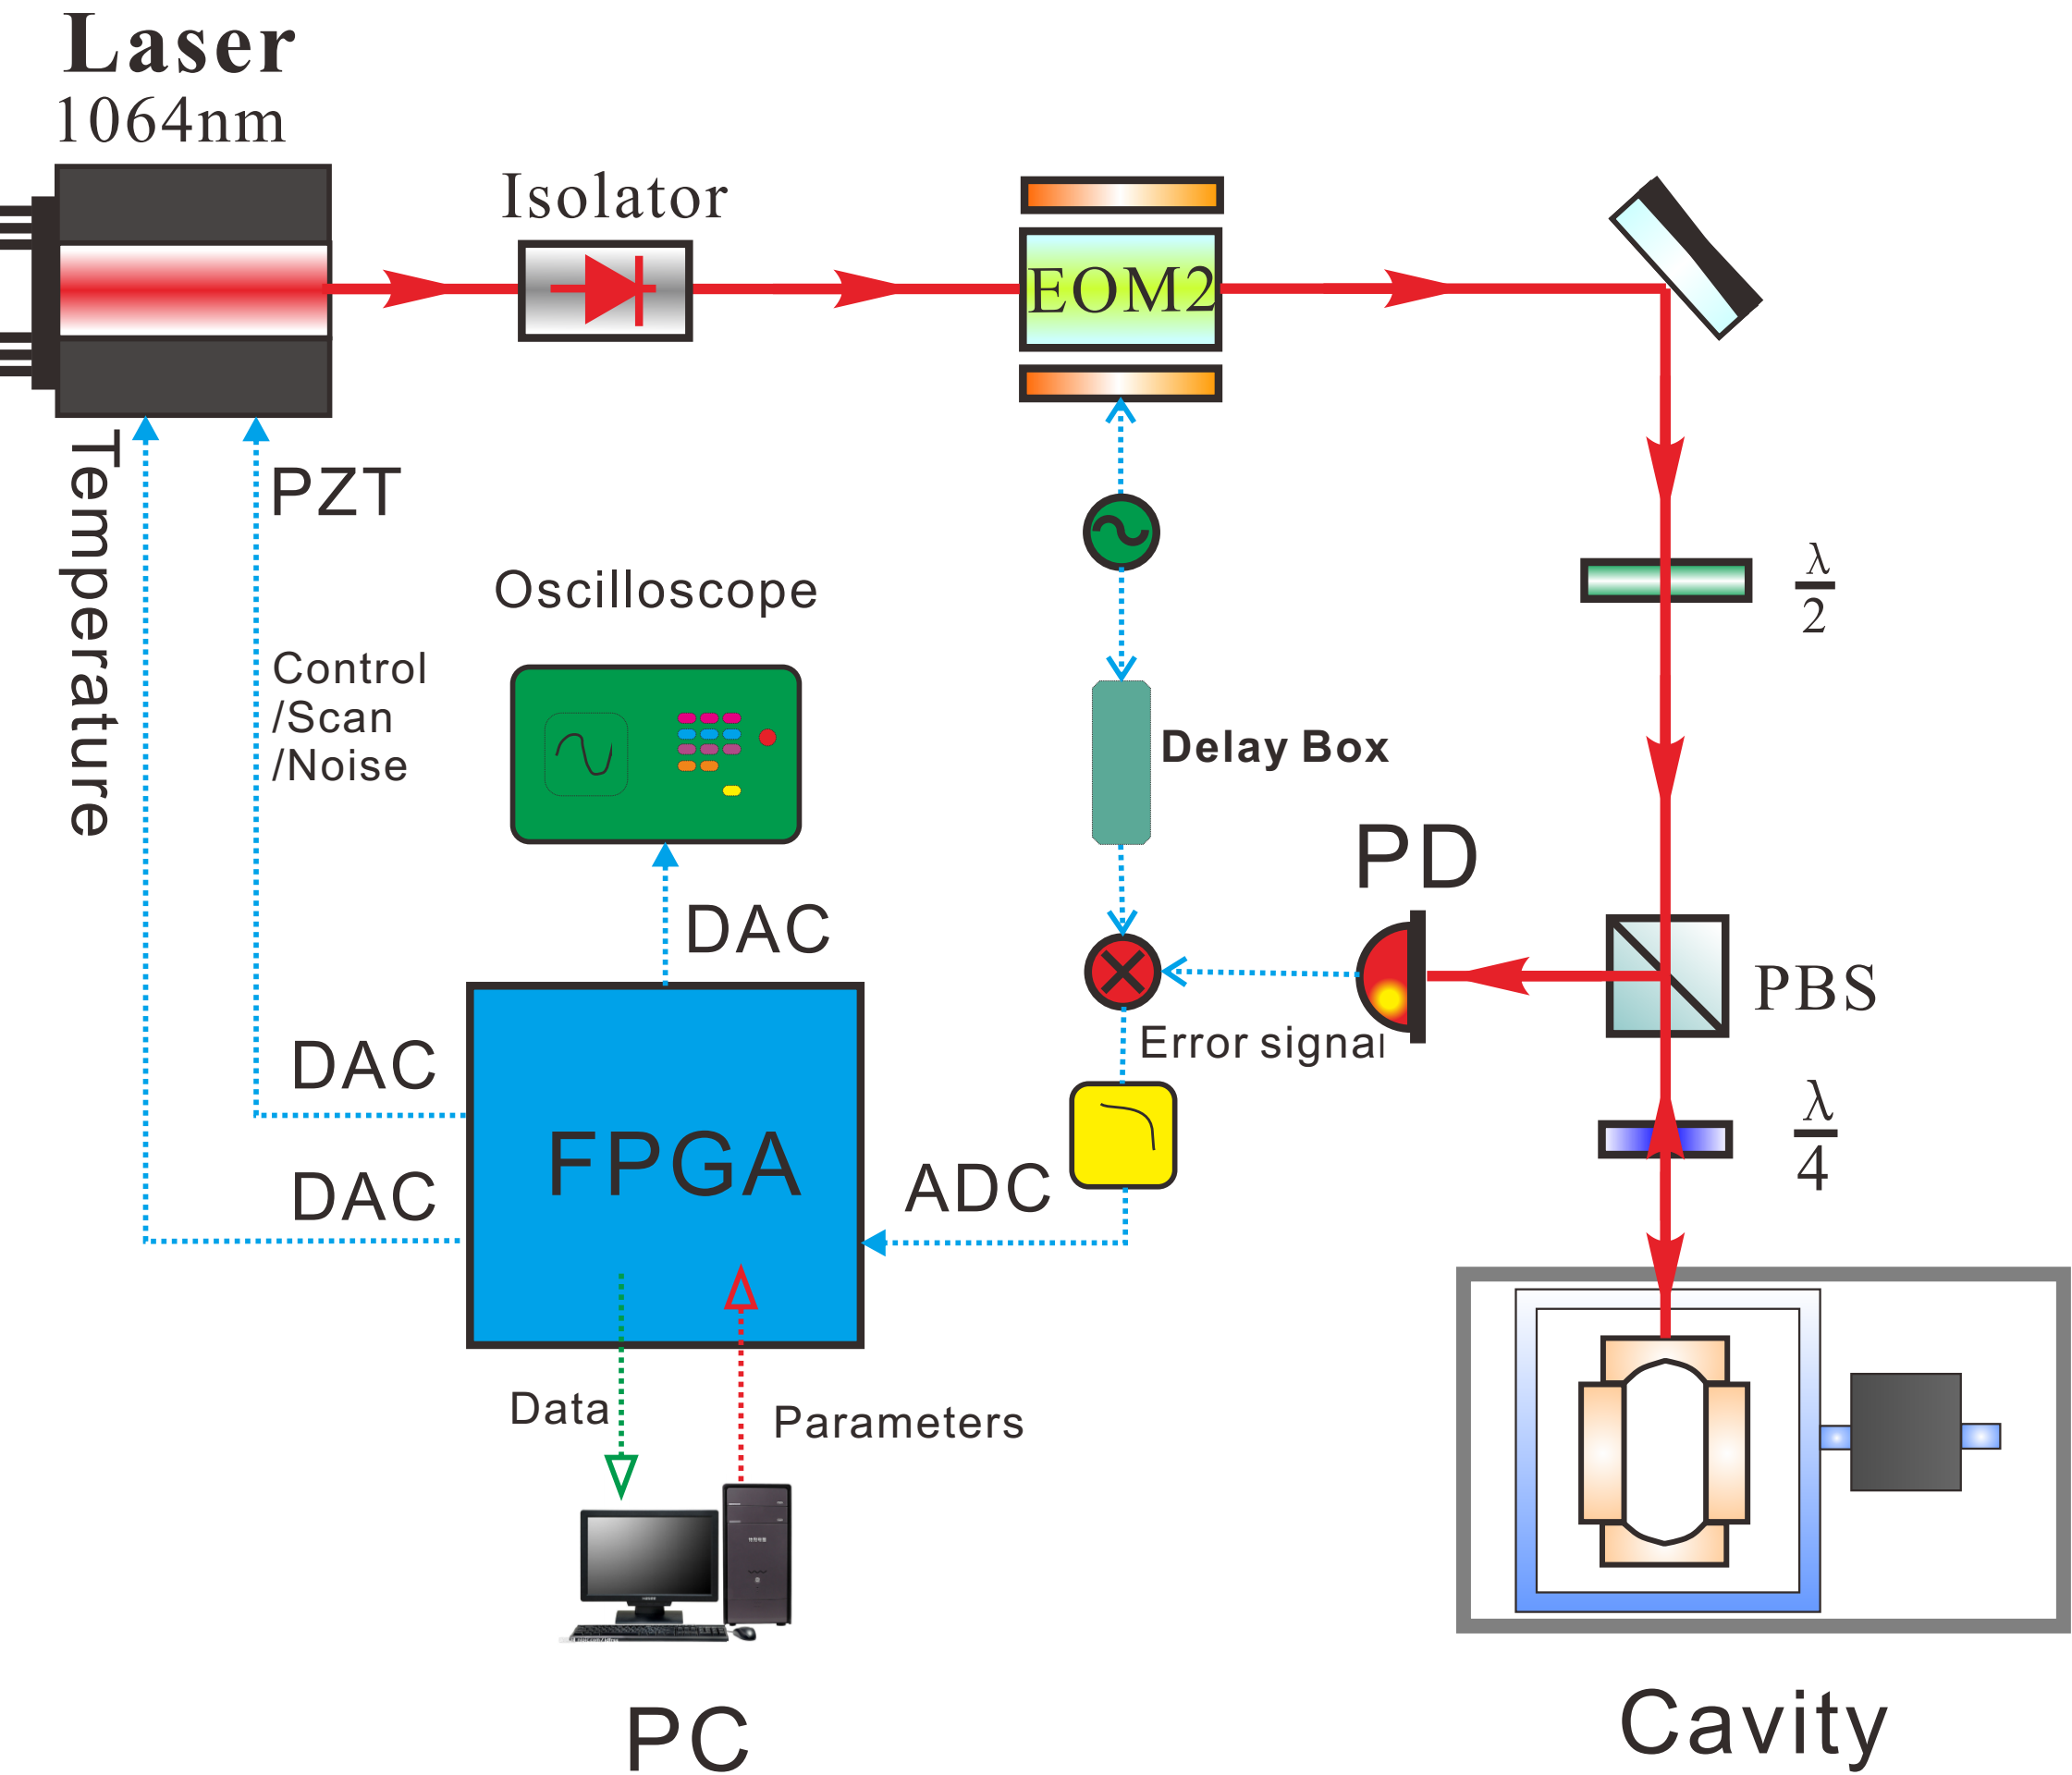
Digital Locking
Long-term running
Self-locking
Remote control
Notes:
For the gyroscope project, since we all know that long-term running of the whole laser system is essential, so currently we are replacing the diode laser with an Nd:YAG solid state laser, and change the current analog circuits to a digital locking system to realize a long-term operation with self-locking and remote control functions.

Slide 21
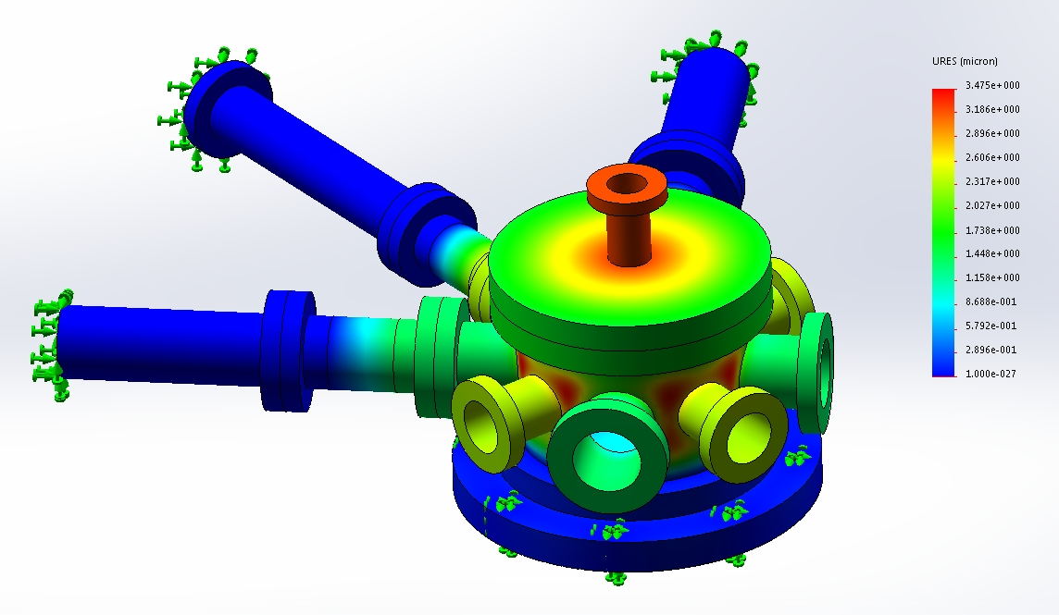
Finite Element Analysis
Bellows Elastic Modulus~8×10⁶Pa
Air pressure~10⁵Pa

Slide 22
Finite Element Analysis
Bellows Elastic Modulus~8×10⁶Pa
Air pressure~10⁵Pa

