Slide 1


A Fiber Optic Gyroscope Prototype with High Bias Stability for Rotational Seismology Phenomena Measurement
Yulin LI, Rongya LUO, Fangyuan CHEN, Zihao CHEN, Dong HE, Chao PENG, Zhengbin LI
liyulin@pku.edu.cn
4th IWGoRS workshop
Tutzing, 2016-6-21

Slide 2
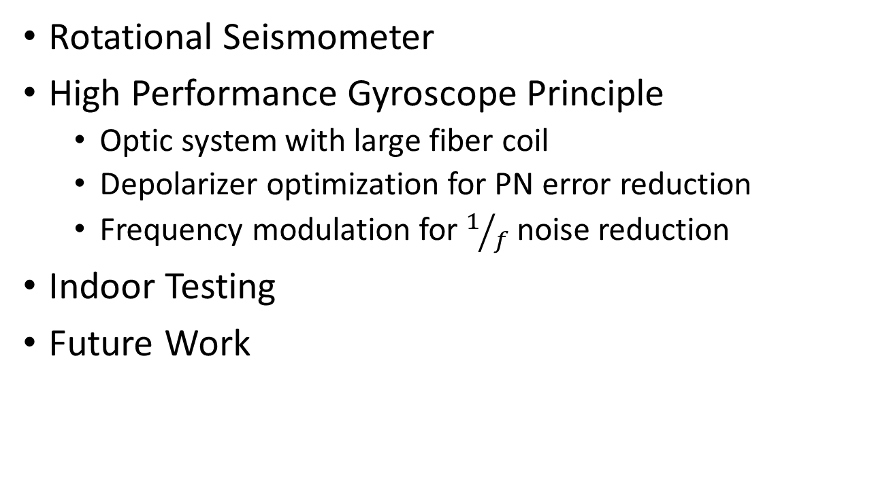
Outline
Rotational Seismometer
High Performance Gyroscope Principle
  Optic system with large fiber coil
  Depolarizer optimization for PN error reduction
  Frequency modulation for $1/f$ noise reduction
Indoor Testing
Future Work

Slide 3
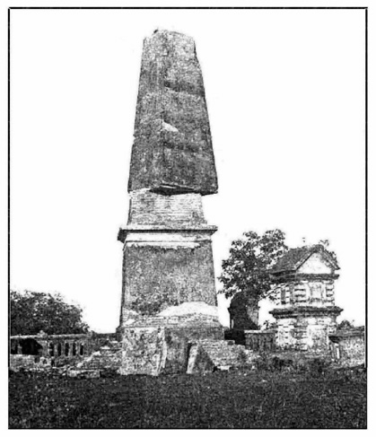
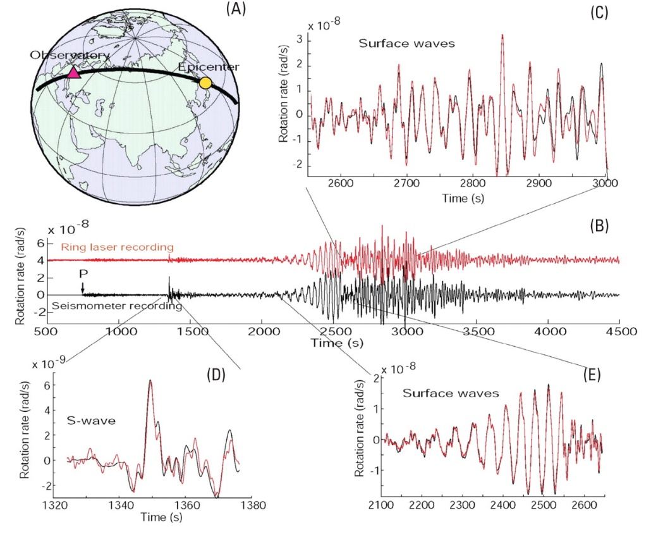
Rotational Seismology
Rotation seismology phenomena have been observed for centuries
  Rotation of a tomb, India, 1899
Seismic motion is composed of translation and rotational motion (6 DOF)
Rotational motion is significant for seismology but lack of study before RLG development
Lee, William H. K., Heiner Igel, and Mihailo D. Trifunac. “Recent Advances in Rotational Seismology.” Seismological Research Letters 80.3 (2009): 479–490.

Slide 4
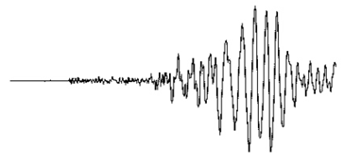
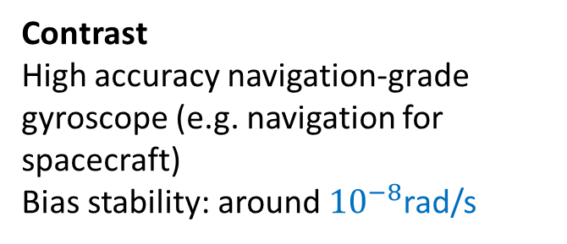

Seismology Rotational Motion
Wide amplitude range
  A few rad/s near seismic source (Nigbor 1994)
  ${10}^{−11}$rad/s at tele-seismic distances (Igel et al. 2005; Schreiber et al. 2005, 2006)
Contrast
High accuracy navigation-grade gyroscope (e.g. navigation for spacecraft)
Bias stability: around ${10}^{−8}$rad/s
Igel, Heiner et al. “Broad-Band Observations of Earthquake-Induced Rotational Ground Motions.” Geophysical Journal International 168.1 (2007): 182–196.

Slide 5
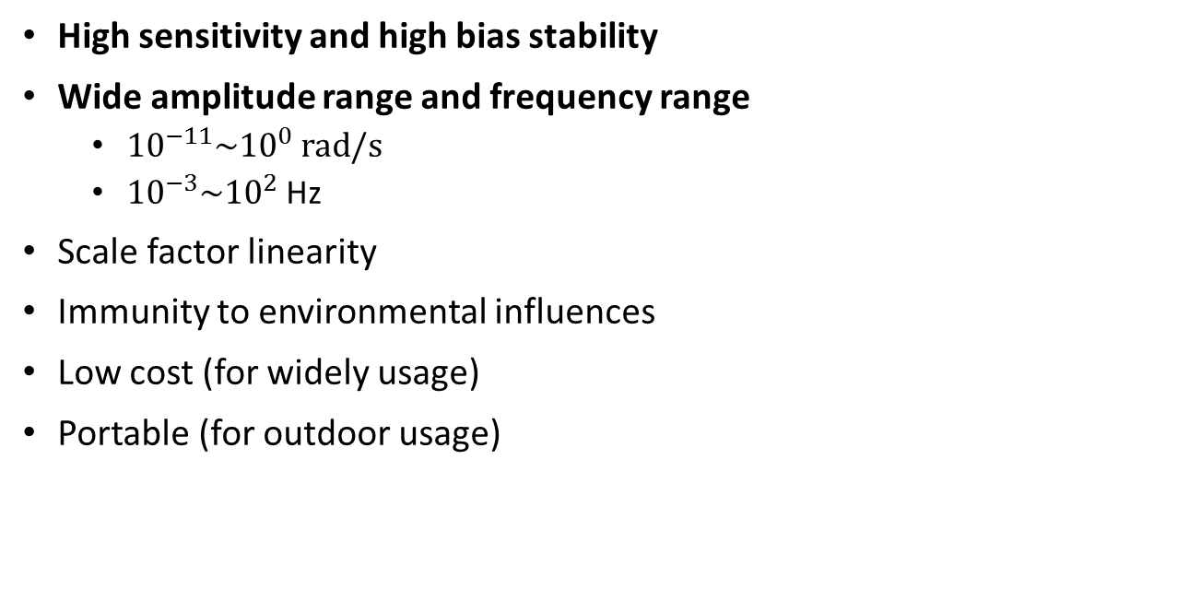
Rotational Seismometer Requirements
High sensitivity and high bias stability
Wide amplitude range and frequency range
  ${10}^{−11}\sim {10}^{0} rad/s$
  ${10}^{−3}\sim {10}^{2}$Hz
Scale factor linearity
Immunity to environmental influences
Low cost (for widely usage)
Portable (for outdoor usage)
How?

Slide 6
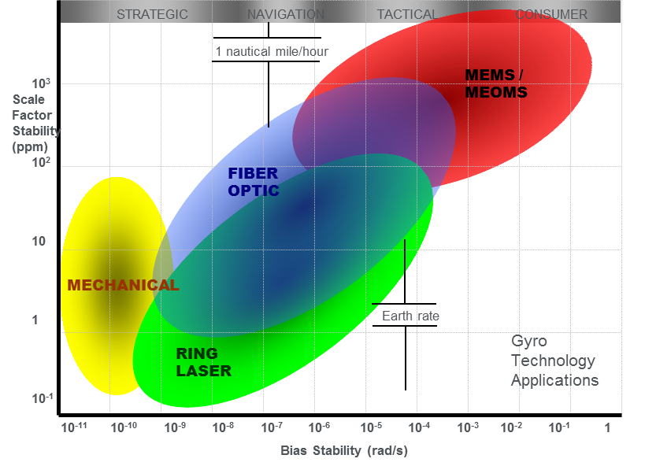
Potential Solutions
Mechanical
Fiber Optic
Ring Laser
MEMS
……
Fiber Optic Gyroscope may be one of the most suitable solution
G. Zhang, “The Principles and Technologies of Fiber-Optic Gyroscope” National Defense Industry Press. Beijing. 2010
Notes:
Micro-electromechanical Systems

Slide 7
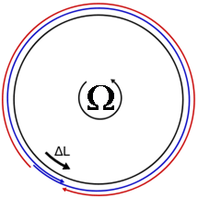
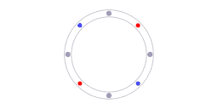
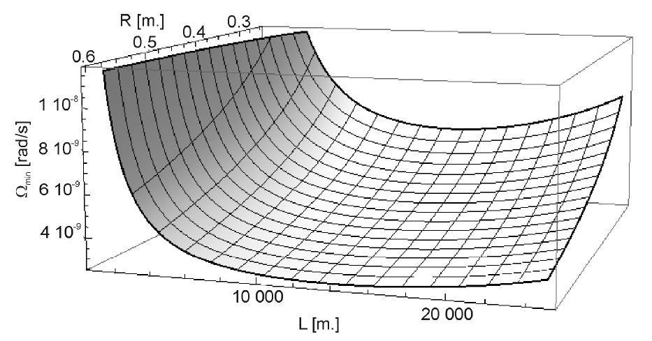
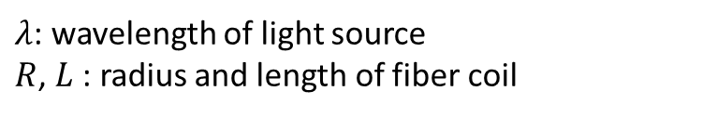
Sagnac Effect and Large Length FOG
To increase R·L to improve sensitivity and stability
Two FOGs were demonstrated:
A 15km-long SMF coil of 0.3m in diameter
A 10km-long SMF coil of 0.2m in diameter
But, noise also increased
e.g. SNR drops due to loss increasing (L. R. Jaroszewicz, et al., 2008)
Sagnac Effect
Sagnac phase shift
$λ$: wavelength of light source
$R$, $L$: radius and length of fiber coil
L. R. Jaroszewicz, et al., in R.Teisseyre, H. Nagahama, E. Majewski (eds.), Physics of Asymmetric Continuum: Extreme and Fracture Processes, Spinger-Verlag, Chap. 2, 2008.

Slide 8
Design Principles
High sensitivity
  Upgrade the products of R and L to increase sensitivity
  SMF fiber with longer length preferable
Main noise increases with large length
  Polarization non-reciprocity error
  1/f fractal noise
  Shupe effect
  SNR drops due to loss increasing
  ……

Slide 9

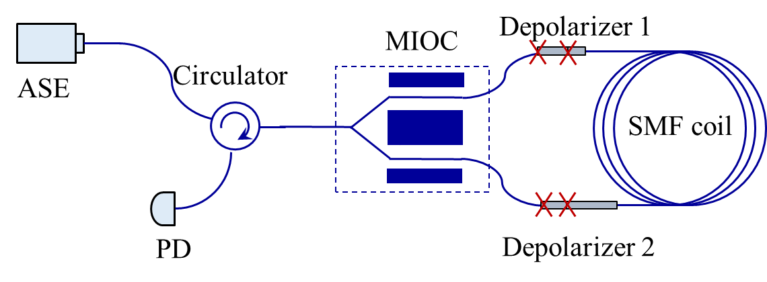
Optical System Design
Open-loop depolarized system under minimum polarization reciprocal configure
Broadband ASE light source with bandwidth 40nm to overcome Rayleigh scattering
MIOC with PMF pig tail for polarizing, modulating and coupling light into fiber coil
SMF coil with 10km or 15km, for high sensitivity and low cost
For polarization non-reciprocity error
Use two depolarizers to ensure reciprocity
DOP < 0.5%
Notes:
Multi-functional Integrated Optical Chip Y-waveguide modulator
amplified spontaneous emission

Slide 10
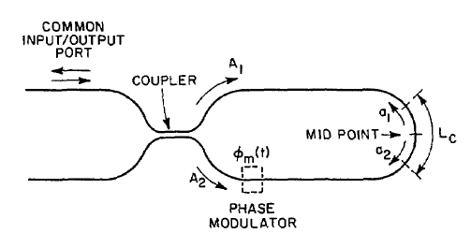
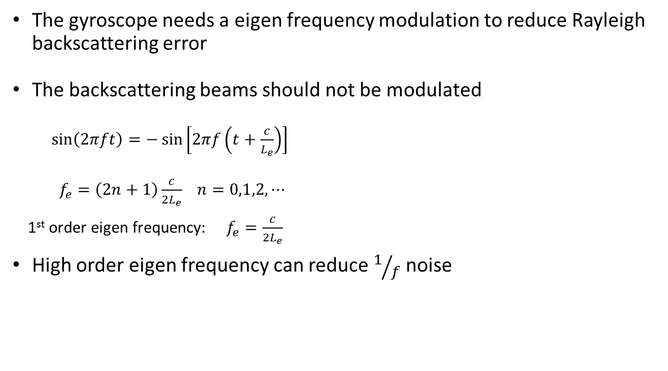
High Order Eigen Frequency Modulation for 1/f Noise Reduction
The gyroscope needs a eigen frequency modulation to reduce Rayleigh backscattering error
The backscattering beams should not be modulated
$\sin\left(2πft\right)=−\sin\left[2πf\left(t+\frac{c}{L_{e}}\right)\right]$
$f_{e}=\left(2n+1\right)\frac{c}{2L_{e}}$ $n=0,1,2,⋯$
1st order eigen frequency: $f_{e}=\frac{c}{2L_{e}}$
High order eigen frequency can reduce $1/f$ noise
Lefevre, H. C., R. A. Bergh, and H. J. Shaw. “All-Fiber Gyroscope with Inertial-Navigation Short-Term Sensitivity.” Optics Letters 7.9 (1982): 454.

Slide 11
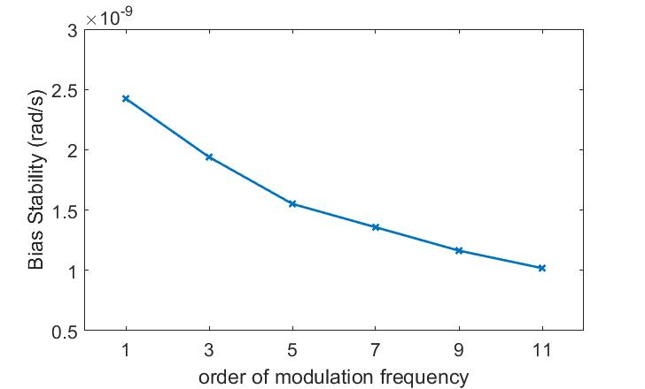
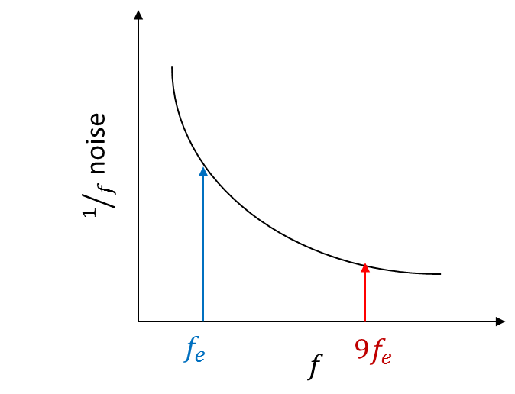
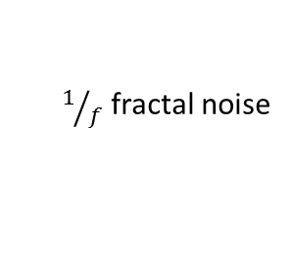
The performance of different order eigen frequency modulation
Bias stability of 10km prototype using different order of modulation frequency
Prototype1
L = 10km
D = 0.2m
$1/f$ fractal noise

Slide 12
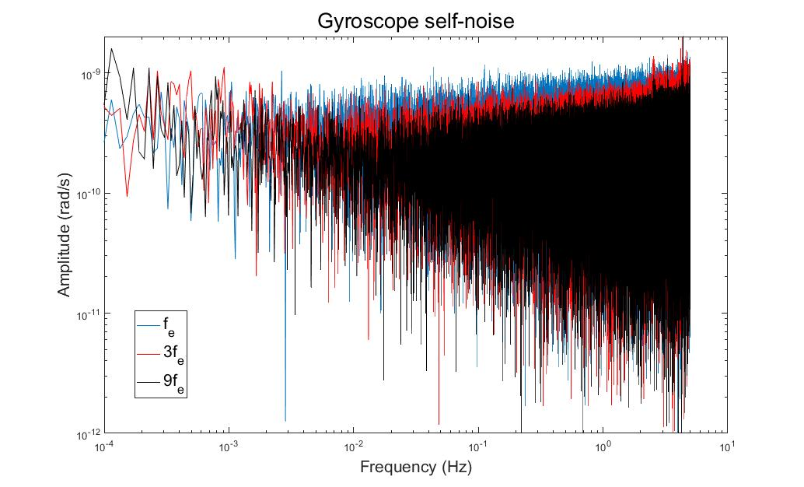
The performance of different order eigen frequency modulation
Prototype2
L = 15km
D = 0.3m
Self-noise at 1Hz, in rad/s/ √Hz : $1.1∗{10}^{−9}$ ($f_{e}$) Vs. $0.7∗{10}^{−9}$ (${9f}_{e}$)

Slide 13
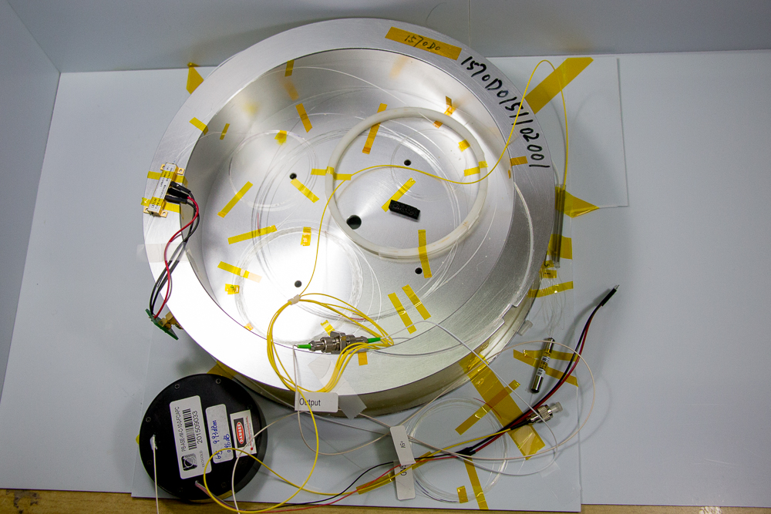
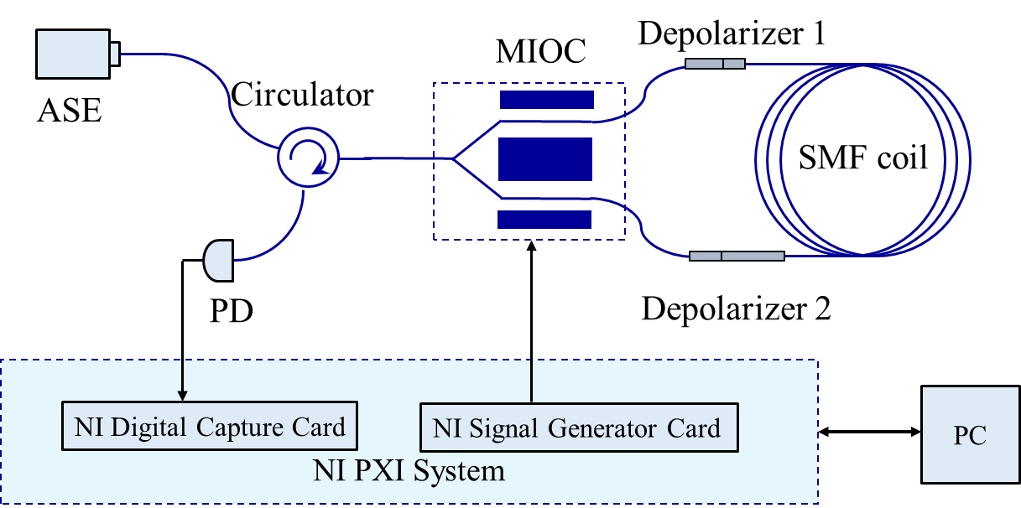
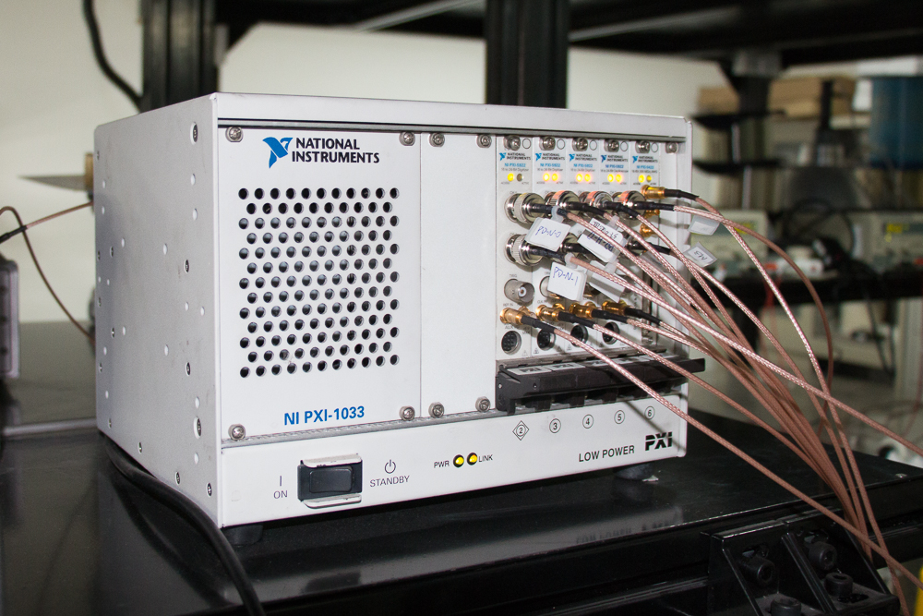
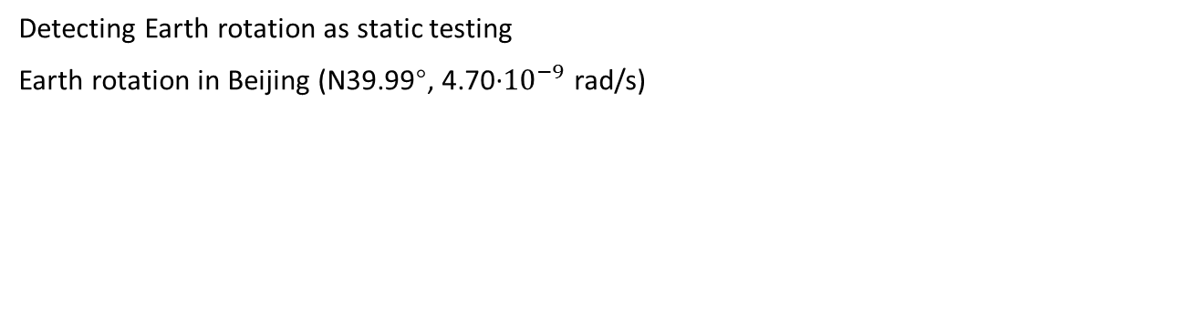
Seismometer Prototype
Detecting Earth rotation as static testing
Earth rotation in Beijing (N39.99°, 4.70·${10}^{−9}$ rad/s)

Slide 14
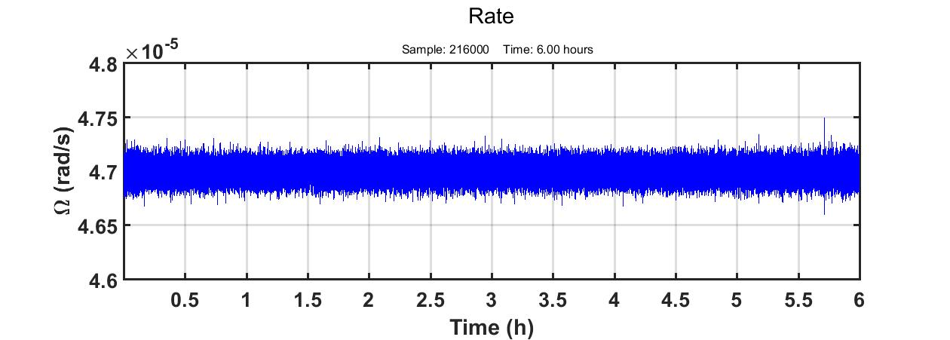
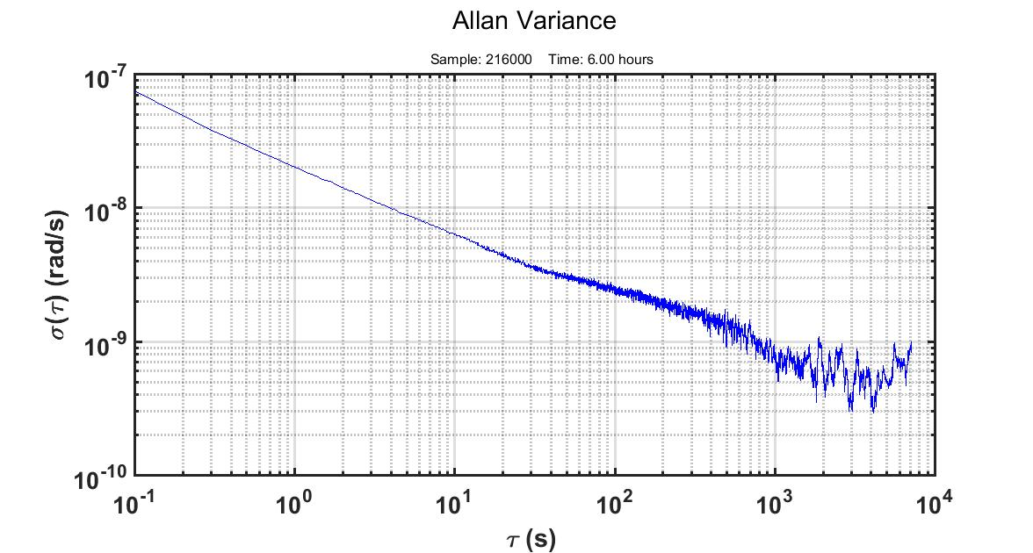
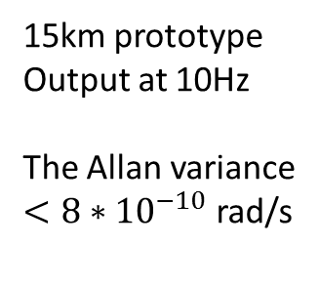
Indoor Test Outcome
15km prototype
Output at 10Hz
The Allan variance
$<8∗{10}^{−10}$ rad/s

Slide 15
Future work
Calibration
Observing seismology rotational motions
Engineering development
6 DOF seismometer development
Notes:
Degree of freedom

Slide 16
Conclusions
The prototype demonstrated can be a suitable choice:
  High bias stability to detect tiny rotational motion
  Enough frequency bandpass for seismic application
  Relatively small size and low cost
Necessary verification:
  Fully test and field observation for seismology rotational motion
Portable development is in progress

Slide 17
Thank you!

