Slide 1
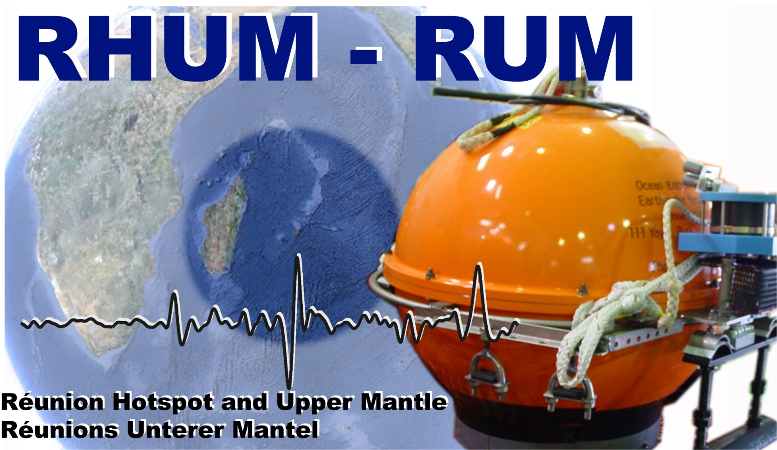
RHUM – Leg1

Slide 2
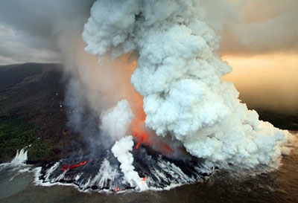
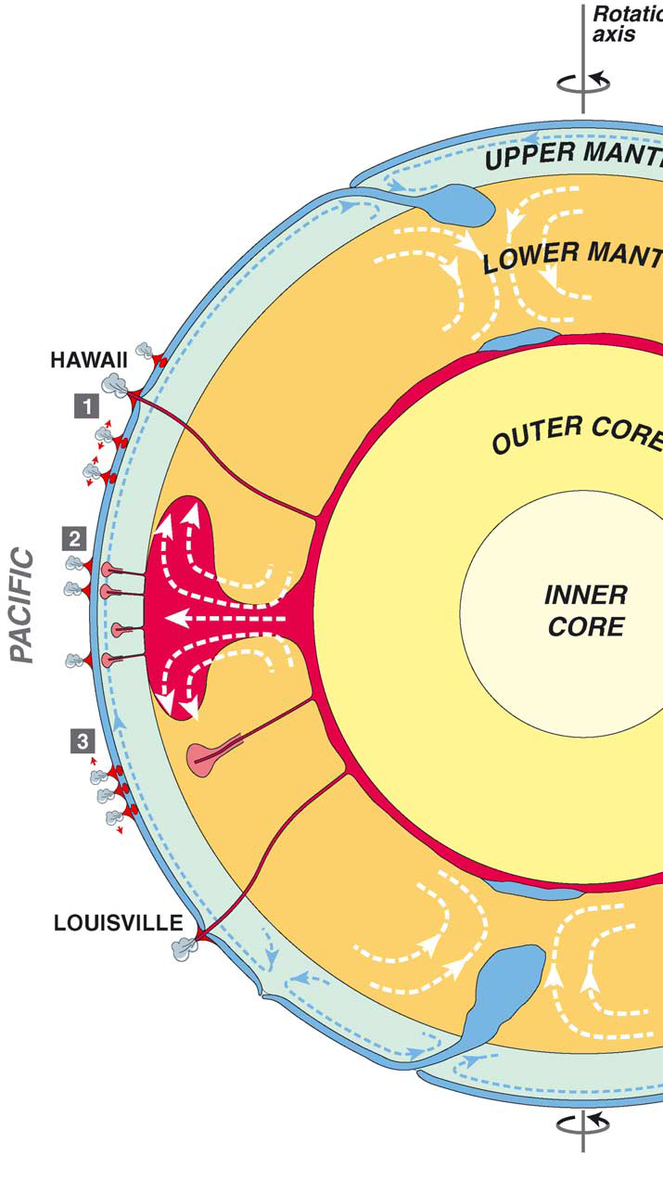
Rationale
D" layer?
Lower mantle anomaly?
Piton de la fournaise,
La Réunion, Avril 2007
Upper mantle
instability?
?
(Courtillot et al., EPSL, 2003)

Slide 3
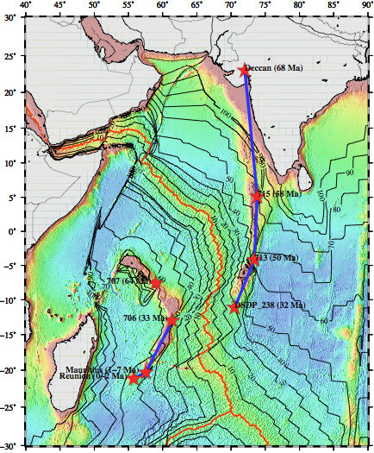
Tectonics
A French-German project funded by ANR & DFG 2012-2015
-> Structure and dynamics of La Réunion mantle plume
Objectives
Imaging upper and lower mantle structures beneath La Réunion hotspot
Relationships with the south African superplume
Signature in the transition zone
Plume-lithosphere interactions, mantle flow, influence of pre-existing structures (ridges, transforms)
Plume – ridge interaction – role of the Rodrigues ridge
Plume signature with the surface observables (Bathymetry, gravimetry, magnetism).

Slide 4
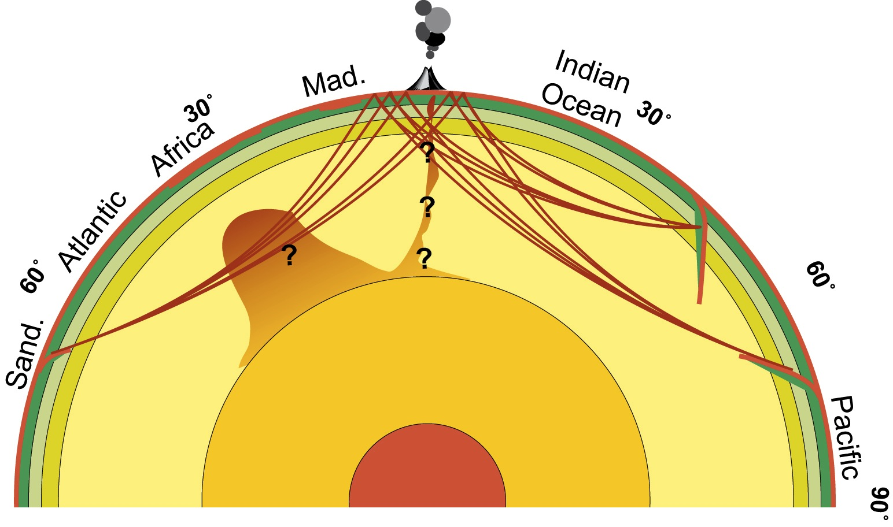
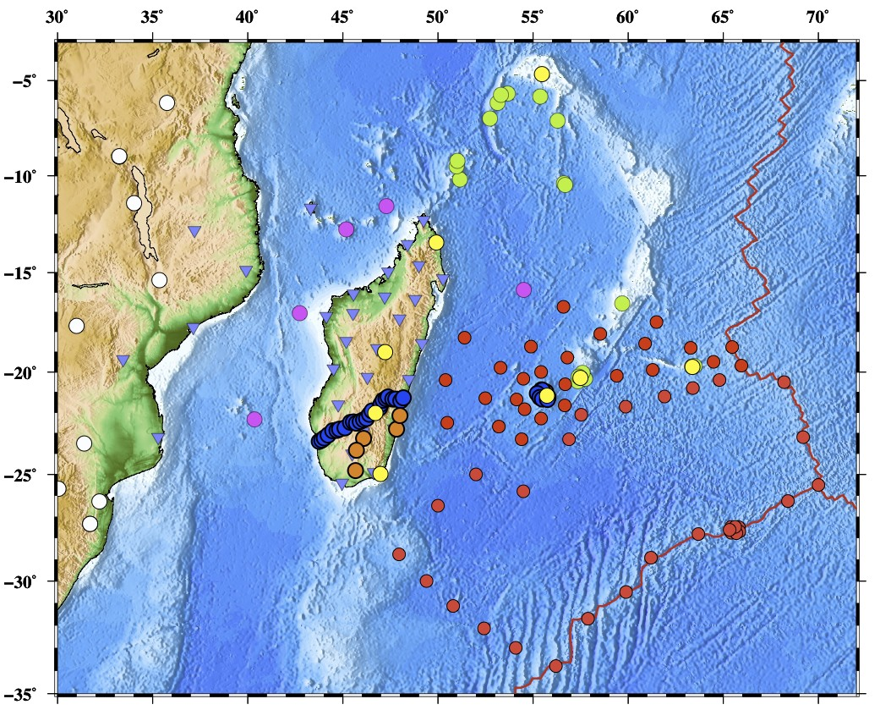
Seismological networks
57 OBS RHUM-RUM
Stations permanentes
12 stations DEPAS
Seychelles – Mauritius - Rodrigues
25 stations GFZ Madagascar
Stations AfricArray
5 stations RHUM Iles Eparses
30 stations US MACOMO
5 stations RHUM Madagascar

Slide 5
Impressions

Slide 6
Lava flow 2007

Slide 7
Route du volcan

Slide 8
Lava lake 2007

Slide 9
Piton de la Fournaise

Slide 10
Marion Dufresne

Slide 11
What we needed …

Slide 12
What we got …

Slide 13
... instead …

Slide 14
... but then …

Slide 15
Assembly

Slide 17
Deployment

Slide 18
Deployment

Slide 19
PC Room

Slide 20
Bathymetry

Slide 21
Karin with the father of plumes

Slide 22
Daily seminars

Slide 23
Leasure

Slide 24
Return (strike again!)

Slide 25
Current location

