Slide 1
Inverse Problems in Geophysics
What is an inverse problem?
https://www.erasmus.gr/microsites/1193/programystc
What is an inverse problem?
Illustrative Example
Exact inverse problems
Nonlinear inverse problems
Examples in Geophysics
Traveltime inverse problems
Seismic Tomography
Location of Earthquakes
Global Electromagnetics
Reflection Seismology
Scope: Understand the concepts of data fitting and inverse problems and the associated problems. Simple mathematical formulation as linear (-ized) systems.

Slide 2
What is an inverse problem?
Forward Problem
Model m
Data d
Inverse Problem

Slide 3
Treasure Hunt
X
X
X
X
Gravimeter
?

Slide 4
Treasure Hunt – Forward Problem
We have observed some values:
10, 23, 35, 45, 56 μgals
How can we relate the observed gravity
values to the subsurface properties?
We know how to do the forward problem:
X
X
X
X
X
Gravimeter
?
This equation relates the (observed) gravitational potential to the
subsurface density.
-> given a density model we can predict the gravity field at the surface!

Slide 5
Treasure Hunt – Trial and Error
What else do we know?
Density sand: 2,2 g/cm³
Density gold: 19,3 g/cm³
Do we know these values exactly?
How can we find out whether and if so
where is the box with gold?
X
X
X
X
X
Gravimeter
?
One approach:
Use the forward solution to calculate many models for a rectangular box
situated somewhere in the ground and compare the theoretical (synthetic)
data to the observations.
->Trial and error method

Slide 6
Treasure Hunt – Model Space
But ...
... we have to define plausible models
for the beach. We have to somehow
describe the model geometrically.
-> Let us
- divide the subsurface into a rectangles with variable density
- Let us assume a flat surface
X
X
X
X
X
Gravimeter
?
surface
x
x
x
x
x
sand
gold

Slide 7
Treasure Hunt – Non-uniqueness
Could we go through all possible models
and compare the synthetic data with the
observations?
at every rectangle two possibilities
(sand or gold)
2⁵⁰ ~ 10¹⁵ possible models
Too many models!
X
X
X
X
X
Gravimeter
We have 10¹⁵ possible models but only 5 observations!
It is likely that two or more models will fit the data (possibly perfectly well)
> Nonuniqueness of the problem!

Slide 8
Treasure Hunt – A priori information
Is there anything we know about the
treasure?
How large is the box?
Is it still intact?
Has it possibly disintegrated?
What was the shape of the box?
Has someone already found it?
This is independent information that we may have which is as important and
relevant as the observed data. This is colled a priori (or prior) information.
It will allow us to define plausible, possible, and unlikely models:
X
X
X
X
X
Gravimeter
plausible
possible
unlikely

Slide 9
Treasure Hunt – Uncertainties (Errors)
Do we have errors in the data?
Did the instruments work correctly?
Do we have to correct for anything?
(e.g. topography, tides, ...)
Are we using the right theory?
Do we have to use 3-D models?
Do we need to include the topography?
Are there other materials in the ground apart from gold and sand?
Are there adjacent masses which could influence the observations?
How (on Earth) can we quantify these problems?
X
X
X
X
X
Gravimeter

Slide 10
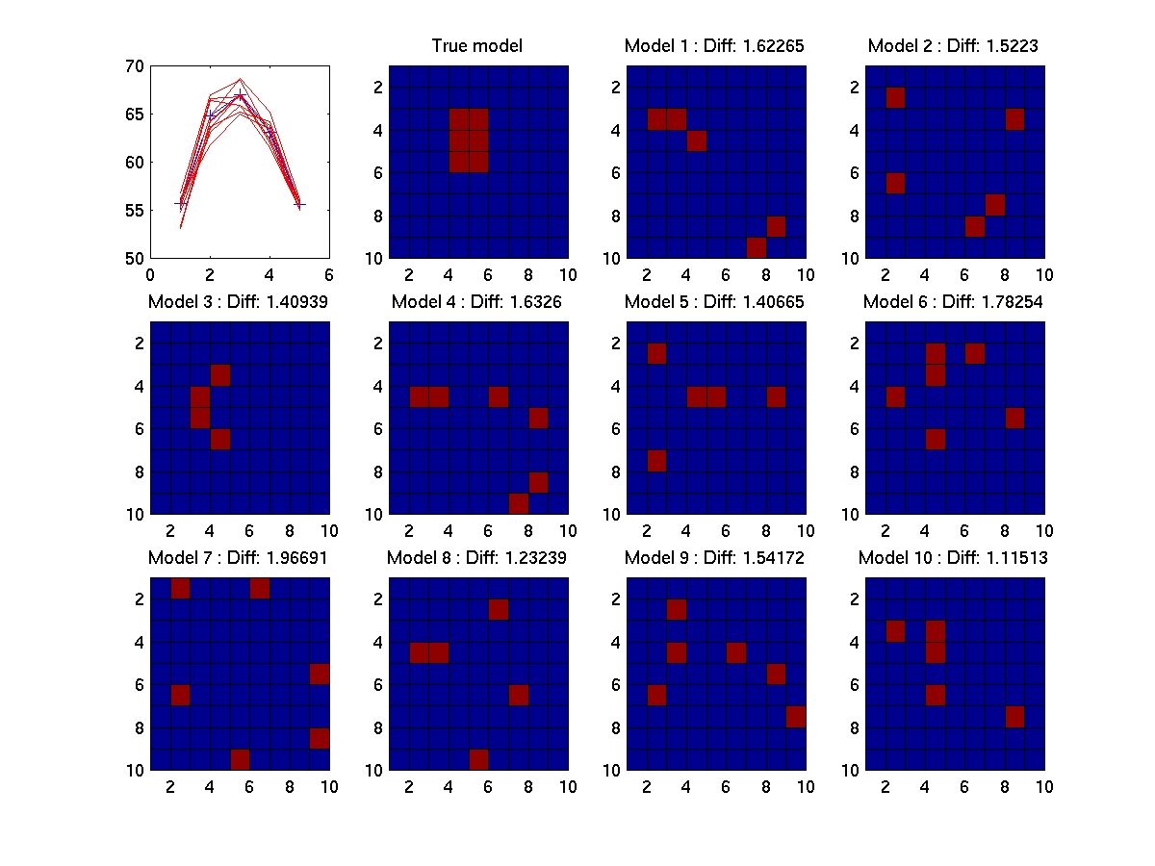
Treasure Hunt - Example
Models with less than 2% error.
X
X
X
X
X
Gravimeter

Slide 11
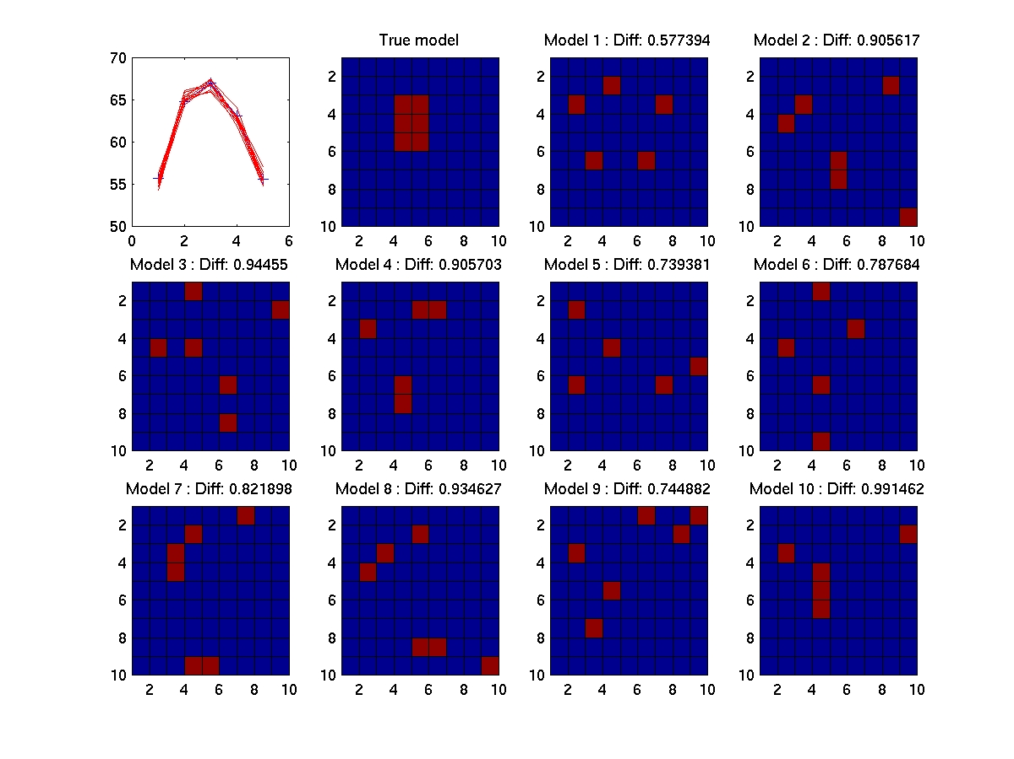
Treasure Hunt - Example
Models with less than 1% error.
X
X
X
X
X
Gravimeter

Slide 12
Inverse Problems - Summary
Inverse problems – inference about physical
systems from data
X
X
X
X
X
Gravimeter
Data usually contain errors (data uncertainties)
Physical theories are continuous
infinitely many models will fit the data (non-uniqueness)
Our physical theory may be inaccurate (theoretical uncertainties)
Our forward problem may be highly nonlinear
We always have a finite amount of data
The fundamental questions are:
How accurate are our data?
How well can we solve the forward problem?
What independent information do we have on the model space (a priori information)?

Slide 13
Corrected scheme for the real world
Forward Problem
True Model m
Appraisal
Problem
Data d
Inverse Problem
Estimated Model

Slide 14
Linear(ized) Inverse Problems
Let us try and formulate the inverse problem mathematically:
Our goal is to determine the parameters of a (discrete) model m_{i,} i=1,...,m from a set of observed data d_{j} j=1,...,n. Model and data are functionally related (physical theory) such that
This is the nonlinear
formulation.
Note that m_{i} need not be model parameters at particular points in space but they could also be expansion coefficients of orthogonal functions (e.g. Fourier coefficients, Chebyshev coefficients etc.).

Slide 15
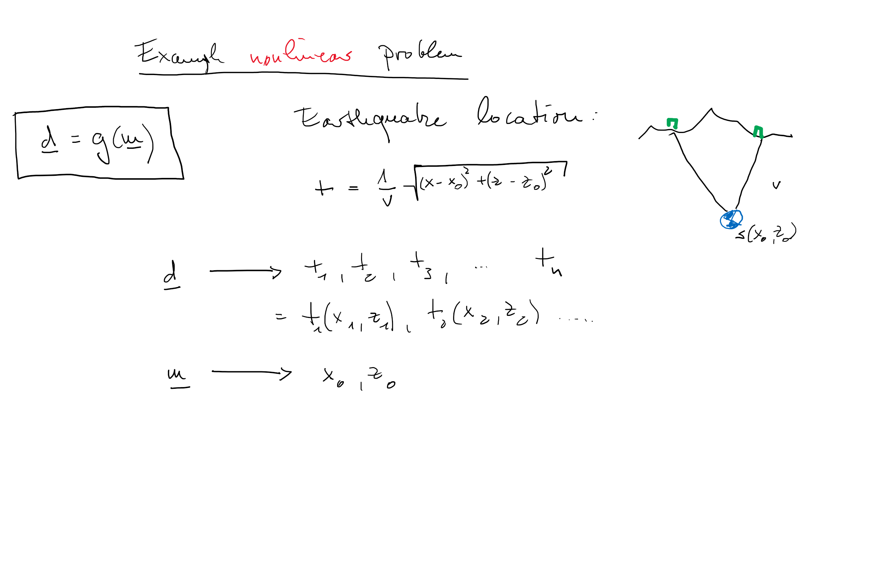
Example

Slide 16

Linear(ized) Inverse Problems
If the functions g_{i}(m_{j}) between model and data are linear we obtain
or
in matrix form. If the functions A_{i}(m_{j}) between model and data are mildly non-linear we can consider the behavior of the system around some known (e.g. initial) model m_{j}⁰:
$$d\left(m_{0}+∆m\right)=d+∆d=G\left(m_{0}\right)+\frac{∂G}{∂m}∆m+ ….$$

Slide 17
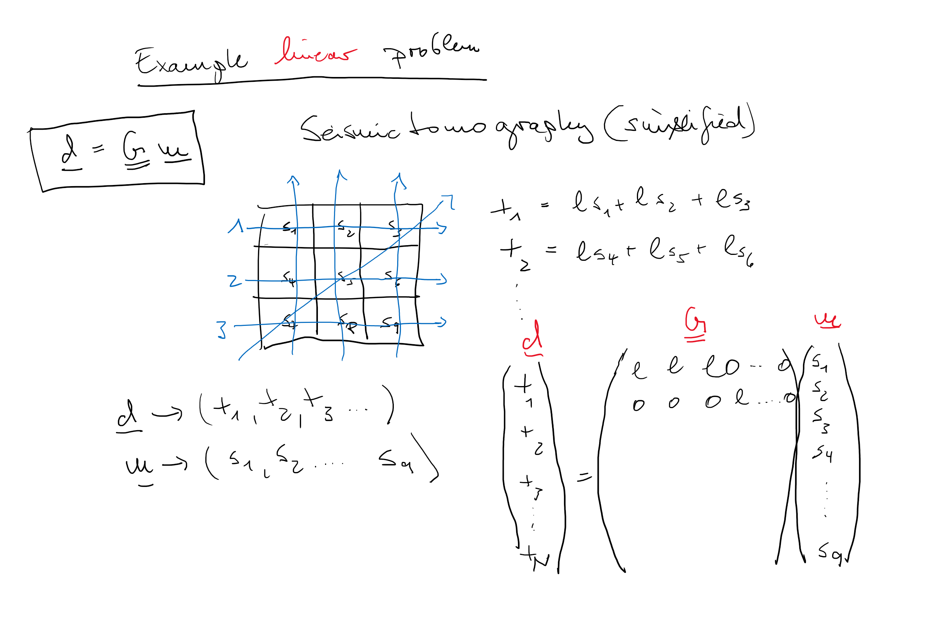
Example

Slide 18
Linear(ized) Inverse Problems
Interpretation of this result:
m₀ may be an initial guess for our physical model
We may calculate (e.g. in a nonlinear way) the synthetic data d=f(m₀).
We can now calculate the data misfit, Δd=d-d₀, where d₀ are the observed data.
Using some formal inverse operator A⁻¹ we can calculate the corresponding model perturbation Dm. This is also called the gradient of the misfit function.
We can now calculate a new model m=m₀+ Dm which will – by definition – is a better fit to the data. We can start the procedure again in an iterative way.

Slide 19

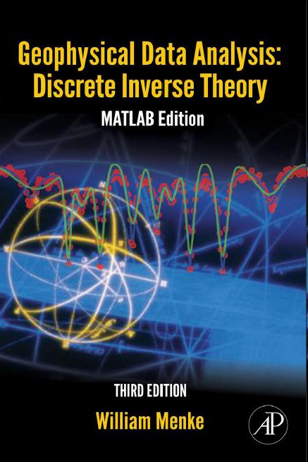
Literature
Stein and Wysession: Introduction to seismology, Chapter 7
Aki and Richards: Theoretical Seismology (1s edition) Chapter 12.3
Shearer: Introduction to seismology, Chapter 5
Menke, Discrete Inverse Problems
http://www.ldeo.columbia.edu/users/menke/gdadit/index.htm
Full ppt files and matlab routines

Slide 20
Formulation
Linear(-ized) inverse problems can be formulated in the following way:
(summation convention applies)
i=1,2,...,N number of data
j=1,2,...,M number of model parameters
G_{ij} known (mxn)
We observe:
- The inverse problem has a unique solution if N=M and det(G)≠0, i.e.
the data are linearly independent
the problem is overdetermined if N>M
the problem is underdetermined if M>N

Slide 21
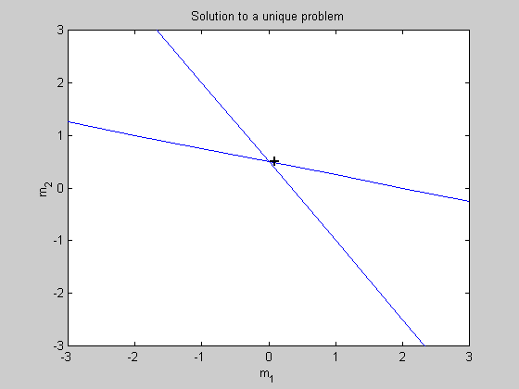
Illustration – Unique Case
In this case N=M, and det(G) ≠0. Let us consider an example
Let us check the determinant of this system: det(G)=10

Slide 22
Illustration – Overdetermined Case
In this case N>M, there are more data than model parameters.
Let us consider examples with M=2, an overdetermined system would
exist if N=3.
A physical experiment which could result in these data:
Individual Weight measurement of two masses m₁ and m₂
leading to the data d₁ and d₂ and weighing both together
leads to d₃. In matrix form:

Slide 23
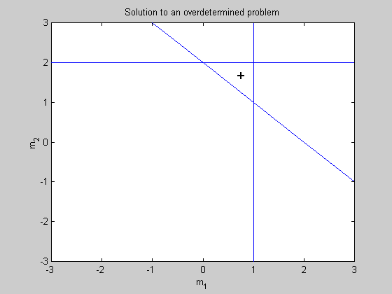
Illustration – Overdetermined Case
Let us consider this problem graphically
A common way to solve this problem is to minimize the
difference between data vector d and the predicted data
for some model m such that
is minimal.

Slide 24
Illustration – Overdetermined Case
Using the L₂-norm leads us to the
least-squares formulation of the
problem. The solution to the
minimization (and thus the inverse
problem) is given as:
best model
In our example the resulting (best) model estimation is:
and is the model with the minimal distance to all three lines in the plot.

Slide 25
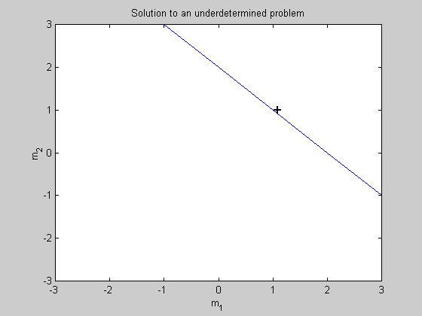
Illustration – Underdetermined Case
Let us assume we made one measurement of the combined weight of two masses:
Clearly there are infinitely many solutions to this problem. A model
estimate can be defined by choosing a model that fits the data exactly
Am=d and has the smallest l₂ norm ||m||. Using Lagrange multipliers
one can show that the minimum norm solution is given by

Slide 26
Nonlinear Inverse Problems
Assume we have a wildly nonlinear functional relationship between model and data
The only option we have here is to try and go – in a sensible way – through the whole model space and calculate the misfit function
and find the model(s) which have the minimal misfit.

Slide 27
Model Search
The way how to explore a model space is a science itself!
Some key methods are:
Monte Carlo Method: Search in a random way through the model space and collect models with good fit.
Simulated Annealing. In analogy to a heat bath, or the generation of crystal one optimizes the quality (improves the misfit) of an ensemble of models. Decreasing the temperature would be equivalent to reducing the misfit (energy).
Genetic Algorithms. A pool of models recombines and combines information, every generation only the fittest survive and give on the successful properties.
Evolutionary Programming. A formal generalization of the ideas of genetic algorithms.

Slide 28
Inversion: the probabilistic approach
The misfit function
can also be interpreted as a
likelihood function:
describing a probability density function (pdf) defined over the
whole model space (assuming exact data and theory). This pdf
is also called the a posteriori probability. In the probabilistic
sense the a posteriori pdf is THE solution to the inverse problem.

Slide 29
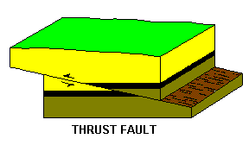
Examples: Earthquake location
Seismometers
Data vector d:
Traveltimes observed at various (at least 3) stations above the earthquake
Model m:
3 coordinates of the earthquake location (x,y,z).
Usually much more data than unknowns: overdetermined system

Slide 30
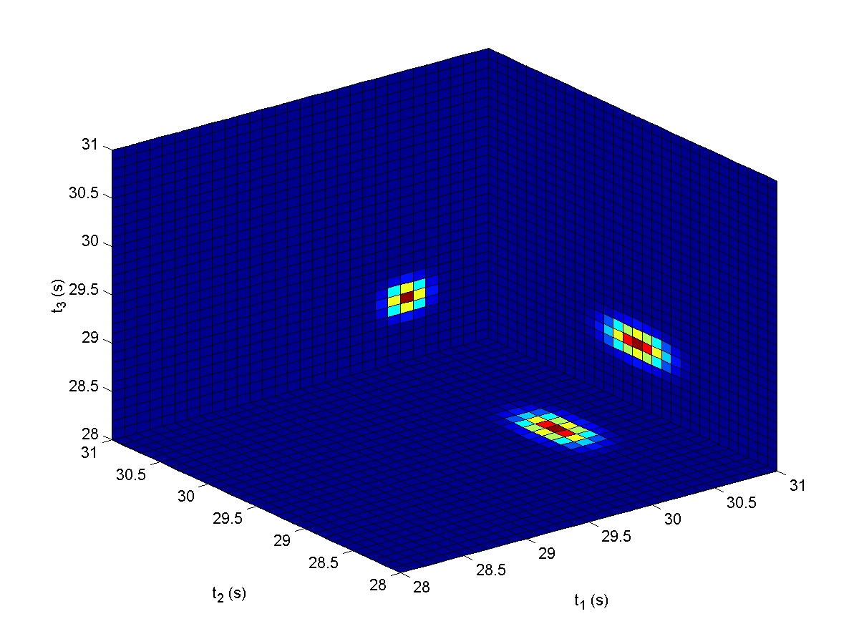
Hypocenter: data uncertainties
Marginal prior probabilities
The stations: s₁(5,0), s₁(10,0), s₁(15,0), s₁(25,0) in km
The velocity model: v=5 km/s
The data: t_{obs}= (30.3, 29.4, 28.6, 28.3)
σ = (0.1, 0.2, 0.1, 0.2)

Slide 31
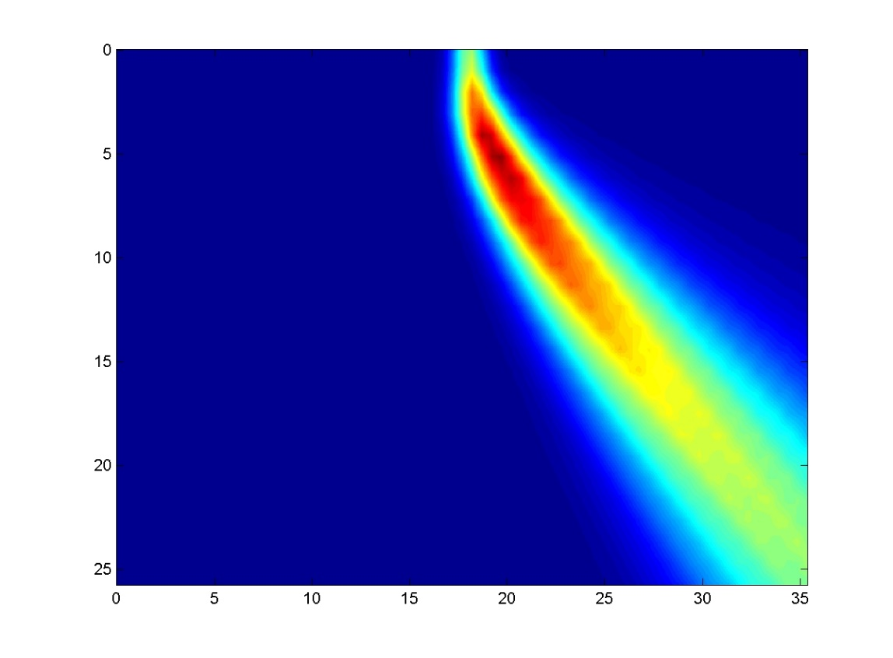
A posteriori: marginal probability
The solution to our inverse problem (x,z – space)
This is the marginal probability
density in the x,z space. One can
Now calculate any desired values
(maximum likelihood point, standard
Deviations, etc. )
Z (km)
X (km)

Slide 32
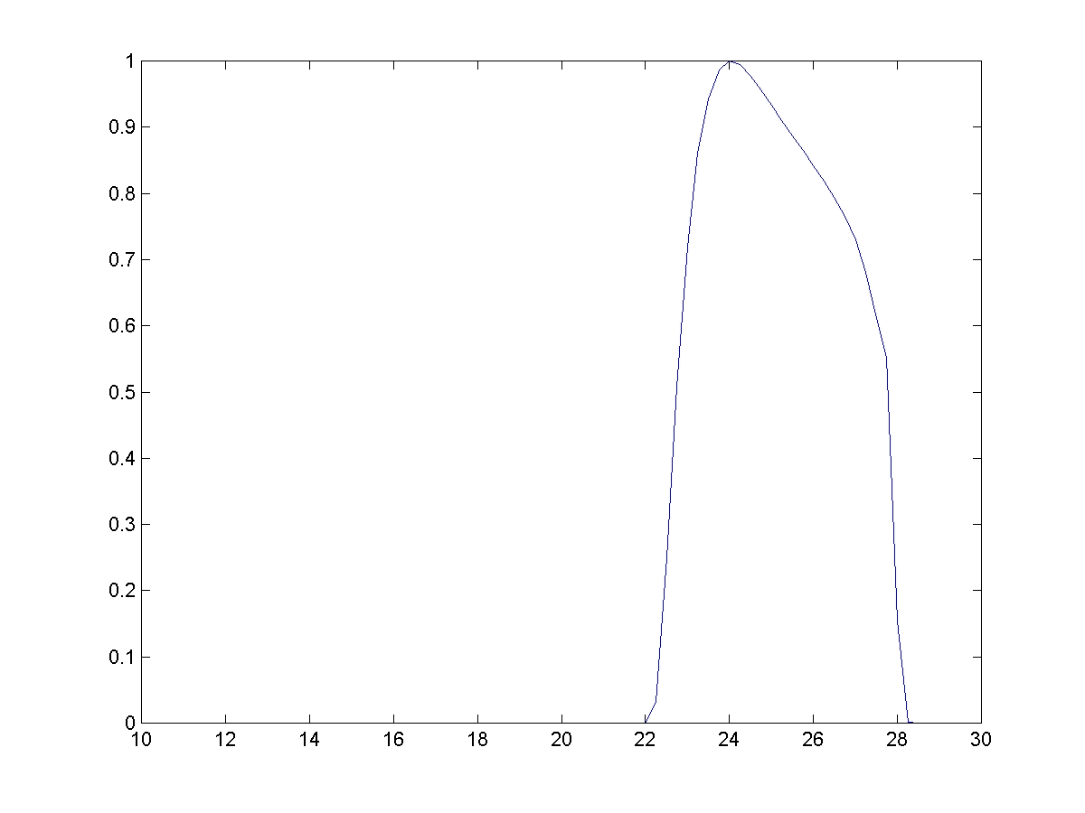
Hypocenter location: a posteriori
The solution to our inverse problem (T- space)
This graph shows the uncertainties on the origin time of the earthquake
p(T)
T(s)

Slide 33
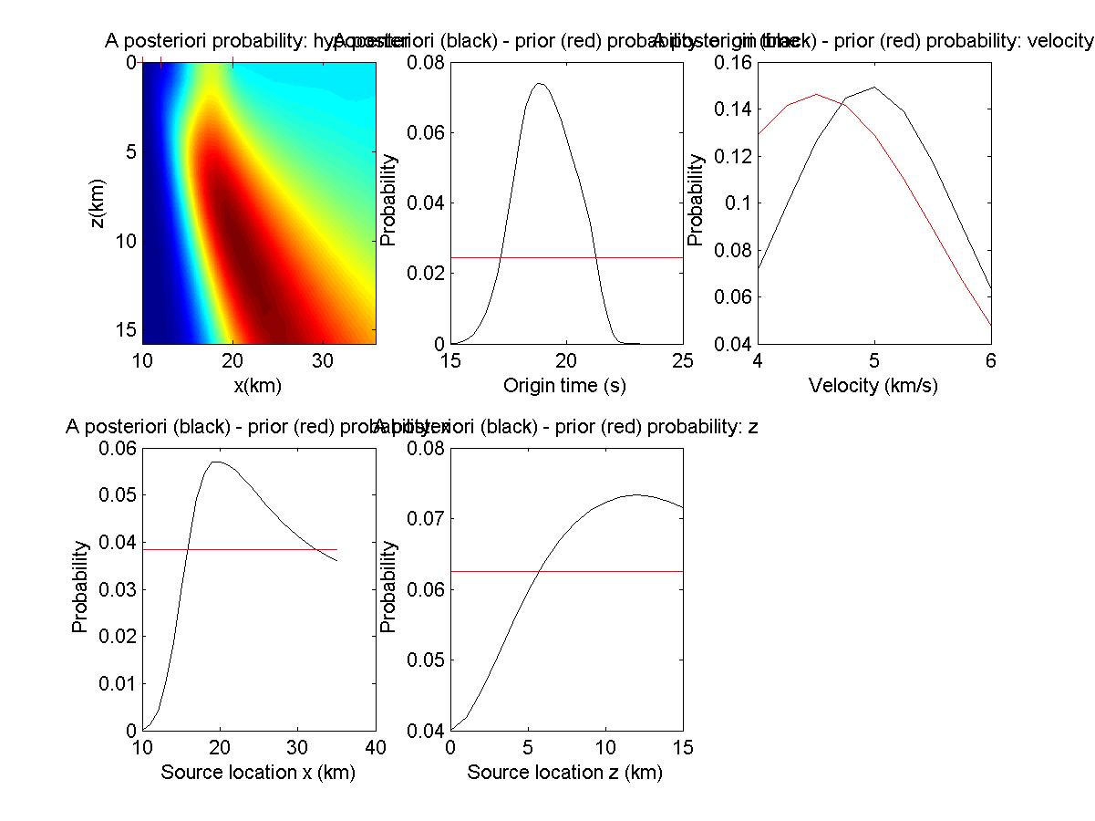
Hypocenter – one sided

Slide 34
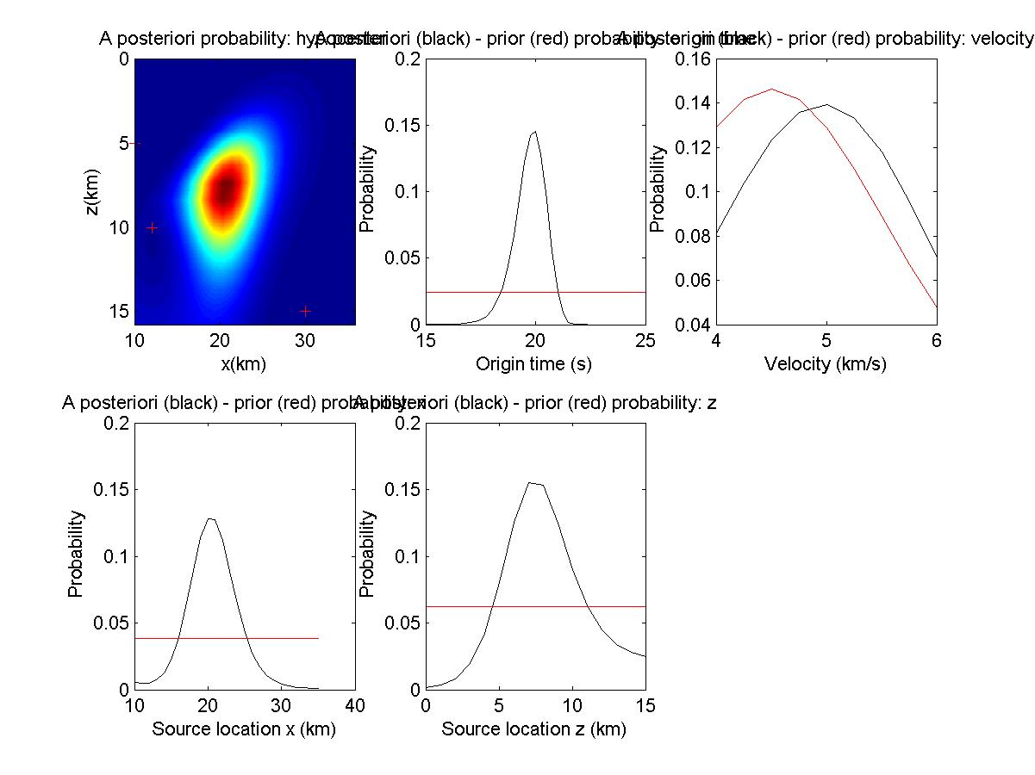
Hypocenter – receivers at depth

Slide 35
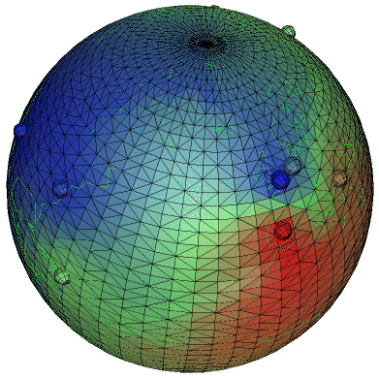
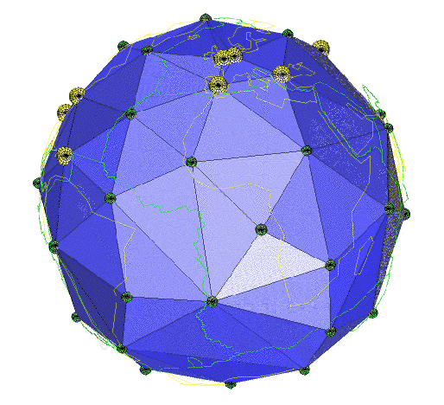
Examples: Global Electromagnetism
Data vector d:
Amplitude and Phase of magnetic field as a function of frequency
Model m:
conductivity in the Earth’s mantle
Usually much more unknowns than data: underdetermined system

Slide 36
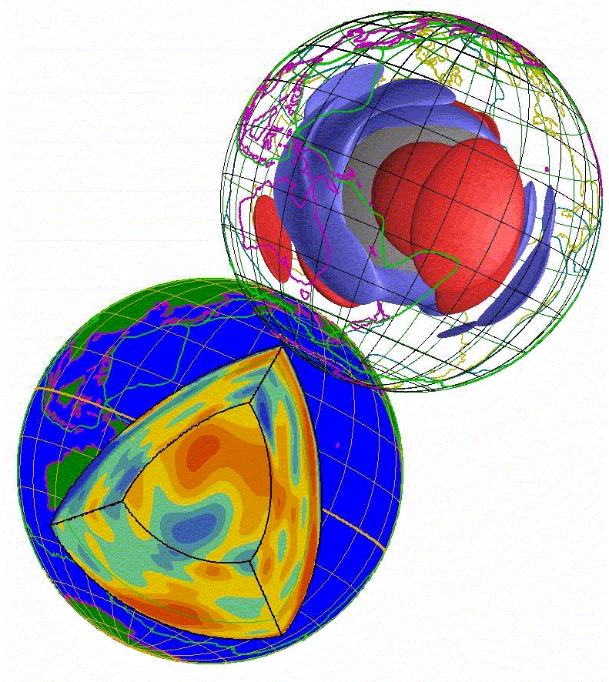
Examples: Seismic Tomography
Data vector d:
Traveltimes of phases observed at stations of the world wide seismograph network
Model m:
3-D seismic velocity model in the Earth’s mantle. Discretization using splines, spherical harmonics, Chebyshev polynomials or simply blocks.
Sometimes 100000s of travel times and a large number
of model blocks: underdetermined system

Slide 37
Examples: Reflection Seismology
Air gun
Data vector d:
ns seismograms with nt samples
-> vector length ns*nt
Model m:
the seismic velocities of the subsurface, impedances, Poisson’s ratio, density, reflection coefficients, etc.
receivers

Slide 38
Inversion: Summary
We need to develop formal ways of
calculating an inverse operator for
d=Gm -> m=G⁻¹d
(linear or linearized problems)
describing errors in the data and theory (linear and nonlinear problems)
searching a huge model space for good models (nonlinear inverse problems)
describing the quality of good models with respect to the real world (appraisal).

