Slide 1

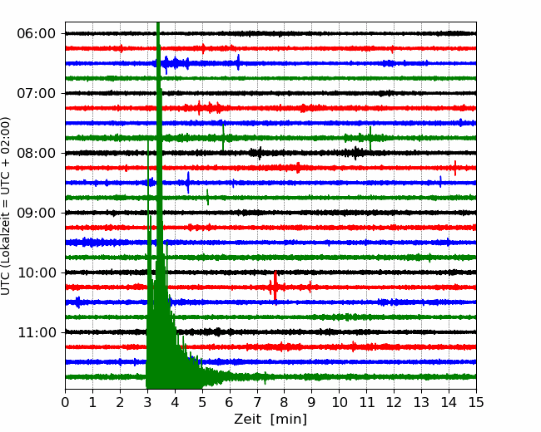

Slide 2
Erdbeben und Seismotektonik
Welche Spuren hinterlassen Erdbeben im Gelände?
Gibt es einfache Modelle dafür (-> elastic rebound)?
Was ist das einfachste physikalische Modell für ein Erdbeben?
Wie kann ich Erdbebenherdparameter bestimmen?
Was bestimmt die Ernergie (Magnitude, Stärke) von Erdbeben?
Sind kleine und große Erdbeben anders?
Was kann man über die Statistik von Erdbeben sagen?

Slide 3
Fault Scarps
Verwerfungen an der Oberfläche

Slide 4
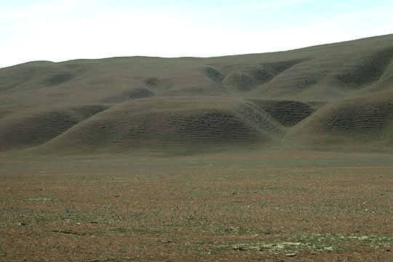
Fault scarps
California

Slide 5
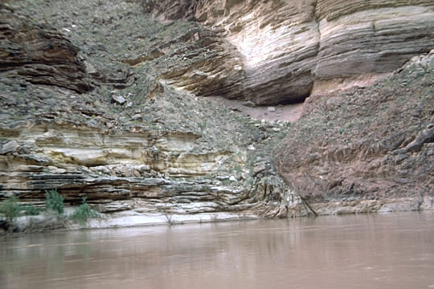
Fault scarps
Grand Canyon

Slide 6
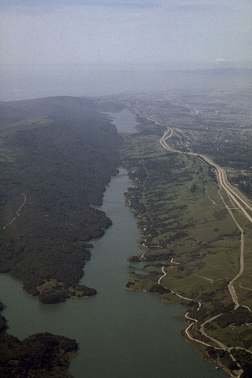
Fault scarps
California

Slide 7
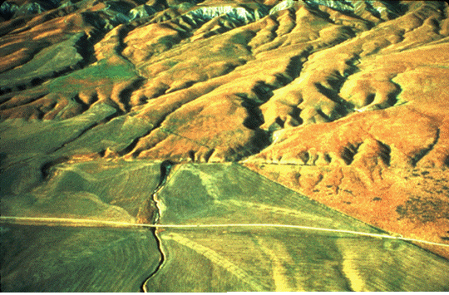
Fault scarps
California

Slide 8
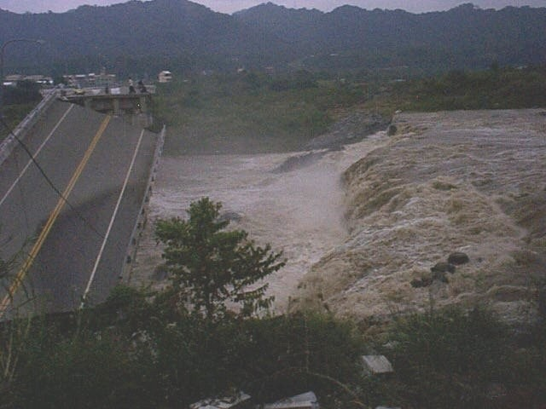
Fault scarps
Taiwan

Slide 9
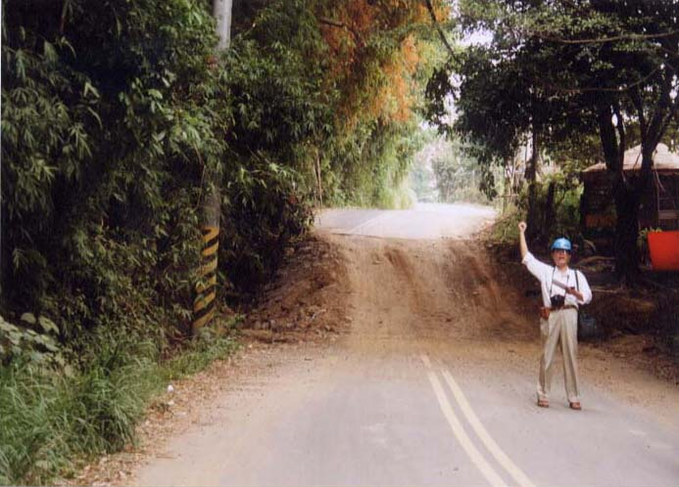
Fault scarps
Taiwan

Slide 10
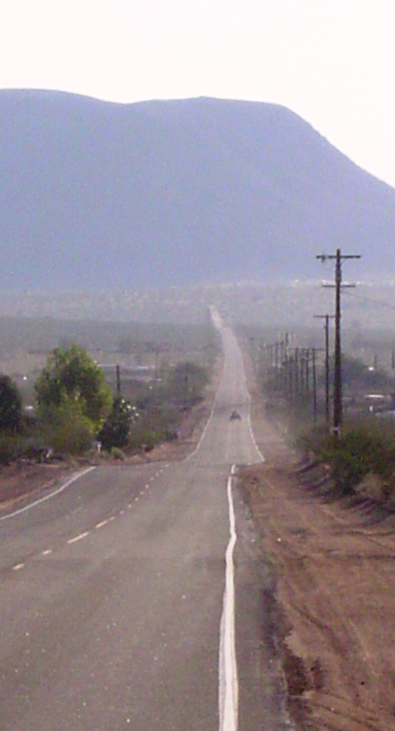
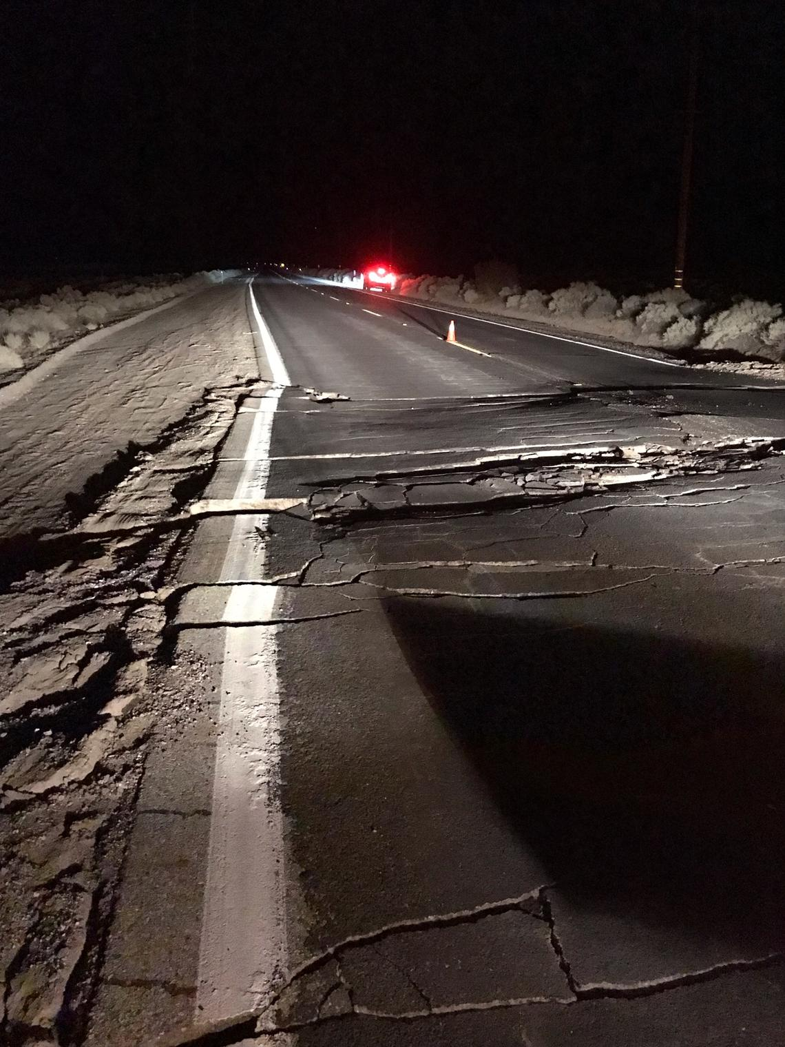

Epicentre Landers, CA

Slide 11
Gibt es einfache Modelle dafür (-> elastic rebound)?
... Great timing for engineers after the 1906 earthquake in San Francisco ...

Slide 12
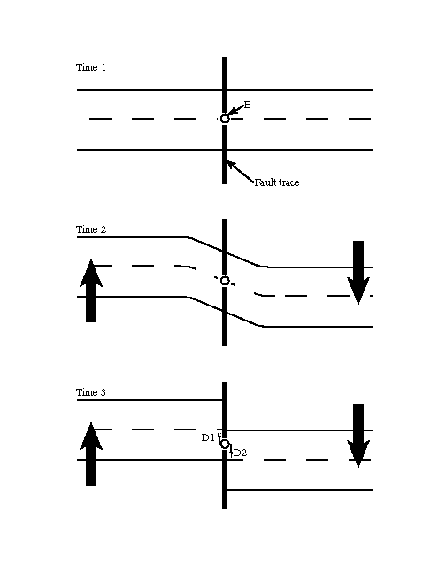
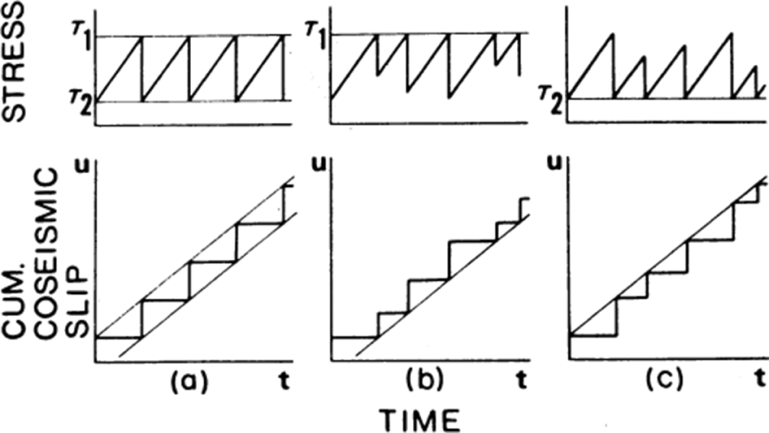
Elastic rebound
Recurrence model

Slide 13
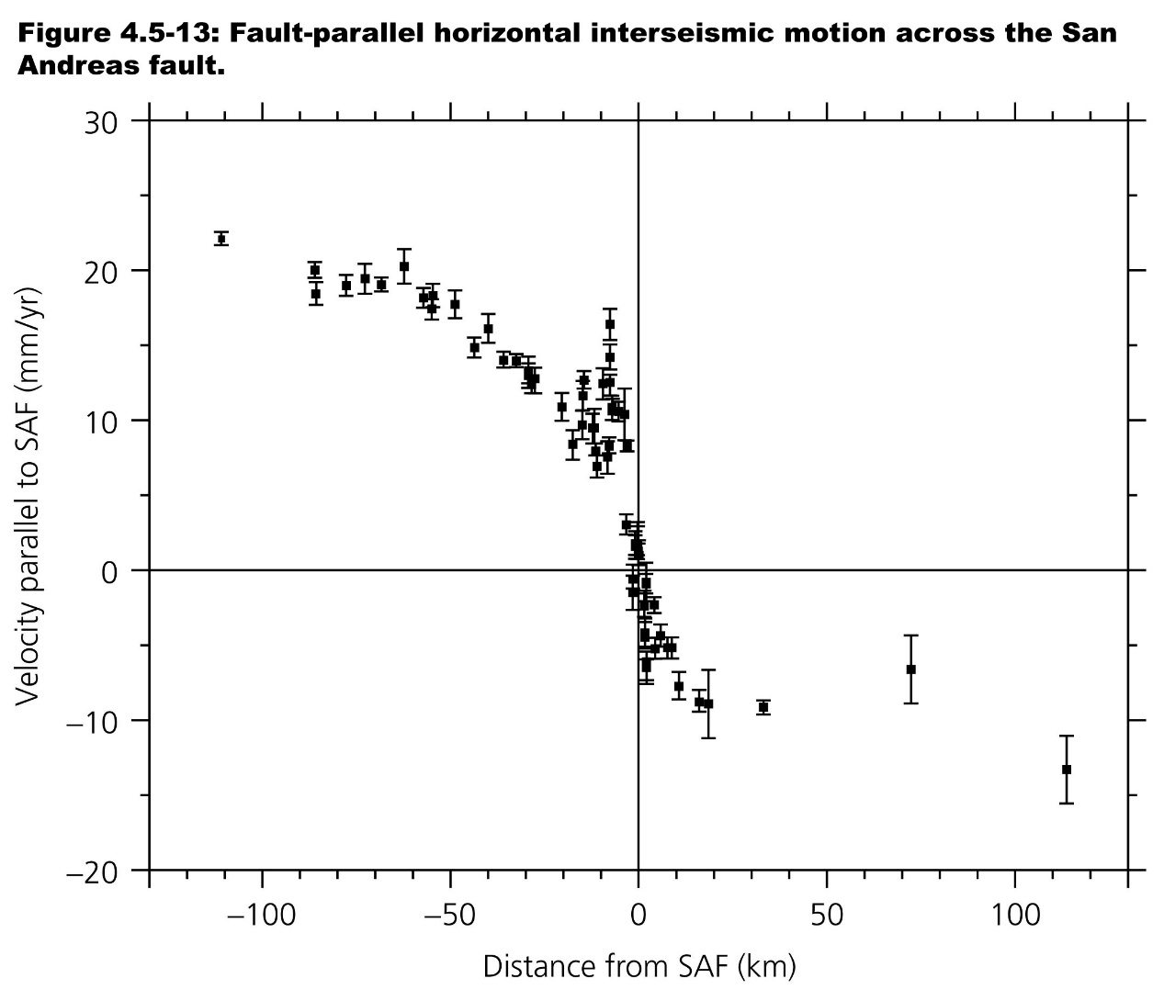
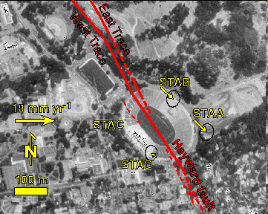
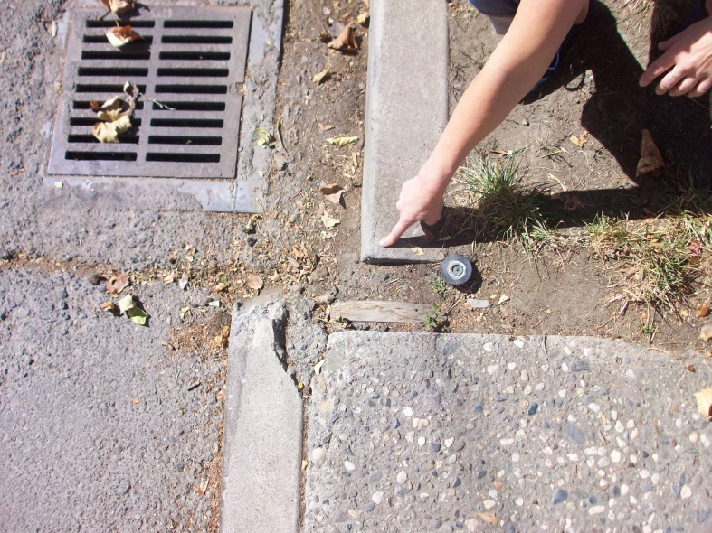
Deformation - Strain
Berkeley Football Stadium

Slide 14
Erdbeben Modell
Punktquelle
Scherdislokation

Slide 15
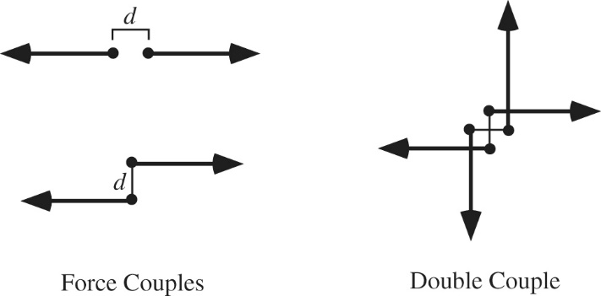
Single and double couples

Slide 16
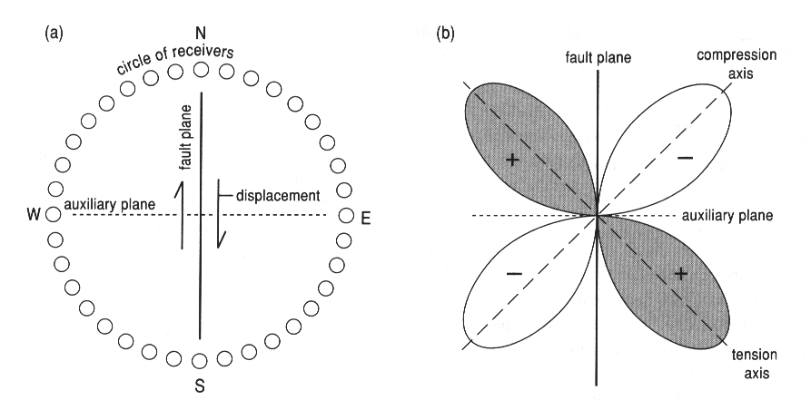
Seismic sources
The basic physical model for a source is two fault
planes slipping in opposite directions

Slide 17
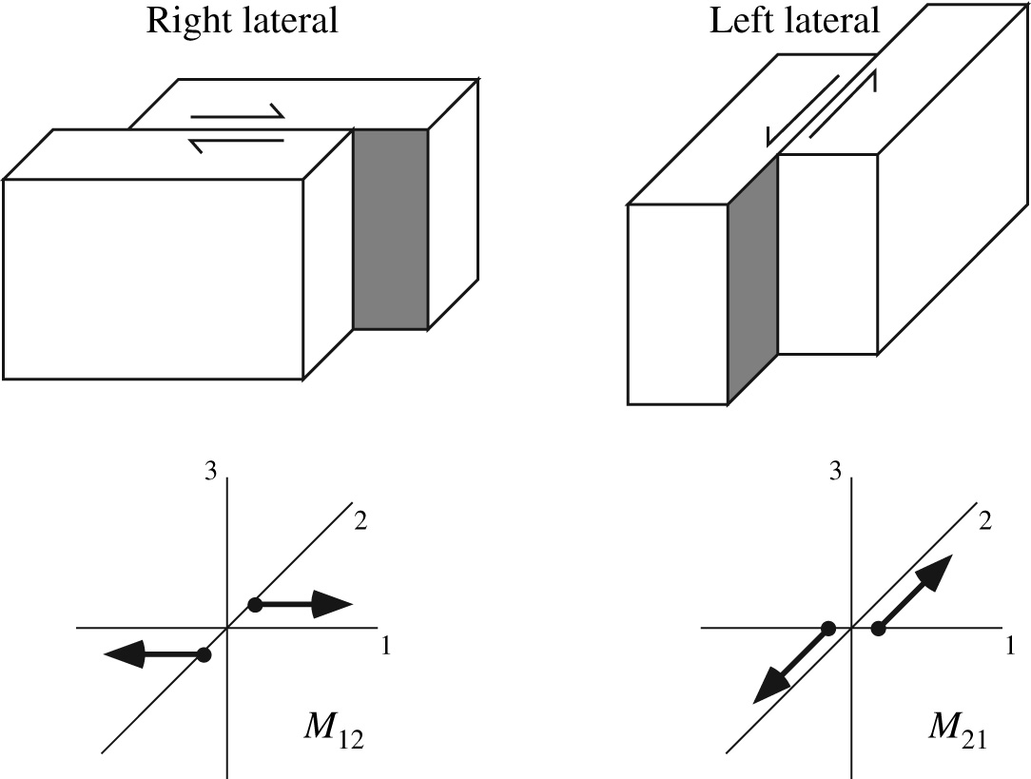
The ambiguity
Same moment tensor, same radiation pattern!

Slide 18
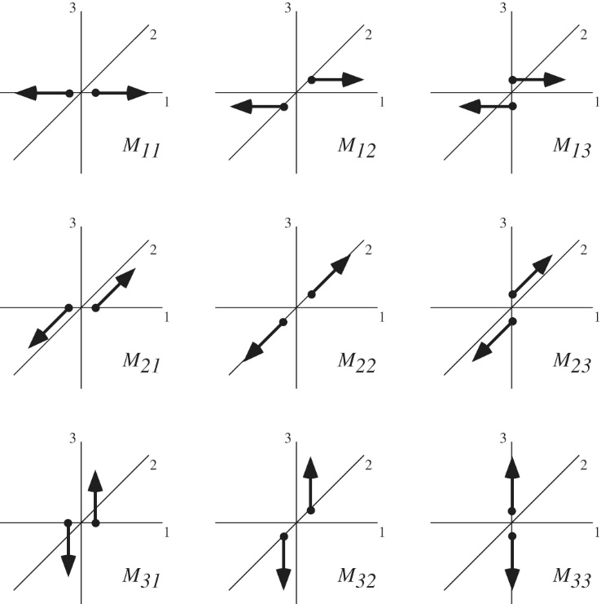
Possible double couples – Moment tensor

Slide 19
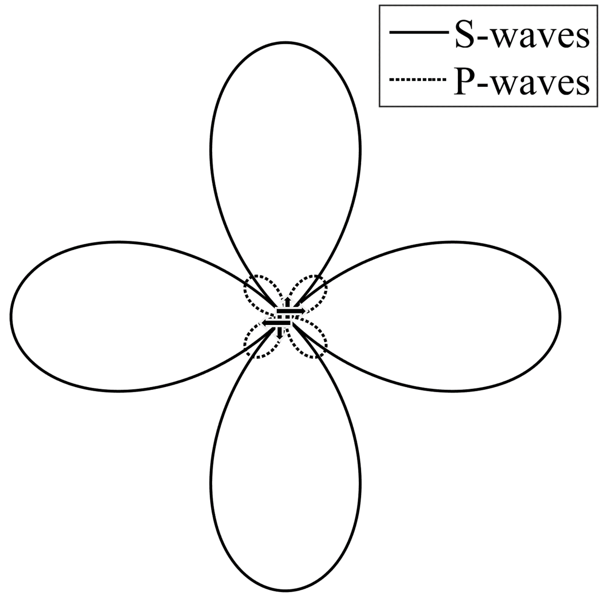
Radiation pattern

Slide 20
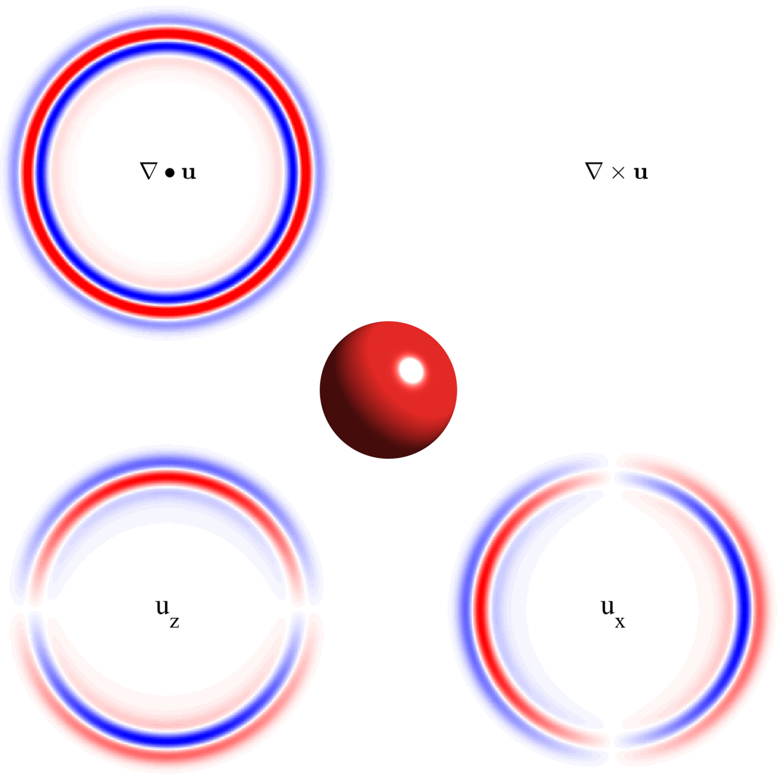
Wavefield explosion

Slide 21
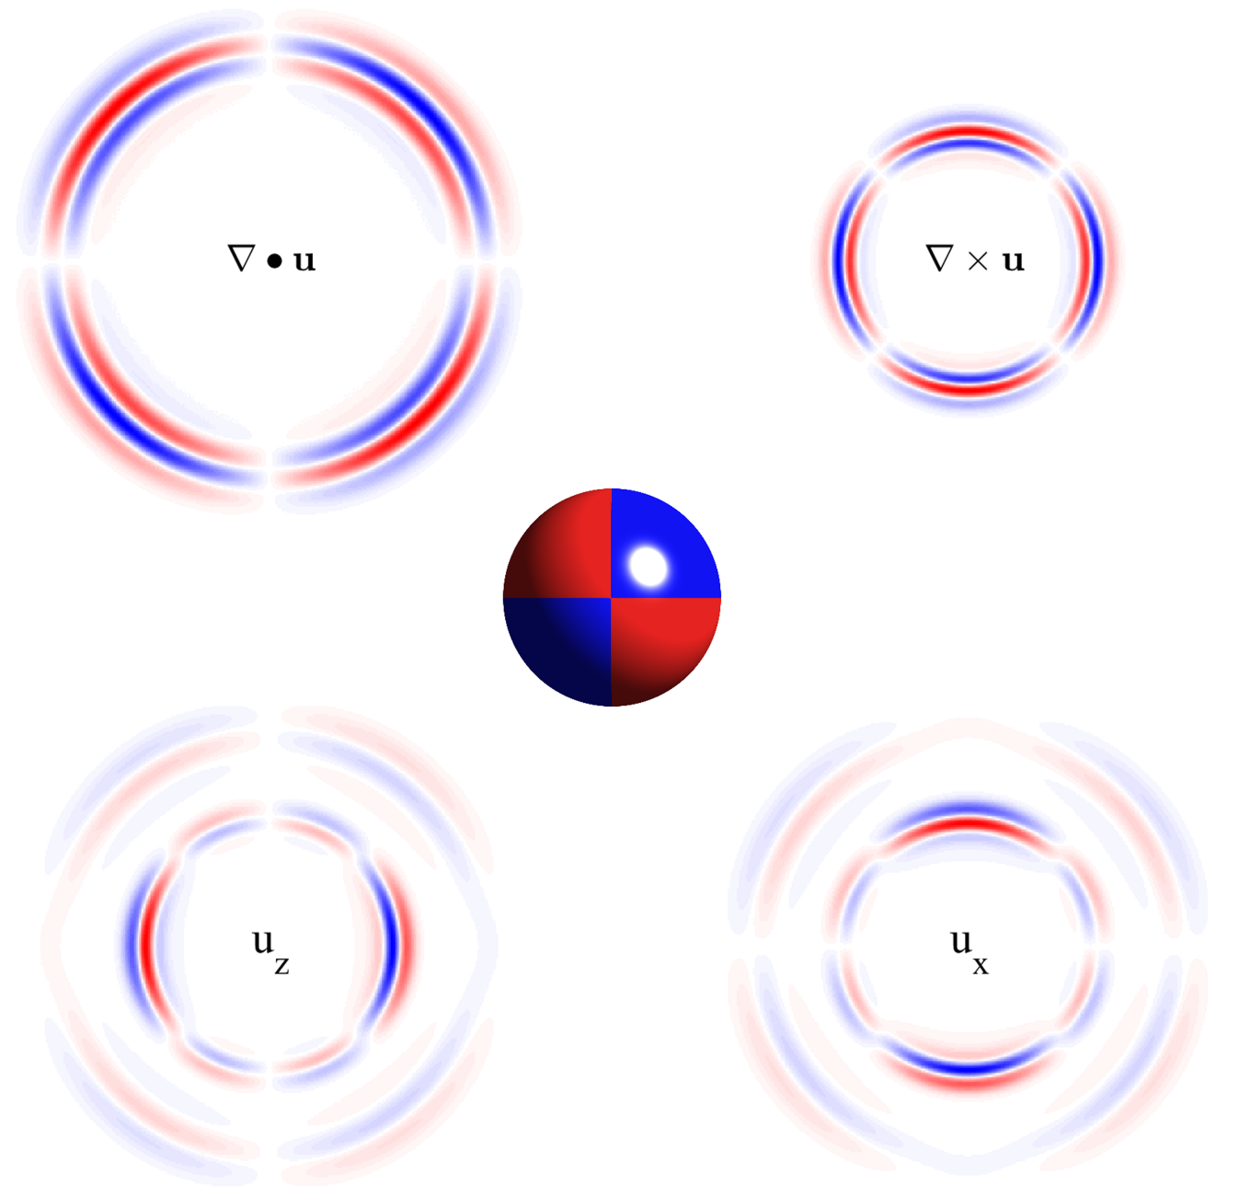
Wavefield double couple

Slide 22
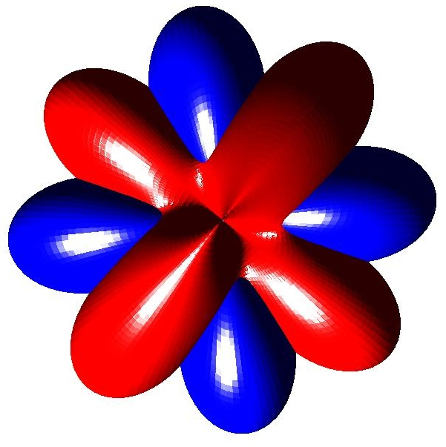
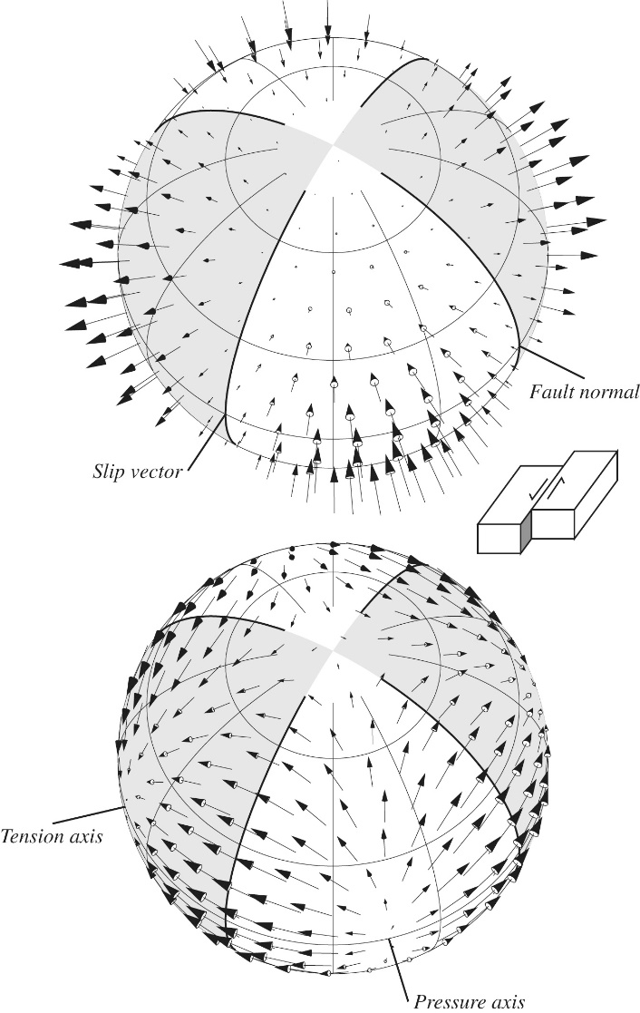
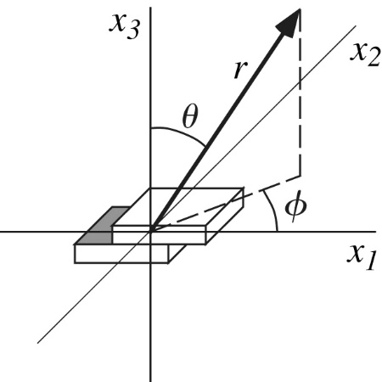
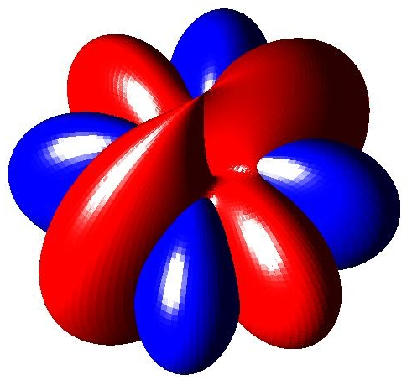
Radiation pattern – first motions
Far field P – blue
Far field S - red

Slide 23
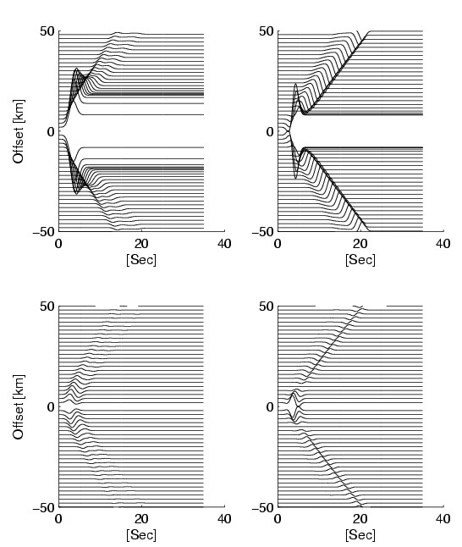
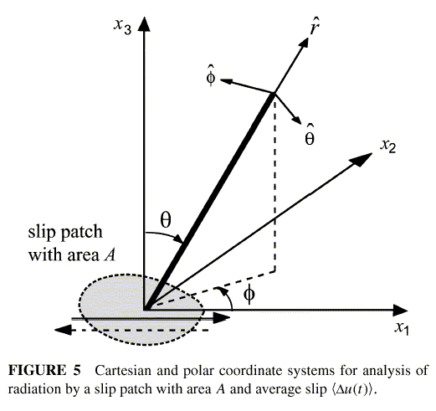
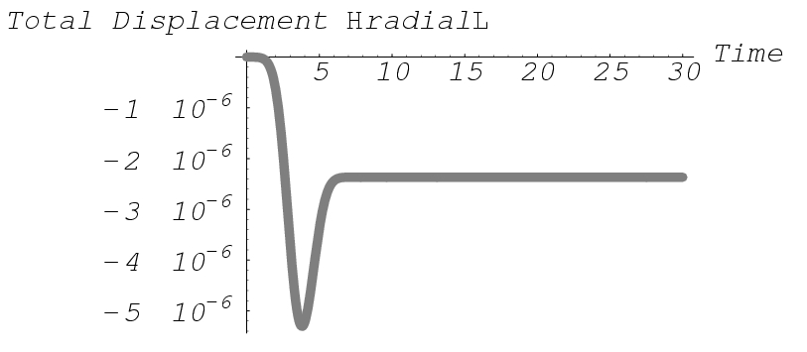
Velocity seismograms-M6.5 point source
Displacement
(static near-field effects)
Velocity

Slide 24
Wie kann ich die Quellgeometrie aus Bebachtungen ableiten?

Slide 25
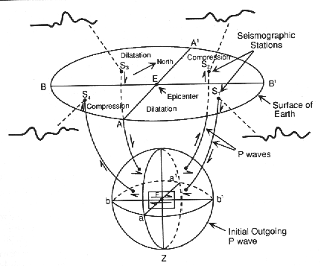
Radiation from shear dislocation – Moment tensor inversion
First motion of P waves at seismometers in various directions.
The polarities of the observed motion is used to determine the point source characteristics.

Slide 26
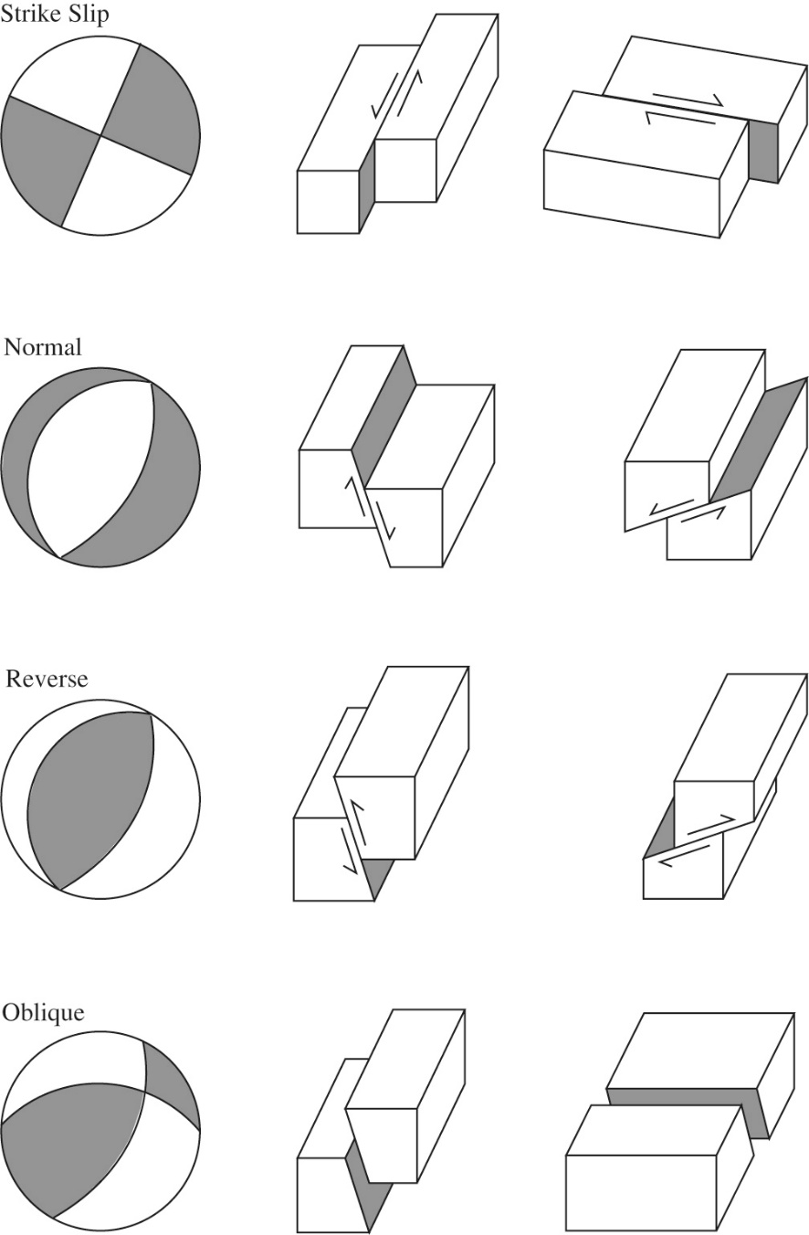
Beach balls and Fault types
Basis fault types and their appearance in the focal mechanisms. Dark regions indicate compressional P-wave motion.

Slide 27
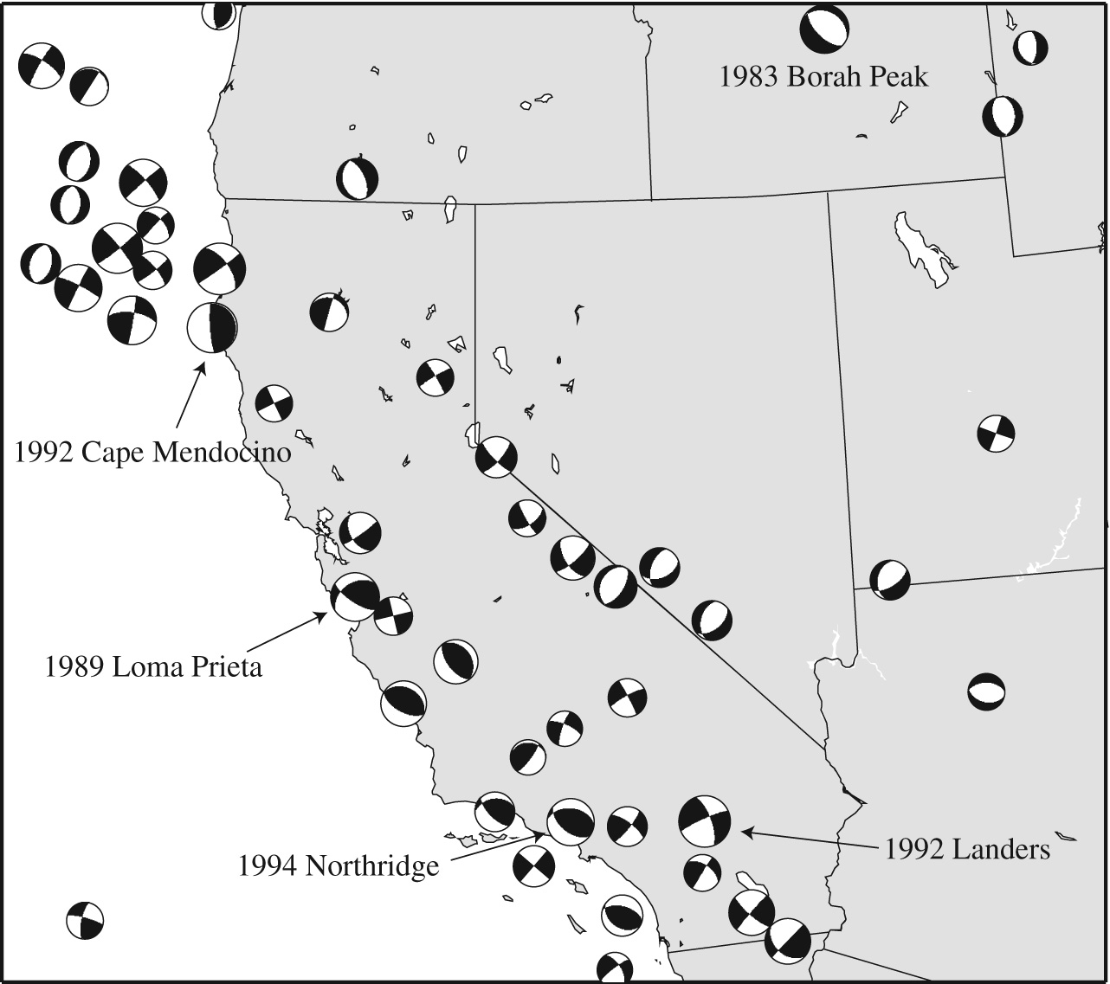
Beachball in California

Slide 28
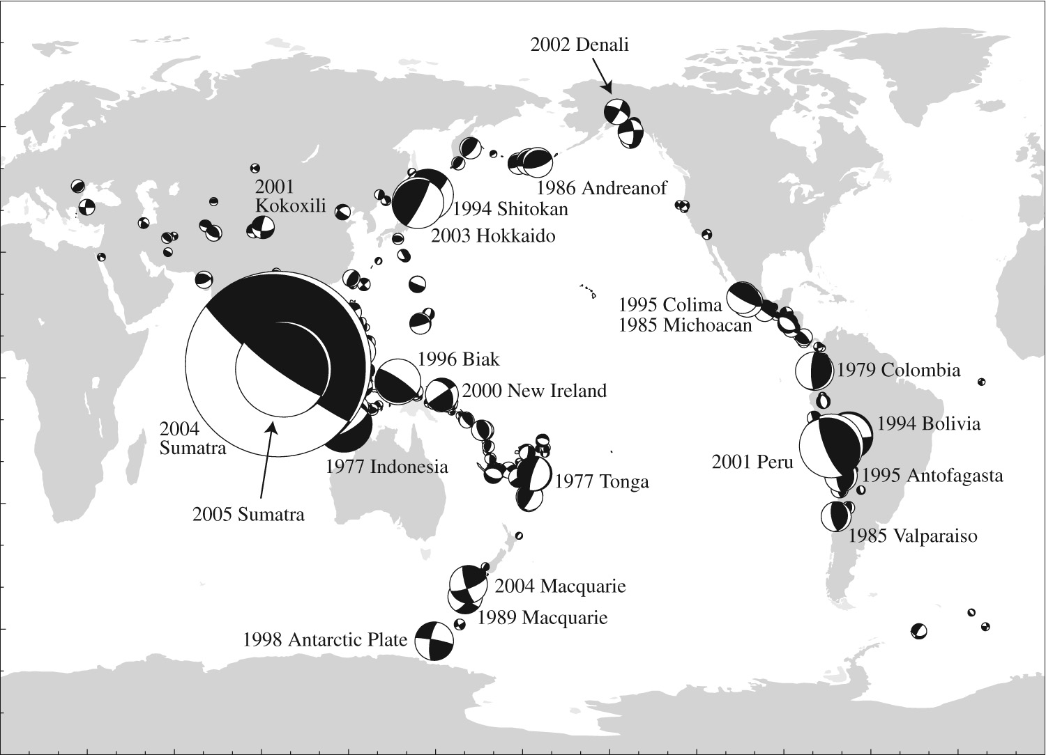
Big earthquakes

Slide 29
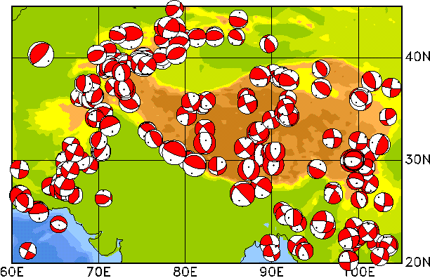
Beachballs - Himalaya

Slide 30
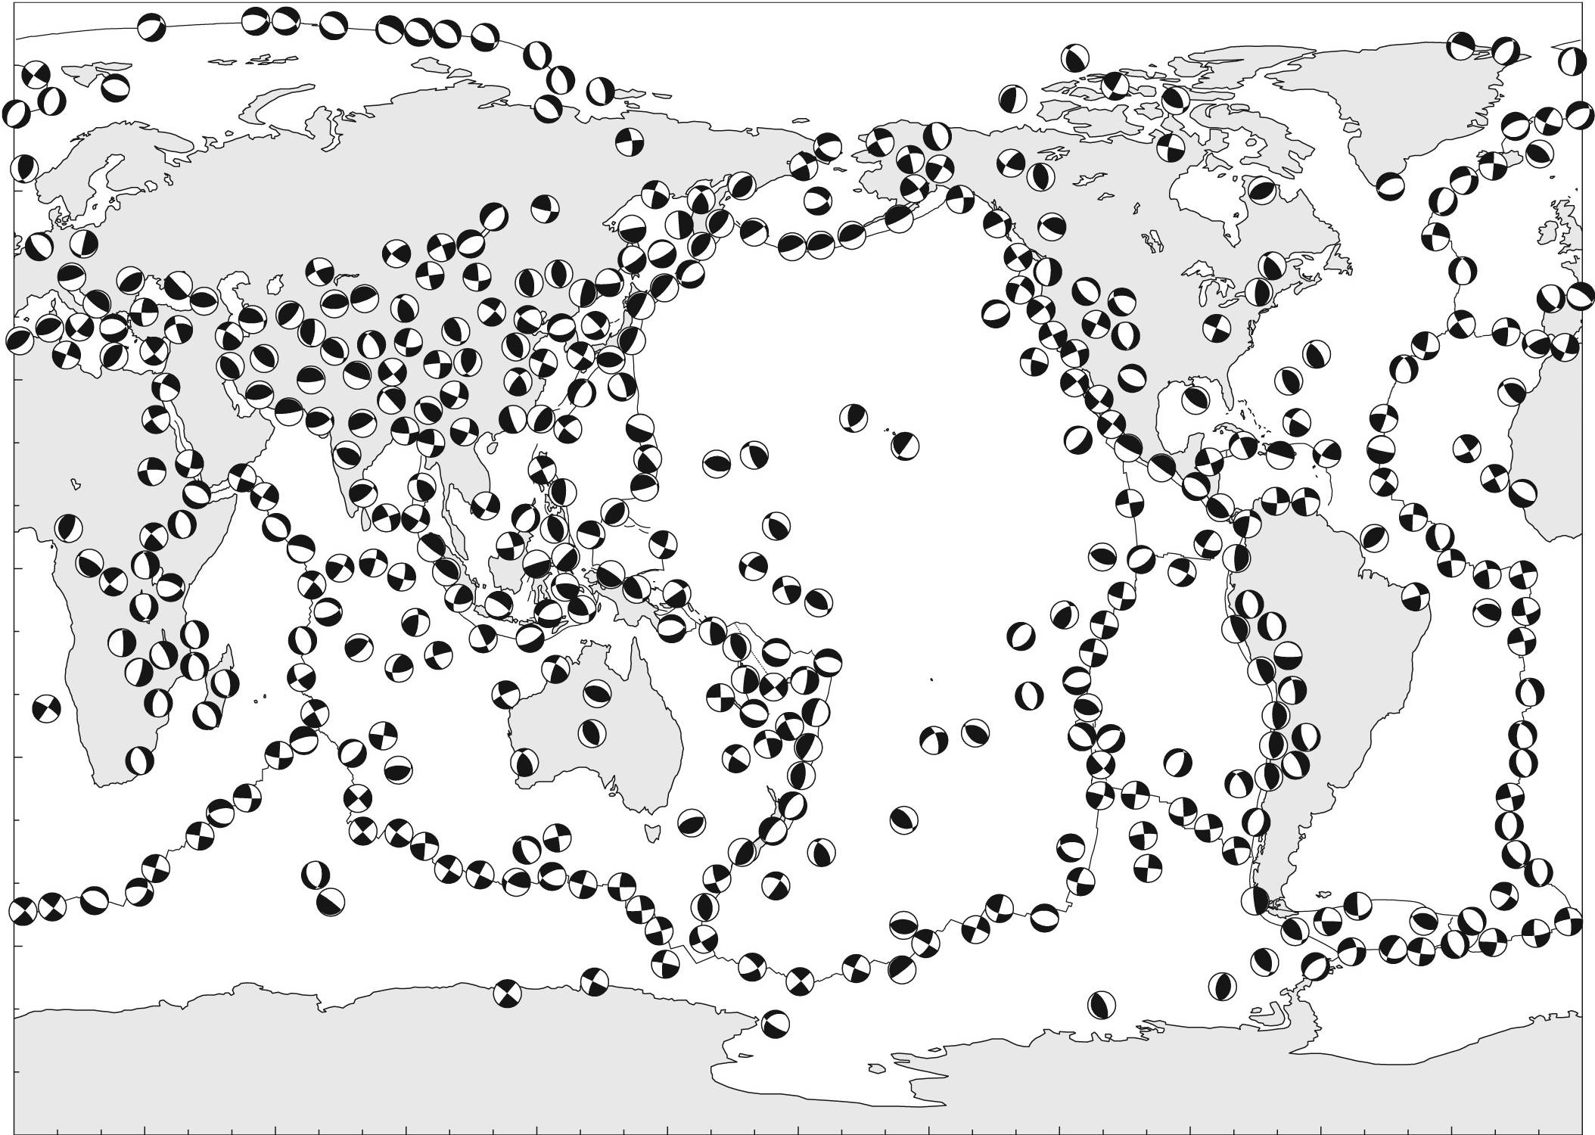
Beachballs - global

Slide 31
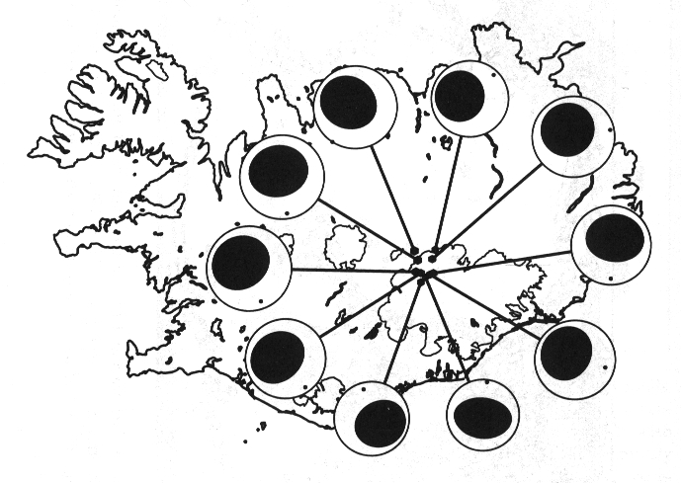
Beachballs - Iceland
Fried eggs: simultaneous vertical extension and horizontal compression

Slide 32
Was ist mit GROSSEN Erdbeben?

Slide 33
Source kinematics
Point source characteristics (source moment tensor, rise time, source moment, rupture dimensions) give us some estimate on what happened at the fault. However we need to take a closer look. We are interested in the space-time evolution of the rupture.
Here is the fundamental concept:
The recorded seismic waves are a superpositions of many individual double-couple point sources.
This leads to the problem of estimating this space-time behavior from observed (near fault) seismograms. The result is a kinematic description of the source.

Slide 34
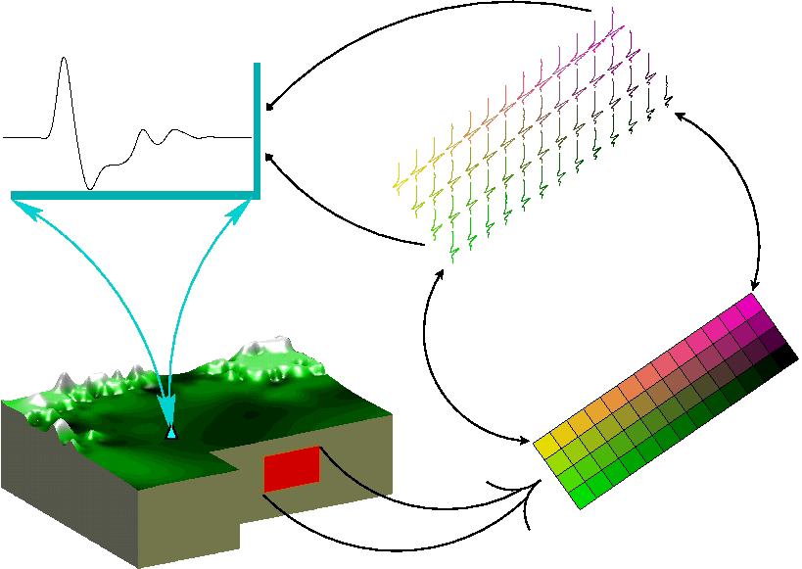

Slide 35
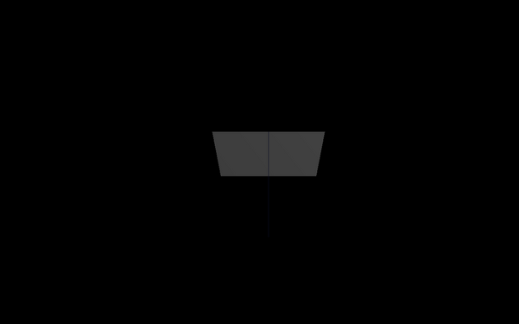
Dynamic rupture

Slide 36
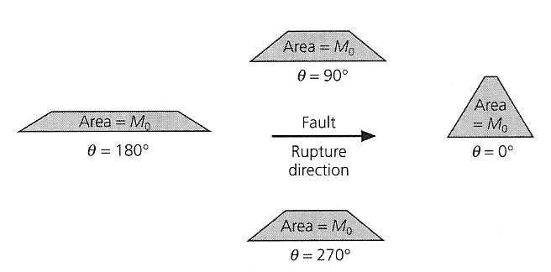
Source directivity
The energy radiation becomes strongly anisotropic (Doppler effect). In the direction of rupture propagation the energy arrives within a short time window.

Slide 37
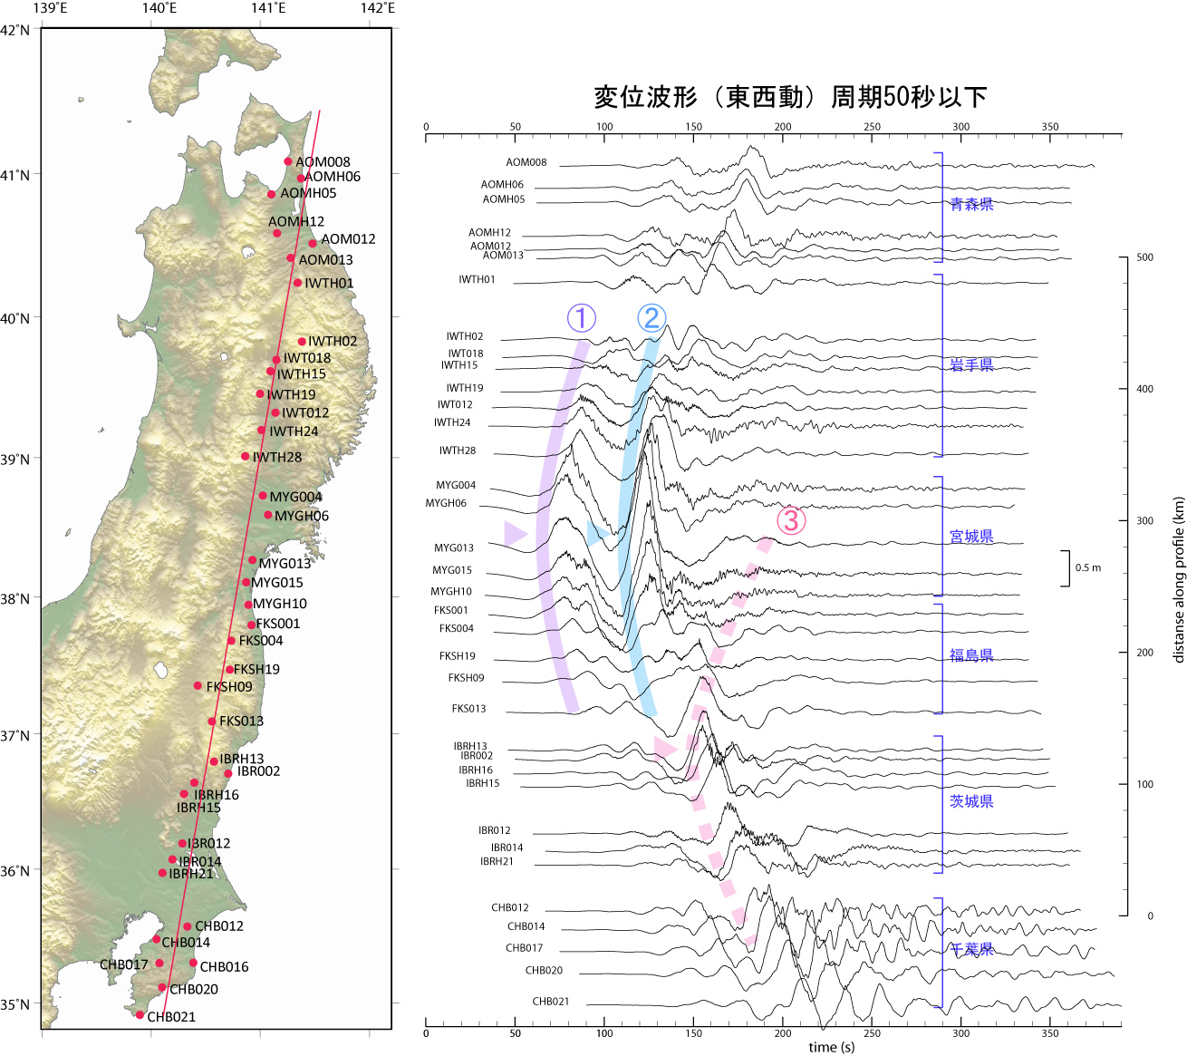
M9 Japan 2011

Slide 38
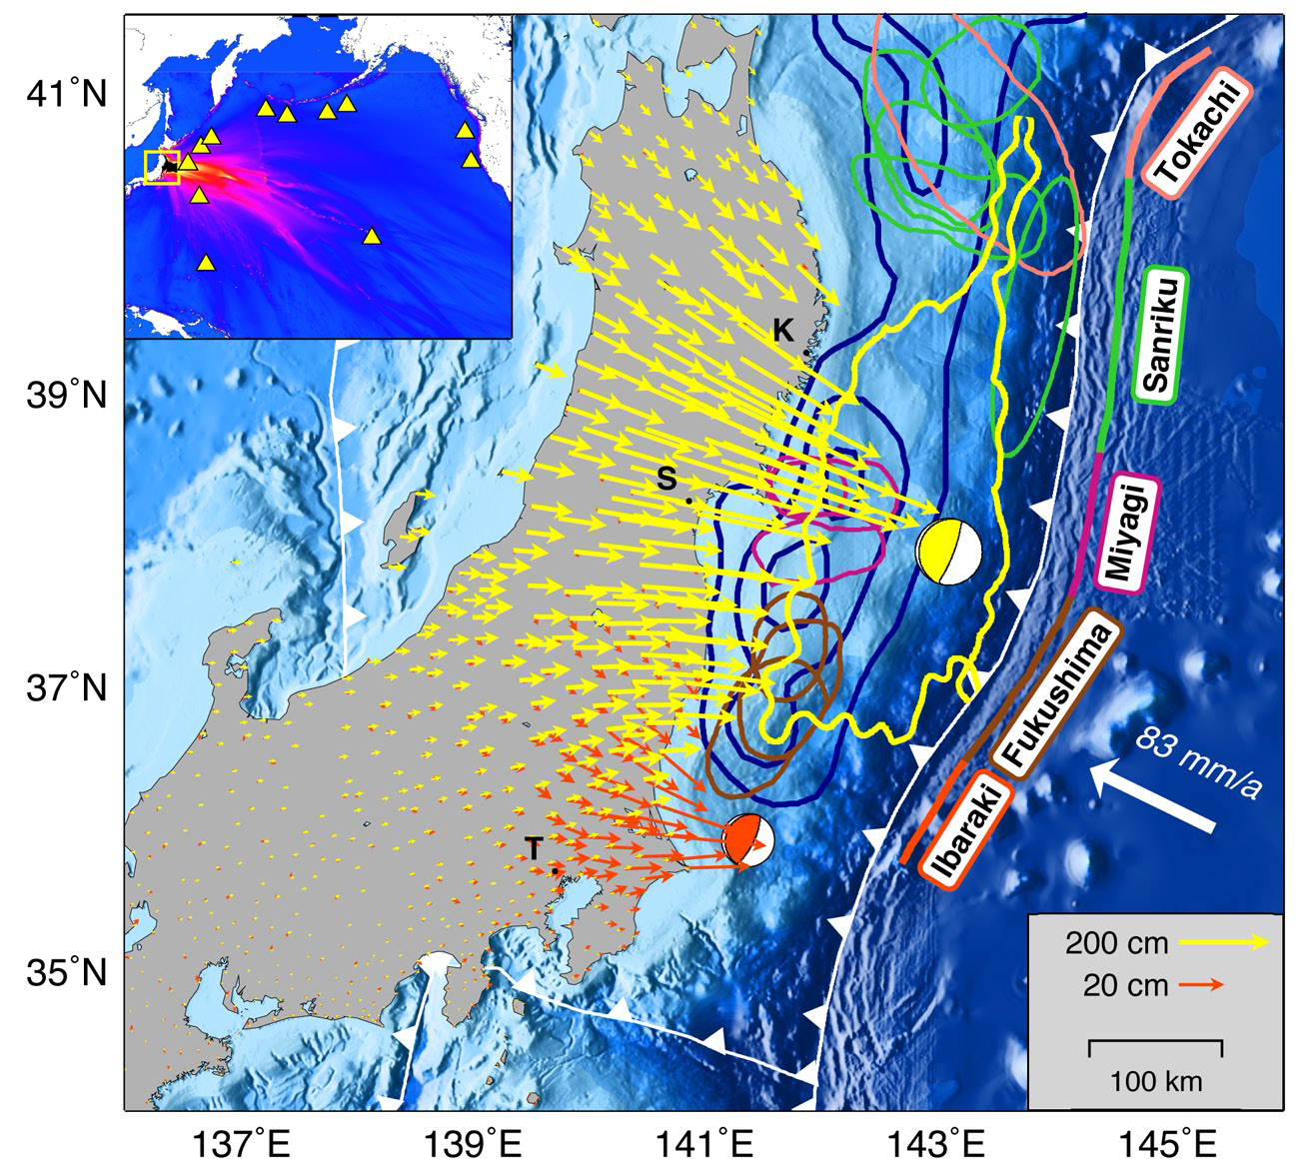
Horizontal displacements
Beobachtete Verschiebungen
(Simons, Science,
2011)

Slide 39
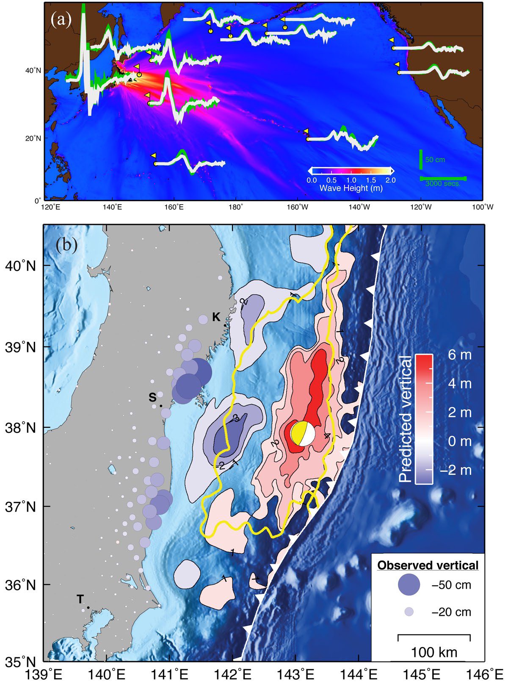
Vertical displacements
Beobachtete Verschiebungen
(Simons, Science,
2011)

Slide 40
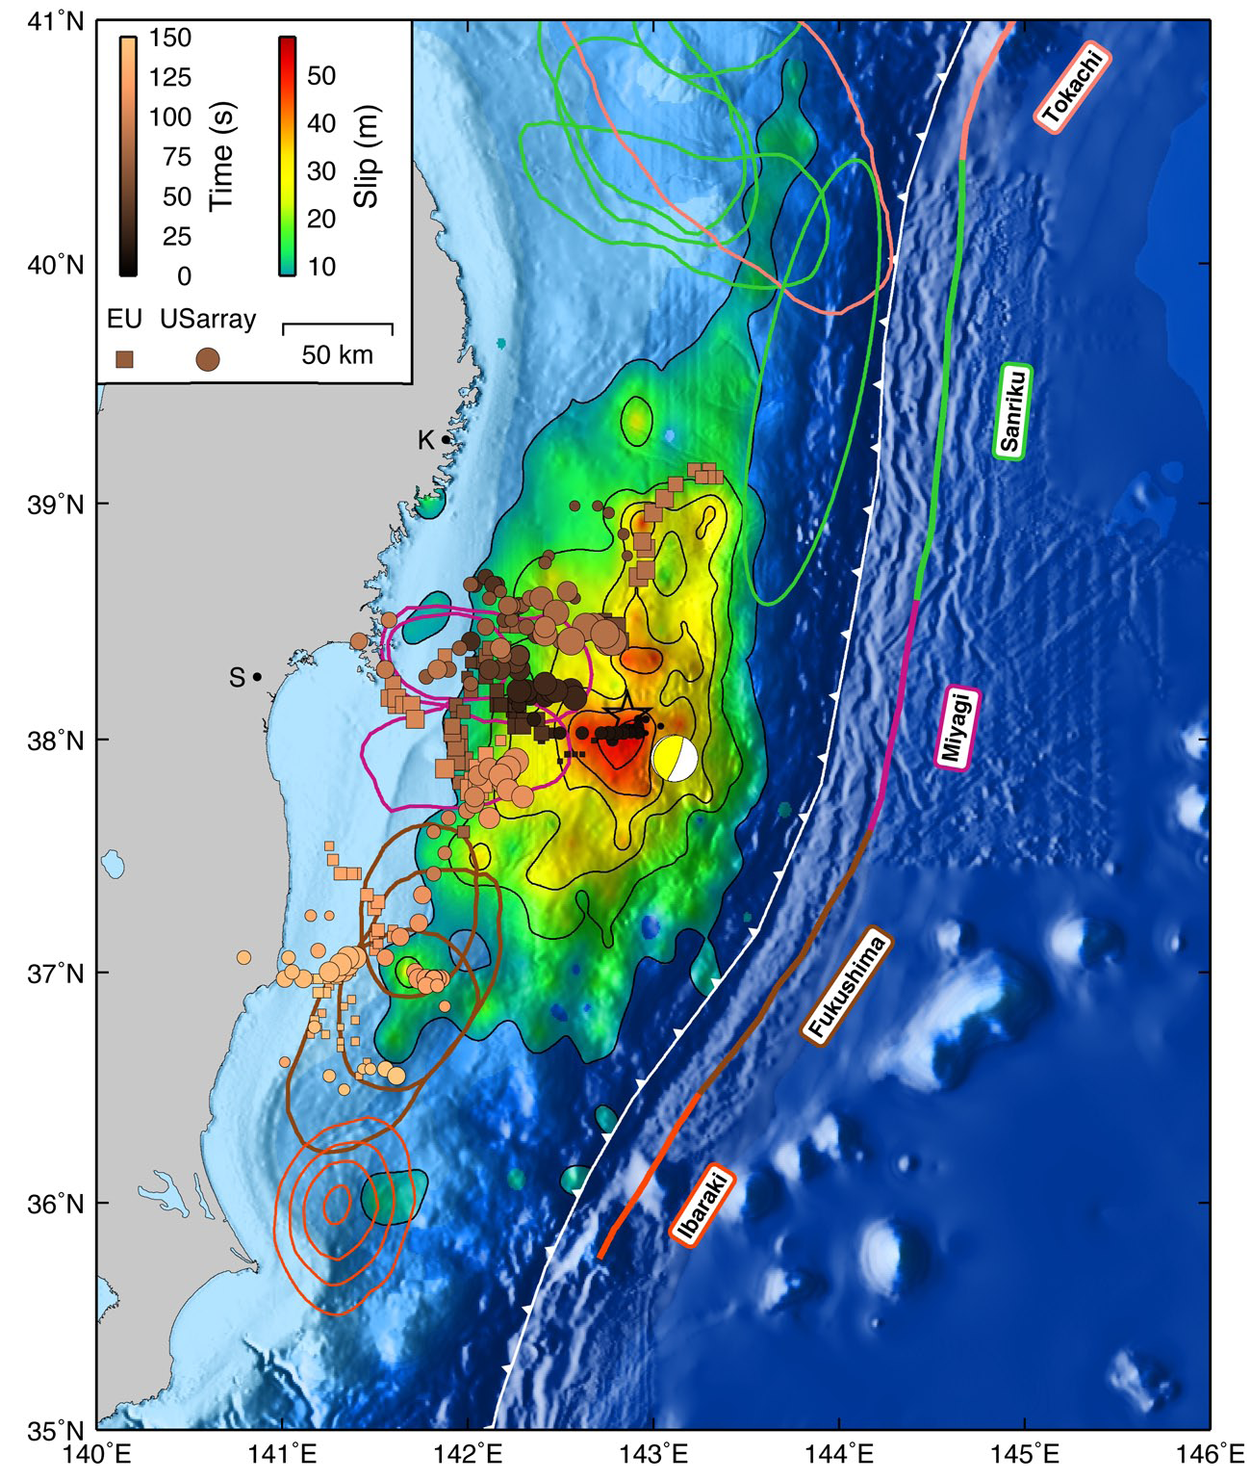
50m slip on the fault!

Slide 41
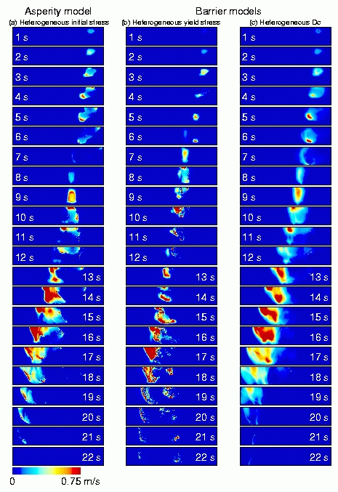
Source kinematics
Slip rate as a function of various fault conditions (Landers earthquake)
Source: K Olsen, UCSB

Slide 42
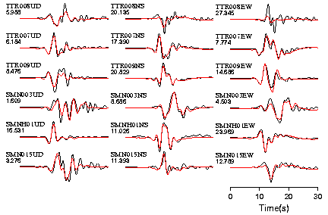
Source kinematics
Fit between observations (red) and finite fault simulations (black)

Slide 43
The California Event (D. Dreger, Berkeley)

Slide 44
Energie von Erdbeben
Magnitude

Slide 45
Seismic moment
Seismologists measure the size of an earthquake using the
concept of seismic moment. It is defined as the force times the
distance from the center of rotation (torque). The moment can be
expressed suprisingly simple as:
M₀ seismic moment
μ Rigidity
A fault area
d slip/displacement

Slide 46
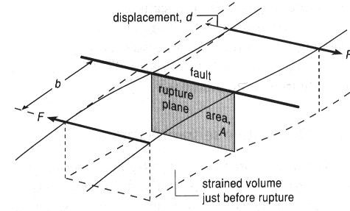
Seismic moment

Slide 47
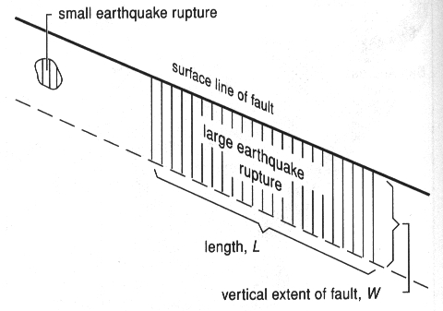
Seismic moment

Slide 48
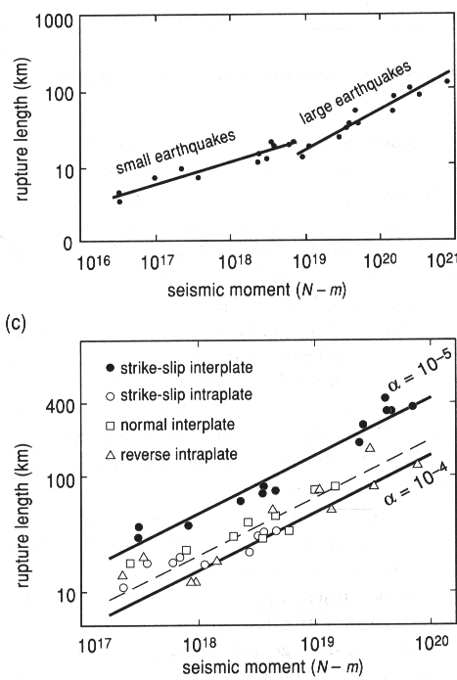
Seismic moment
There are differences in
the scaling of large and
small earthquakes

Slide 49
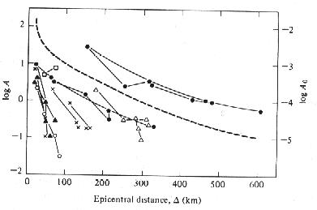
Magnitude Scales - Richter
Data from local earthquakes in California
The original Richter scale was based on the observation that the amplitude of seismic waves systematically decreases with epicentral distance.

Slide 50
Magnitude Scales - Richter
M seismic magnitude
A amplitude
T period
f correction for distance
C_{s} correction for site
C_{r} correction for receiver
M_{L} Local magnitude
M_{b} body-wave magnitude
M_{s} surface wave magnitude
M_{w} energy release

Slide 51
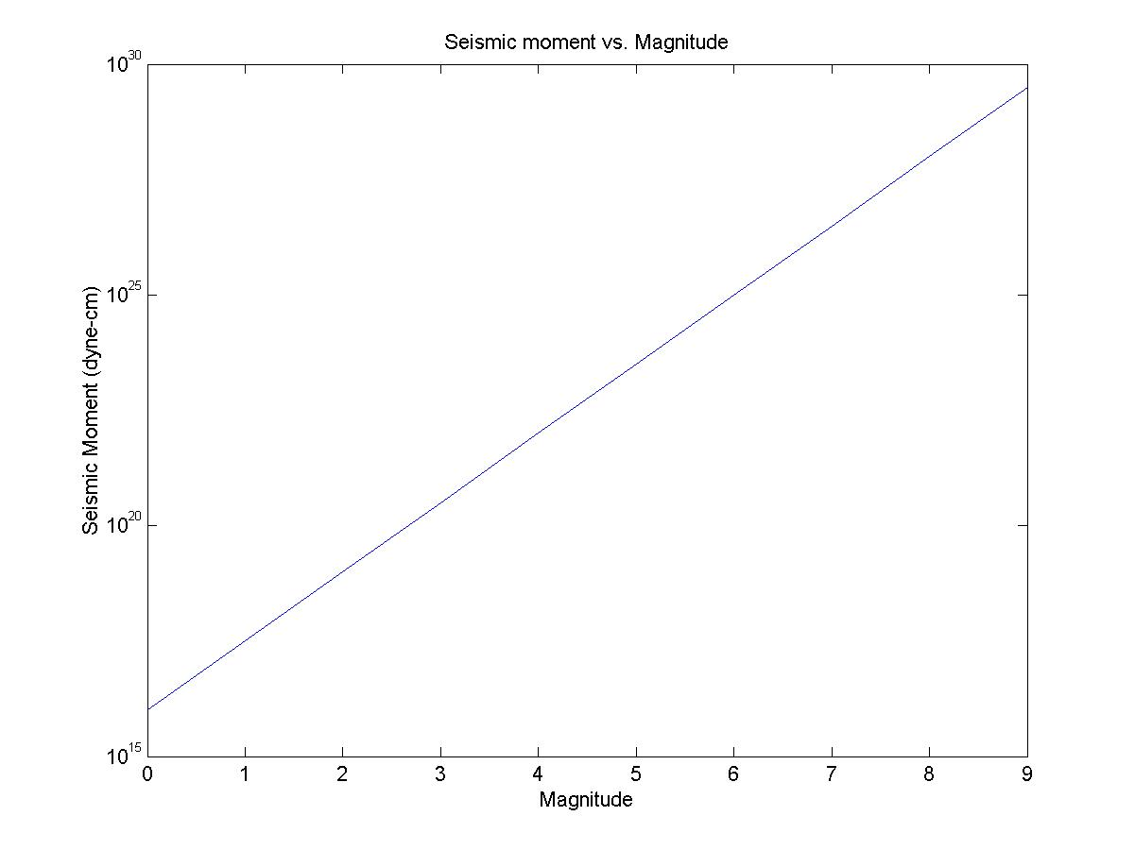
Seismic moment - magnitude
There is a standard way of converting the seismic moment
to magnitude M_{w}:

Slide 52
Seismic energy
Richter developed a relationship between magnitude
and energy (in ergs)
... The more recent connection to the seismic moment
(dyne-cm) (Kanamori) is

Slide 53
Seismic energy (Examples)
Richter TNT for Seismic Example
Magnitude Energy Yield (approximate)
-1.5 6 ounces Breaking a rock on a lab table
1.0 30 pounds Large Blast at a Construction Site
1.5 320 pounds
2.0 1 ton Large Quarry or Mine Blast
2.5 4.6 tons
3.0 29 tons
3.5 73 tons
4.0 1,000 tons Small Nuclear Weapon
4.5 5,100 tons Average Tornado (total energy)
5.0 32,000 tons
5.5 80,000 tons Little Skull Mtn., NV Quake, 1992
6.0 1 million tons Double Spring Flat, NV Quake, 1994
6.5 5 million tons Northridge, CA Quake, 1994
7.0 32 million tons Hyogo-Ken Nanbu, Japan Quake, 1995;
Largest Thermonuclear Weapon
7.5 160 million tons Landers, CA Quake, 1992
8.0 1 billion tons San Francisco, CA Quake, 1906
8.5 5 billion tons Anchorage, AK Quake, 1964
9.0 32 billion tons Chilean Quake, 1960
10.0 1 trillion tons (San-Andreas type fault circling Earth)
12.0 160 trillion tons (Fault Earth in half through center, OR
Earth's daily receipt of solar energy)

Slide 54
Erdbebenstatistik

Slide 55
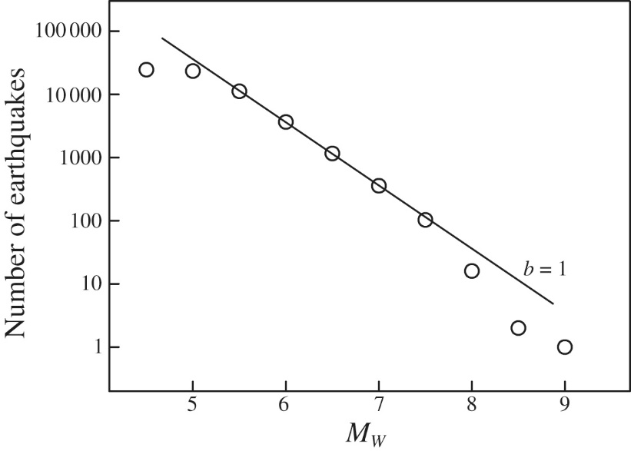

Gutenberg-Richter Gesetz

Slide 56
Seismic sources
Far away from the source (far-field) seismic sources are best described as point-like double couple forces. The orientation of the initial displacement of P or S waves allows estimation of the orientation of the slip at depth.
The determination of this focal mechanism (in addition to the determination of earthquake location) is one of the routine task in observational seismology. The quality of the solutions depends on the density and geometry of the seismic station network.
The size of earthquakes is described by magnitude and the seismic moment. The seismic moment depends on the rigidity, the fault area and fault slip in a linear way. Fault scarps at the surface allow us to estimate the size of earthquakes in historic times.

