Slide 1
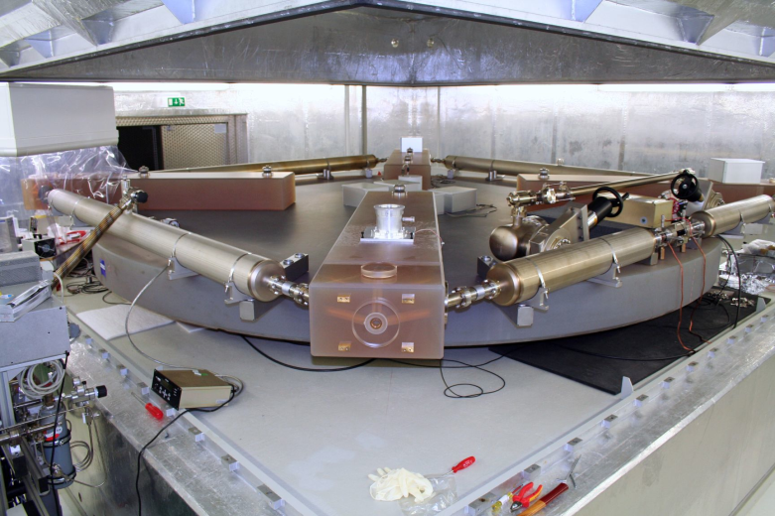
What can we learn from rotational ground motions?
Heiner Igel¹, Moritz Bernauer¹, Felix Bernauer¹, Alain Cochard^{1,7}, Martin van Driel, Ana Ferreira², Andreas Fichtner^{1,5}, Peter Gaebler¹, Roberto Guidotti¹, Celine Hadziioannou¹, Dieter Kurrle^{1,4}, Maria Fernanda Nader-Nieto¹, Ulrich Schreiber³, Toshiro Tanimoto⁸, Frank Vernon⁶, Joachim Wassermann¹ and others
¹ LMU Munich, Germany
² UEA Norwich, UK
³ TU Munich, Germany
⁴ now at State earthquake service, Freiburg, Germany
⁵ now at ETH Zurich
⁶ IGPP, UCSD, La Jolla, USA
⁷ EOST Strasbourg
⁸ UC Santa Barbara, USA

Slide 2
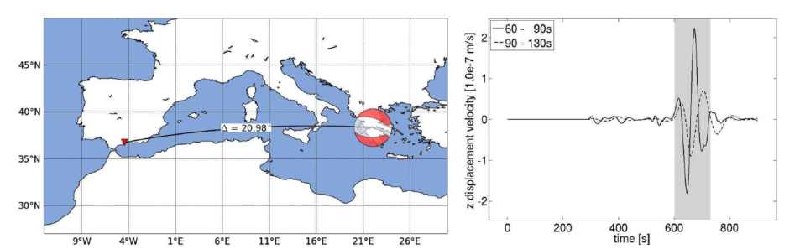
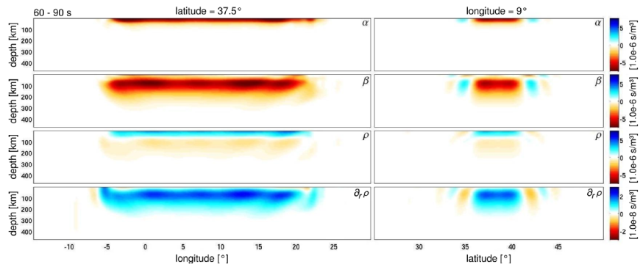
Ground Rotations
Outline
Rotations: Why bother?
Theory: What to expect?
Instruments: Rotation sensors
Observations
  Direct vs array-derived
  Earth‘s free oscillations
  Ocean generated noise, microseisms
Seismic Inverse problems incl. rotations (and strain)
Conclusions and Outlook

Slide 3
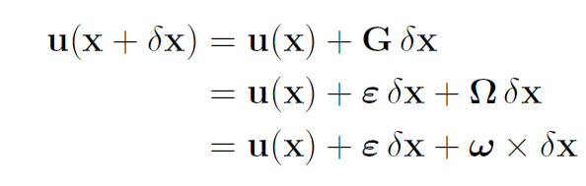
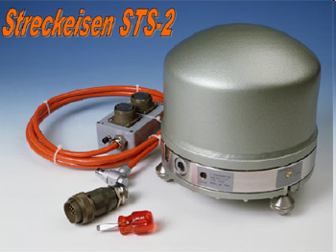
Translation, strain, rotation
translation
rotation
strain

Slide 4
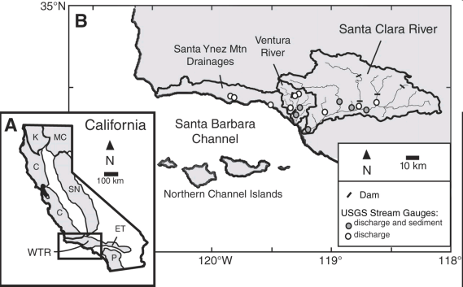
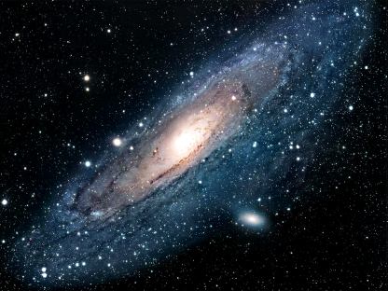
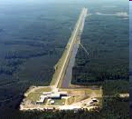
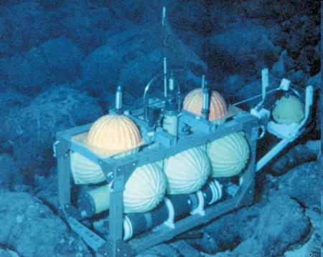
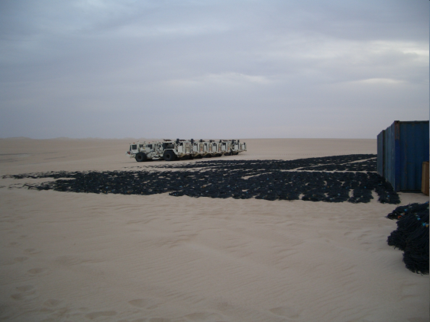
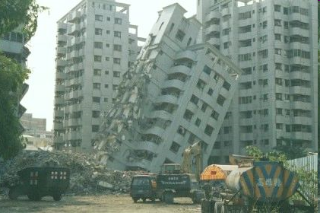
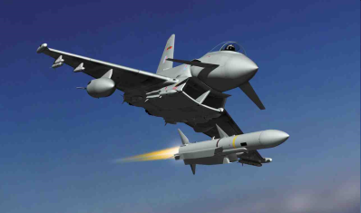
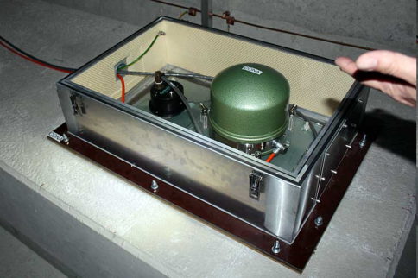
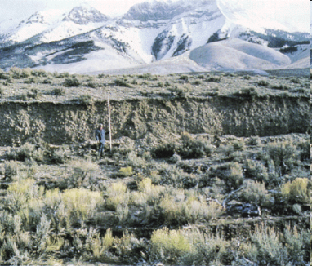
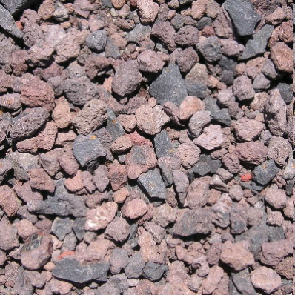

Why bother?
ω_{z}
ω_{y}
ω_{x}

Slide 5
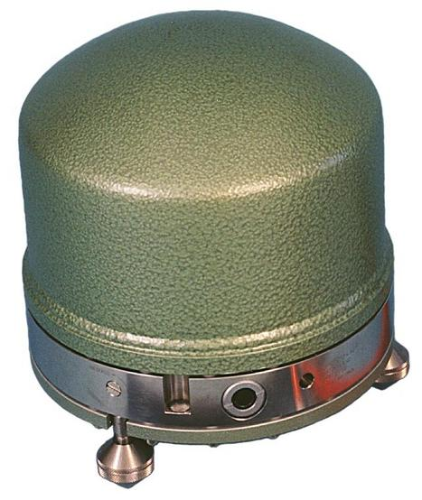
Seismic instruments
… are contaminated by rotational motions!
… tilt noise relevant close to earthquake source, volcanoes, and
long-period seismology
… pure tilt (rotation around horizontal axes) has never
been observed (in the seismological broadband)
… sea-floor horizontal componentes affected by interface waves

Slide 6
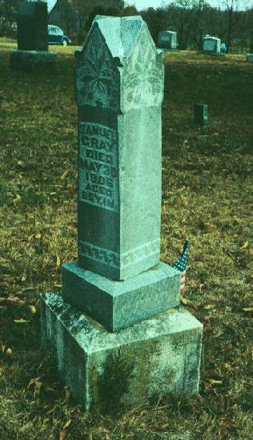
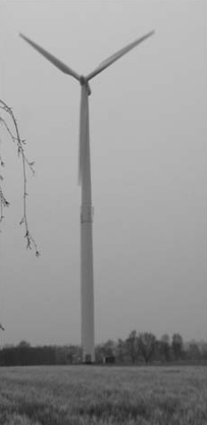
Earthquake engineering
… measuring interstory drift
… structural health monitoring
… damage due to rotational motions
… paleo-seismology

Slide 7
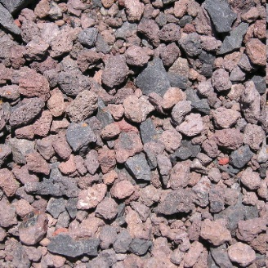

Rheology
… open questions in geological
block rotations
… is (non-)linear elasticity the right rheology close to earthquakes or in a multi-phase reservoir rock?
… every earthquake induces permanent rotations (not only displacements!
-> Cosserat media, non-symmetric stresses

Slide 8

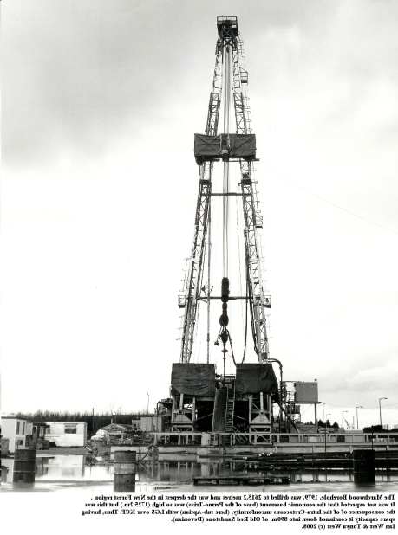
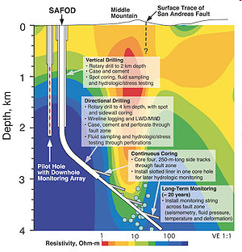
Geophysical Exploration
… today O(10000) instruments are used in seismic exploration experiments
… >3 component sensors (e.g., translation and rotation) might reduce the number of stations required for imaging!
… tomographic reconstruction (boreholes, etc) with rotations

Slide 9
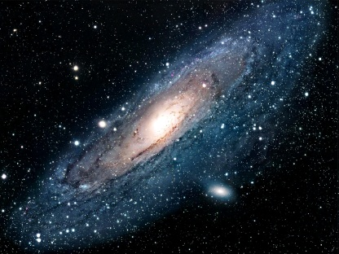
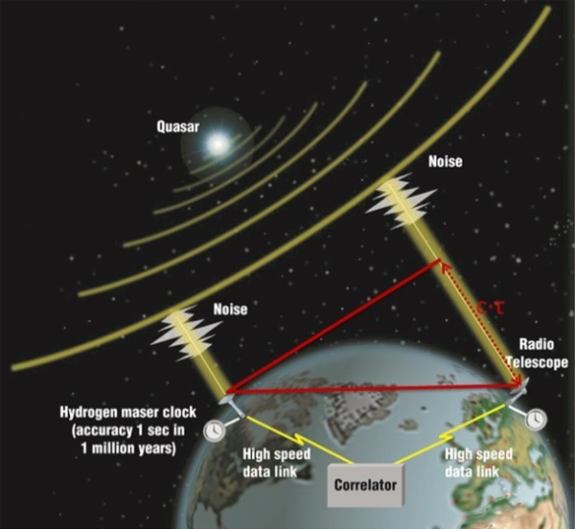
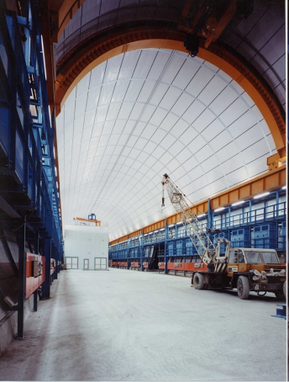
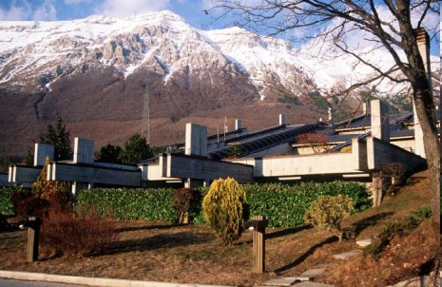
Geodesy/Cosmology
… direct measurement of Earth‘s rotation vector
… gravitational wave measurements LIGO, VIRGO, LISA on Earth and in space
… seismic decoupling of strain meters
… unterstanding the fabric of space time (Lense-Thirring effect)

Slide 10
THEORY

Slide 11
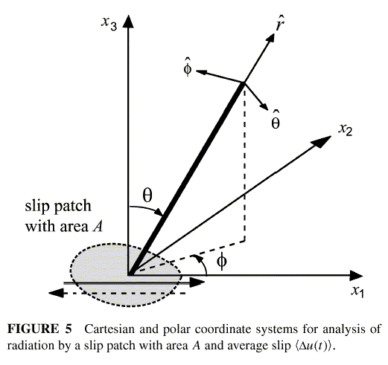
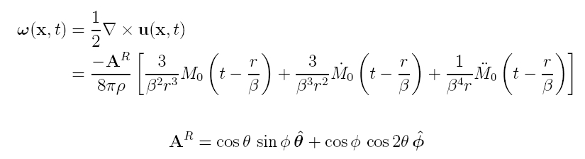
Double-couple point source
Rotations are zero before S arrival
Far-field P-rotation is not zero! Only the sum of all contributions cancel!
Cochard et al. (2006)

Slide 12
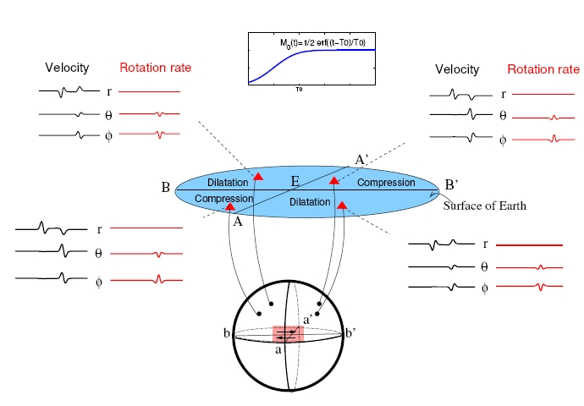
Rotations from point dislocation
Theory
full space

Slide 13
Plane shear waves
Theory
Plane transversely polarized wave propagating in x-direction with phase velocity c
rotation rate – transverse acceleration
Acceleration
Rotation rate
Rotation rate and acceleration should be in phase and the amplitudes scaled by two times the horizontal phase velocity

Slide 14
Instruments

Slide 15
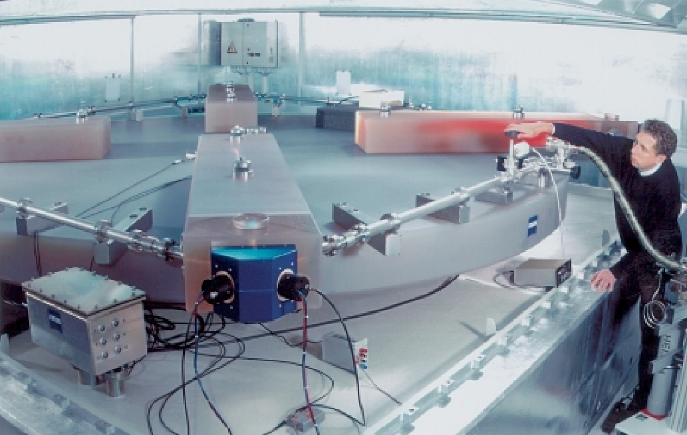
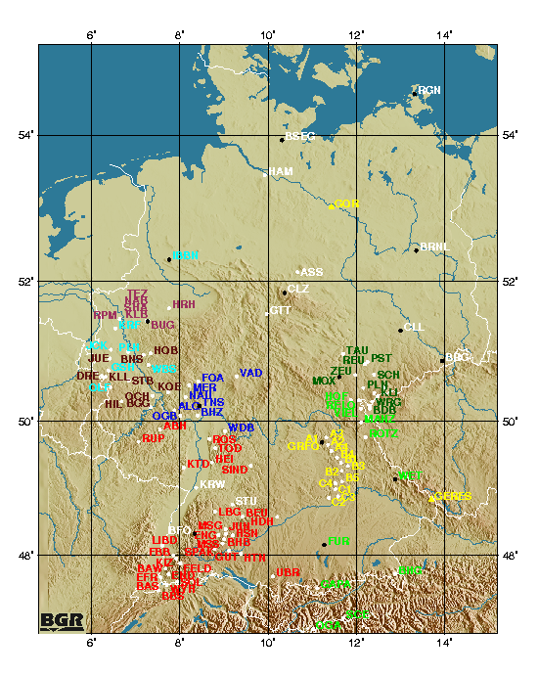
Ring Laser Rotation Sensor
Instrumentation
Instrument principle described in Schreiber et al., BSSA, 2009, special issue.
Ring Laser
Real-time data display at www.rotational-seismology.org

Slide 16

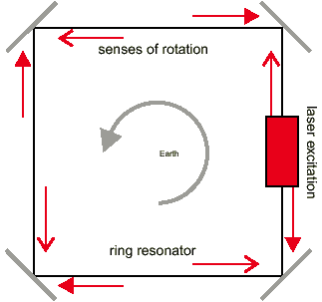
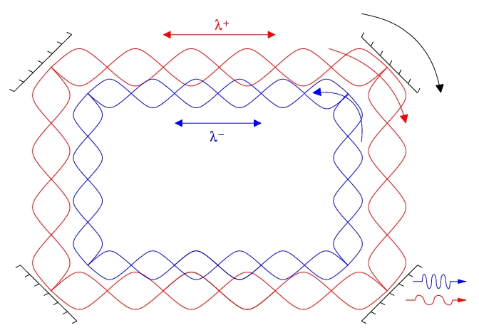
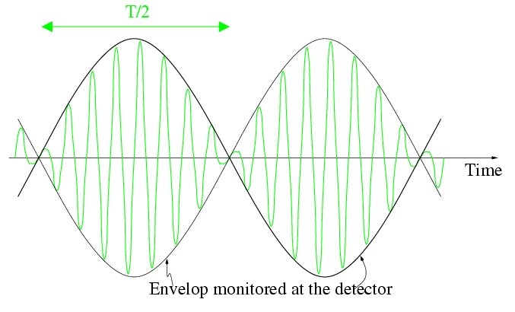
Measurement principle
Instrumentation
Ring laser technology developed by the groups at the Technical University Munich and the University of Christchurch, NZ

Slide 17


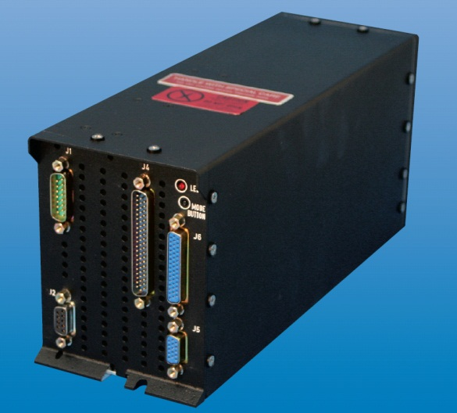
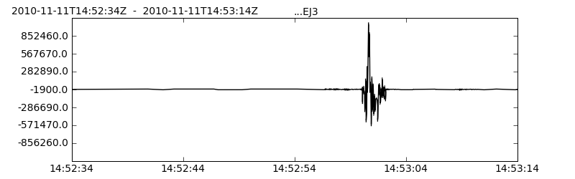
Fiber-optic gyro
… first portable sensor for broadband seismology
… developed by LITEF (Freiburg), iXBlue (Paris)
… sensitivity 10⁻⁷⁽⁻⁹⁾ rad/s
… standard seismological data output (mseed)
… prototype is currently being tested

Slide 18
OBSERVATIONS

Slide 19
Earthquake-induced rotations
Observations
Plane wave analysis
tells us:
Waveforms (transverse acceleration and rotation rate) should be in phase
The ratio between acceleration and rotation rate is proportional to phase velocity
This can be used for seismic tomography without travel times
References (e.g.):
Pancha et al., GRL, 2000
Igel et al., GJI 2007
Ferreira and Igel, BSSA, 2009
Kurrle et al., GRL, 2010
Fichtner et al., BSSA, 2009
Bernauer et al., Geophysics, 2009
rotation rate – transverse acceleration
Love waves

Slide 20
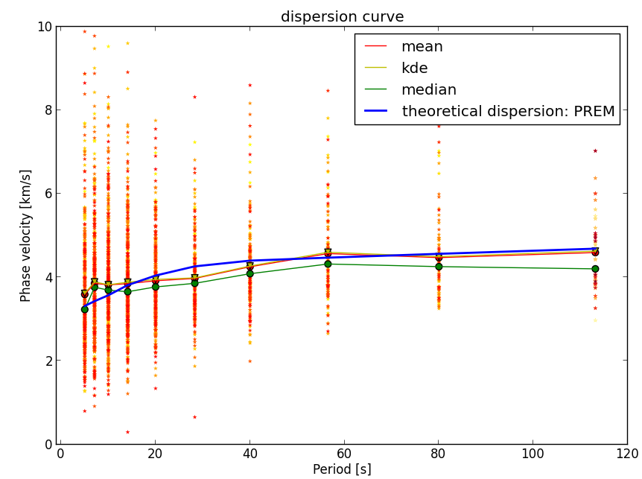
Love wave dispersion

Slide 21
Rotations from arrays
Theory
seismometers
ω_{z}
v_{y}
v_{x}
v_{y}
v_{y}
v_{x}
v_{x}
v_{y}
v_{x}
Rotational motion estimated from seismometer recordings

Slide 22
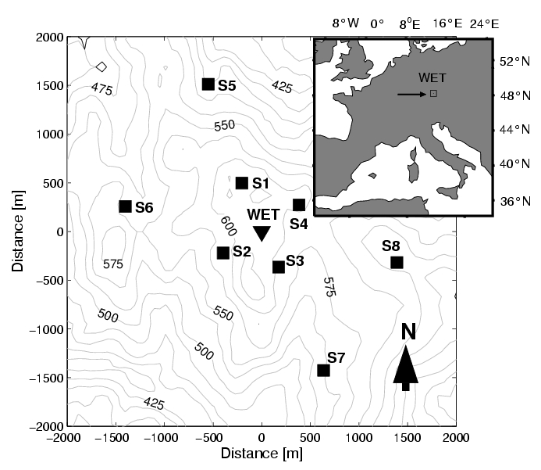
Array-derived rotation?
Observations

Slide 23
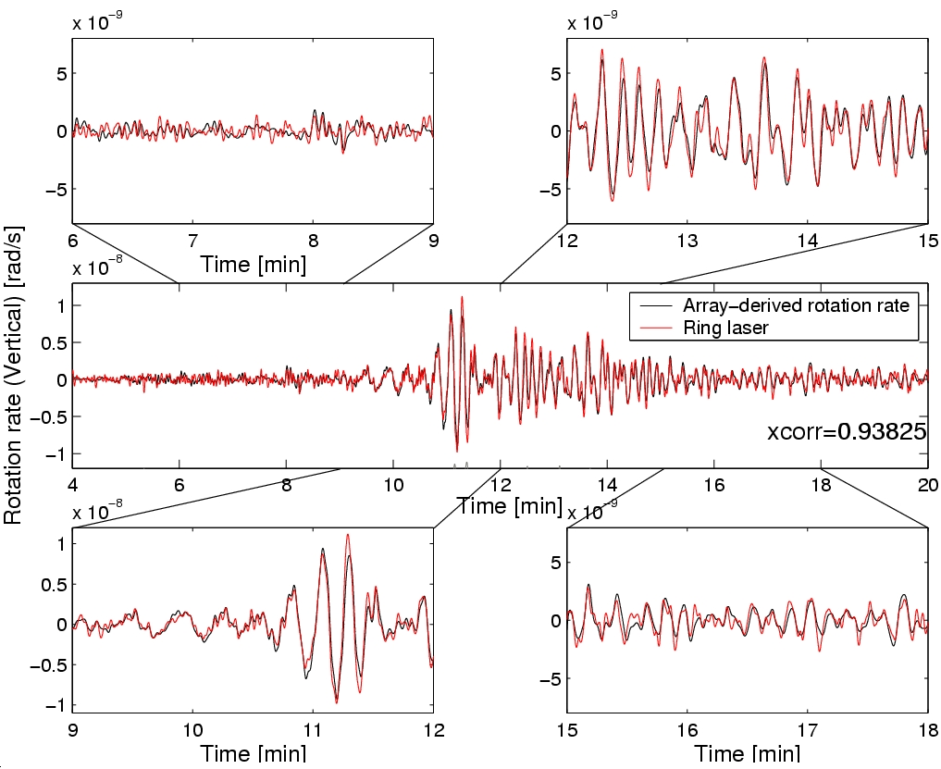
Array-derived rotation
Observations
From Suryanto et al (2006, BSSA)

Slide 24
Free Oscillations?
Observations
Widmer et al., BSSA, 2009

Slide 25
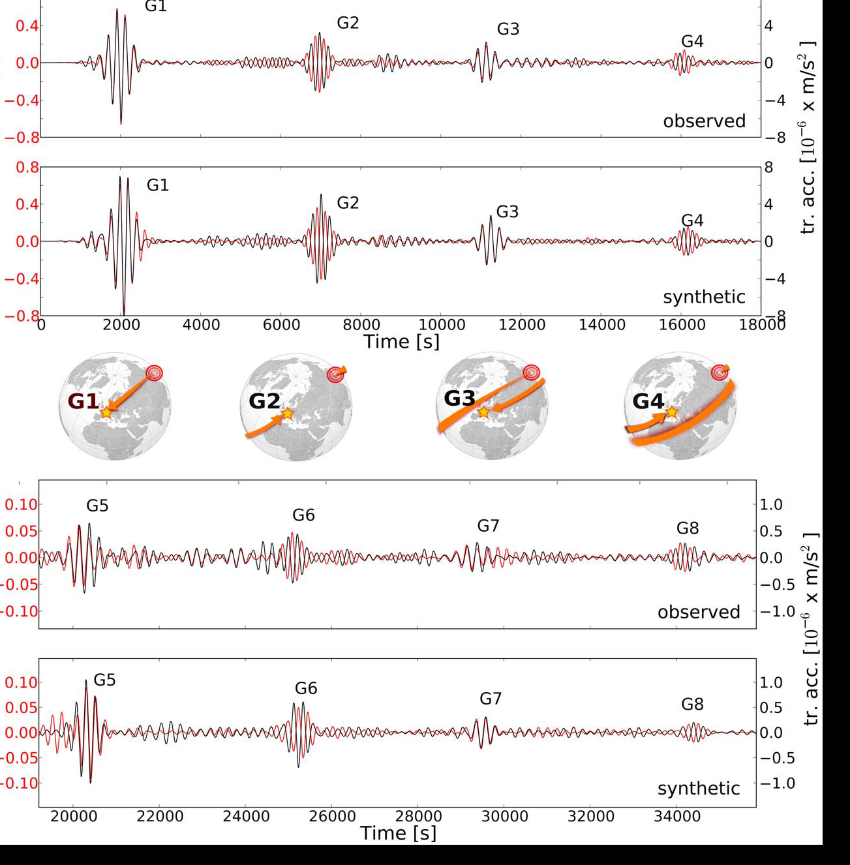
Tohoku-Oki M9 Earthquake
Love waves GX traveling around the Earth
Black – seismometer
Red – ring laser
Igel et al., GRL, 2011

Slide 26
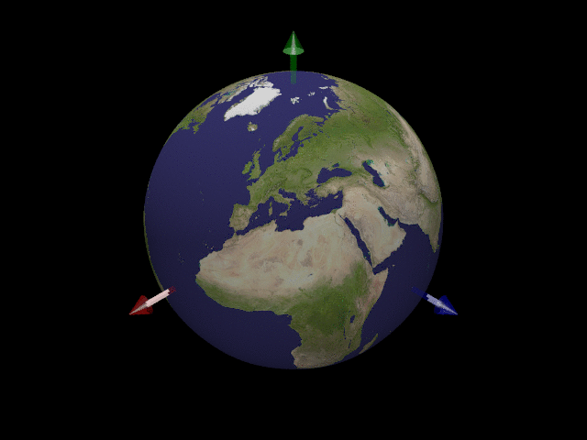
Earth‘s free oscillations
Observations
Torsional mode, n=0, ℓ=5, |m|=4. period ≈ 18 minutes
Source: http://icb.u-bourgogne.fr/nano/MANAPI/saviot/terre/index.en.html

Slide 27
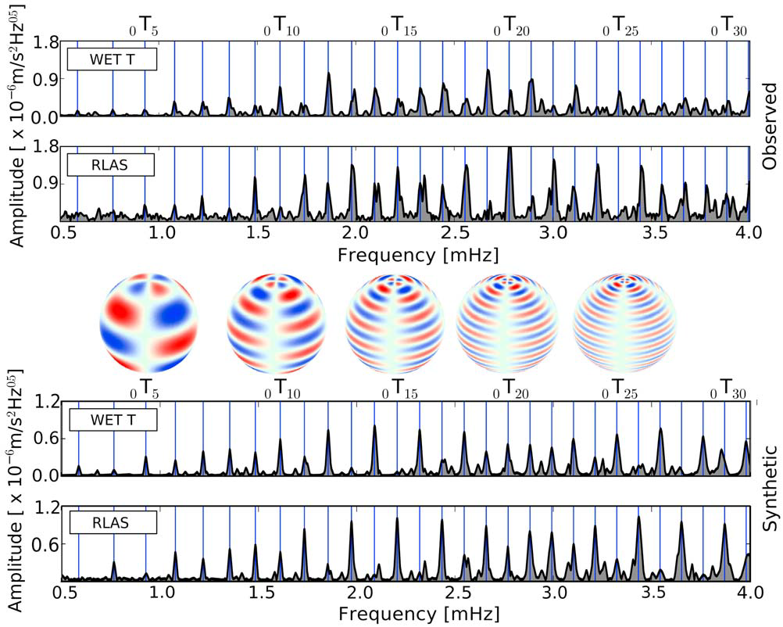
Tohoku-Oki M9 Earthquake
Free oscillation spectra
48h Tohoku event (Nader-Nieto et al., J. Seis. 2012)

Slide 28
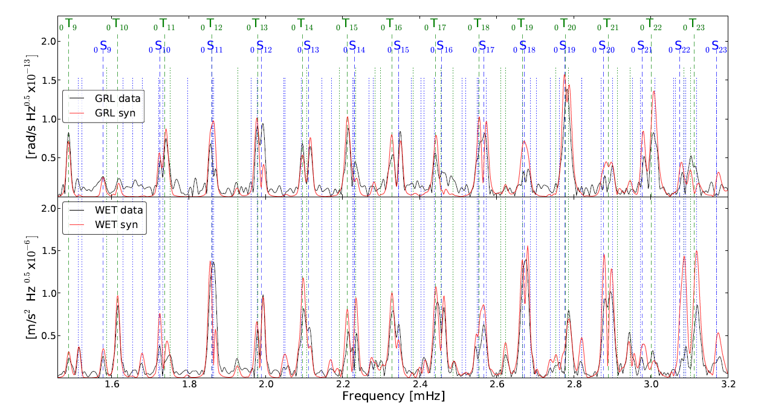
Earth‘s free oscillations
Evidence for coupling
Torsional mode, n=0, ℓ=5, |m|=4. period ≈ 18 minutes
Tohoku event (Nader-Nieto et al., GJI, 2014 accepted)

Slide 29
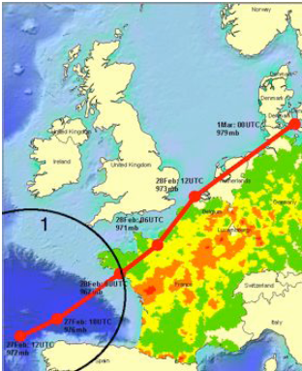
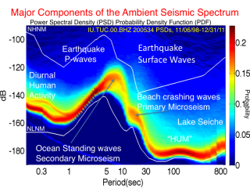
Ocean generated noise
Observations

Slide 30
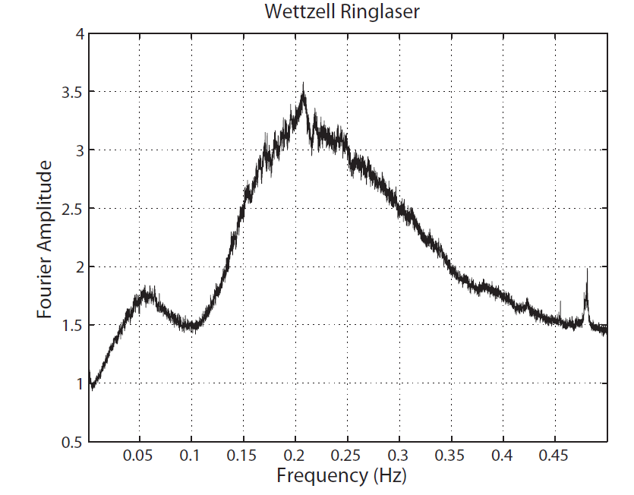
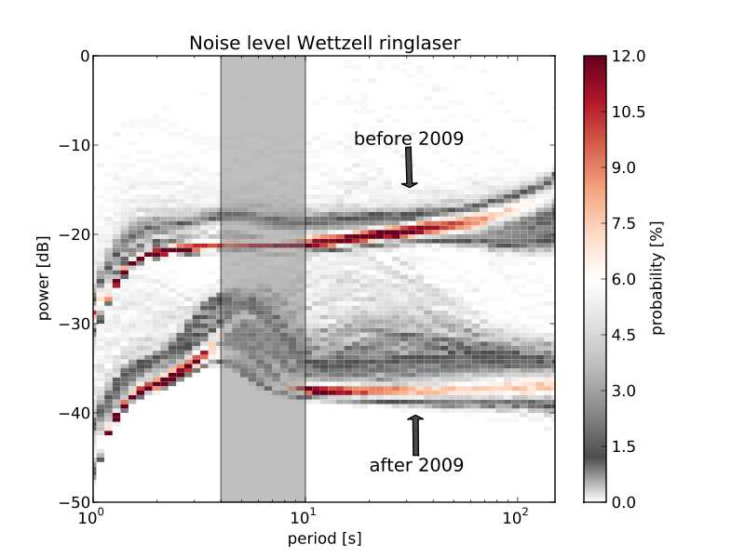
S/N Improvement in 2009
Secondary
Primary

Slide 31
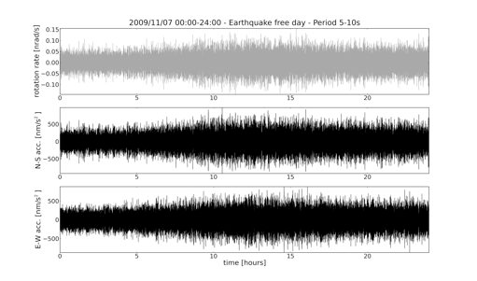
Ambient Noise
Observations
Ring laser
Seismo NS
Seismo EW
Are they systematically related?

Slide 32
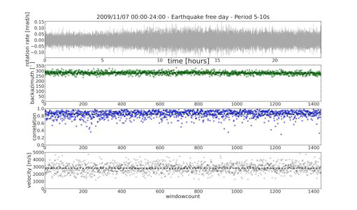
Ambient Noise
Observations
Rotation rate
Back azimuth
Correlation coefficient
Phase velocity
Total length 24 hours, window length 1 minute

Slide 33
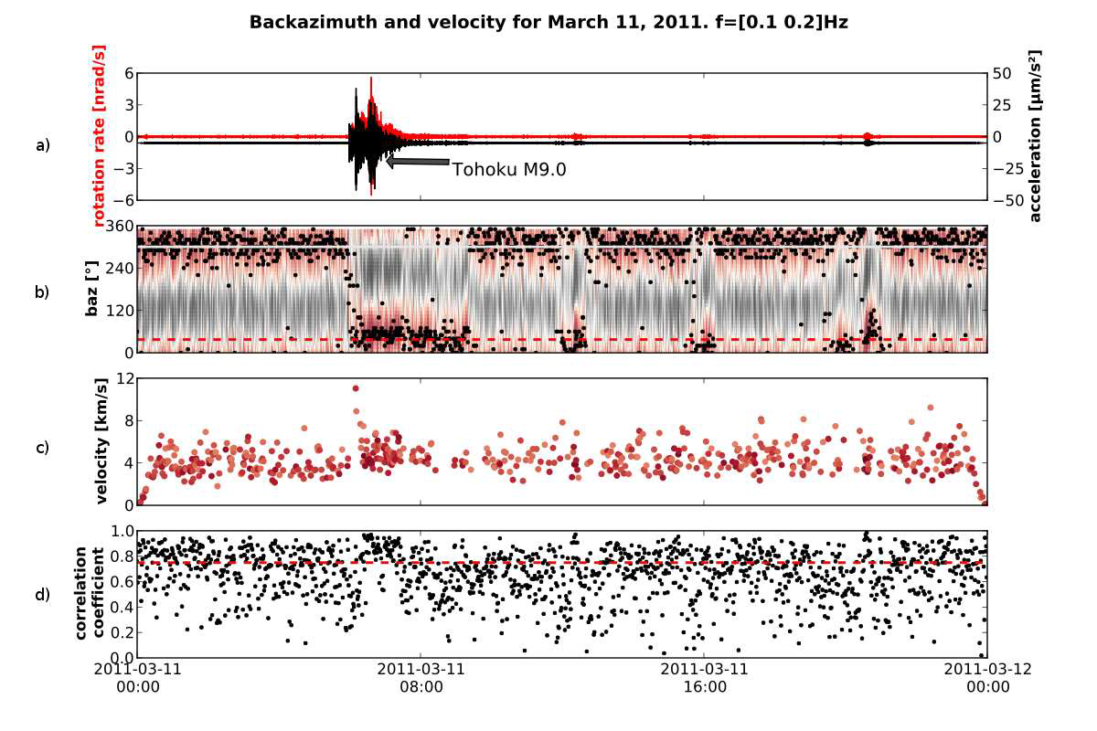
Ambient Noise
Observations
(From Hadziioannou et al., J. Seis. 2012)

Slide 34
The seismic inverse problem for structure and source

Slide 35
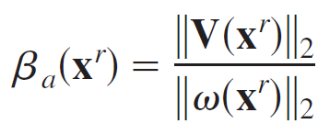
Let s define a new observable…
… and call it apparent shear velocity (the same principle works with translations and strain) …

Slide 36

… and calculate sensitivity kernels …
Tomography without travel times!
(Bernauer et al., 2009)
Local sensitivity to structure
below receiver

Slide 37





Can we generalize this concept?
… in words …
Let us assume we have N scalar seismic observables (e.g., finite-frequency travel times, translations, strains, rotations … which (combination of) observables maximise the sensitivity w.r.t. the desired geophysical parameter (e.g., density, Lame parameters, P-S velocities) ?
… mathematically …
weighted observables
data perturbations via kernels
Weighted kernels
Kernel power
Objective function for weights w and desired balance b_{j}

Slide 38


Density and seismic tomography

Slide 39

Reducing trade-offs with optimal obervables
Trade-off w.r.t. density inversion reduced
Improved imaging for density perturbations from travel times
Methodology reproduces earlier results for apparent shear velocity (Bernauer et al., 2014)

Slide 40



Finite source inversion
(including rotations)
Finite source inversion
with N classic 3C seismometes
with N/2 6C sensors (incl. 3C rotations)
How does the finite source inversion problem change?

Slide 41

Marginal probabilities rise time and rupture speed
N 3C sensors
N/2 6C sensors
rise time
rise time
rupture speed
rupture speed

Slide 42


Monte Carlo Sampling Information Gain
Shannon information content
N/2 6C sensors almost always recover rupture velocity and rise time better than N 3C sensors
(Bernauer et al. 2014)

Slide 43
Conclusions
Why bother? Well, it is a new observable worth exploring
Recording more than the translational components (+rotation or strain components) allows recovering wavefield properties like phase velocities and propagation directions from point measurements
Application of the adjoint techniques allows tomographic inversion of amplitudes (ratios) for velocity models
Observations of Earth‘s free oscillations (torsional modes) are complementary (to standard observations)
Pure broadband tilt (uncontaminated by transverse accelerations) has never been observed
Rotational measurements might help to separate L- and R-wave parts in the ambient noise field. The origin of the Love waves are not well understood!
Surprising benefits for finite source inversion, when having collocated observations.

Slide 44




The ROMY Project
(2014-2019)
Investigating all aspects of rotational seismology
Ring laser in Munich (4 components)
Portable pilot rotation sensor for weak motion seismology – field observations
Applications:
  Observing all ground motion components (vs. 3D array)
  Global seismology
  Free oscillations, hum
  Origin of ocean generated noise
  Volcano seismology
  Source inversion and tomography
  Enginering applications
  OBS studies
  Geodesy – (full rotation vector)
  Cosmology (Lense-Thirring Effect)

