Slide 1
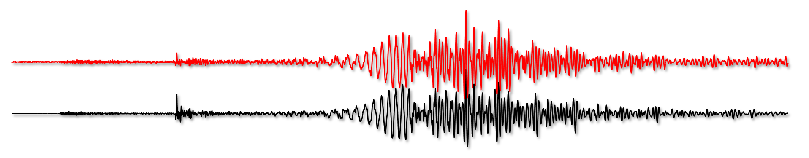
Rotational Motions in Earth Science and Engineering
Heiner Igel¹, Karl Ulrich Schreiber², Joachim Wassermann¹, Felix Bernauer¹
¹Ludwig-Maximilians-University Munich
²Fundamentalstation Wettzell, Technical University Munich
[Definition] Rotational Motions: The seismic wavefield
[Science] What are rotational motions good for?
          tomography, earthquake physics, volcanology, marine geophysics, exploration, planetology, engineering
[Technology] Technical requirements, state of the art
            current sensors, specifications
  [Market] Seismic networks, instrument pools, agencies

Slide 2
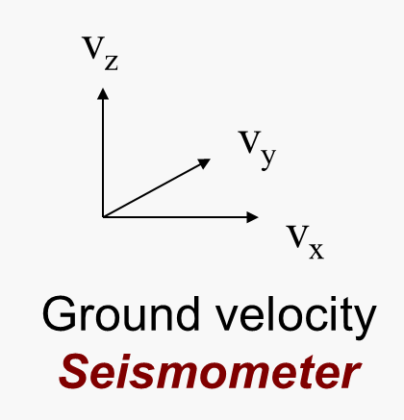
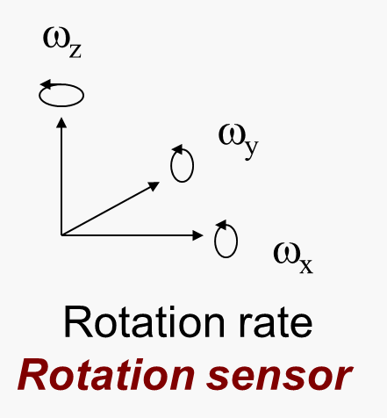
[Definition] Rotational Ground Motions
Notes:
I want to highlight what is routinely observed and what is missing

Slide 3
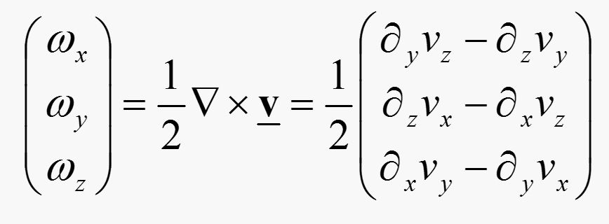
[Definition] Rotational Ground Motions
Rotation rate is the curl of the (velocity) wave field
For plane shear waves
Notes:
Only equations I would show, message: rotations are related to derivatives that could be obtained by array measurements, but …

Slide 4
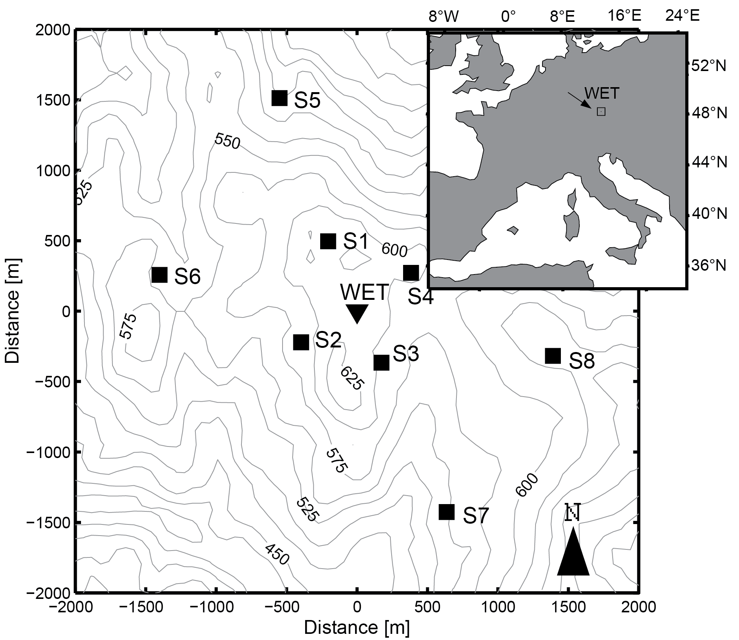
[Definition] Array Derivation
array-derived rotation rate
ring laser measurement
Problems:
Array size dependent
Number of sensors required (>6)
High station quality required
Highly sensitive to station errors
No quality control (callibration)
Notes:
We need to discuss away the comment „you can do this with arrays“ it is an option on some case but does not help in the science cases we discuss …

Slide 5
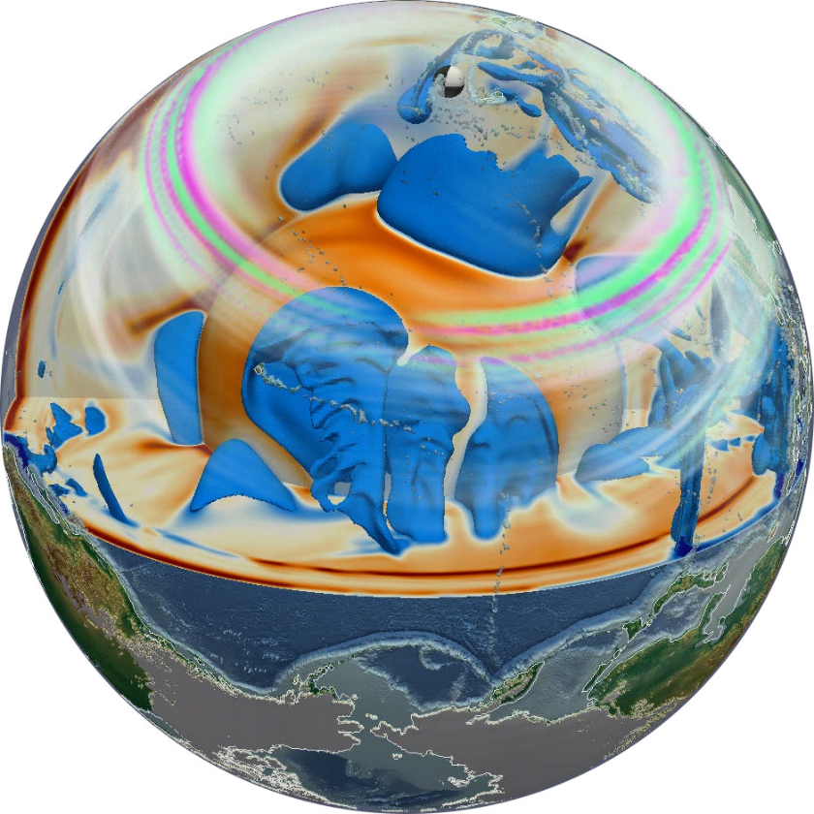
[Science] – Why we need measurements of rotations!
[Better (translational) observations]
Volcanology – marine geophysics – (Earth‘s free oscillations)
[Better constraints on physical parameters]
Seismic tomography – earthquake physics – exploration – volcanology – planetary seismology
[Observing complete motions]
Engineering
Notes:
.. this is a transition slide highlighting the „why“ rotations might be useful

Slide 6
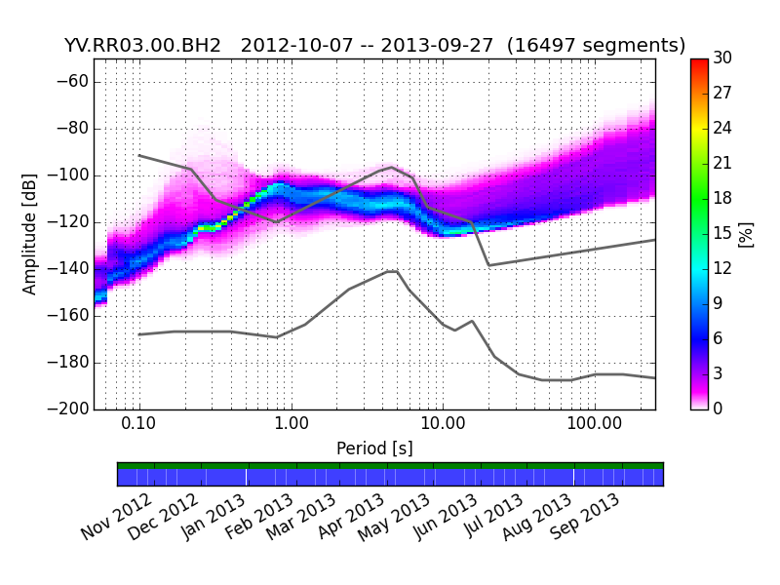
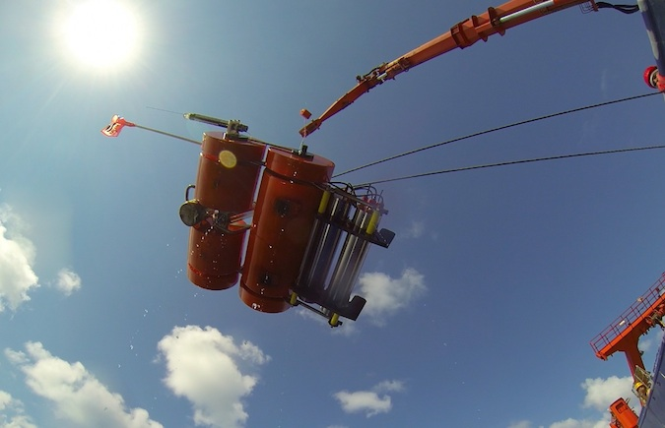
[Science] – Marine Geophysics: Ocean Bottom Sensors
Amplitude range | Frequency range
1 nrad/s– 200 μrad/s | 0.01 – 20 Hz
Comments: Low power consumption required <3W. Very expensive experiments.
Notes:
I will explain the graph and the high noise levels on horizontal components for OBS records, I think this is the most interesting application and deserves a little more detail

Slide 7
[Science] – Marine Geophysics: Ocean Bottom Sensors
Experiment site
OBS System
Fiber-optic gyro

Slide 8
[Science] – Marine Geophysics: Ocean Bottom Sensors
First direct measurements of tilt-seismometer coupling
Very high correlation between translations and rotations
Unexpected high amplitudes observed!
Effects dominate in period interval T [5 – 20s]
Some correlation with wave height is observed
OBS records can be corrected for tilt effects -> S/N improvement!
Notes:
I will briefly explain the high relvance of this observation for ocean bottom seismometry, highlighting the tilt-translation coupling

Slide 9
[Science] – Volcanology (Monitoring)
Amplitude range | Frequency range
10 nrad/s – 200 μrad/s | 0.001 – 20 Hz
Comments: Power consump-tion <8W. Permanent monitoring tasks.
Strong tilt-seismometer coupling
Unusual strong rotational ground motions
Large unconventional source of ground motion (e.g., dyke movement, bubble explosions, ring subsidence)
Monitoring of internal processes hampered by tilt-seismometer coupling (erroneous conclusions)
So far demonstration only with theoretical seismograms

Slide 10
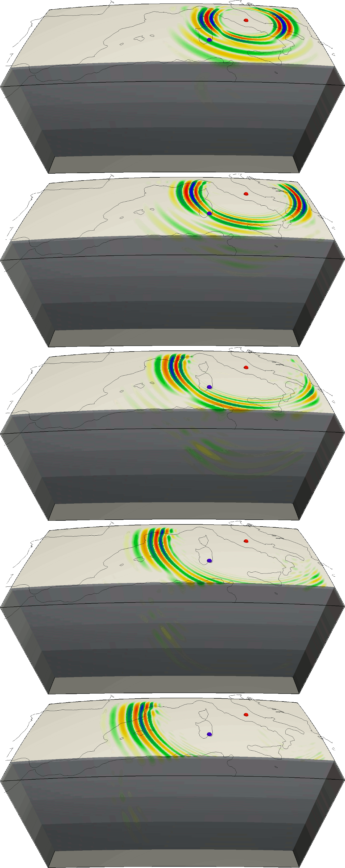
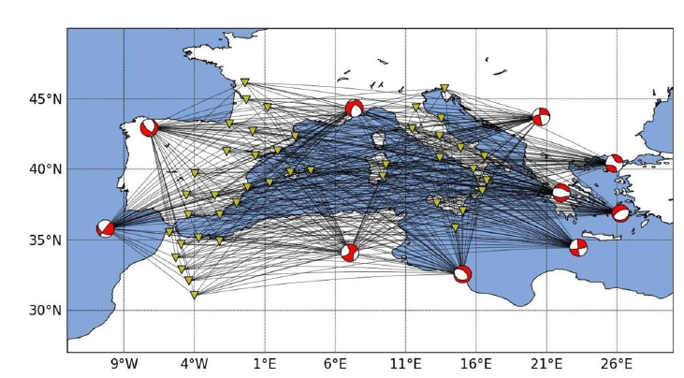
[Science] – Seismic Tomography
Amplitude range | Frequency range
1 nrad/s – 5 μrad/s | 0.01 – 20 Hz
Comments: Interesting for all networks. Near receiver tomography.
Collocated seismometer – rotation observations allows recovering structure around sensor location (local sensitivity)
Particularly relevant for:
  Sparse networks
  Singe station setups
  Borehole situations
Proof of concept with synthetic seismograms (see publications)

Slide 11
[Science] – Earthquake Physics
Amplitude range | Frequency range
1 nrad/s – 5 μrad/s | 0.01 – 20 Hz
Comments: Immediate appli-cations, aftershock activities, improves source information
Surprise from theoretical studies: significant improvement of source inversion by additional rotation observations
Substantial improvement (reduction) of logistics with 3C+3C sensors
Better recovery of source depth (highly relevant for tsunami early warning, induced seismicity)

Slide 12
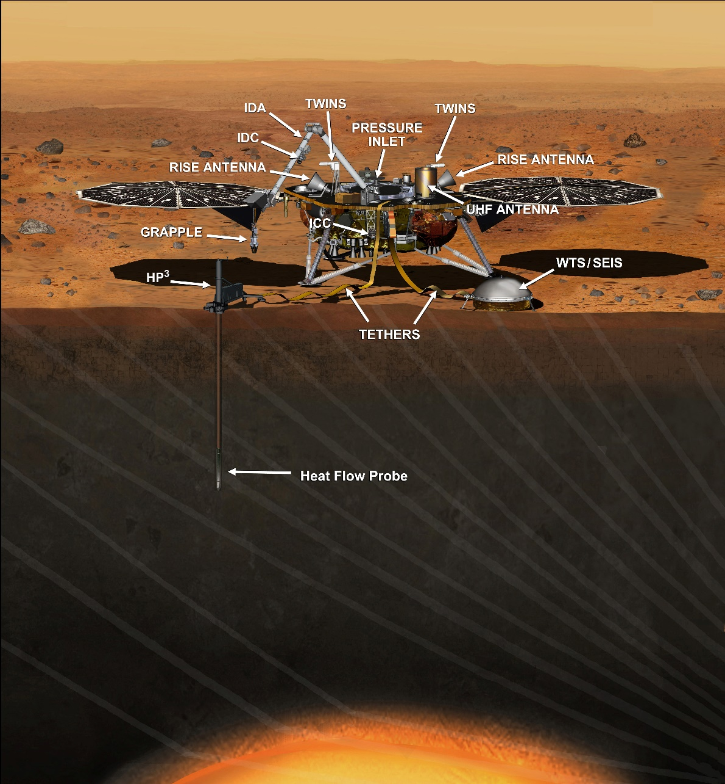
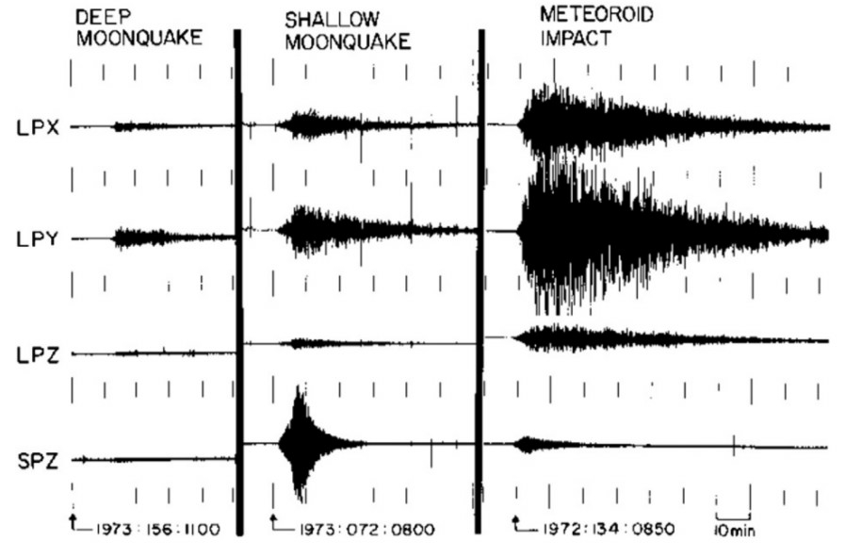
[Science] – Planetology
Amplitude range | Frequency range
? | 0.001 – 20 Hz
Comments: Improved tomo-graphy, more processing options, wave type separation, noise analysis. Not a big market.
Notes:
I will explain why this is relevant

Slide 13
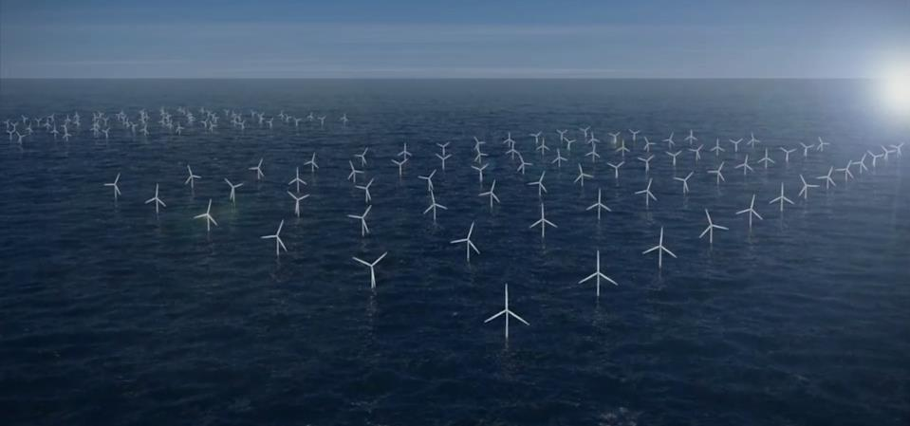
[Science] – Engineering
Amplitude range | Frequency range
? | 0.001 – 20 Hz
Comments: Structural health monitoring, interstory drifts, strain information
Rotation observations allow observing absolut motions of tall structures (accelerometers cannot deliver this)
Absolut differential motions allow detailed structural health analysis (e.g., after earthquakes, storms)

Slide 14
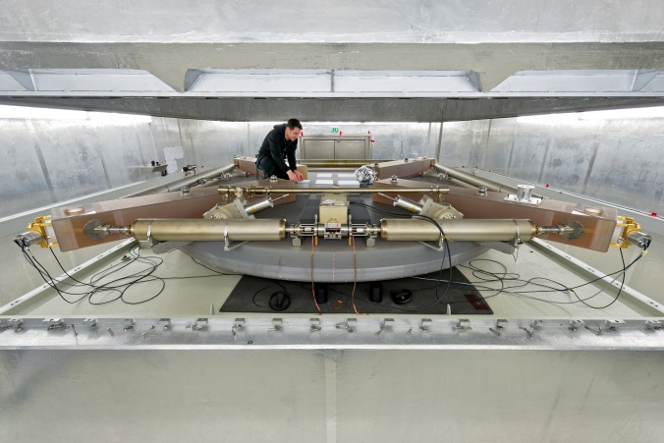
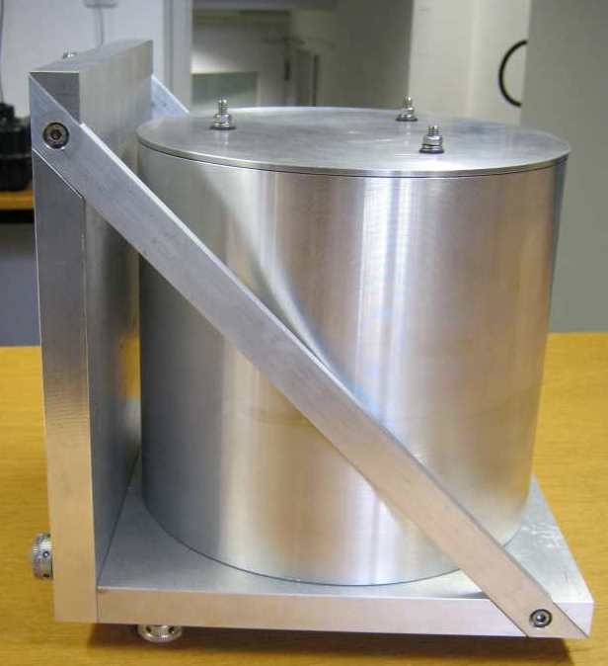
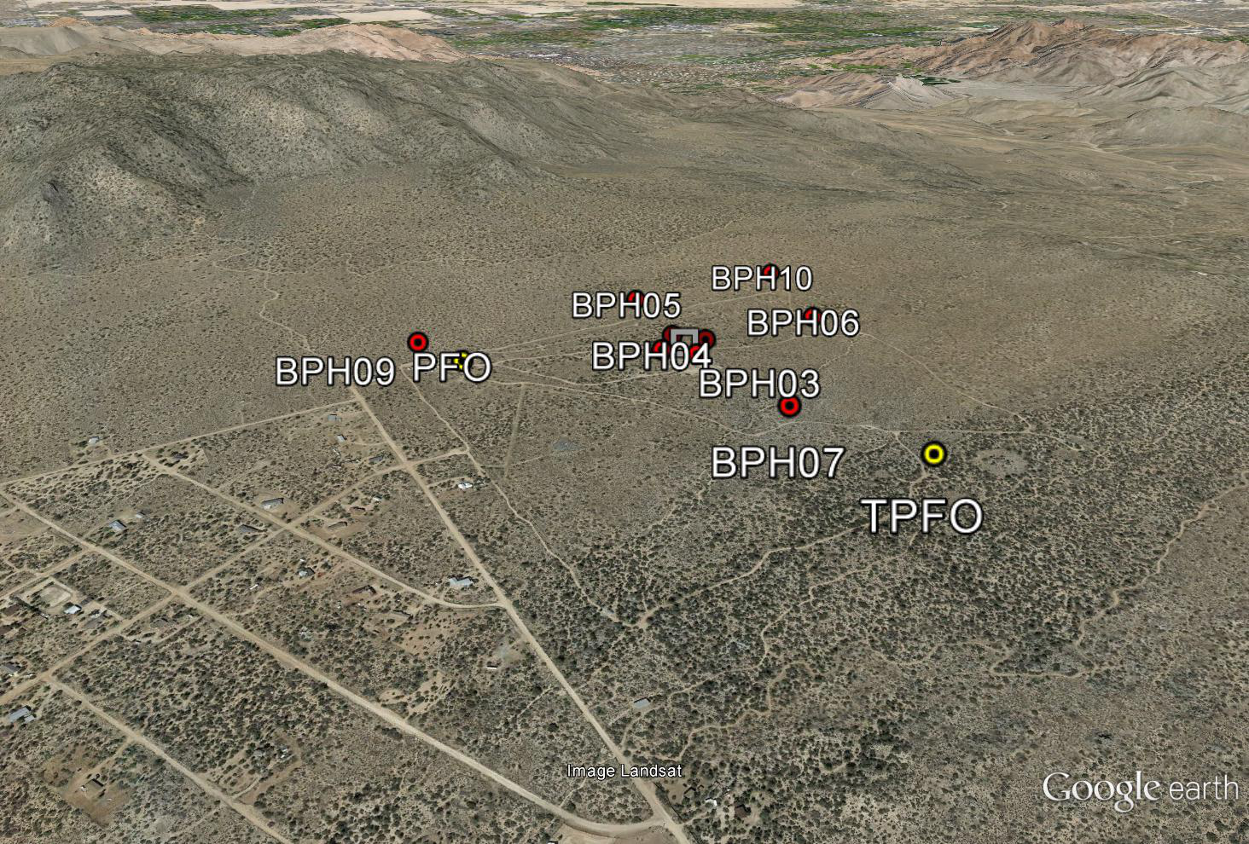
[Technology] – State of the Art
Observatory Instruments
ring lasers
seismology – space geodesy
Field Instruments
fibre-optic gyros
Earthquake physics, tomography, volcanology, marine seismology
Seismic Arrays
seismometers
noise analysis, local tomography
Notes:
Transition slide indicating the need for portable sensors

Slide 15
[Technology] – Requirements Summary
Seismology needs a portable broadband weak-motion rotation sensor for a wide range of scientific applications. The key requirements are:
Amplitude range | Frequency Range | Power
1 nrad/s – 5 μrad/s | 0.001 – 20 Hz | 5-8 W
Comments: Many applications [0.02-10Hz]; some applications require lowest possible power (ocean bottom); strong motion sensitivity not required.
Notes:
That is a key slide which leads to Frederic presentation afterwards

Slide 16
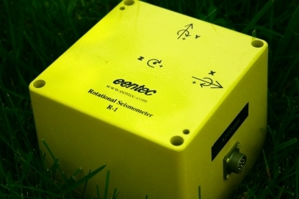
[Technology] – State of the Art
 | Linear transfer function | Sensitivity limit | Sensitive to translation | Sensitive to temperature change
FOG | YES | Ok (with some effort) | NO | NO
Mechanical gyros | YES | NOT Ok | YES | Not tested
Small scale arrays | YES | NOT Ok | YES | NO
Liquid based sensors | NO | NOT Ok | Not tested | YES

Slide 17
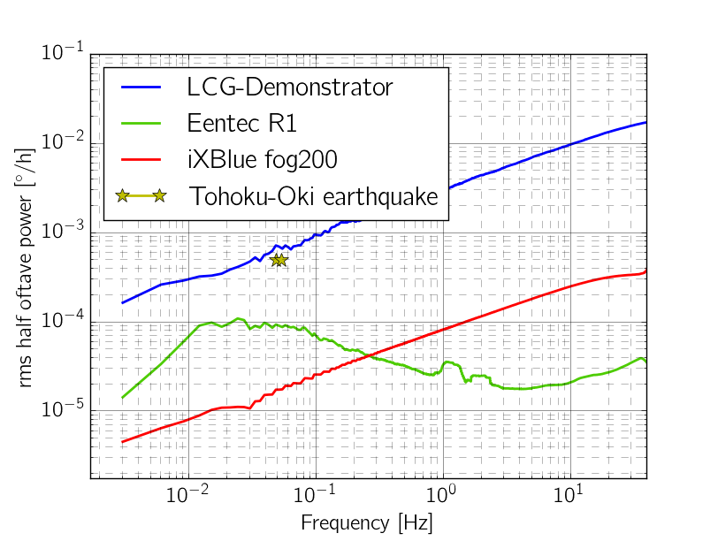
[Technology] – State of the Art
Peak rotational ground motion observed for the M9.1 Tohoku earthquake at 10.000km distance
Notes:
Maybe we could add a line in here with our desired frequency dependent sensitivity

Slide 18
[Technology] – Conclusions
Currently there is no sensor tailormade for the wide range of applications in seismology
The applicability of rotational ground motions to seismology/engineering has been demonstrated (theory, ring laser observations)
Fiber-optic technology seems to be the only viable path at the present time
It iXBlue test sensor is close to the desired requirements
Lowering the noise floor (by not much) substantially increases the domains of application

Slide 19
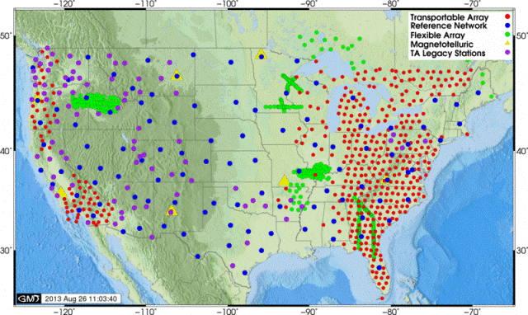
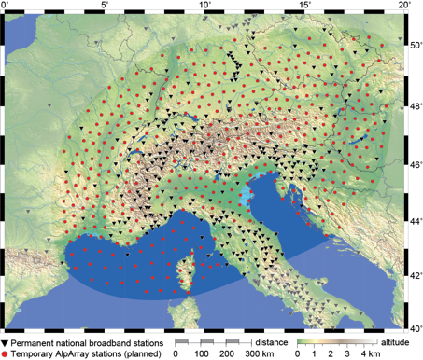
[Markets] – Seismic Networks, Agencies
USArray
AlpArray
Notes:
Look at all these sensors around!

Slide 20
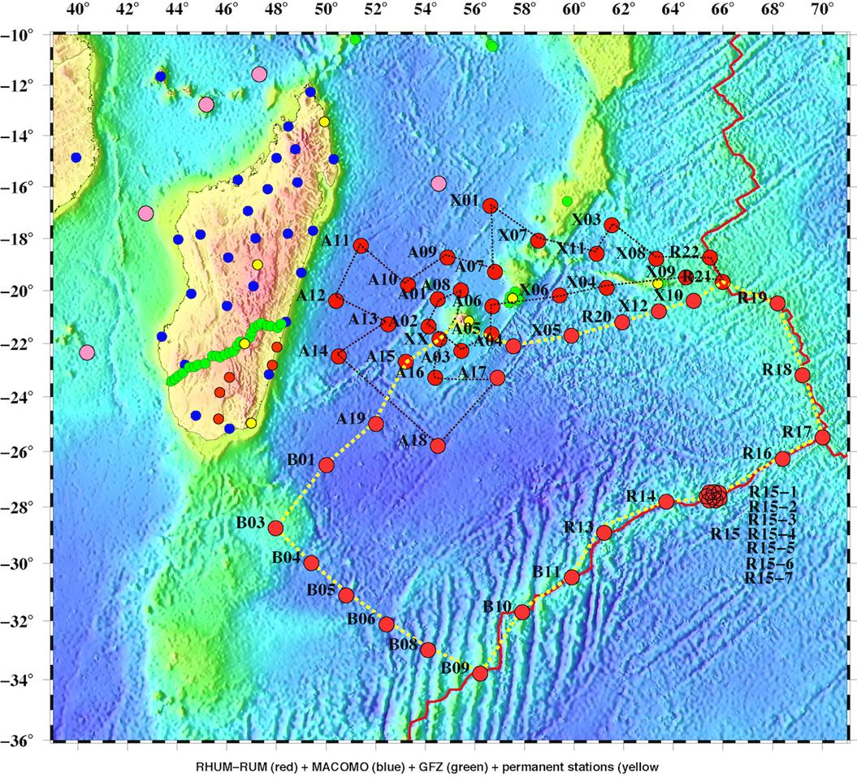
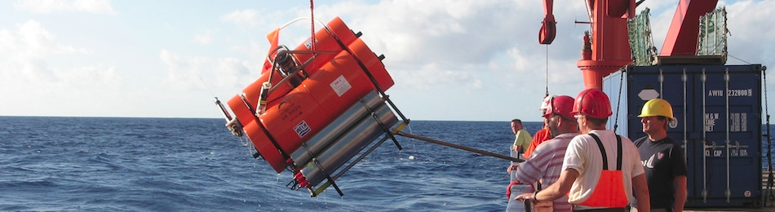
[Markets] – Seismic Networks, Agencies
Ocean bottom sensors
French-German RHUM-RUM ocean bottom seismometer network 2012-2013
60 OBS

Slide 21
[Markets] – Seismic Networks, Agencies
Potential Buyers (estimated number of seismic sensors/ocean bottom sensors):
Governmental agencies, geological surveys (USGS, BGS, BRGM, JAMSTEC, ERI) with permanent seismic networks (3000/50)
National/International instrumentation pools (DEPAS, RESIF, PASSCAL, OBSIP, AlpArray) for experimental campaigns (2000/300)
Geophysical Exploration (100000/1000s)
Space agencies (few/0)
It is estimated that at least a fraction of classic seismometers would be equipped with 3C+3C sensors.
Notes:
This is the slight where the $ signs will light up in the eyes of the owners

Slide 22
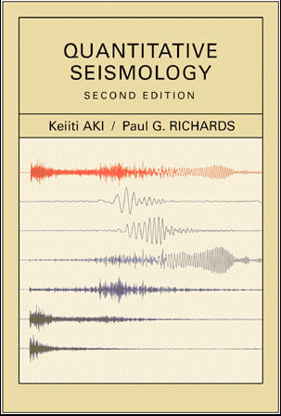
… before concluding …
„The state-of-the-art sensitivity of the general rotation-sensor is not yet enough for a useful geophysical application“ (Aki and Richards, Quantitative Seismology, 1980)
„(...) note the utility of measuring rotation near a rupturing fault plane (...), but as of this writing seismology still awaits a suitable instrument for making such measurements“ (Aki and Richards, Quantitative Seismology, 2nd edition 2002)
Seismologists‘ Bible

Slide 23

Conclusions
Seismology has been waiting for a portable broadband sensor for rotational motions for decades. To date no such sensor exists.
Ring laser observations sparked the interest in this motion type. Many theoretical and observational studies have proven that colocated measurements of translation and rotations have a great potential.
An International Working Group on Rotational Seismology is active (chaired by LMU) promoting research and applications.
A high-profile project has been funded by the European Research Council for the first time in this domain of research (visibility, dissemination).
The community needs proof-of-concept with observations. With current iXBlue technology we are not far from reaching the specification targets.
It has been demonstrated that high-resolution rotation sensors have a wide range of applications (science, exploration, engineering)
Notes:
I would say here that we know that the race is on to develop the 1st portable sensor for seismology (ATA, eentec, ..) but that we believe iXBlue could be the fastest to reach the market,

Slide 24
Relevant recent publications
Donner, S., Bernauer, M., Igel, H., Inversion for seismic moment tensors combining translational and rotational ground motions, Geophys. J. Int., submitted
Wassermann, J., Wieteck, A., Hadziioannou, C.,and Igel, H., Towards a Single Station Approach for Microzonation: Using Vertical Rotation Rate to Estimate Love-Wave Dispersion Curves and Direction Finding, Bull. Seis. Soc. Amer., submitted.
Lindner, F., J. Wassermann, M. Schmidt-Aursch, K.U. Schreiber and H. Igel, Sea-floor ground rotation observations: potential for improving signal-to-noise ratio on horizontal OBS components, SRL, submitted.
Tanimoto, T.; Hadziioannou, C.; Igel, H.; Wassermann, J.; Schreiber, U. and Gebauer, A. (2015), Estimate of Rayleigh-to-Love wave ratio in the secondary microseism by co-located ring laser and seismograph, Geophys. Res. Lett., in press, doi: 10.1002/2015GL063637.
van Driel, M.; Wassermann, J.; Pelties, C.; Schiemenz, A. & Igel, H. (2014), Tilt Effects on Moment Tensor Inversion in the Nearfield of Active Volcanoes , Geophysical Journal International, 1711-1721, doi:10.1093/gji/ggv209.
Igel, H., M. Bernauer, J. Wassermann, and K. U. Schreiber (2015), Rotational Seismology: Theory, Instrumentation, Observations, Applications, in Encyclopedia of Complexity and System Science, edited by WHK Lee,Springer-Verlag New York.
Bernauer, M.; Fichtner, A. & Igel, H. (2014), Reducing non-uniqueness in finite source inversion using rotational ground motions, Journal of Geophysical Research: Solid Earth, 119(6), 4860-4875, doi: 10.1002/2014JB011042.
Bernauer, M.; Fichtner, A. & Igel, H. (2014), Optimal observables for multi-parameter seismic tomography, Geophysical Journal International, 198(2), 1241-1254, doi: 10.1093/gji/ggu204.
Schreiber, K.U.; Gebauer, A.; Igel, H.; Wassermann, J.; Hurst, R.B. & Well, J.P. (2014), The Centennial of the Sagnac Experiment in the Optical Regime: From a Tabletop Experiment to the Variation of Earth Rotation, Comptes rendus de l'Academie des Sciences, 15(10), 859-865, doi: 10.1016/j.crhy.2014.10.003.

Slide 25
[Science] – Geophysical Exploration
Amplitude range | Frequency range
? | 0.001 – 20 Hz
Comments: Improved tomo-graphy, more processing options, wave type separation, noise analysis. Not a big market.

