Slide 1
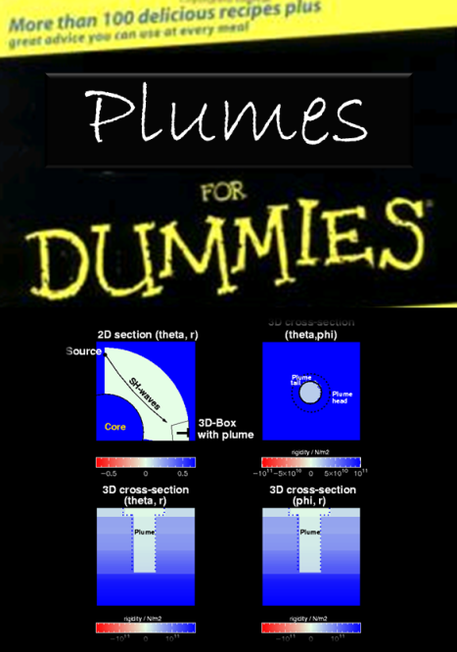
Why (the hell) is it so difficult to image plumes? or
The seismic signature of plumes
Pictures from dissertation by Markus Treml (LMU, 2006). Collaboration with Saskia Goes, Ed Garnero, Nick Schmerr, Mike Thorne, Gabi Laske, Jason Morgan, Karin Sigloch and others.

Slide 2
Objectives
What is the seismic signature of a (likely) plume structure?
What (additional) wave form effects can we expect (beyond travel time effects)
What seismic phases should we analyse?
What experimental setup is optimal?

Slide 3
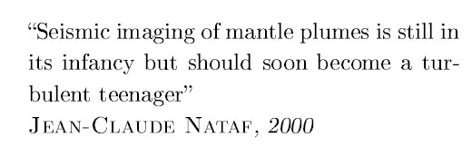
Outline
Intro
The magic of wave front healing
Learning from the forward problem
  Travel time effects
  Amplitude effects
Conclusions

Slide 4
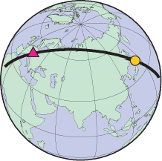
Intro – our observations
March 11, 2011, Tohoku-Oki earthquake M9.0
Arrival times
Surface waves
Source information

Slide 5
From short to long periods
Decreasing frequency content
Increasing spatial wavelengths
Increasing non-linearity
Increasing computational cost
raw broadband data
120 minutes

Slide 6
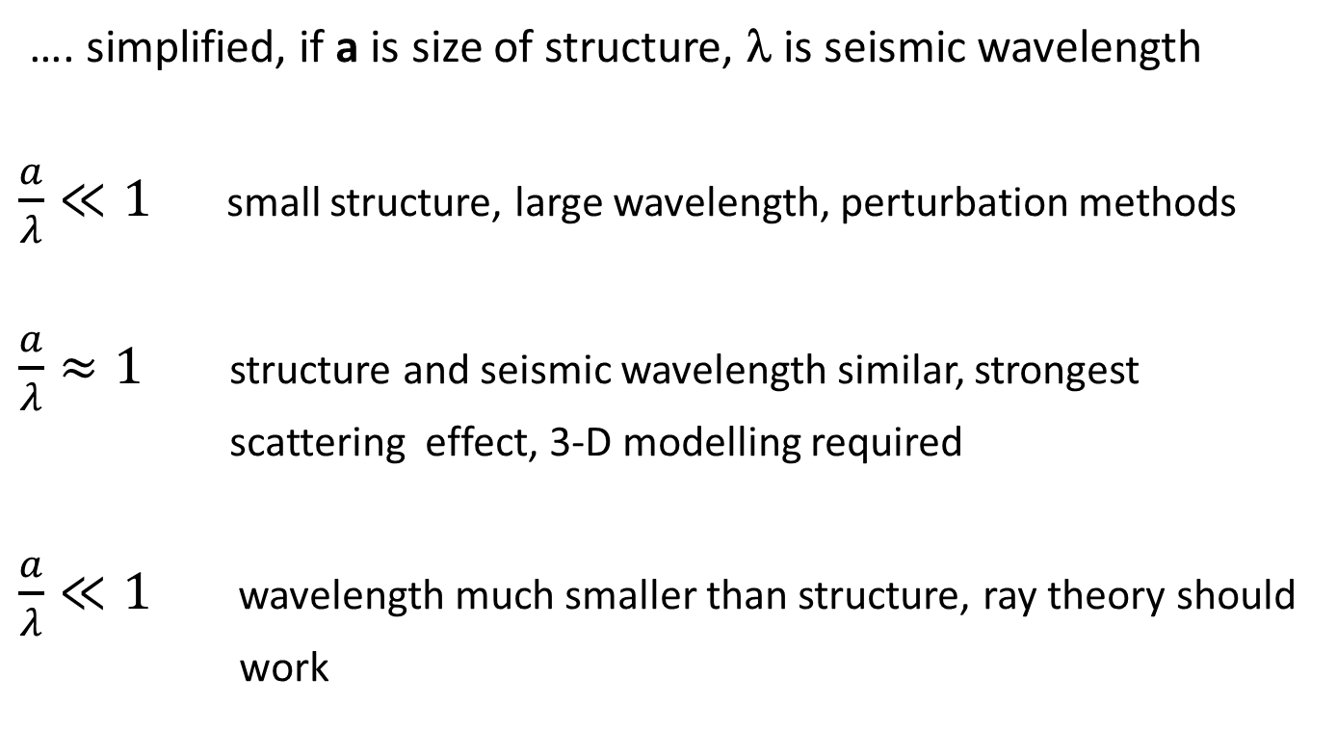
Waveform effects and scattering
…. simplified, if a is size of structure, λ is seismic wavelength
$\frac{a}{λ}≪1$ small structure, large wavelength, perturbation methods
$\frac{a}{λ}≈1$ structure and seismic wavelength similar, strongest
scattering effect, 3-D modelling required
$\frac{a}{λ}≪1$ wavelength much smaller than structure, ray theory should
work

Slide 7
Consequence for plumes
Plume width a = 100 km
Dominant period T = 20 s (5 s)
Velocity v_{p}=8km/s
Wavelength λ_{p} = 160 km (40 km)
Velocity v_{s}=6km/s
Wavelength λ_{s} = 120 km (30 km)
-> we expect waveform effects

Slide 8
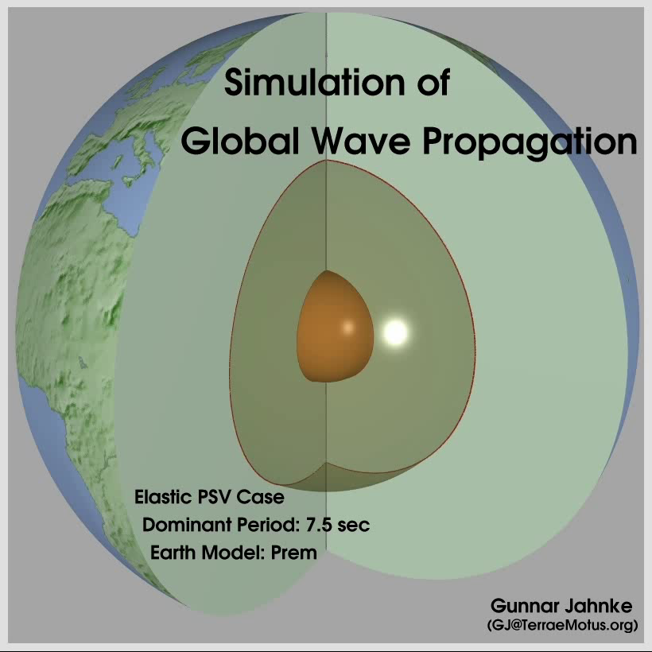
T

Slide 9
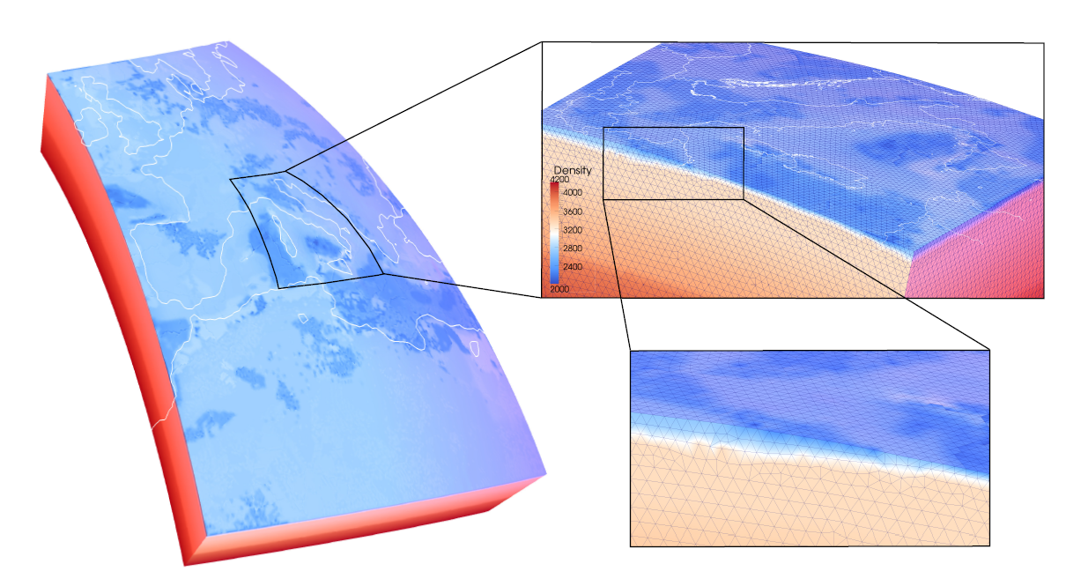
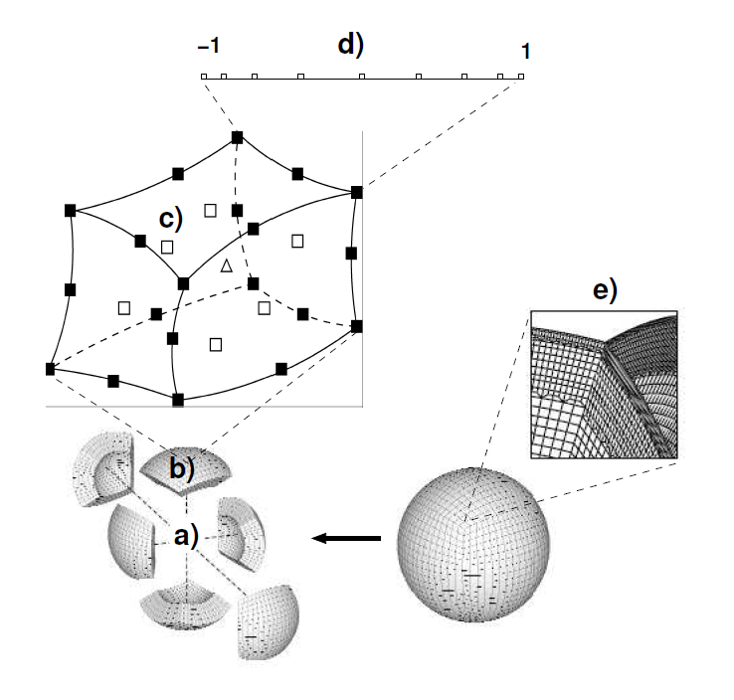
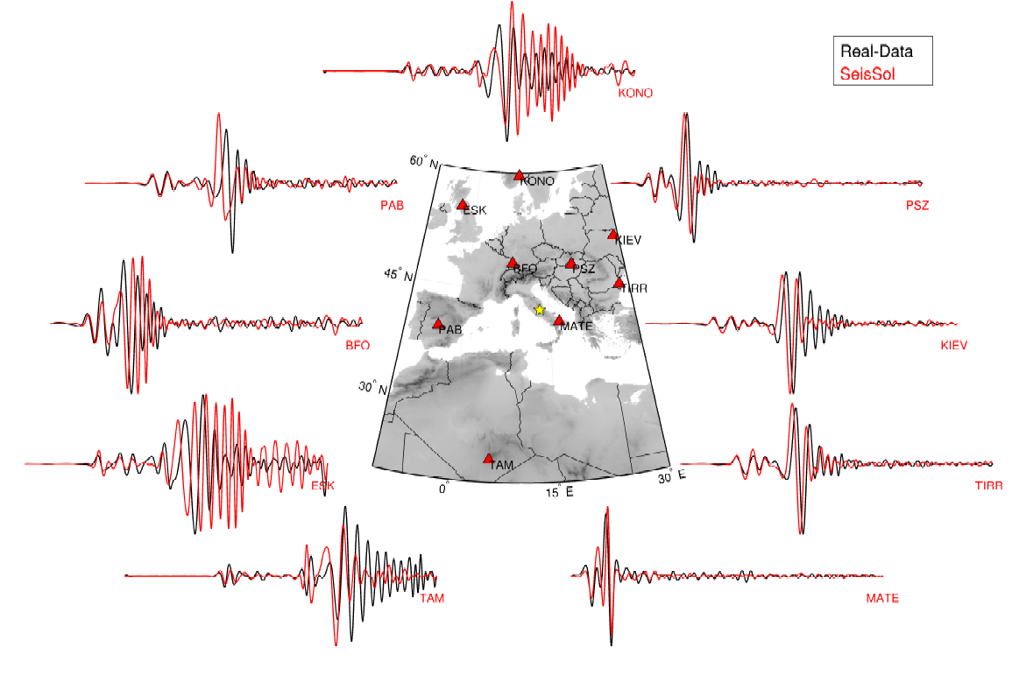
Forward modelling

Slide 10
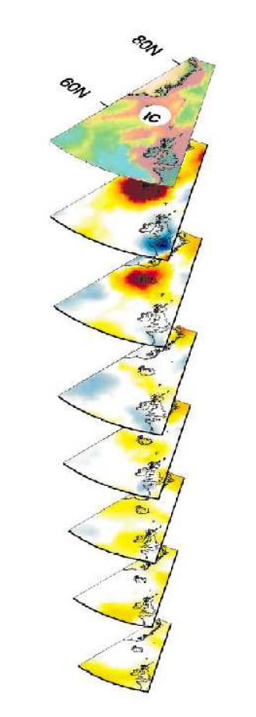
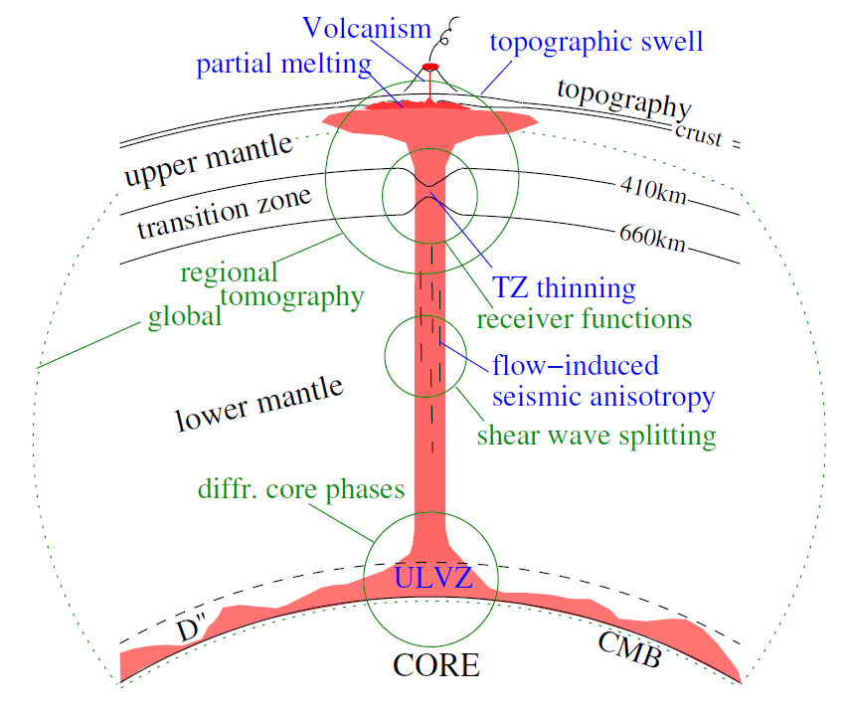
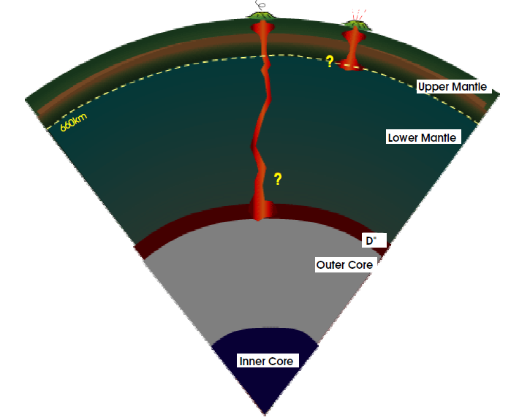
What do (likely) plumes look like?

Slide 11
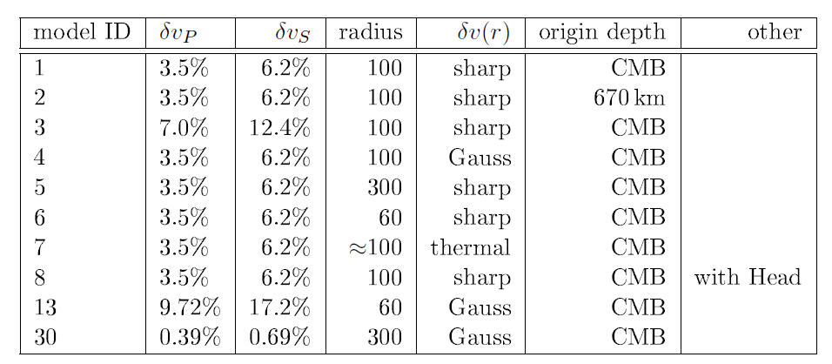
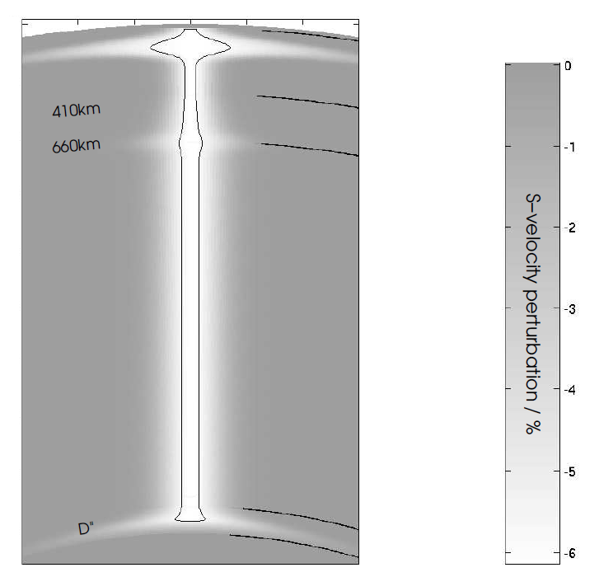
Synthetic plume
Plume parameters:
Head size, form
Tail radius
Pertrubation magnitude
Tail boundaries
No attenuation

Slide 12
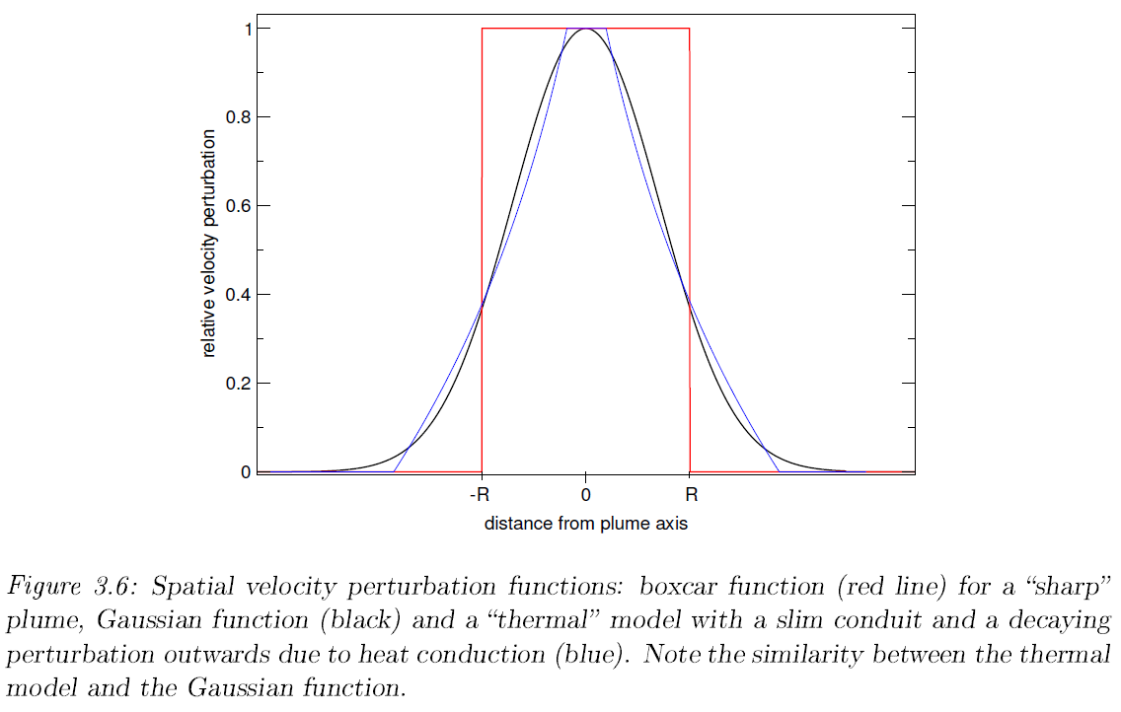
Velocity cross sections

Slide 13
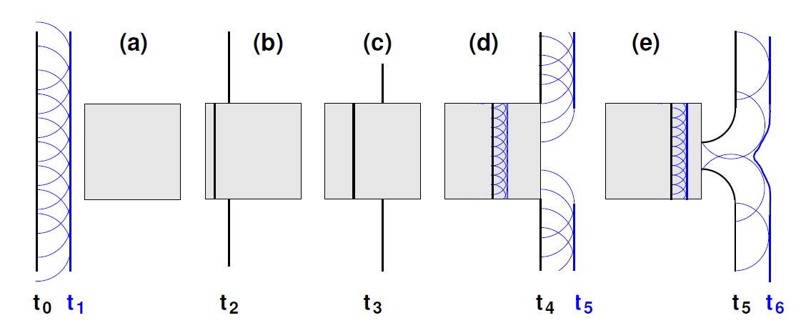
Wavefront healing
(Huygens principle)
In theory high-velocity zones do NOT loose their phase effect

Slide 14
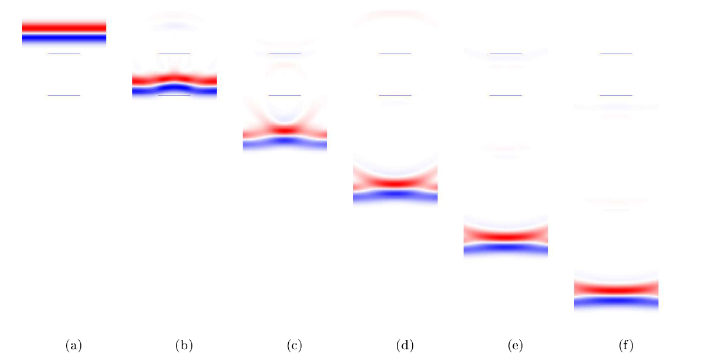
Wavefront healing (simulation)
Time

Slide 15
Motivation
… in addition to travel time (phase) effects
Are there frequency-dependent effects that can be predicted?
Are there amplitude effects that can be exploited?
Where can these effects be observed?

Slide 16
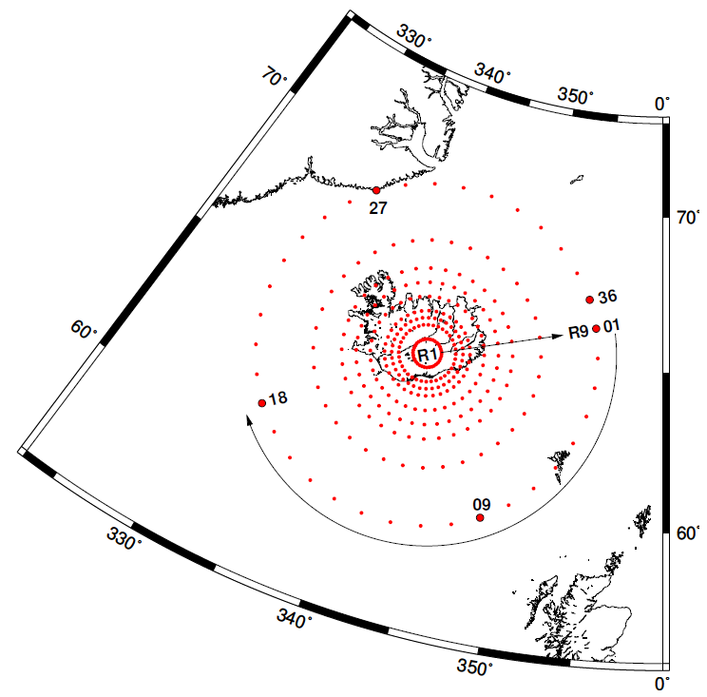
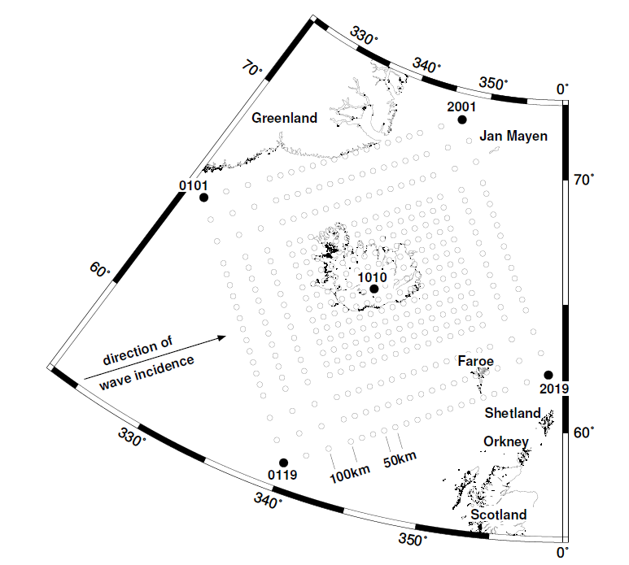
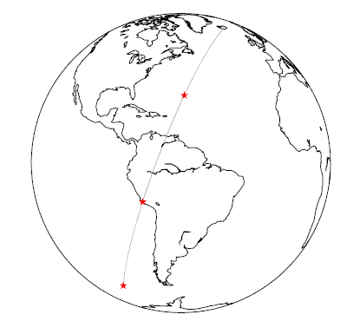
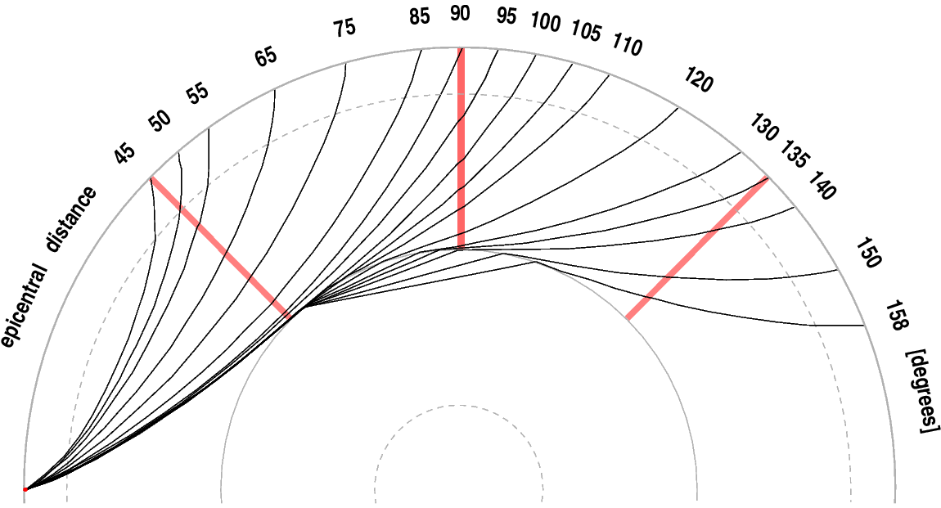
Experimental
setup

Slide 17
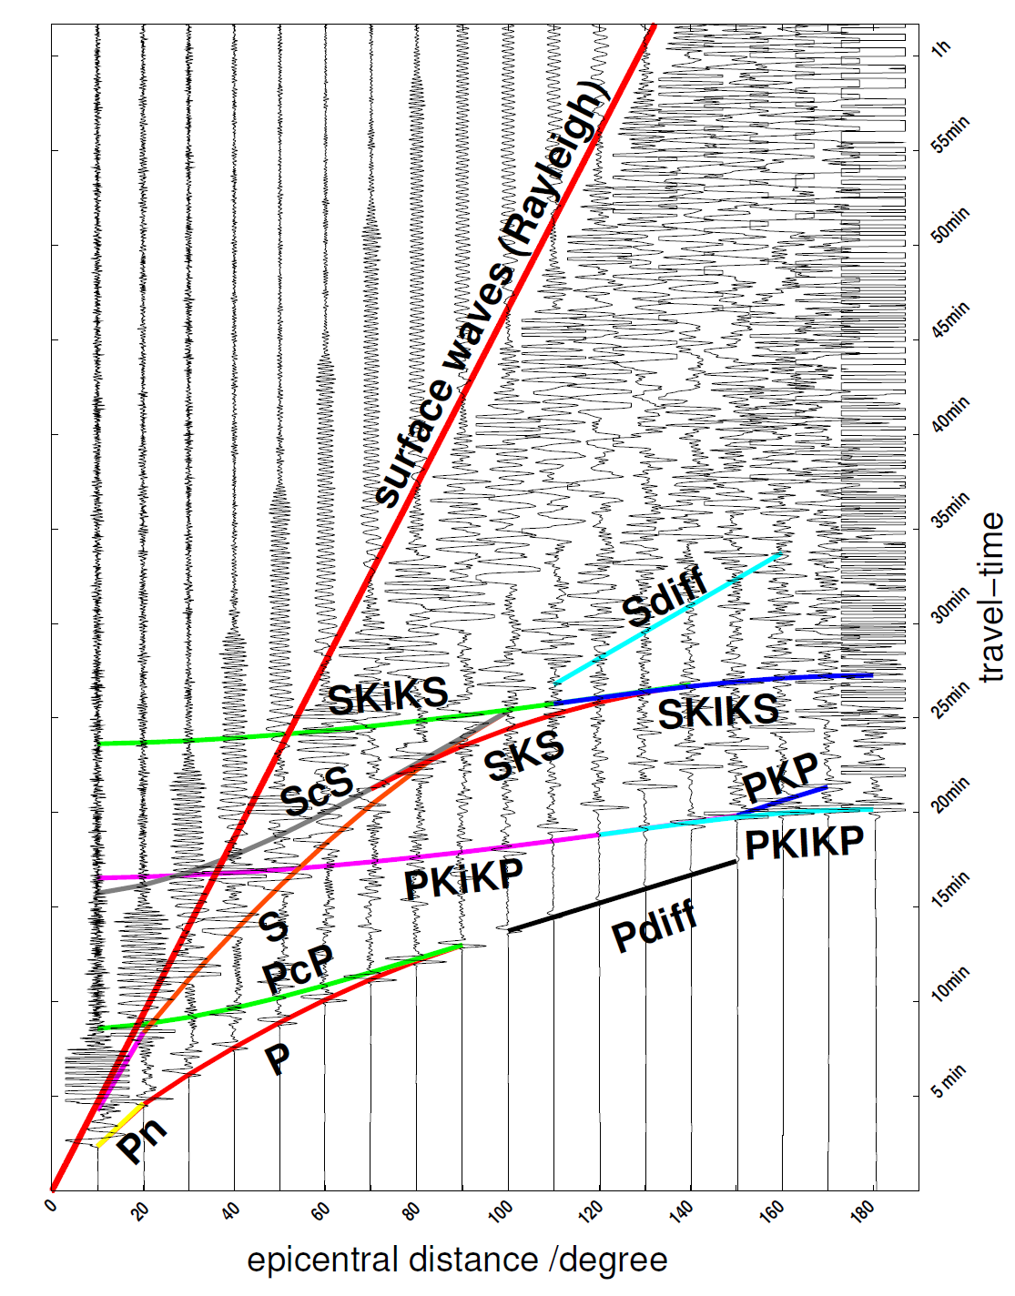
Sample seismogram section
(PREM unfiltered)

Slide 18
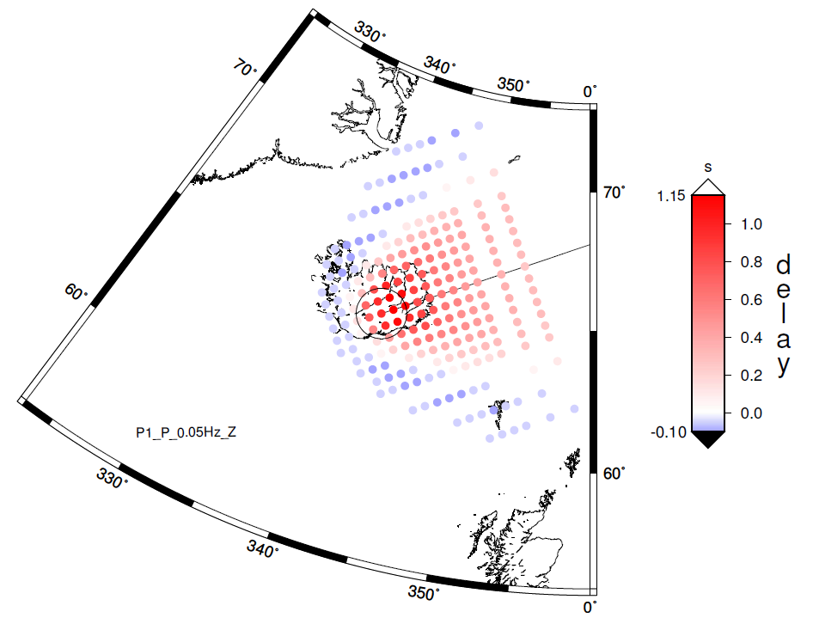
Travel time shadows (P@90°)

Slide 19
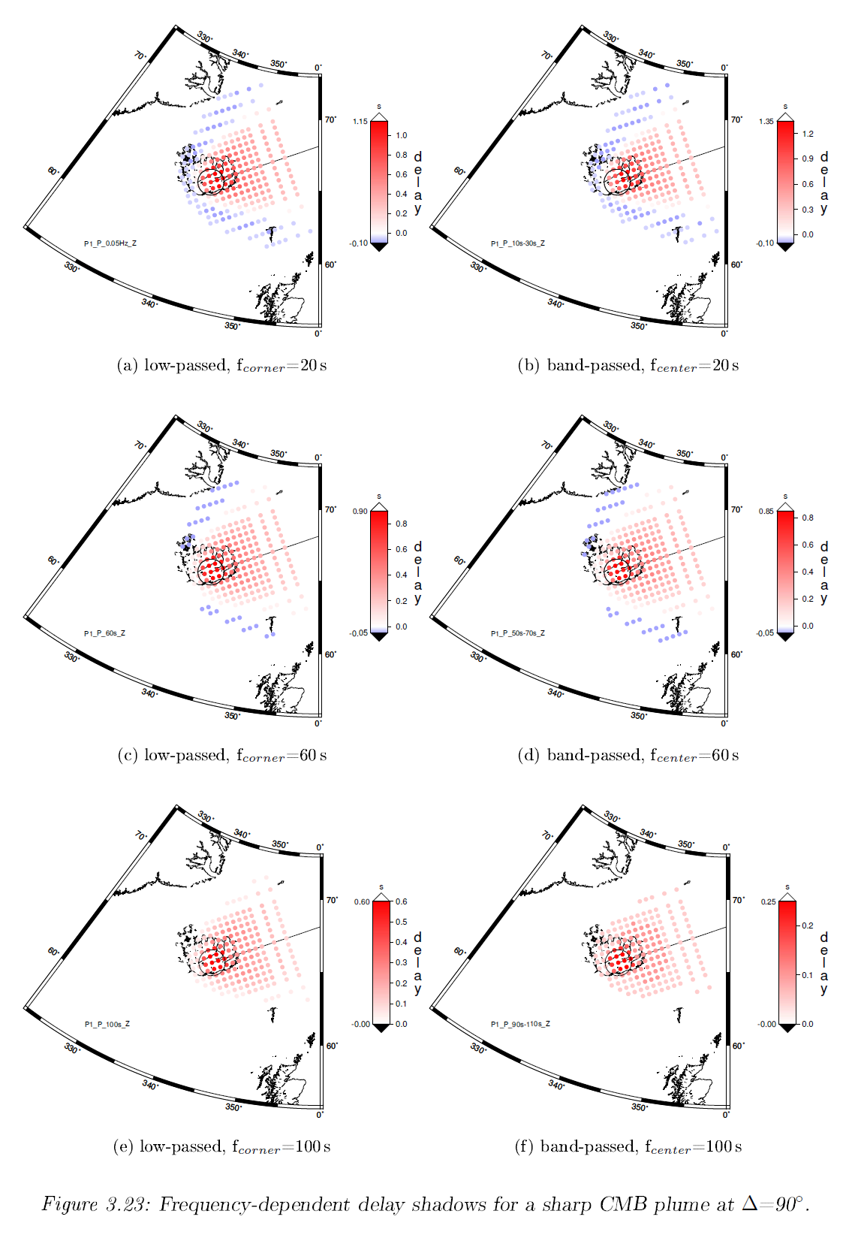

Slide 20
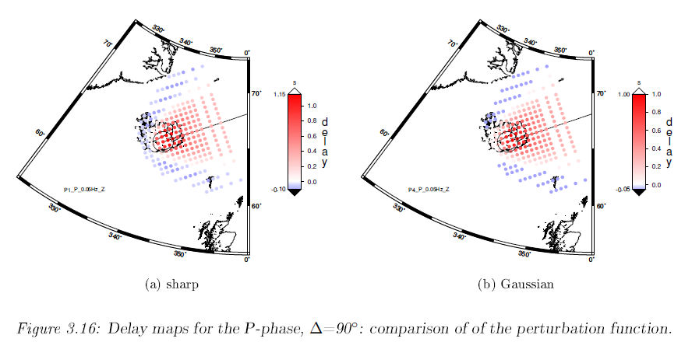
Sharp vs. Gaussian

Slide 21
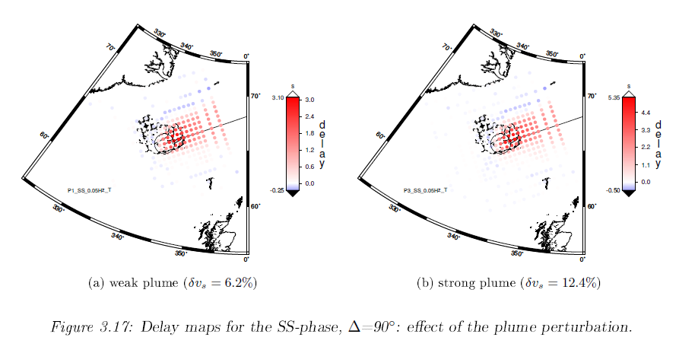
Weak vs. strong plume

Slide 22
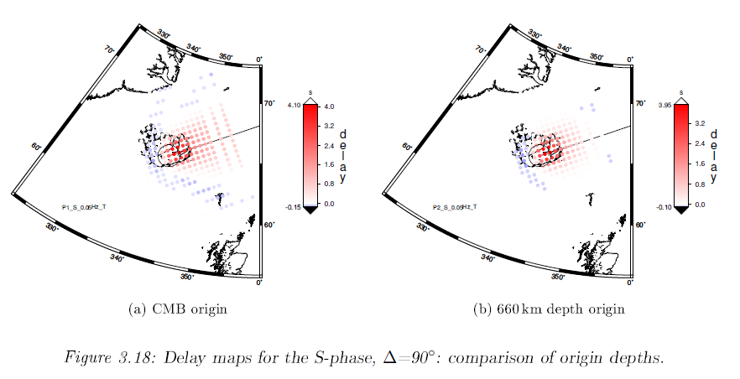
Deep vs. shallow

Slide 23
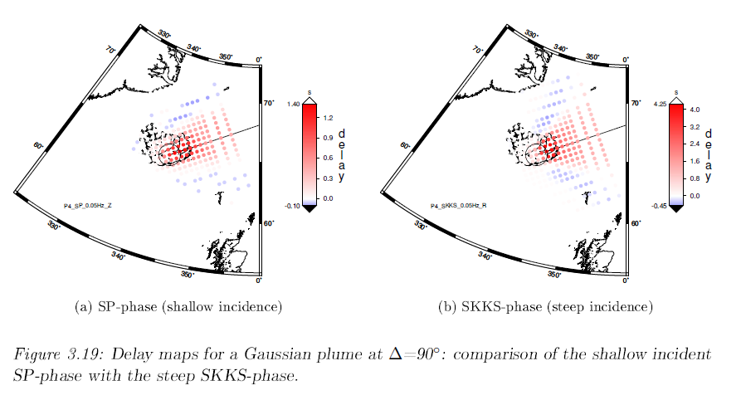
SP vs. SKKS

Slide 24
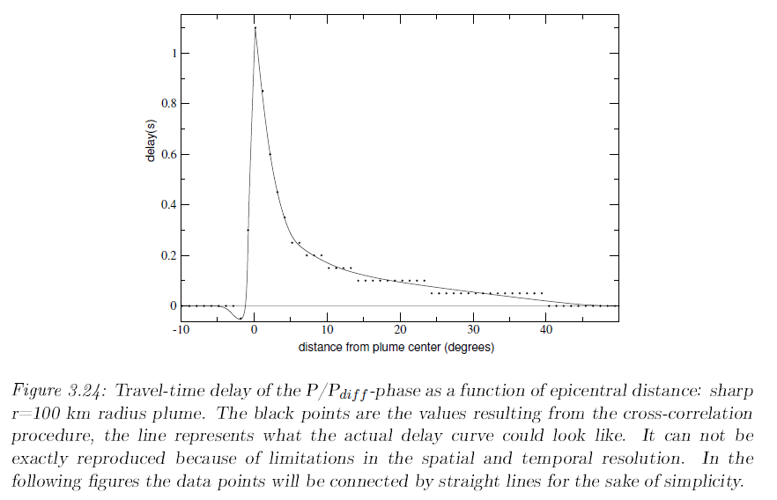
Delay along great circle

Slide 25
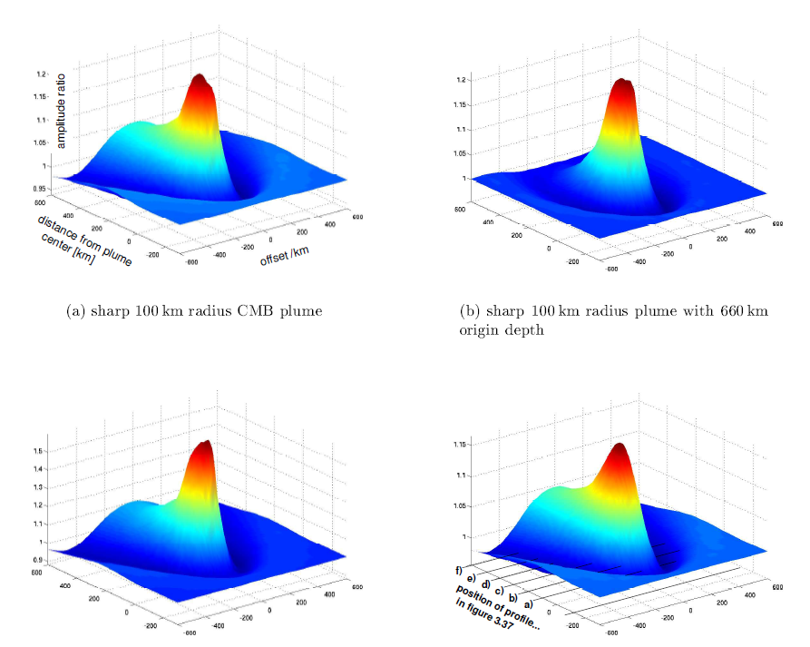
Amplitude effects

Slide 26
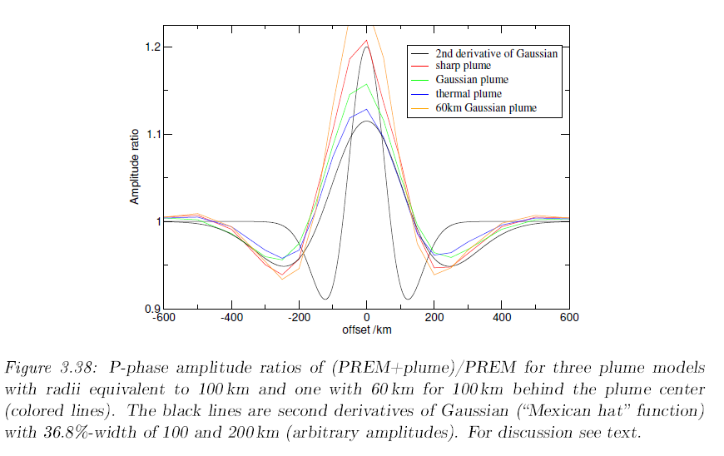
Amplitude effects - cross section

Slide 27
Conclusions
Due to their smooth, small scale, and low-velocity nature plumes are difficult to image using transmission tomography (like fault zones)
Tomographic studies of RHUM-RUM (any kind) should be accompanied by forward modelling studies of appropriate plume structures in the observed broad frequency band (today that is not a problem!)

Slide 28
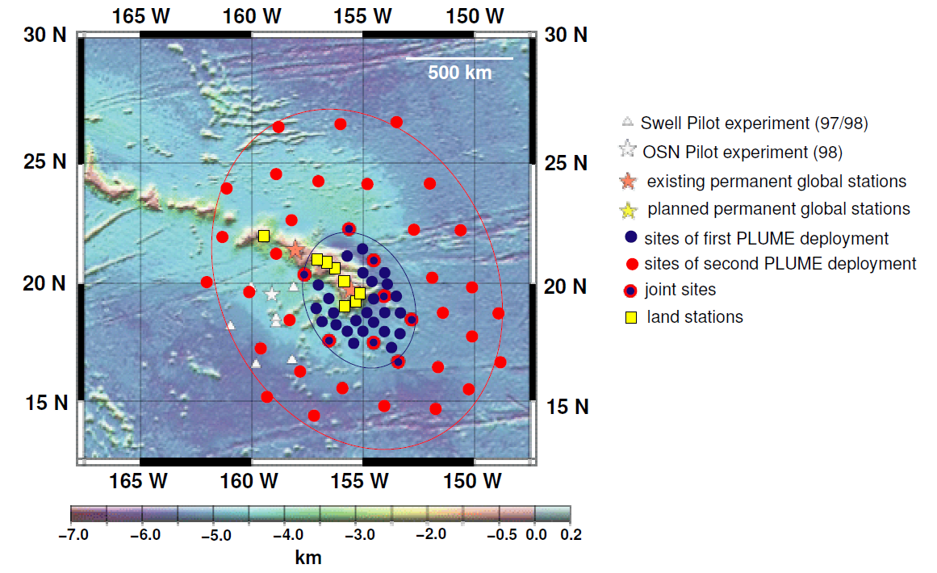
Con

Slide 29
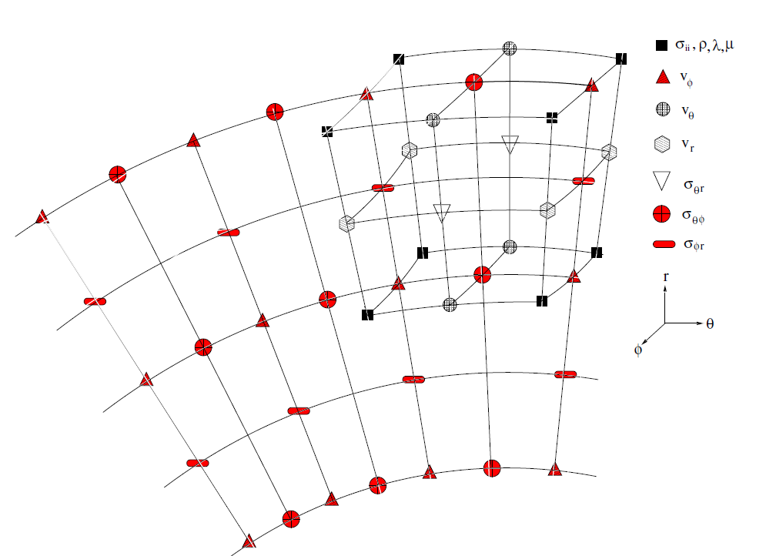
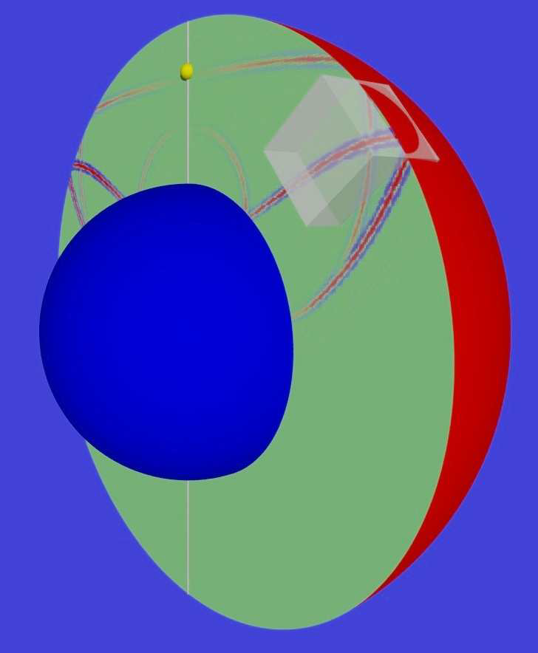
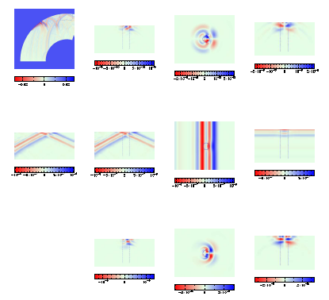
Hybrid Modelling (axi-symmetric into 3-D section)

