Slide 1
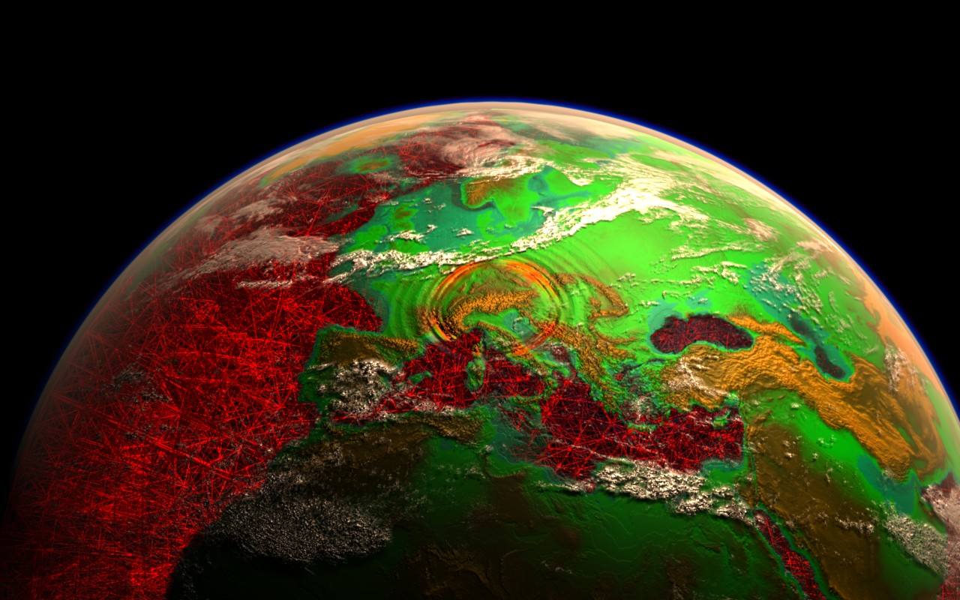
Seismic Tomography
Data, Modeling, Uncertainties
Heiner Igel, LMU Munich

Slide 2
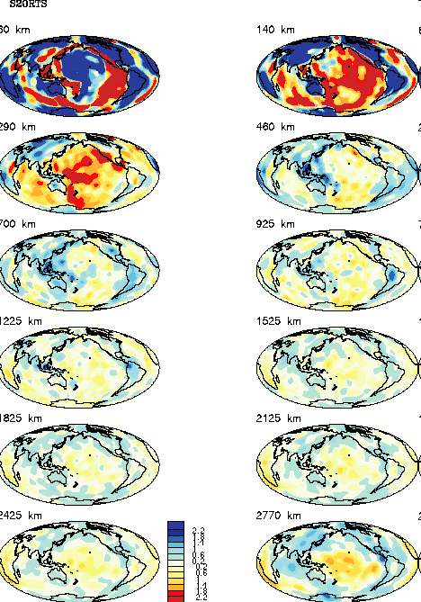
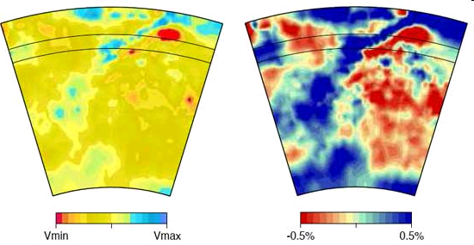
Seismic tomography global and continental scales
Ricard et al., 2005
Fichtner et al., 2009
Ritsema et al., 2004

Slide 3
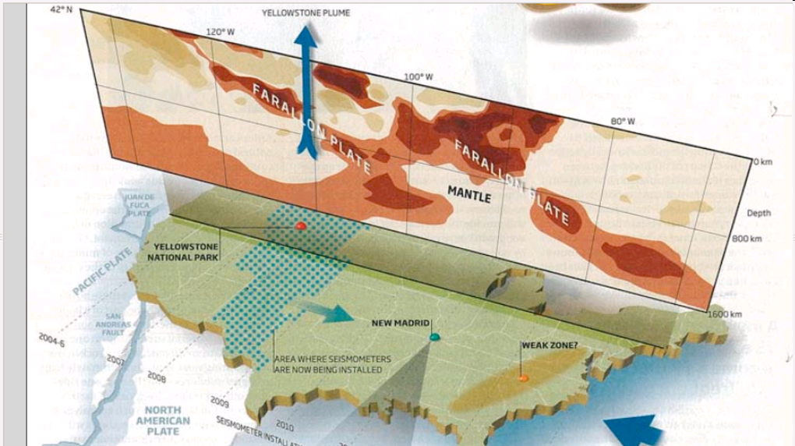
Science
Fact or fiction?
Significant geodynamic feature?
Amplitude correct?
Spatial scale correct?
Depth correct?

Slide 4
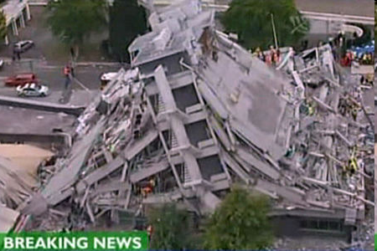
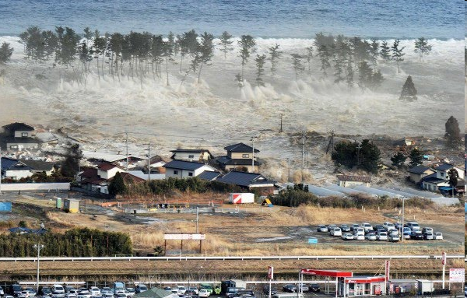
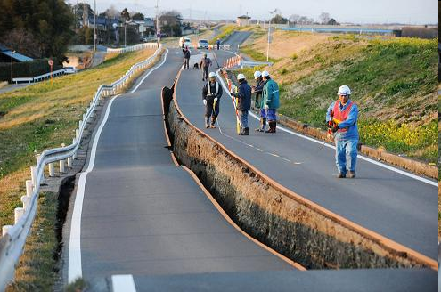
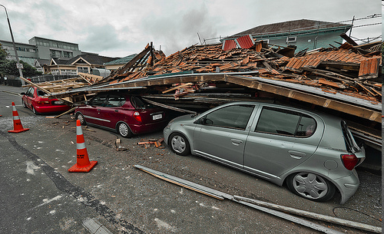
What went so horribly wrong?
Christchurch, February 2011
Tohoku-Oki, March 2011

Slide 5
Outline
Introduction: earthquakes, seismic observations, the seismo-tomographic problem
„Classic“ tomography using seismic rays
Full waveform inversion using 3-D simulation technology – adjoint approach
Summary and Outlook

Slide 6
Sources of seismic energy

Slide 7
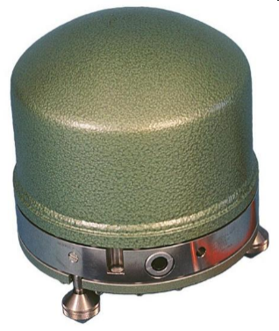
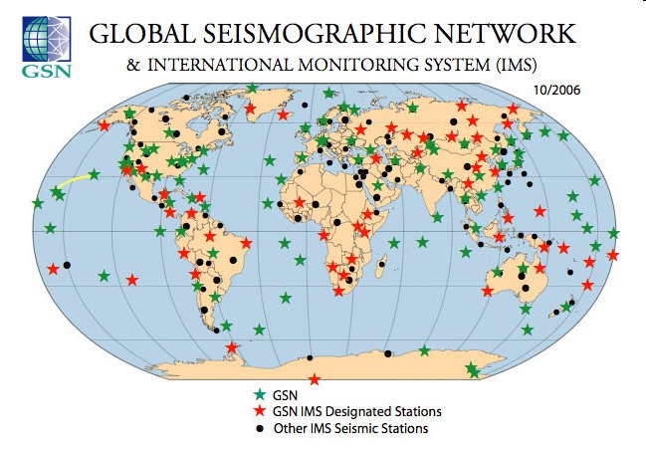
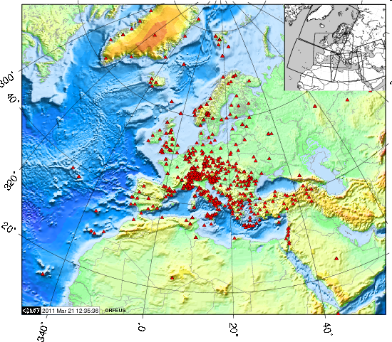
Observational networks
Approx. 1000 instruments in Europe alone
It is unlikely that we populate the oceans with seismometers in the near future!

Slide 8
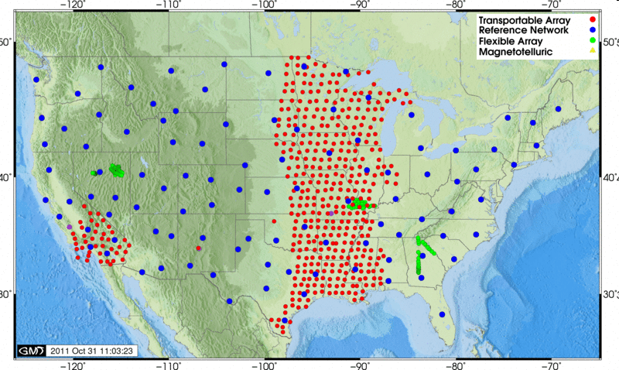
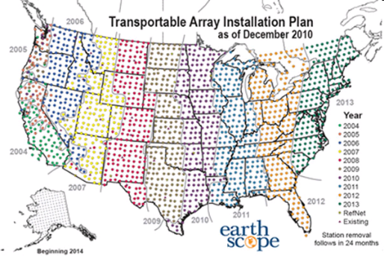
US Array
… new classes of continental scale tomographic models are around the corner …

Slide 9
What is the nature of observations and their sensitivities to Earth‘s structure in seismology?

Slide 10
… on a seismically quiet day …
„noise“
Ground motion
amplitude (e.g., [m/s])
Time
March 11, 2011, seismometer located in Germany

Slide 11
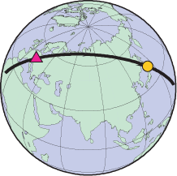
… that turns catastrophic …
March 11, 2011, Tohoku-Oki earthquake M9.0
Arrival times
Surface waves
Source information

Slide 12
Temporal scales (vertical ground motion)
Decreasing frequency content
Increasing spatial wavelengths
Increasing non-linearity
Increasing computational cost
raw broadband data
120 minutes

Slide 13
Simplified convolutional model
The (noise free) seismic observation is a convolution of the source signal with a Green‘s function …
U(ω,r) =
S(ω) G(ω,r) I(ω,r)
Impulse response of the Earth, contains all information on Earth‘s internal structure, site conditions
-> tomography
Seismic instrument response affects amplitudes and phase information
Raw data in seismic archives, usually ground velocities in three orthogonal directions
Source mechanism, the magnitude, the source time behaviour
The problem is linear w.r.t.sources (see talk by M. Mai)

Slide 14
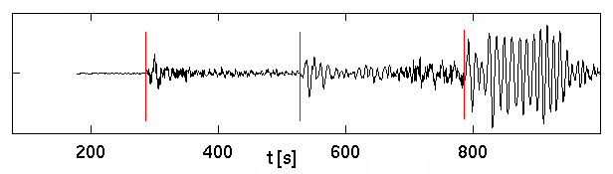
Let‘s briefly summarize …
Seismograms are affected by structure and source
The seismic tomography problem requires (in principle) the source to be known (or assumed to be known)
There are two strategies to solve the inverse problem
Classic seismic tomography
Full waveform inversion (FWI)
Reduce information drastically (travel times)
Reduce physics to a high-frequency approximation (ray theory)
Identify specific signals in seismic data (P and S wave arrivals, reflections, etc.)
Use linear inverse theory to solve for 3-D velocity structure
Use (low-passed) full waveforms as data
Solve complete forward problem (3-D elastic wave propagation)
Apply adjoint techniques to relate data perturbation to Earth model perturbation
Iteratively minimize overall misfit between data and synthetics

Slide 15
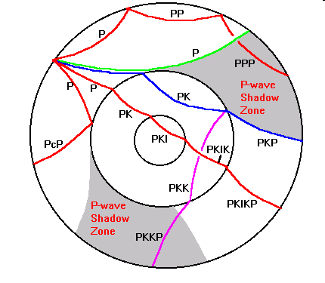
Seismic tomography
using rays
We ignore surface wave inversion and inversion of free oscillation spectra as the mathematical structure is similar

Slide 16
Seismic ray theory
… is a non linear problem as the ray path depends on the seismic velocity model … after linearization …
Travel time perturbations
with respect to an initial model
Dimension m
Sensitivity of the i-th measurement to the j-th model parameter (basis function, pixel)
Dimension m x n
Solution model (seismic velocities)
Dimension n

Slide 17
d
What is a travel time perturbation?
“Picking the onset is at best ambiguous
or inaccurate, sometimes impossible.” (Nolet)

Slide 18
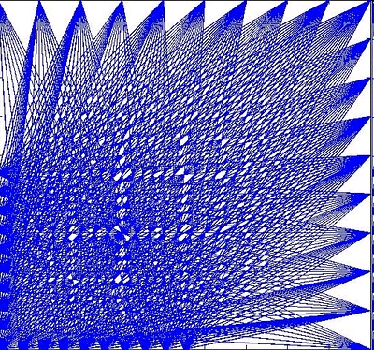
G
Operator that relates the model (perturbation) to the observable (travel time perturbation). In general it is an integral over the ray path (volume in case of finite frequencies)
The ij entries to G correspond to the i-th ray path affected by the j-th slowness value (pixel or basis function).
The choice of the basis functions strongly affects the density of G

Slide 19
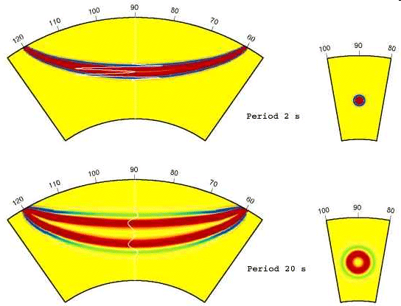
G - sensitivities
We can describe the effect of model perturbations on an observable (e.g., travel time dT) by a sensitivity kernel K_{X} for Earth model parameters seismic velocities (V_{P}, V_{S}) and density
Issues:
Trade offs
Amplitude information
Little sensitivity on density
Low velocity anomalies

Slide 20
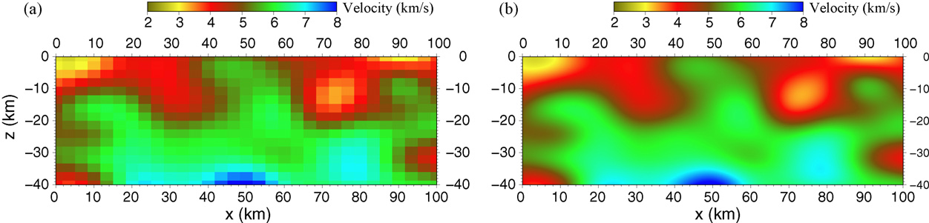
m
Ray-based tomographic problems have (only) P and/or S velocities as unknowns (not density, impedance, etc).
Possible parametrizations: blocks, complex volumes, splines, spherical harmonics, irregular tetrahedra, etc.
Blocks
Splines

Slide 21
Solution to the Inverse Problem
Basic least squares (LS) solution of the linear (-ized) inverse problem with D containing the cumulative effects of the regularization (smoothing) constraints (e.g., Tikhonov regularization)
Solution of this equation with conjugate gradient, LSQR, or other.
Typical dimensions:
Δd -> 10⁷ travel time perturbations
Δm -> 10⁵ ⁻ 10⁶ unknowns

Slide 22
Example
Rawlinson et al., 2010

Slide 23
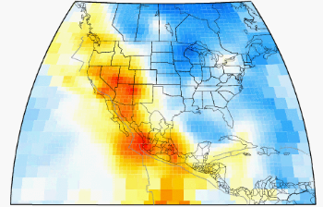
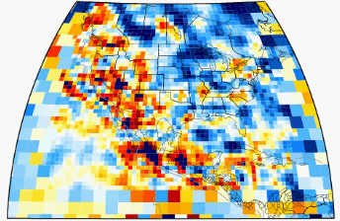
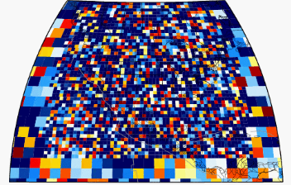
Regularization and smoothing
Decreasing misfit
Increasing model complexity
Increasing number of degrees of freedom
Courtesy: L. Boschi

Slide 24
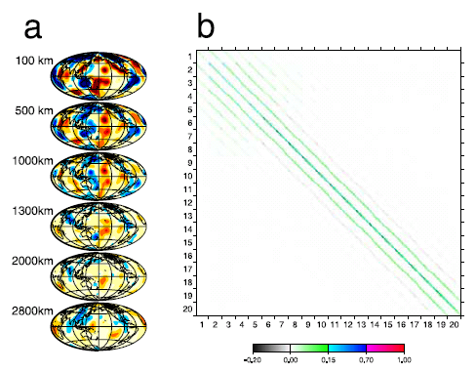
Examples
R
Boschi (2003)
Rows of R for a well resolved pixel at 700 km depth

Slide 25
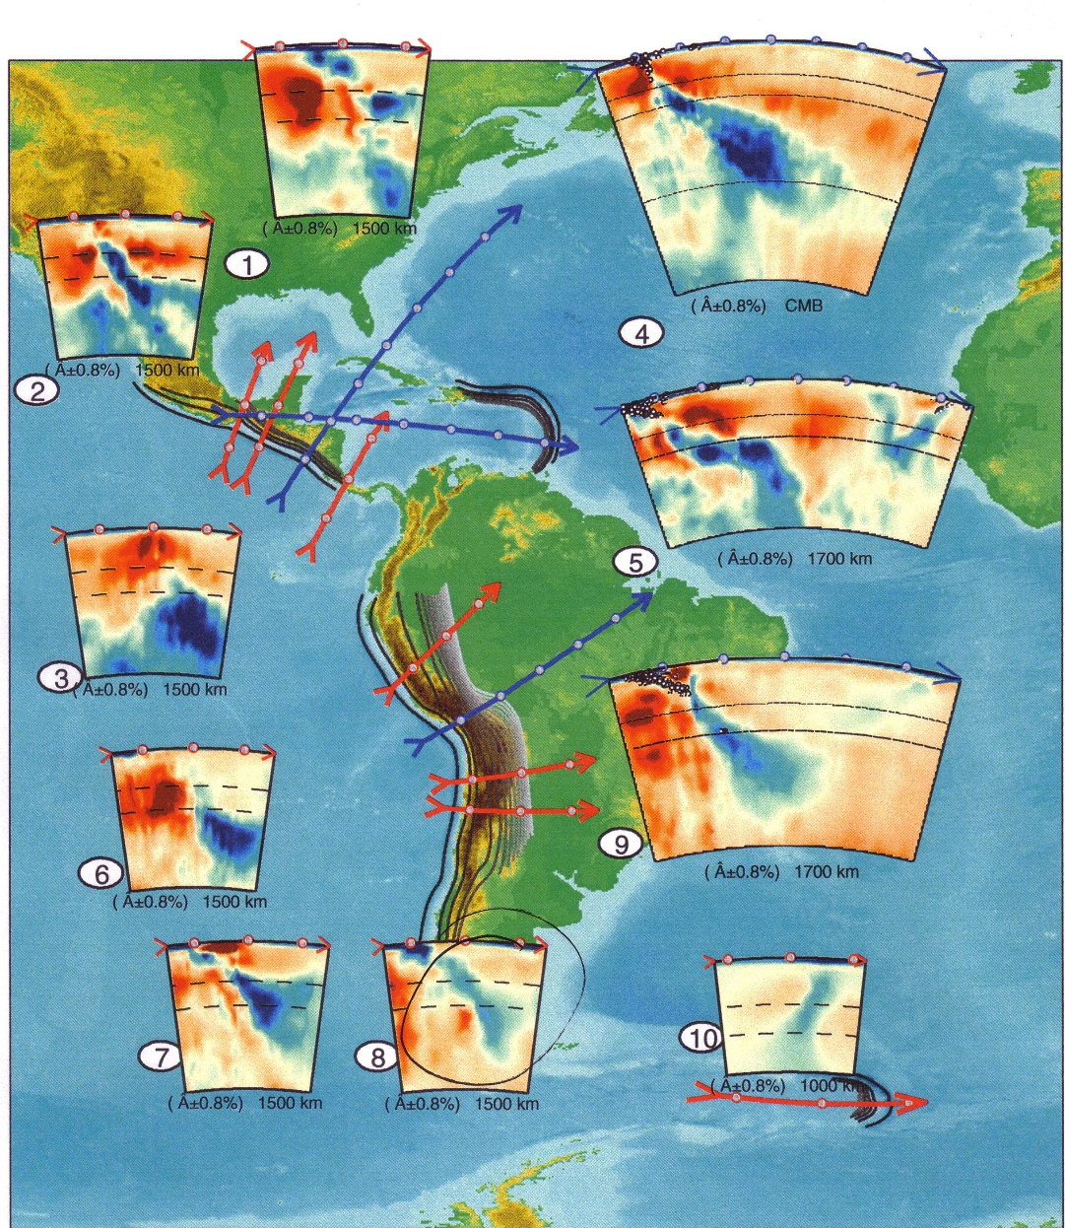
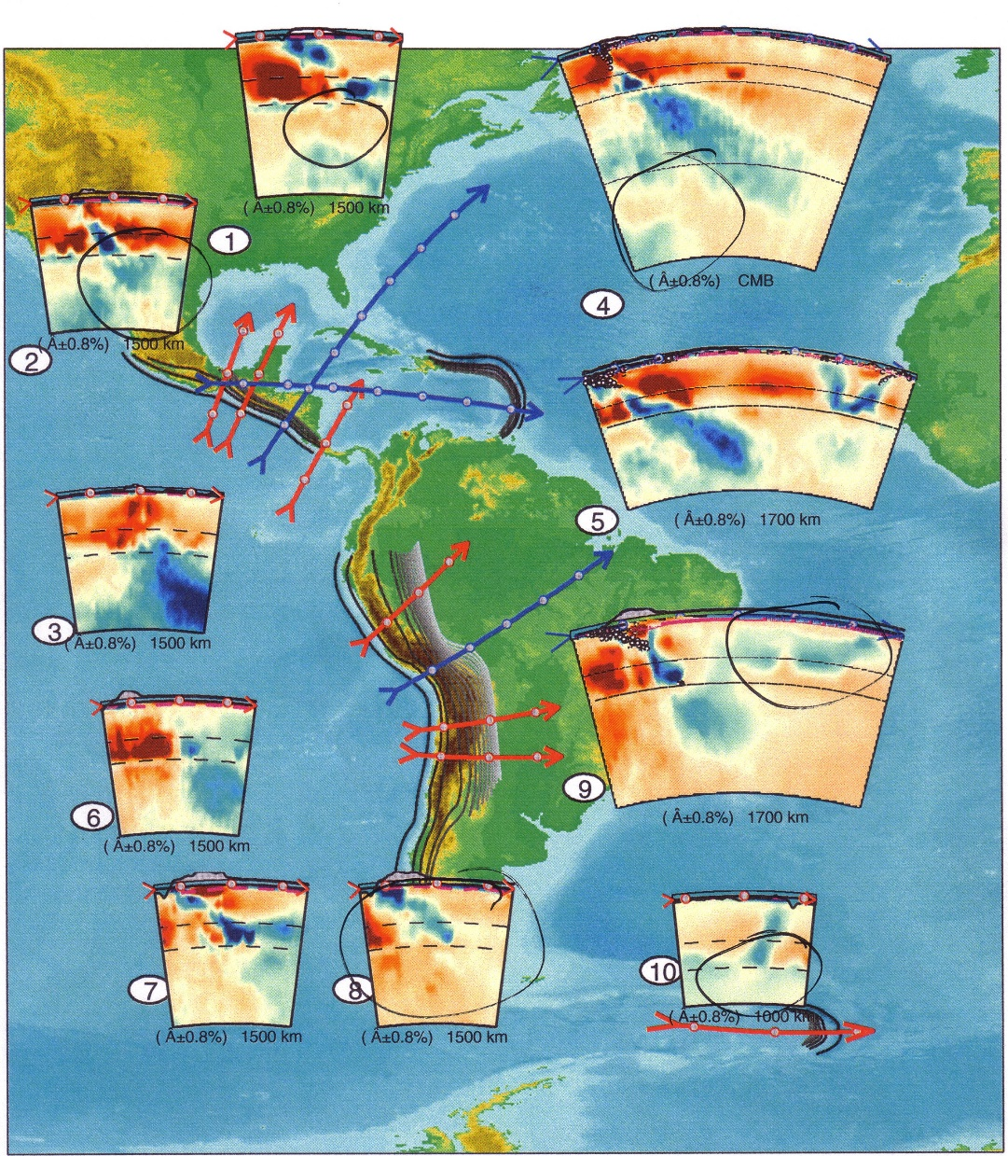
Exploring null spaces using SVD misfit remains the same (< ε)
Original Modified
Courtesy: de Wit and Trampert

Slide 26

Ray-based tomography – future directions
… from infinite to finite frequencies …
Extracting travel times at different frequencies facilitates the solution of the system and adds information on the model (?)
Finite-frequency tomography using complete kernels calculated with 3-D wave propagation tools
Using Monte Carlo type techniques to quantify resolution (see talk by R. Zhang) in a Bayesian framework
Calculating resolution matrix R for really big systems (not done yet)

Slide 27
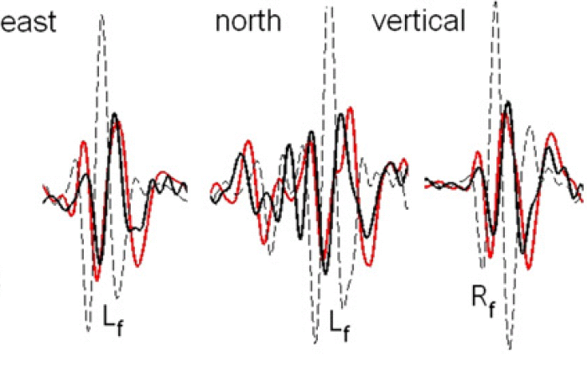
The real thing:
Full waveform inversion

Slide 28
Forward problem

Slide 29
Forward problem
Seismology (waves and rupture) has a good benchmarking culture!

Slide 30

Three stages of FWI
forward problem
sensitivities
inversion
seismic wave propagation through heterogeneous Earth models
dissipation & anisotropy
spectral-element discretisation of the seismic wave equation
Quantify misfit between theory and observations
Relate data perturbation to model perturbation (adjoint -> gradient)
Improve gradient (preconditioning)
Find appropriate step length
Calculate model update
Adapt temporal and spatial scales (multigrid)
Iterate until satisfactory fit
Estimate uncertainties?

Slide 31
Misfit calculation

Slide 32
Time – frequency misfits

Slide 33
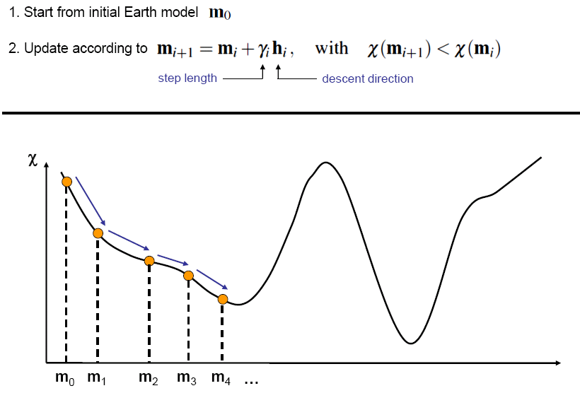
Gradient-based inversion

Slide 34
Multi-scale approach

Slide 35
The gradient (adjoint based)

Slide 36
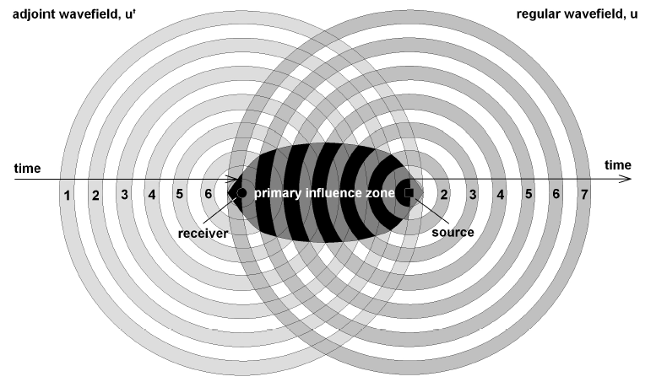
The sensitivity kernel
The interaction of the regular and the adjoint fields generates a primary influence zone.
First-order scattering from within the primary influence zone affects the measurement.

Slide 37
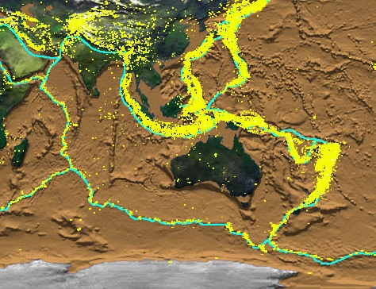
An example of full waveform inversion on a continental scale

Slide 38
FWI sensitivity kernels
Gradient is calculated by back propagating adjoint sources (differences between theory and observations at receivers) separately for each of the approx. 40 earthquakes

Slide 39
Preconditioning
Corrections for geometric spreading effects and reduces the sensitivity with respects to structures near source and receiver

Slide 40
Misfit improvement

Slide 41
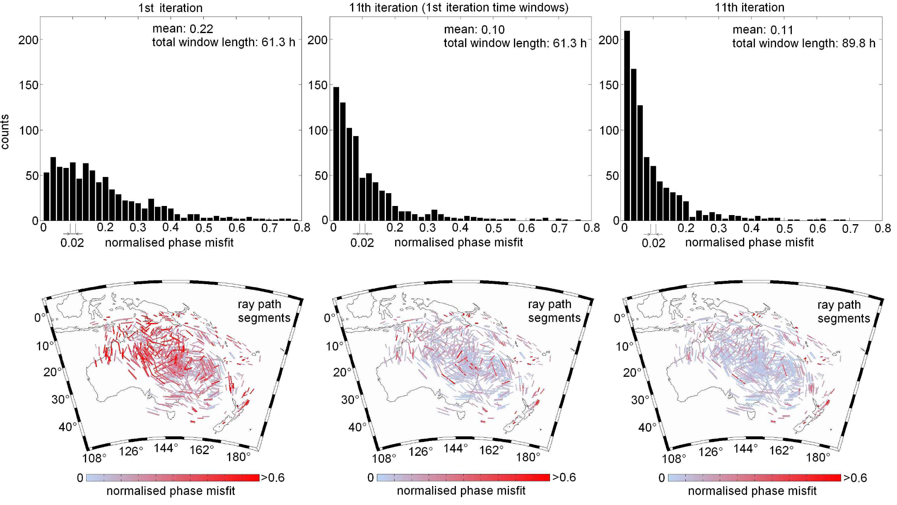
Global misfit improvement

Slide 42
Reconstructed Earth model

Slide 43
Checkerboard test – Resolution?

Slide 44
So what?
strategies to quantify resolution

Slide 45
Why so difficult for FWI?
Non linear dependence of data on model parameters
Sensitivity matrix can not be computed explicitly (as in linear problems for moderately large problems)
Forward problem too expensive to allow fully probabilistic approaches or neural networks (except for lower-dimensional problems, see poster by Käufl et al.)

Slide 46
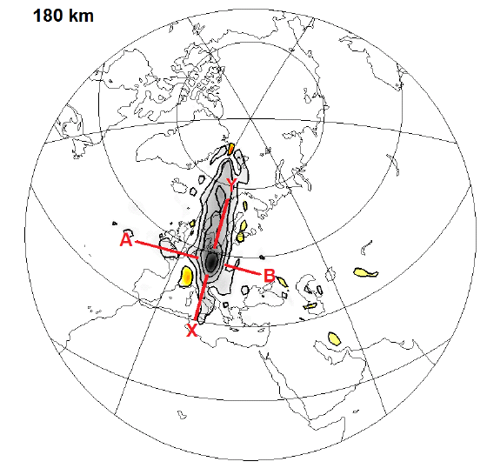
Point spread functions
Trade off between S velocity perturbation at the yellow star
and the S velocity in the neighbouring regions (at certain depth)
Compare with R in previous slides (Boschi, 2003)!

Slide 47
Resolution length
High resolution NS direction
High resolution EW direction

Slide 48
Image distortion
Point-perturbations displaced by imaging
Distortion = [position of point perturbation] – [centre of mass of its blurred image]
What you see may be somewhere else!

Slide 49
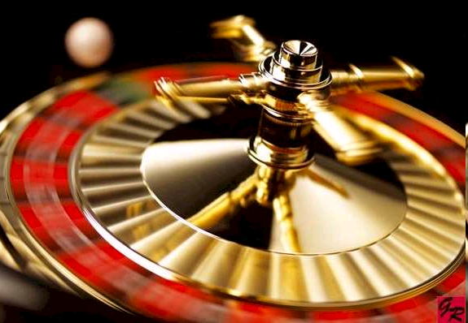

Slide 50
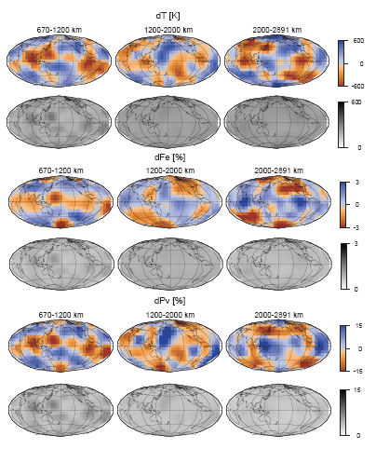
Tomography using Monte Carlo methods
The use of MC methods is restricted to systems with limited degrees of freedom (dozens for generally nonlinear problems)
Mosca

Slide 51
What we really should be doing …

Slide 52
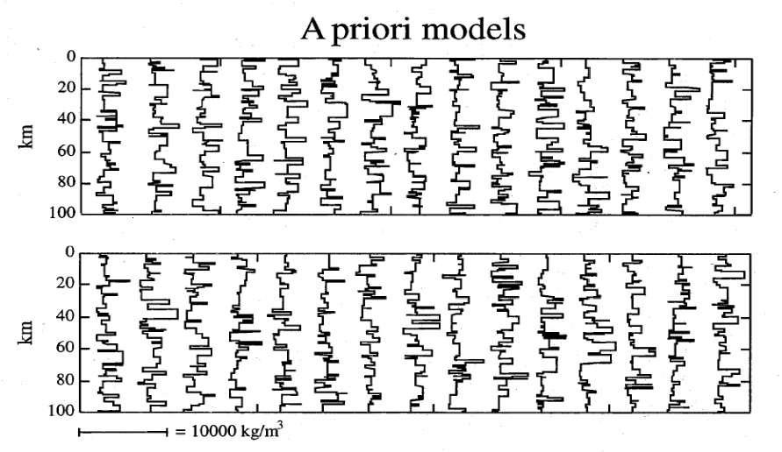
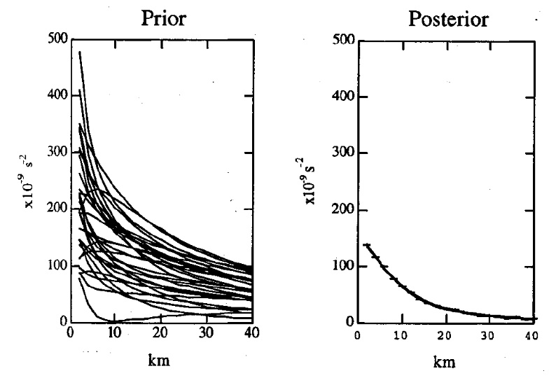
Open issues with the probabilistic approach
How can we properly describe prior information?
How should we describe data uncertainties, errors (if not Gaussian)?
How should we describe defficiencies in our theory?
What are optimal parametrization schemes of the Earth model and the model space search
Moosegaard and Tarantola, 1995

Slide 53
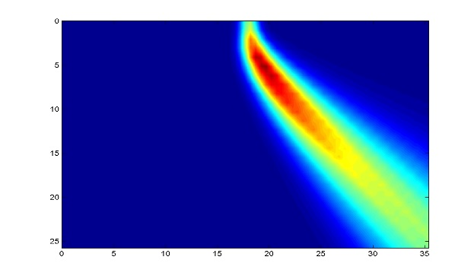
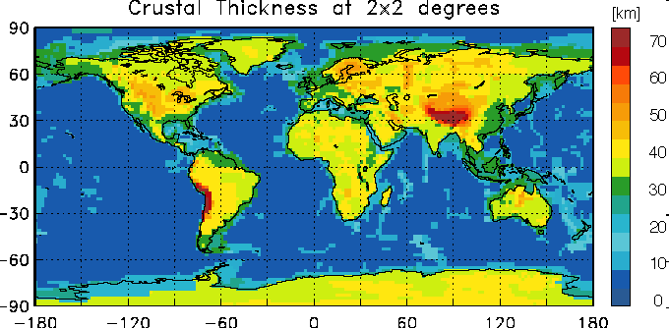
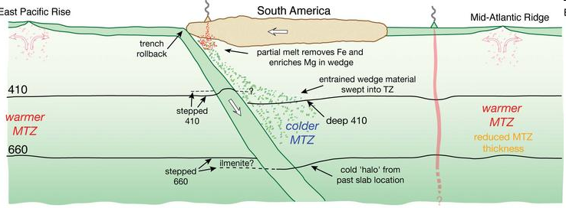
Summary and Outlook
Model space is huge
Source and receivers unevenly distributed (no fix in sight!)
Source parameters uncertain (depth, mechanism)
Forward model inadequate (general anisotropy, Q)
Trade-offs between Earth properties
Near surface (crustal) structure inadequately known
Topography of internal interfaces may be important

Slide 54
Summary and Outlook (cont‘d)
Errors in the measurements (instrument orientation, instrument response, flipped polarity, timing errors)
Modelling deficiencies (e.g., numerical dispersion, topography)
Scattering (effects of small scale structures -> mantle is actually faster!)
Noise statistics unknown

Slide 55
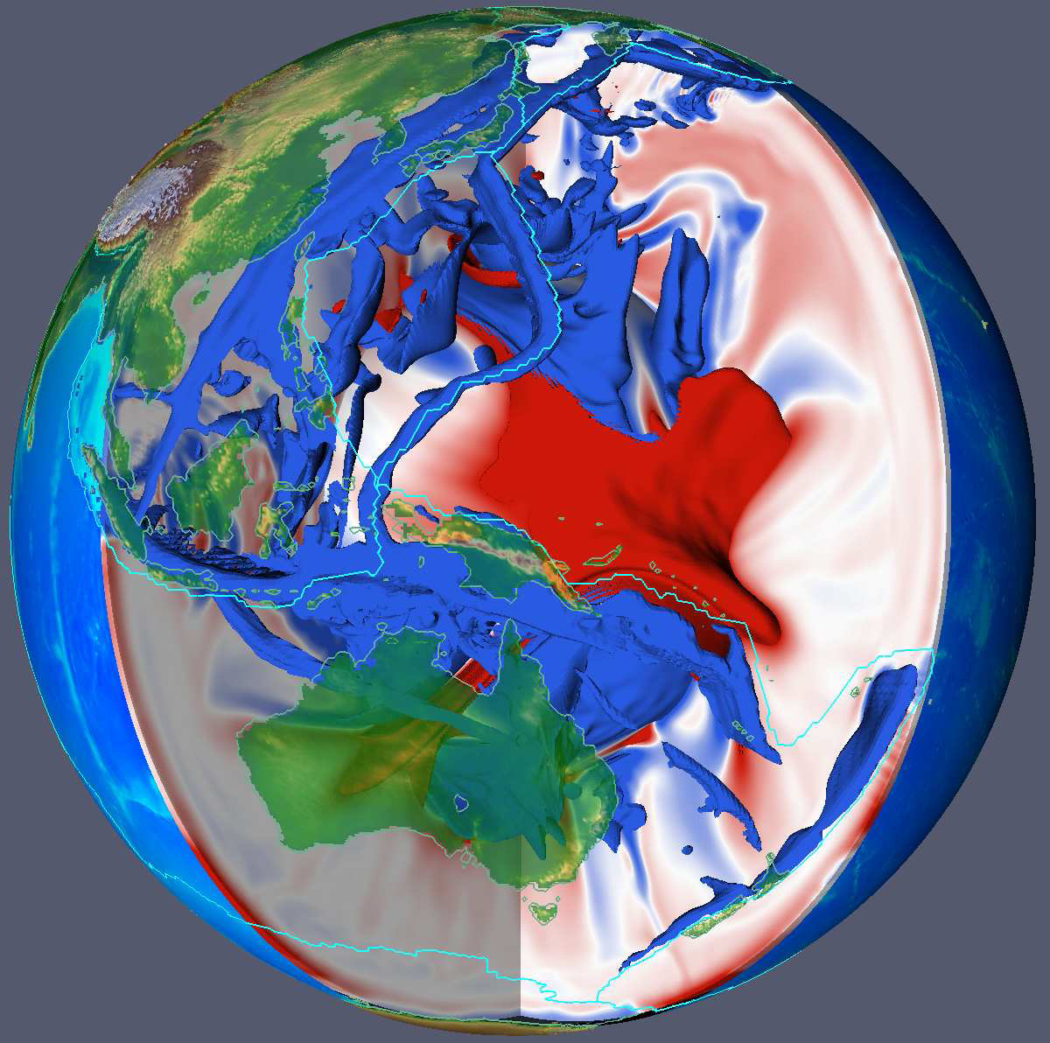
Summary: final comments
Quantifying uncertainties is a research question and not a standardized procedure
Many of our SCIENCE stories are told without sufficient uncertainty quantification
Even if we can calculate uncertainties … how do we convey that information (visually, acoustically)?
Will Exascale really help??

Slide 56
Thank you!

Slide 57
Strategies to estimate resolution
Synthetic data for a test model
Resolution matrix R

Slide 58
Hessian and covariance
Earth model m(x) and misfit functional
Hessian
… and the equivalence with probabilistic approach …
Variances
Following strategy suggested by Fichtner and Trampert, GJI, 2011

